Slide 1
Friendly URLs are Friendly!
An Arena Module for
Friendly URL Management
Derek Mangrum Señior Developer
Central Christian Church AZ (Cccev)
Email: Nick.Airdo@CentralAZ.com
Twitter: @airdo
#RefreshCache

Slide 2
Arena… Not So Friendly.
https://www.centralaz.com/Arena/default.aspx?page=4679&promotionId=1101
https://www.centralaz.com/Arena/default.aspx?page=4648
https://www.centralaz.com/Arena/default.aspx?page=4222&profileId=5173&occurrenceId=63188

Slide 3
Mo’ Better Friendly!
Our Communications Department prefers:
http://www.centralaz.com/baptism
http://www.centralaz.com/blog
http://www.centralaz.com/easter
Used on slides in Weekend Service, print materials, etc.

Slide 4
Manual Set Up
Connect to the web server
Add Physical Folder
Windows Explorer | Navigate to location | ‘New Folder’
Add Virtual Directory
IIS Manager | Navigate to Site | Right Click | Add Virtual Directory
Enter Alias | Enter/Navigate to Physical path
Configure HTTP Redirect
Select Virtual Directory | Double-click HTTP Redirect | Check ‘Redirect requests…’ box | Enter Redirect Destination | Set other settings | Click Apply

Slide 5
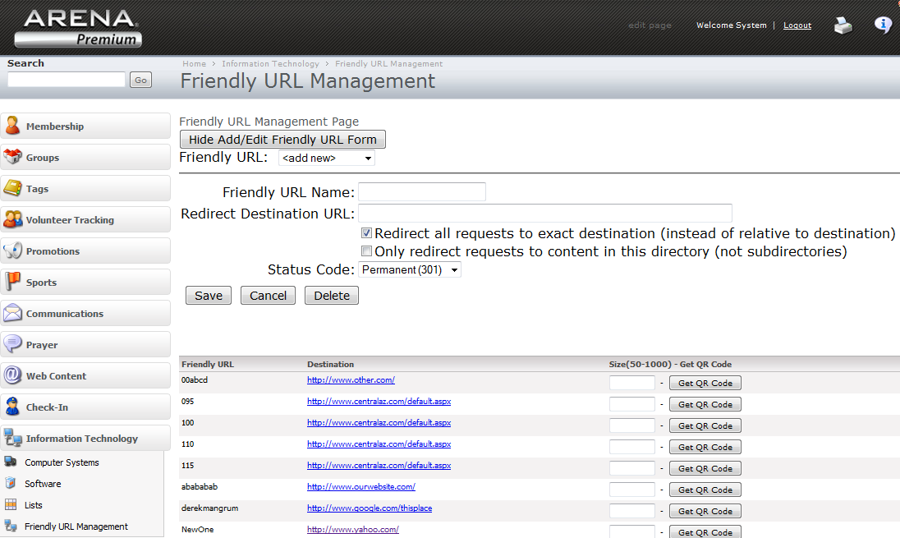
fURL Management Arena Module

Slide 6
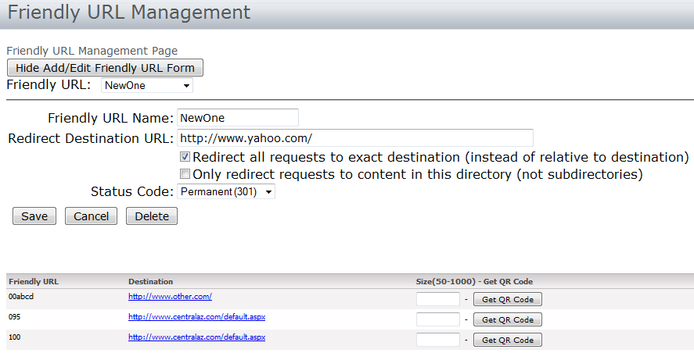
fURL Demo
Add
Edit
Delete
QR Code
Validate Destination

Slide 7
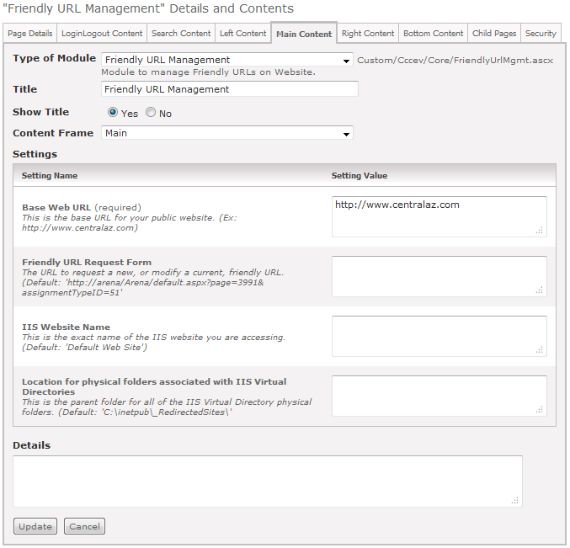
fURL Demo

Slide 8
Requirements and Resources
http://redmine.refreshcache.com/projects/cccev-web-collection/wiki/Friendly_Url_Management
Or
http://www.centralaz.com/fURLmgt

Slide 9
Questions?
Anyone?
Anyone??

Slide 10
The End
THANK YOU!
derek.mangrum@centralaz.com
480-305-7550
http://grinding-it-out.blogspot.com/

