Slide 1

Hi! I am Chattybot

Slide 2
Agenda
What are some of the problems/challenges am I going to solve and how?
Who is my audience?
How am I going to engage my audience?
What activities do I facilitate that would not otherwise be possible?
What are some of the challenges will I encounter?

Slide 3
Some of the problems and solutions:

Slide 4
First Problem: availability 24/7
Most students desire answers outside of classrooms and most of the time, outside of instructors’ work hours
I mean if I’m pulling all-nighter, it’s kind of cool to get some answers!

Slide 5
That won’t be a problem for me because I don’t really have to sleep, rest, or even take a day off!

Slide 6
Second Problem: Quick Responses
Nowadays, students expect to get right answers in no time!
Instructors after all, are simply humans. They take their time to respond to our emails/messages

Slide 7
Oh believe me, I’m pretty fast in responding. Have you ever heard of the speed of light? I’m kinda that fast!

Slide 8
Third Problem: Internet Connection
Most of the time, students are required to have internet access to post/get answers
Refugees have limited internet access most of the time.

Slide 9
If you set me up right, you don’t have to have special apps installed or even internet access. You can use your regular messaging app that comes natively with the device

Slide 10
Audience:
My audiences can be:
A single student to enforce more focus on the student
A group of students to enforce engagement and collaborations between students
Instructors to enlighten them about new techniques
Parents to inform them about theirs children’s situations

Slide 11
How am I going to engage my audience?
I can send my students reminders about quizzes, papers, …etc due dates
I can ask my students to participate to events and polls
I can have my students to undergo some pop quizzes to determine their understanding levels; this also tells me a lot about instructors
I can keep track of my students progress

Slide 12
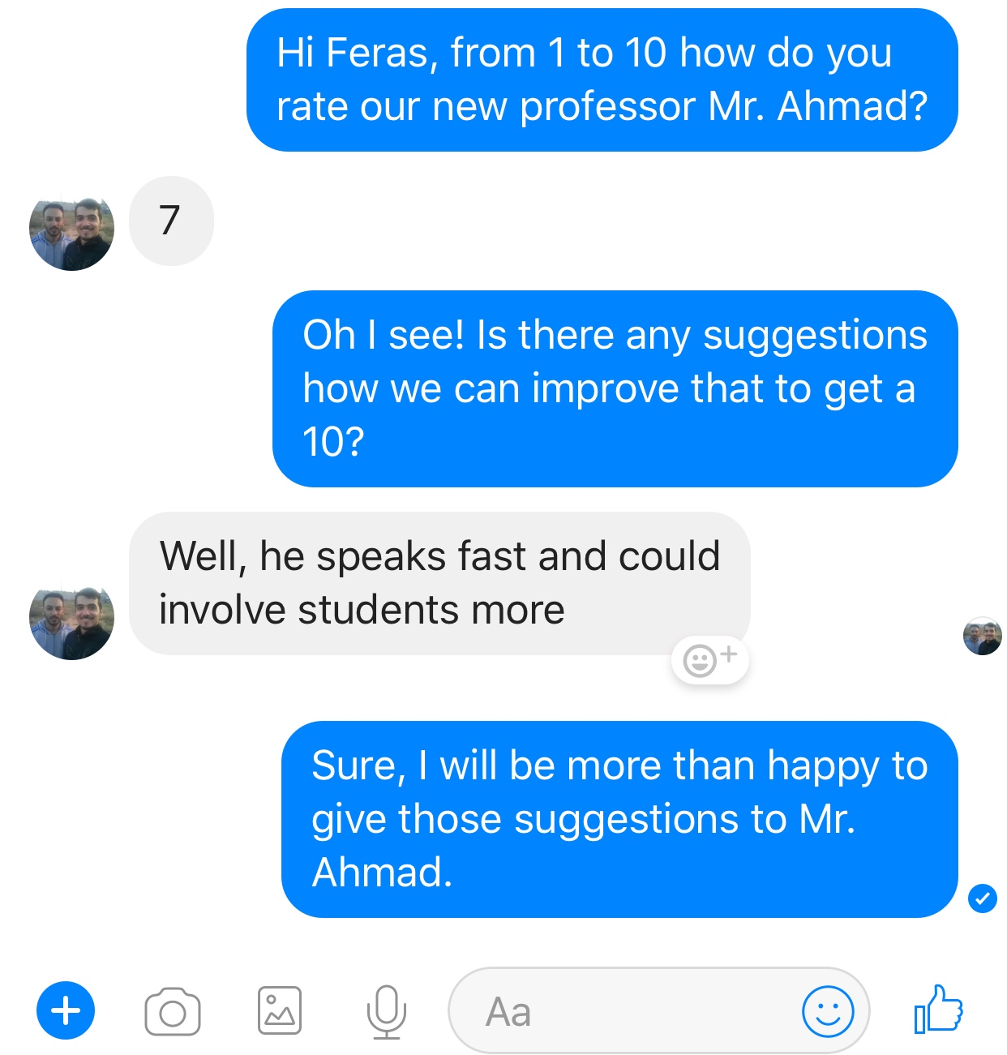
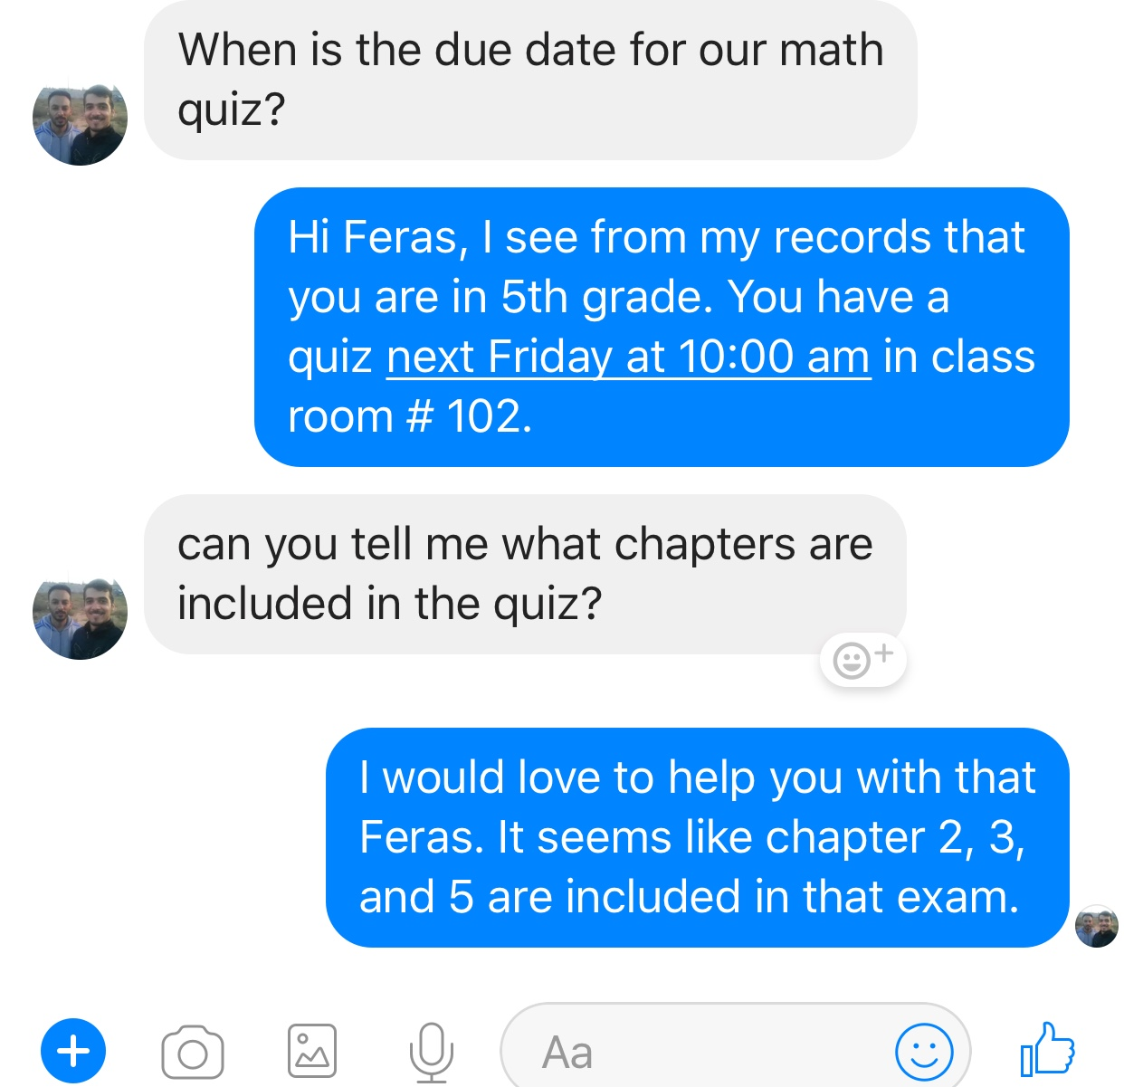

Slide 13
What activities do I facilitate that would not otherwise be possible?
I can chat with more than one students simultaneously
I can reduce the number of required instructors, thus the cost
I can be a great asset to the instructors because through me they can determine what students understand and don’t understand what

Slide 14
What are some of the challenges will I encounter?
Language barrier: The number of languages I understand are limited!
Different dialects: some languages, like Arabic, have many dialects and that could be really challenging
I cannot solve everything
I am not really there just yet: I am still learning and I might need a few more years to get where I want to be

Slide 15
End of Presentation

