Slide 1
Q1
Fill in the name of each 3-dimensional shape.
Box
Pot
Shaker
Cabbage
Hat
A
Cube, Cylinder, Cone, Sphere, Cone
B
Rectangular Prism, Cylinder, Cone, Sphere, Cone
C
Rectangular Prism, Sphere, Cylinder, Cube, Cone
D
Cube, Cylinder, Cube, Ball, Triangle

Slide 2
Q1 - Answer
Fill in the name of each 3-dimensional shape.
Box
Pot
Shaker
Cabbage
Hat
A
Cube, Cylinder, Cone, Sphere, Cone
B
✓ Rectangular Prism, Cylinder, Cone, Sphere, Cone
C
Rectangular Prism, Sphere, Cylinder, Cube, Cone
D
Cube, Cylinder, Cube, Ball, Triangle
Next Question →

Slide 3
Q2
Draw how to make an animal using shapes. Which shows a correct animal?
A
Animal arrangement 1 (incorrect)
B
Animal arrangement 2 (Correct)
C
Animal arrangement 3 (incorrect)
D
Animal arrangement 4 (incorrect)

Slide 4
Q2 - Answer
Draw how to make an animal using shapes. Which shows a correct animal?
A
Animal arrangement 1 (incorrect)
B
✓ Animal arrangement 2 (Correct)
C
Animal arrangement 3 (incorrect)
D
Animal arrangement 4 (incorrect)
Next Question →

Slide 5
Q3
Draw how to make a robot using shapes. Which shows a correct robot?
A
Robot arrangement 1 (incorrect)
B
Robot arrangement 2 (Correct)
C
Robot arrangement 3 (incorrect)
D
Robot arrangement 4 (incorrect)

Slide 6
Q3 - Answer
Draw how to make a robot using shapes. Which shows a correct robot?
B
✓ Robot arrangement 2 (Correct)
Next Question →

Slide 7
Q4
Put all the shapes together. Circle the shape they can make. (3 cubes)
Given shapes:
A
Single cube
B
L-shaped configuration
C
Straight line
D
T-shaped configuration

Slide 8
Q4 - Answer
Put all the shapes together. Circle the shape they can make. (3 cubes)
Given shapes:
B
✓ L-shaped configuration
Next Question →

Slide 9
Q5
Can the parts of Shape A be used to make Shape B?
Shape A:
Shape B:
A
B
Yes
No

Slide 10
Q5 - Answer
Can the parts of Shape A be used to make Shape B?
A
B
Yes
✓ No
Next Question →

Slide 11
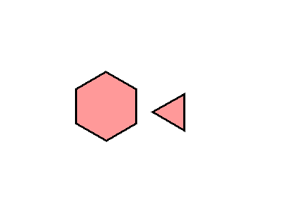
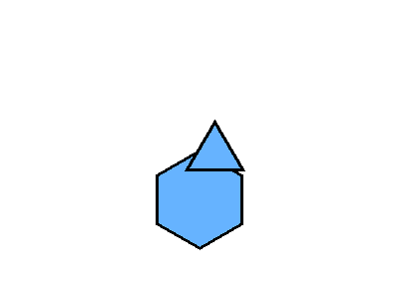
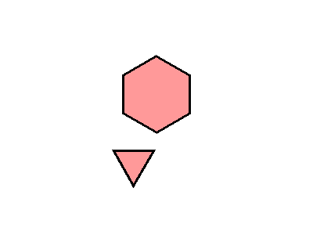
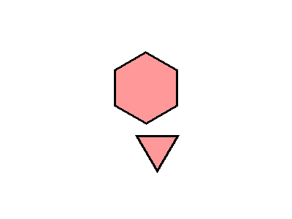
Q6
How can you make a different shape using the same parts?
Given shapes: Hexagon + Triangle
A
B
C
D

Slide 12
Q6 - Answer
How can you make a different shape using the same parts?
B
✓ Correct Answer
Next Question →

Slide 13
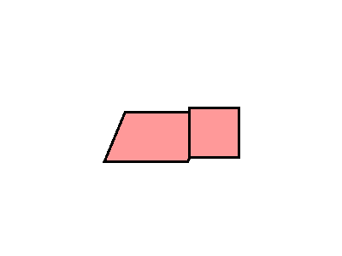
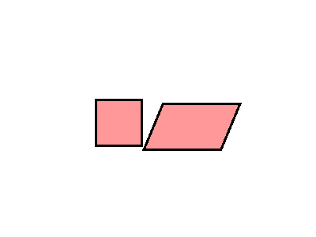
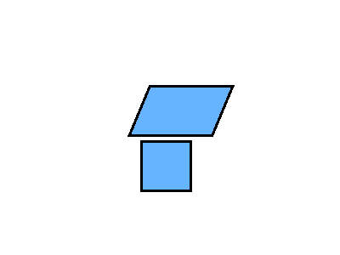
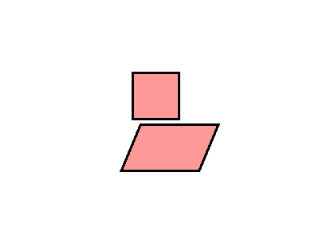
Q7
How can you make a different shape using the same parts?
Given shapes: Parallelogram + Square
A
B
C
D

Slide 14
Q7 - Answer
How can you make a different shape using the same parts?
C
✓ Correct Answer
Next Question →

Slide 15
Q8
Can the parts of Shape A be used to make Shape B? (Diamond shape)
A
B
Yes
No

Slide 16
Q8 - Answer
Can the parts of Shape A be used to make Shape B? (Diamond shape)
A
B
✓ Yes
No
Next Question →

Slide 17
Q9
How do you know the shape is NOT a rectangle? Match with one reason only.
A
B
Shape is not closed
Shape has more than 4 sides
C
D
Shape is not 2-dimensional
Shape has fewer than 4 sides (Correct)

Slide 18
Q9 - Answer
How do you know the shape is NOT a rectangle? Match with one reason only.
D
✓ Shape has fewer than 4 sides (Correct)
Next Question →

Slide 19
Q10
How can you use the parts of this shape to make a rectangle? (L-shaped figure)
A
B
Configuration 1
Configuration 2
C
D
Configuration 3 (Correct)
Configuration 4

Slide 20
Q10 - Answer
How can you use the parts of this shape to make a rectangle? (L-shaped figure)
C
✓ Configuration 3 (Correct)
Next Question →

Slide 21
Q11
Put all the shapes together. Circle the shape they can make. (Cylinder + Cone)
A
B
Stacked cylinder and cone (Correct)
Merged into sphere
C
D
Separate shapes
Different configuration

Slide 22
Q11 - Answer
Put all the shapes together. Circle the shape they can make. (Cylinder + Cone)
A
✓ Stacked cylinder and cone (Correct)
Next Question →

Slide 23
Q12
Can you make Shape B from Shape A? (Cone → Pyramid)
A
B
Yes
No

Slide 24
Q12 - Answer
Can you make Shape B from Shape A? (Cone → Pyramid)
A
B
Yes
✓ No
Next Question →

Slide 25
Q13
Can you make Shape B from Shape A? (T-shaped blocks)
A
B
Yes
No

Slide 26
Q13 - Answer
Can you make Shape B from Shape A? (T-shaped blocks)
A
B
Yes
✓ No
Next Question →

Slide 27
Q14
What 3 items around you are 3-dimensional shapes?
A
B
Ball=Sphere, Cup=Cylinder, Book=Cube
Pencil=Cylinder, Box=Rectangular Prism, Basketball=Sphere (Correct)
C
D
Hat=Cone, Can=Cube, Ball=Circle
Block=Rectangular Prism, Apple=Sphere, Crayon=Prism

Slide 28
Q14 - Answer
What 3 items around you are 3-dimensional shapes?
B
✓ Pencil=Cylinder, Box=Rectangular Prism, Basketball=Sphere (Correct)
Next Question →

Slide 29
Q15
Draw how to make an animal using shapes. Which shows a correct animal?
A
B
Animal arrangement 1
Animal arrangement 2
C
D
Animal arrangement 3 (Correct)
Animal arrangement 4

Slide 30
Q15 - Answer
Draw how to make an animal using shapes. Which shows a correct animal?
C
✓ Animal arrangement 3 (Correct)
Next Question →

Slide 31
ANSWER KEY
Q1: B Q6: B Q11: A
Q2: B Q7: C Q12: B
Q3: B Q8: A Q13: B
Q4: B Q9: D Q14: B
Q5: B Q10: C Q15: C

