Slide 1
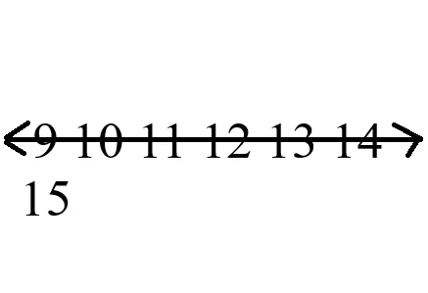
Question 1 of 27
Number Line: Understanding the Problem
TEACHING SLIDE
Johnny is trying to make a number line from 0 to 20. Look at what he did. What's the problem?
A. He drew the numbers first and they're too big, so the line doesn't fit
B. He didn't use a pencil (pencil is better than pen)
C. He forgot to include the number 10
D. His paper was too small
Skip

Slide 2
Question 1 of 27
Number Line: Understanding the Problem
Johnny is trying to make a number line from 0 to 20. Look at what he did. What's the problem?
A. He drew the numbers first and they're too big, so the line doesn't fit ✓
B. He didn't use a pencil (pencil is better than pen)
C. He forgot to include the number 10
D. His paper was too small
Great! Johnny should have drawn the LINE first, then added the numbers. When he drew the big numbers first, there wasn't room for the whole line!

Slide 3
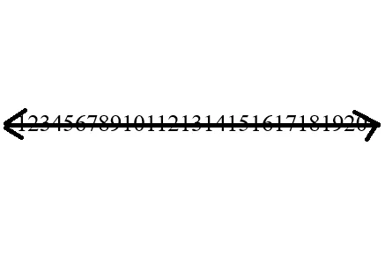
Question 2 of 27
Number Line: Spacing Matters
TEACHING SLIDE
Maria made a number line from 0 to 20 with all the right numbers. But what's the problem?
A. The numbers are too close together to hop between them properly
B. She used the wrong numbers
C. The line should go from 1 to 19 instead
D. She made it too long
Skip

Slide 4
Question 2 of 27
Number Line: Spacing Matters
Maria made a number line from 0 to 20 with all the right numbers. But what's the problem?
A. The numbers are too close together to hop between them properly ✓
B. She used the wrong numbers
C. The line should go from 1 to 19 instead
D. She made it too long
Yes! When numbers are squished together, you can't see the spaces to count by hops. We need space BETWEEN the numbers so we can jump from one to the next.

Slide 5
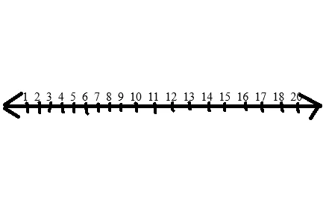
Question 3 of 27
Number Line: Complete vs Incomplete
TEACHING SLIDE
Look at this number line. What mistake did the student make?
A. The spacing is wrong
B. The number 19 is missing
C. The line should start at 1, not 0
D. All the numbers are too small
Skip

Slide 6
Question 3 of 27
Number Line: Complete vs Incomplete
Look at this number line. What mistake did the student make?
A. The spacing is wrong
B. The number 19 is missing ✓
C. The line should start at 1, not 0
D. All the numbers are too small
Correct! Every number from 0 to 20 needs to be there. The number 19 was skipped. A complete number line has NO gaps.

Slide 7
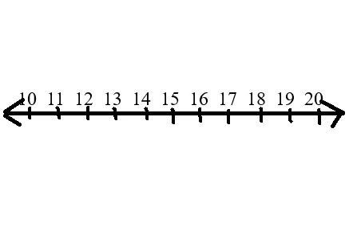
Question 4 of 27
Number Line: Partial Lines Are OK!
TEACHING SLIDE
Is it OK to make a partial number line from 10 to 20 instead of 0 to 20?
A. No, it always has to start at 0
B. Yes, as long as all the numbers in that range are there and evenly spaced
C. No, partial lines are never correct
D. Only if you write 'partial' at the top
Skip

Slide 8
Question 4 of 27
Number Line: Partial Lines Are OK!
Is it OK to make a partial number line from 10 to 20 instead of 0 to 20?
A. No, it always has to start at 0
B. Yes, as long as all the numbers in that range are there and evenly spaced ✓
C. No, partial lines are never correct
D. Only if you write 'partial' at the top
Perfect! You can make a number line for ANY range - 10-20, 5-15, whatever. As long as all numbers in that range are there with even spacing, it's correct!

Slide 9
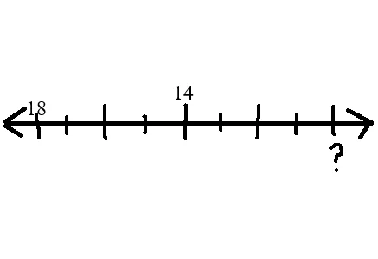
Question 5 of 27
Decrement Method: Counting Backwards
TEACHING SLIDE
To solve 18 - 8, we start with 18 and make 8 marks (crosses) counting down to get our answer. What's 18 - 8?
A. 8
B. 10
C. 9
D. 11
Skip

Slide 10
Question 5 of 27
Decrement Method: Counting Backwards
To solve 18 - 8, we start with 18 and make 8 marks (crosses) counting down to get our answer. What's 18 - 8?
A. 8
B. 10 ✓
C. 9
D. 11
Yes! When we start with 18 and count down 8 times (making crosses), we land on 10. So 18 - 8 = 10!

Slide 11
Question 6 of 27
Decrement Method: Let's Try It!
NOW YOU TRY!
Use the decrement method. Start with 15 and count down 6. What do you get?
A. 8
B. 9
C. 10
D. 21
Skip

Slide 12
Question 6 of 27
Decrement Method: Let's Try It!
Use the decrement method. Start with 15 and count down 6. What do you get?
A. 8
B. 9 ✓
C. 10
D. 21
Correct! 15 - 6 = 9. You started with 15 and counted down 6 times to land on 9.

Slide 13
Question 7 of 27
Decrement Method: Practice
NOW YOU TRY!
Start with 14 and count down 5. What's your answer?
A. 8
B. 9
C. 19
D. 10
Skip

Slide 14
Question 7 of 27
Decrement Method: Practice
Start with 14 and count down 5. What's your answer?
A. 8
B. 9 ✓
C. 19
D. 10
Great! 14 - 5 = 9. You counted down from 14 five times and landed on 9.

Slide 15
Question 8 of 27
Decrement Method: More Practice
NOW YOU TRY!
Start with 16 and count down 4. What do you get?
A. 11
B. 13
C. 12
D. 20
Skip

Slide 16
Question 8 of 27
Decrement Method: More Practice
Start with 16 and count down 4. What do you get?
A. 11
B. 13
C. 12 ✓
D. 20
Perfect! 16 - 4 = 12. You started with 16 and counted down 4 times to get 12.

Slide 17

Question 9 of 27
Place Value: Tens and Ones
TEACHING SLIDE
This student drew 16 circles for the number 16. What's the problem?
A. 16 circles is not enough
B. There's no way to see that it's 1 ten and 6 ones
C. Circles are the wrong shape
D. There are 17 circles, not 16
Skip

Slide 18
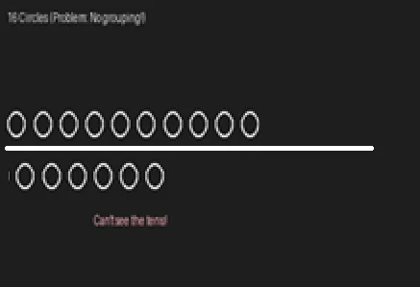
Question 9 of 27
Place Value: Tens and Ones
This student drew 16 circles for the number 16. What's the problem?
A. 16 circles is not enough
B. There's no way to see that it's 1 ten and 6 ones ✓
C. Circles are the wrong shape
D. There are 17 circles, not 16
Yes! When all 16 circles are in a line, we can't see the groups of 10. We need to show 1 group of 10 (separated) and 6 single ones.

Slide 19
Question 10 of 27
Place Value: The Right Way
TEACHING SLIDE
How do we show that 16 = 1 ten and 6 ones?
A. Draw 16 circles in a line
B. Draw a group of 10 circles, then a line separator, then 6 circles
C. Write '10' and '6' above the circles
D. Use two different colors
Skip

Slide 20
Question 10 of 27
Place Value: The Right Way
How do we show that 16 = 1 ten and 6 ones?
A. Draw 16 circles in a line
B. Draw a group of 10 circles, then a line separator, then 6 circles ✓
C. Write '10' and '6' above the circles
D. Use two different colors
Perfect! When we group 10 together and separate it with a line from the 6 ones, we can clearly see the tens place and ones place!

Slide 21
Question 11 of 27
Place Value: Show 13 Correctly
NOW YOU TRY!
How many ONES would you draw after separating the TEN from 13?
A. 1 one
B. 3 ones
C. 10 ones
D. 13 ones
Skip

Slide 22
Question 11 of 27
Place Value: Show 13 Correctly
How many ONES would you draw after separating the TEN from 13?
A. 1 one
B. 3 ones ✓
C. 10 ones
D. 13 ones
Great! 13 = 1 ten + 3 ones. So after separating the group of 10, you'd draw 3 single ones.

Slide 23
Question 12 of 27
Place Value: Show 27 Correctly
NOW YOU TRY!
To show 27 = tens and ones, how many TENS and how many ONES?
A. 2 tens and 7 ones
B. 7 tens and 2 ones
C. 2 tens and 2 ones
D. 20 tens and 7 ones
Skip

Slide 24
Question 12 of 27
Place Value: Show 27 Correctly
To show 27 = tens and ones, how many TENS and how many ONES?
A. 2 tens and 7 ones ✓
B. 7 tens and 2 ones
C. 2 tens and 2 ones
D. 20 tens and 7 ones
Perfect! 27 = 2 tens + 7 ones. You'd draw two groups of 10, then 7 single ones.

Slide 25
Question 13 of 27
Doubles: The Right Shape
TEACHING SLIDE
This student tried to show 8 + 8 by drawing circles vertically. Why is this a problem?
A. Vertical shapes are never allowed
B. You can't count the circles easily or see both groups
C. Circles should be squares
D. There should be 16 circles, not 8
Skip

Slide 26
Question 13 of 27
Doubles: The Right Shape
This student tried to show 8 + 8 by drawing circles vertically. Why is this a problem?
A. Vertical shapes are never allowed
B. You can't count the circles easily or see both groups ✓
C. Circles should be squares
D. There should be 16 circles, not 8
Yes! When you draw doubles, you need to show TWO EQUAL GROUPS side by side (left to right). Vertical or spilled patterns make it hard to see the two groups.

Slide 27

Question 14 of 27
Doubles: Watch for Odd Numbers
TEACHING SLIDE
This student tried to show 15 but arranged the circles in pairs. What's the problem?
A. Pairs are not allowed for doubles
B. There are 16 circles, not 15 - one too many!
C. Circles should be drawn vertically
D. Odd numbers can never be shown with circles
Skip

Slide 28
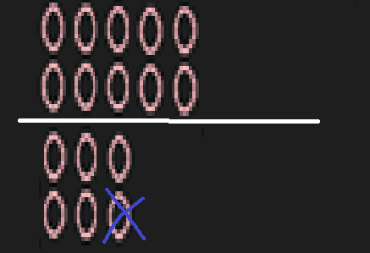
Question 14 of 27
Doubles: Watch for Odd Numbers
This student tried to show 15 but arranged the circles in pairs. What's the problem?
A. Pairs are not allowed for doubles
B. There are 16 circles, not 15 - one too many! ✓
C. Circles should be drawn vertically
D. Odd numbers can never be shown with circles
Correct! When you count the pairs, there are 8 pairs = 16 circles, but the student wanted to show 15. That's one too many! Doubles always show EVEN numbers (pairs work perfectly for those).

Slide 29

Question 15 of 27
Doubles: Show 6 + 6
NOW YOU TRY!
How would you draw 6 + 6 using the correct doubles method?
A. 6 circles on the left, 6 circles on the right, equal groups
B. 12 circles in a line
C. 3 circles on top, 3 circles on bottom
D. 6 pairs arranged vertically
Skip

Slide 30
Question 15 of 27
Doubles: Show 6 + 6
How would you draw 6 + 6 using the correct doubles method?
A. 6 circles on the left, 6 circles on the right, equal groups ✓
B. 12 circles in a line
C. 3 circles on top, 3 circles on bottom
D. 6 pairs arranged vertically
Perfect! You'd draw 6 circles on the left and 6 circles on the right, so anyone can see the two EQUAL GROUPS. That's what doubles are!

Slide 31
Question 16 of 27
Doubles: Show 10 + 10
NOW YOU TRY!
To show 10 + 10 = 20, you would draw:
A. 10 circles on the left, 10 circles on the right
B. 20 circles in a line
C. 2 groups of 10
D. A and C are the same thing
Skip

Slide 32
Question 16 of 27
Doubles: Show 10 + 10
To show 10 + 10 = 20, you would draw:
A. 10 circles on the left, 10 circles on the right
B. 20 circles in a line
C. 2 groups of 10
D. A and C are the same thing ✓
Great! A and C are exactly the same - when you draw 10 on the left and 10 on the right, you're showing 2 equal groups of 10, which is the doubles method!

Slide 33
Question 17 of 27
Doubles: Show 4 + 4
NOW YOU TRY!
Draw 4 + 4 using correct doubles. How many circles total will you draw?
A. 4 circles
B. 8 circles
C. 6 circles
D. 16 circles
Skip

Slide 34
Question 17 of 27
Doubles: Show 4 + 4
Draw 4 + 4 using correct doubles. How many circles total will you draw?
A. 4 circles
B. 8 circles ✓
C. 6 circles
D. 16 circles
Perfect! You'd draw 4 circles on the left and 4 circles on the right = 8 circles total. That's why we call it 4 + 4 = 8!

Slide 35
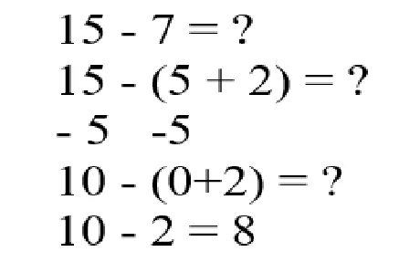
Question 18 of 27
Circle Reduction: Breaking Apart
TEACHING SLIDE
In Circle Reduction, we break the number we're subtracting into parts. For 15 - 7, we break 7 into 5 + 2. Then: 15 - 5 = 10, then 10 - 2 = 8. What's 15 - 7?
A. 5
B. 7
C. 8
D. 15
Skip

Slide 36
Question 18 of 27
Circle Reduction: Breaking Apart
In Circle Reduction, we break the number we're subtracting into parts. For 15 - 7, we break 7 into 5 + 2. Then: 15 - 5 = 10, then 10 - 2 = 8. What's 15 - 7?
A. 5
B. 7
C. 8 ✓
D. 15
Excellent! By breaking 7 into 5 + 2, we can subtract in steps: 15 - 5 = 10, then 10 - 2 = 8. So 15 - 7 = 8!

Slide 37
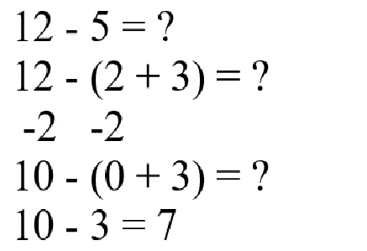
Question 19 of 27
Circle Reduction: Another Example
TEACHING SLIDE
For 12 - 5, we break 5 into 2 + 3. Then: 12 - 2 = 10, then 10 - 3 = 7. What's 12 - 5?
A. 5
B. 6
C. 7
D. 12
Skip

Slide 38
Question 19 of 27
Circle Reduction: Another Example
For 12 - 5, we break 5 into 2 + 3. Then: 12 - 2 = 10, then 10 - 3 = 7. What's 12 - 5?
A. 5
B. 6
C. 7 ✓
D. 12
Great! By breaking 5 into 2 + 3, we subtract in steps: 12 - 2 = 10, then 10 - 3 = 7. So 12 - 5 = 7!

Slide 39
Question 20 of 27
Circle Reduction: Try 14 - 6
NOW YOU TRY!
For 14 - 6, break 6 into 4 + 2. What do you get? (14 - 4 = 10, then 10 - 2 = ?)
A. 6
B. 8
C. 10
D. 20
Skip

Slide 40
Question 20 of 27
Circle Reduction: Try 14 - 6
For 14 - 6, break 6 into 4 + 2. What do you get? (14 - 4 = 10, then 10 - 2 = ?)
A. 6
B. 8 ✓
C. 10
D. 20
Perfect! 14 - 4 = 10, then 10 - 2 = 8. So 14 - 6 = 8!

Slide 41
Question 21 of 27
Circle Reduction: Try 16 - 7
NOW YOU TRY!
For 16 - 7, break 7 into 6 + 1. What do you get? (16 - 6 = 10, then 10 - 1 = ?)
A. 7
B. 8
C. 9
D. 16
Skip

Slide 42
Question 21 of 27
Circle Reduction: Try 16 - 7
For 16 - 7, break 7 into 6 + 1. What do you get? (16 - 6 = 10, then 10 - 1 = ?)
A. 7
B. 8
C. 9 ✓
D. 16
Great! 16 - 6 = 10, then 10 - 1 = 9. So 16 - 7 = 9!

Slide 43
Question 22 of 27
Circle Reduction: Try 13 - 5
NOW YOU TRY!
For 13 - 5, break 5 into 3 + 2. What do you get? (13 - 3 = 10, then 10 - 2 = ?)
A. 5
B. 7
C. 8
D. 13
Skip

Slide 44
Question 22 of 27
Circle Reduction: Try 13 - 5
For 13 - 5, break 5 into 3 + 2. What do you get? (13 - 3 = 10, then 10 - 2 = ?)
A. 5
B. 7
C. 8 ✓
D. 13
Perfect! 13 - 3 = 10, then 10 - 2 = 8. So 13 - 5 = 8!

Slide 45
Question 23 of 27
Commutative Property: Order Doesn't Matter
TEACHING SLIDE
Look at these two addition problems.
5+10 = 10+5
What do you notice?
A. They have different answers
B. The numbers are in different order but the answer is the same
C. One is correct and one is wrong
D. You can't add numbers in different orders
Skip

Slide 46
Question 23 of 27
Commutative Property: Order Doesn't Matter
Look at these two addition problems.
5+10 = 10+5
What do you notice?
A. They have different answers
B. The numbers are in different order but the answer is the same ✓
C. One is correct and one is wrong
D. You can't add numbers in different orders
Excellent! This is the Commutative Property - we can add numbers in any order and get the same answer. 10 + 5 = 15 AND 5 + 10 = 15!

Slide 47
Question 24 of 27
Fact Families: Different Partners, Same Sum
TEACHING SLIDE
Look at these two problems.
5+5 = 4+6
What's the same about them?
A. The numbers are exactly the same
B. They have the same answer even though the partners are different
C. One has more numbers than the other
D. The second one is always bigger
Skip

Slide 48
Question 24 of 27
Fact Families: Different Partners, Same Sum
Look at these two problems.
5+5 = 4+6
What's the same about them?
A. The numbers are exactly the same
B. They have the same answer even though the partners are different ✓
C. One has more numbers than the other
D. The second one is always bigger
Perfect! Different partners can make the same sum! There are LOTS of ways to make 10: 5+5, 4+6, 3+7, 2+8, 1+9, 0+10. This is called a Fact Family!

Slide 49
Question 25 of 27
Commutative Property: Try It!
NOW YOU TRY!
If 7 + 3 = 10, what does 3 + 7 equal?
A. 7
B. 3
C. 10
D. 13
Skip

Slide 50
Question 25 of 27
Commutative Property: Try It!
If 7 + 3 = 10, what does 3 + 7 equal?
A. 7
B. 3
C. 10 ✓
D. 13
Great! 3 + 7 = 10, just like 7 + 3 = 10. The order doesn't change the sum!

Slide 51
Question 26 of 27
Cumulative Addition: Adding Three Numbers
TEACHING SLIDE
When adding THREE numbers like 5 + 5 + 5, we add the FIRST TWO first: 5 + 5 = 10. Then add the third: 10 + 5 = 15. What's 5 + 5 + 5?
A. 5
B. 10
C. 15
D. 20
Skip

Slide 52
Question 26 of 27
Cumulative Addition: Adding Three Numbers
When adding THREE numbers like 5 + 5 + 5, we add the FIRST TWO first: 5 + 5 = 10. Then add the third: 10 + 5 = 15. What's 5 + 5 + 5?
A. 5
B. 10
C. 15 ✓
D. 20
Perfect! 5 + 5 = 10, then 10 + 5 = 15. So 5 + 5 + 5 = 15!

Slide 53
Question 27 of 27
Cumulative Addition: Try It!
NOW YOU TRY!
What's 4 + 4 + 4? (Remember: Add the first two numbers first!)
A. 4
B. 8
C. 12
D. 16
Skip

Slide 54
Question 27 of 27
Cumulative Addition: Try It!
What's 4 + 4 + 4? (Remember: Add the first two numbers first!)
A. 4
B. 8
C. 12 ✓
D. 16
Excellent! 4 + 4 = 8, then 8 + 4 = 12. So 4 + 4 + 4 = 12!

Slide 55
Answer Key
1st Grade PA Core Math Benchmark - All 27 Questions
Q1: A
Q15: A
Q2: A
Q16: D
Q3: B
Q17: B
Q4: B
Q18: C
Q5: B
Q19: C
Q6: B
Q20: B
Q7: B
Q21: C
Q8: C
Q22: C
Q9: B
Q23: B
Q10: B
Q24: B
Q11: B
Q25: C
Q12: A
Q26: C
Q13: B
Q27: C
Q14: B

