Slide 1

Q1 - TEACHING
Why did God tell Adam and Eve they could not eat of the one tree in the Garden of Eden?
A. Because God said "It's forbidden" and even though I don’t understand, I have faith that God wants what’s best for us.
C. Because that tree was a gift someone else was supposed to care for
B. Because God wanted the tree for himself
D. None of the Above

Slide 2
Q1 - ANSWER ✓
God didn't give the rule because it was arbitrary. He gave it because He loves Adam and Eve. God wants a real relationship with people He created. A relationship with true love means both people make choices to trust and obey each other. God was teaching Adam and Eve about kindness: being kind to God means trusting Him.
A. Because God said "It's forbidden" and even though I don’t understand, I have faith that God wants what’s best for us✓
Next Question →

Slide 3
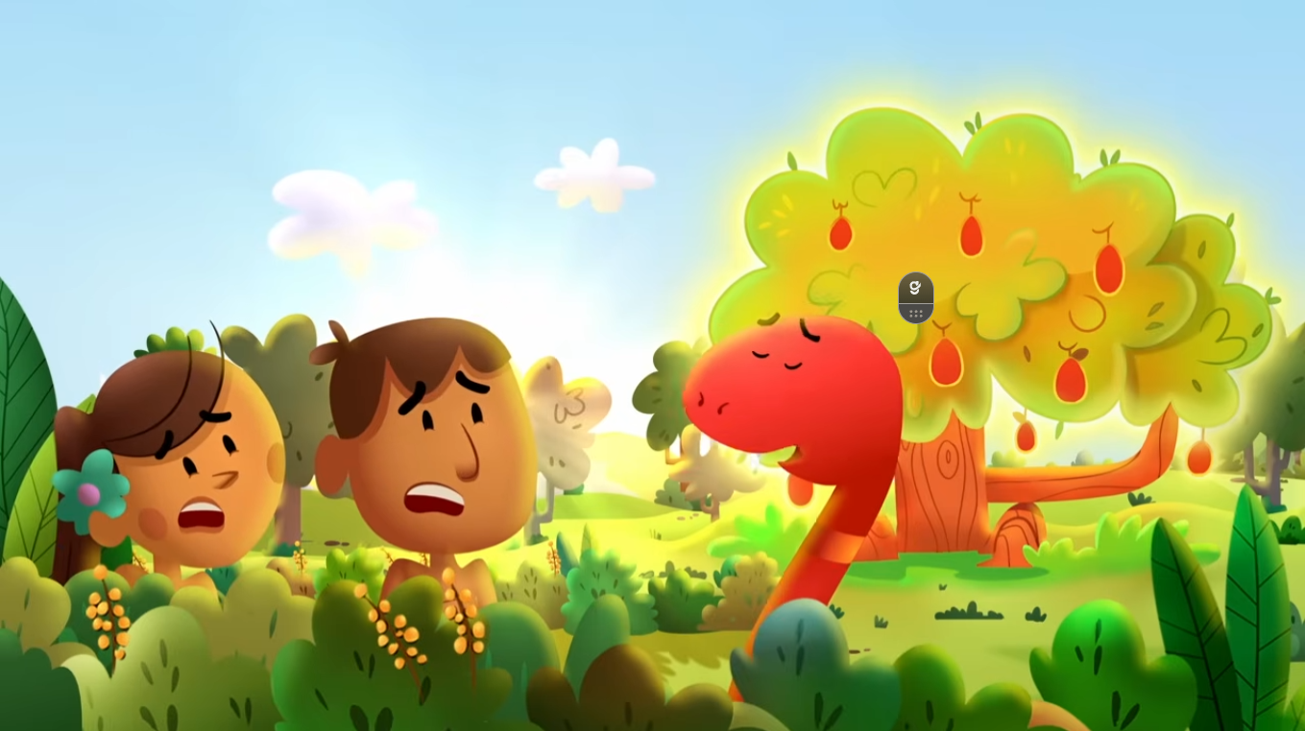
Q2 - TEACHING
How did the Snake trick Adam and Eve into disobeying God?
A. The Snake threatened to hurt them if they didn't eat of the tree
C. The Snake flopped on the floor and made a scene until they did what the Snake asked
B. The Snake pretended to be their friend and promised to help them fulfill their desires if they disobeyed God
D. All of the Above

Slide 4
Q2 - ANSWER ✓
The snake was clever. It pretended to be Adam and Eve's friend and said, "God doesn't really mean that. If you eat this fruit, you'll be smart and powerful like God!" The snake made something bad sound good. This is the opposite of kindness. Real kindness tells the truth and helps people do what's right, not what they want when it's wrong.
B. The Snake pretended to be their friend and promised to help them fulfill their desires if they disobeyed God ✓
Next Question →

Slide 5
Q1 - TEACHING
Why did God tell Adam and Eve they could not eat of the one tree in the Garden of Eden?
A. Because God said "It's forbidden" and even though I don’t understand, I have faith that God wants what’s best for us.
C. Because that tree was a gift someone else was supposed to care for
B. Because God wanted the tree for himself
D. None of the Above

Slide 6
Q1 - ANSWER ✓
God didn't give the rule because it was arbitrary. He gave it because He loves Adam and Eve. God wants a real relationship with people He created. A relationship with true love means both people make choices to trust and obey each other. God was teaching Adam and Eve about kindness: being kind to God means trusting Him.
A. Because God said "It's forbidden" and even though I don’t understand, I have faith that God wants what’s best for us✓
Next Question →

Slide 7
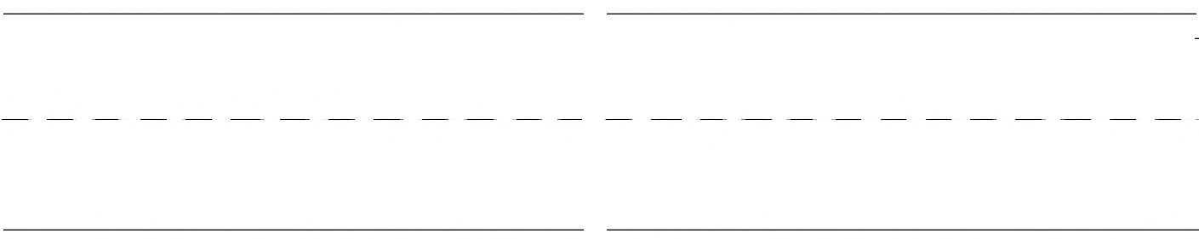
Q27- GUARDIAN ASSESSMENT: OPINION & INFORMATIVE
Is it better to be kind to others or to be selfish? Why or why not?
Use an example from the Bible to explain your answer.
☐ 1. Chooses kindness over selfishness
☐ 3. Explains WHY kindness is better than selfishness
Scoring: _____ out of 4
☐ 2. Uses a clear example from Bible stories we learned
☐ 4. Shows that kindness connects to the Bible stories

