Slide 1

REGARDS
Develop Business extensions

Slide 2
Overview
Development set-up
Business service plugin : FITS Reader
Business microservice : NameResolver service

Slide 3

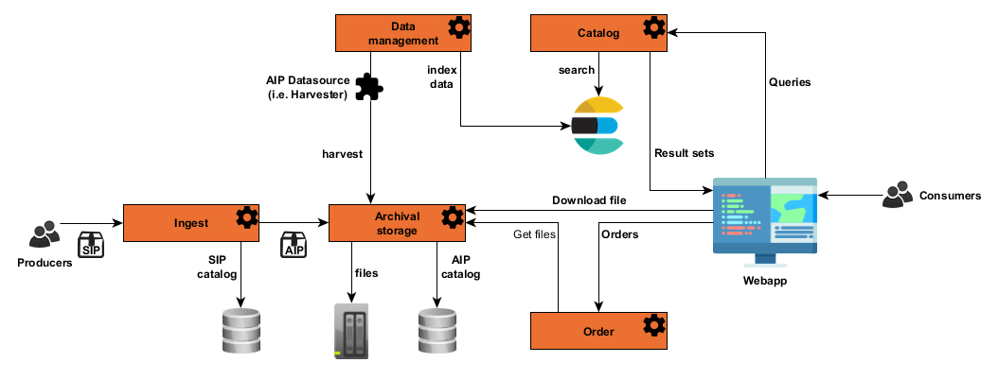
Overview – Microservices API
Overview
REGARDS

Slide 4
Overview – Microservices API
Overview
Each REGARDS microservice provides a documentation of his own API at
https://regardsoss.github.io
Administration
Authentication
Access (project & instance)
Catalog
Data management
Data provider
Ingest
Order
Storage

Slide 5
Overview – Extension points
Overview
Each REGARDS microservice provides his own extension points.
You can find each of them in the online documentation at
https://regardsoss.github.io
Authentication
  Customize user authentication system
Catalog :
  Customize search engines
  Add new business services on catalog entities
Datamanagement
  Customize access rights on entities
  Add business logic on attribute entities calculation
  Add new way to crawl entities from an external data source
Dataprovider
  Customize how to generate the SIP to ingest from input provider data
Ingest
  Customize how to generate the AIP to store from input provider SIP
Storage
  Add new storage system for your data
  Add new strategy to select which storage system to use

Slide 6
Overview – github repositories
Overview
regards-bom : Handle global versions and dependencies
regards-microservice : Regards framework
regards-cloud : Central configuration & registry
regards-admin
regards-authentication
regards-storage
regards-dam
regards-catalog
regards-ingest
regards-dataprovider
regards-order
regards-access : Back-end for Front-end
regards-frontend : Webapp

Slide 7
Overview – Plugins documentation page
Overview
To get a first overview of plugin management in REGARDS framework, you can consult the
documentation page :
https://regardsoss.github.io/development/framework/modules/plugins

Slide 8
Overview – Framework
Overview
Framework starter modules can be found in github documentation at :
https://regardsoss.github.io/development/framework/starters
Main modules for developpers
Amqp : Listen & send messages on the global application bus message
Authentication : Retrieve current authenticated user
Feign : Rest client to communicate with other microservices
Jobs : Add new job in the centralized queue
Gson : Json formatter
Communication between microservices
Application bus message
Microservice Rest clients

Slide 9
Overview
Development set-up
Business service plugin : FITS Reader
Business microservice : NameResolver service

Slide 10
Set-up – Install a REGARDS server
Set-up
First of all, you need a functional REGARDS server. To install a new one, please follow the
installation guide.
Configure server : https://regardsoss.github.io/getting-started/configuration
Run installation : https://regardsoss.github.io/getting-started/izpack/

Slide 11
Set-up – Prerequisite
Set-up
1. Maven 3.6.X
2. Java IDE (Eclipse, Intelij, Netbean, …) with maven connector.
3. Git client

Slide 12
Set-up – Get sources from github
Set-up
1. Clone github repositories
git clone https://github.com/RegardsOss/regards-bom.git
git clone https://github.com/RegardsOss/regards-microservice.git
git clone https://github.com/RegardsOss/regards-admin.git
git clone https://github.com/RegardsOss/regards-storage.git
git clone https://github.com/RegardsOss/regards-dam.git
git clone https://github.com/RegardsOss/regards-catalog.git
git clone https://github.com/RegardsOss/regards-ingest.git
git clone https://github.com/RegardsOss/regards-plugins.git
2. Compile each repository
> mvn clean install -DskipTests

Slide 13
Overview
Development set-up
Business service plugin : FITS Reader
Business microservice : NameResolver service

Slide 14

Business plugin – Create your maven module
Business
1. Open source repository on you favorite IDE and import it as a Maven project
2. Create your own maven module for your new plugin in the associated microservice
Module
3. Add associated microservice plugin module dependency to your pom.xml
For exemple to create a catalog plugin add :
4. Create a new class which implements the plugin interface.

Slide 15
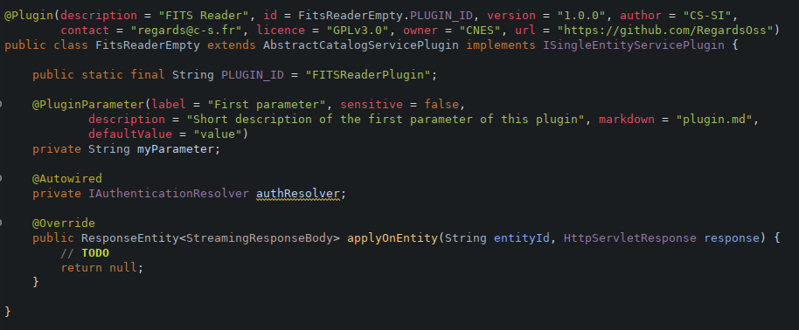
Business plugin – Create your maven module
Business
NOTE : Only classes in package fr.cnes.regards are scanned by REGARDS framework.

Slide 16
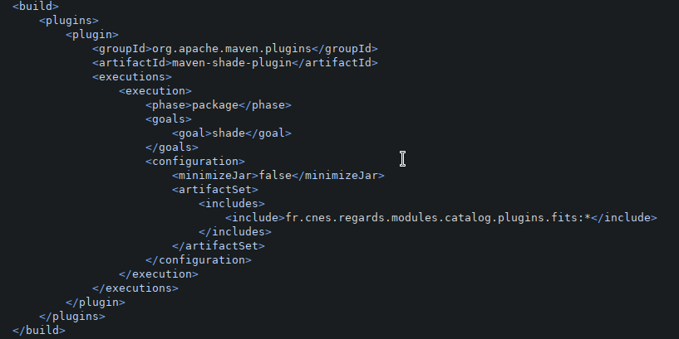
Business plugin – Create your maven module
Business
5. As your plugin jar has to be selfsufficient, you must compile it using the maven shaded
plugin. To do this, add the code below in your pom.xml
You have to include all the needed dependencies to package in your plugin.

Slide 17
Business plugin – Create your maven module
Business
6. You can now compile your plugin
> cd rs-plugins/catalog-services/fits-reader-plugin
> mvn clean install
7. Last step, you can add your plugin to the REGARDS server by following the documentation
at :
https://regardsoss.github.io/getting-started/plugins

Slide 18


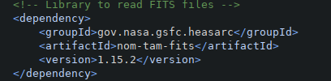
Business service – FITS Reader plugin
Business
Steps to create a plugin to read FITS meta data and return results in JSON format :
1. Retrieve the DataObject entity from the REGARDS catalog thanks to the entityId provided as
a parameter of the method applyOnEntity. To do this, use the ServiceHelper :
2. For each file of the returned DataObject :
  Check if the file is a FITs file
  Check if the file is online (aka downloadable)
  Add the autorization token to the file URL thanks to the IauthenticationResolver
  Read the FITs file properties thanks to mom-tam-fits library.

Slide 19
Business service – FITS Reader plugin
Business
3. Return a JSON formated response thanks to the static factory
CatalogPluginResponseFactory.
4. Compile your plugin and copy it to the REGARDS server for test it.
5. Restart the catalog microservice.
6. Instanciate your plugin from Administration IHM in “DataAccess / Services”
7. Use it from User IHM

Slide 20
Overview
Development set-up
Business service plugin : FITS Reader
Business microservice : NameResolver Service

Slide 21
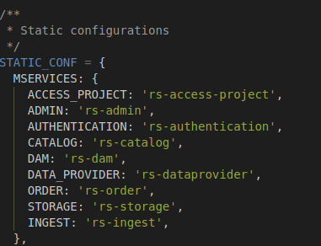
Business microservice – NameResolver Service
Business
Steps to create a microservice :
1. Generate a new maven project using the microservice archetype.
2. Generate a new maven module using the module archetype.
3. Compile your microservice.
4. Deploy your microservice.
5. Add your microservice name in the list of microservice
supervized by the Administration IHM.To do this, edit the
REGARDS/www/config/staticConfiguration.js :
6. check that your microservice is up in the administration
IHM

Slide 22
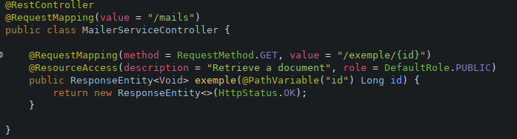
Business microservice – NameResolver Service
Businness
Generate your first REST endpoint :
RestController : Spring annotation to create associated bean
RequestMapping : Spring annotation to define endpoint
ResourceAccess : Regards annotation to add endpoint to administration access control
Parameters & response : See Spring documentation at
https://docs.spring.io/spring/docs/3.2.x/spring-framework-reference/html/mvc.html

Slide 23
Business microservice – NameResolver Service
Business
Now that your service is up, you can develop the NameResolver business.
To do this :
1. Create a table “t_named_geometry” and the domain @Entity associated.
2. Create the JPA Respository to request the table.
3. Create the service NameResolverService to run the repository search
4. Create the REST Controller to call the service.

Slide 24
Business microservice – NameResolver Service
Business
Database access
REGARDS is a multitenant microservice framework
REGARDS use Spring-jpa to access data
Database access is configured for each microservice.
One schema is created per microservice.
You can configure your new microservice database thanks to instance admin IHM.
To know more about spring-jpa :
https://docs.spring.io/spring-data/jpa/docs/2.1.5.RELEASE/reference/html/

