Slide 1



Slide 2

RegenAI
Empowering Farmers
RegenAI
RegenAI
Empowering Farmers, Restoring Earth

Slide 3
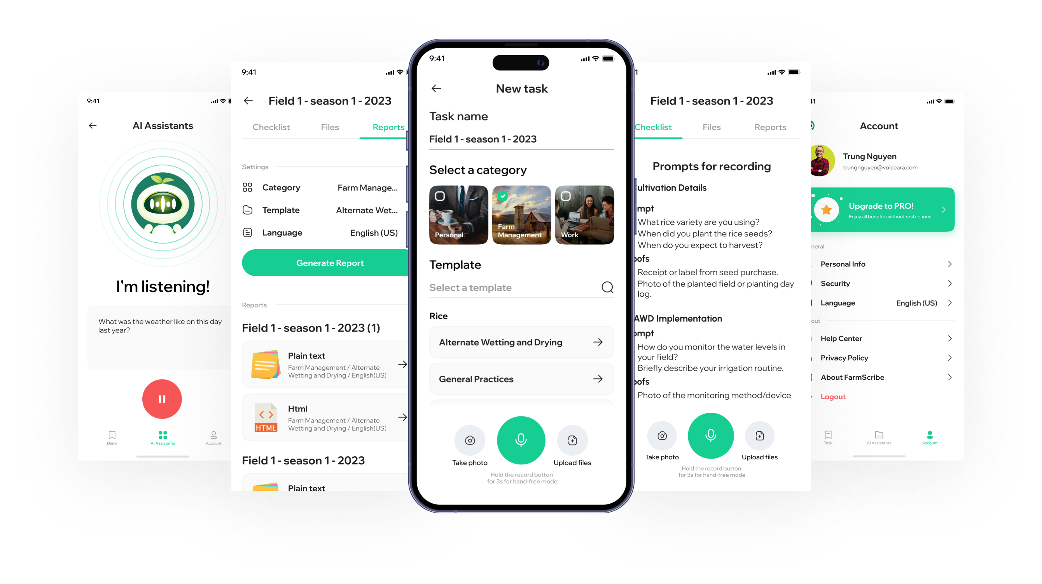

Nguyễn Thị Lý

Slide 4
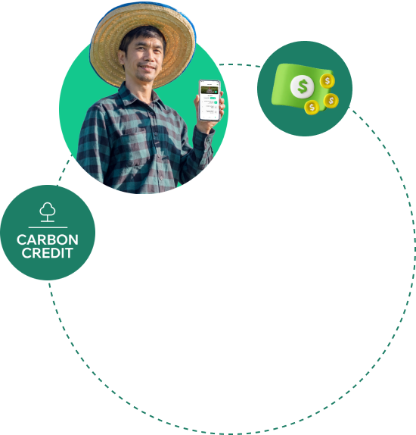
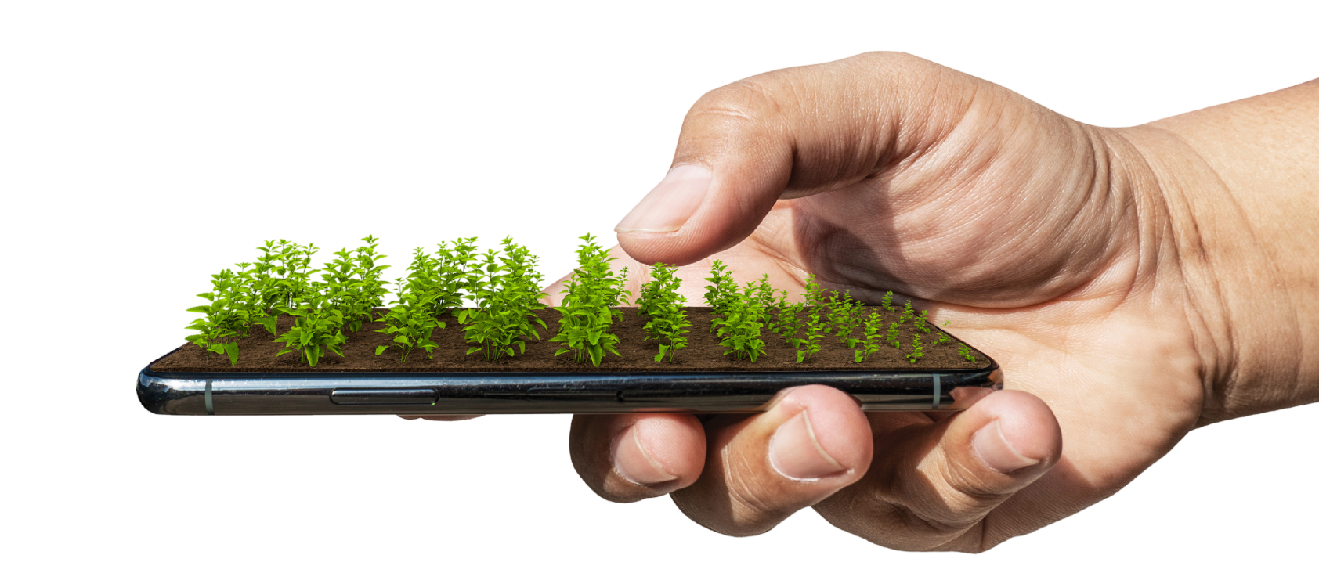

Slide 5

