Slide 1



Slide 3
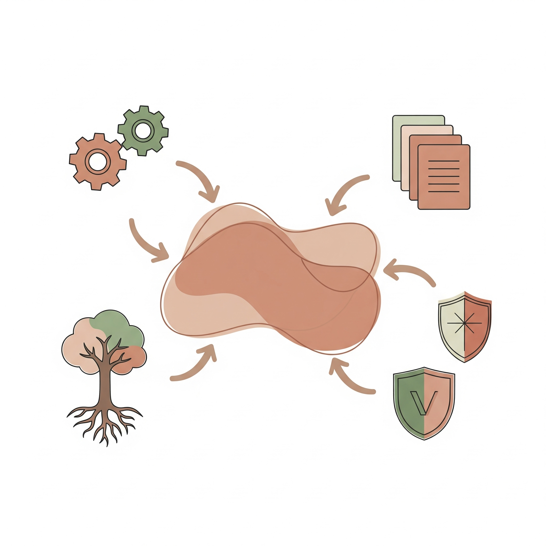
Complex
Quantification
Reports/ Documentation
RegenAI
MMRV
Suite
Standard Compliance
Management
Inputs

