Slide 1
Ion Switching Identify the number of channels open at each time point
WhyKiki
December 2021

Slide 2
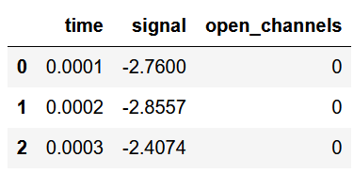

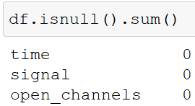
Data
Original train dataset
(from kaggle)
features
dimension
Null values
time
signal
no. of open channels
5 Mio observations
3 columns
No null values
https://www.kaggle.com/c/liverpool-ion-switching/overview/evaluation

Slide 3
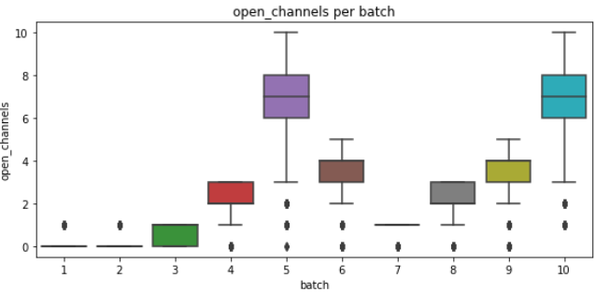
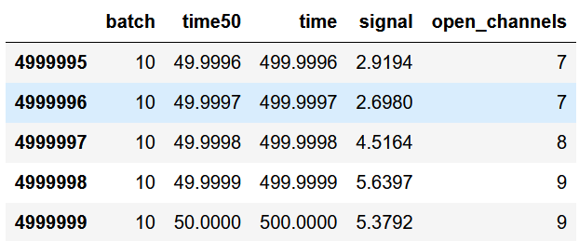
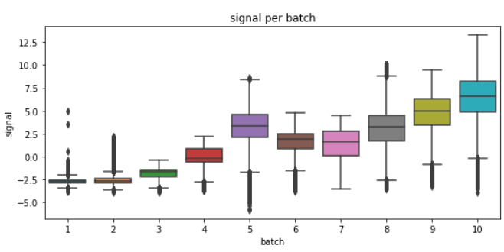
Data exploration - 1
https://www.kaggle.com/c/liverpool-ion-switching/overview/evaluation

Slide 4
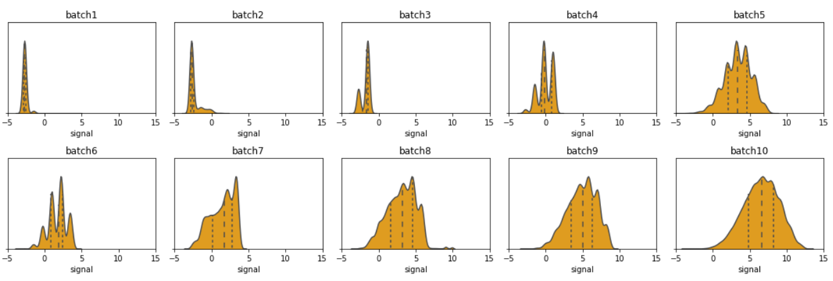
Data exploration - 2
Signal per batch
- density distribution -

Slide 5
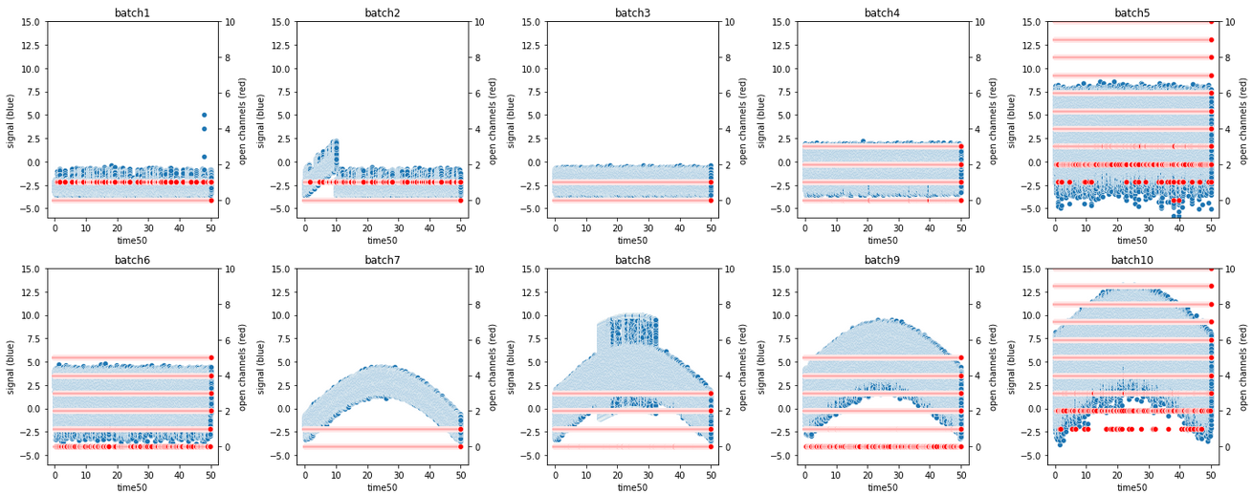
Data exploration – 3a
Signal (blue) and number of open channels (red) over time per batch

Slide 6
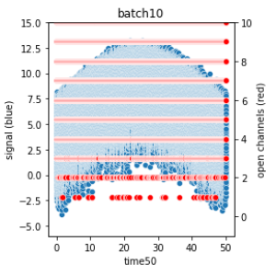
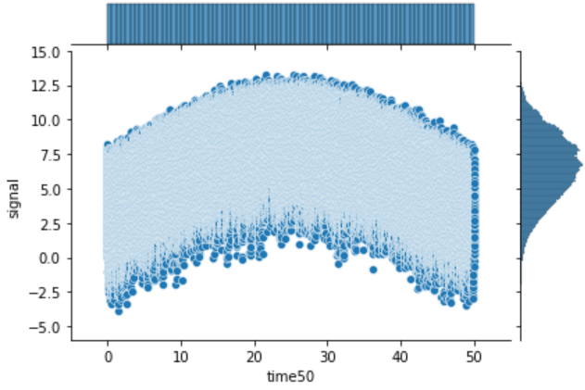
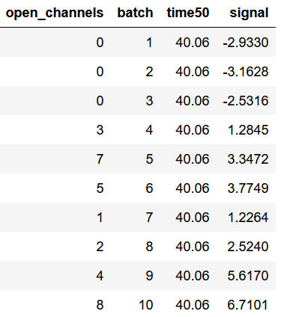
Data exploration – 3b
signal (blue) and number of open channels (red) per batch
signal over time
(signal density on the right side)
batch 10

Slide 7
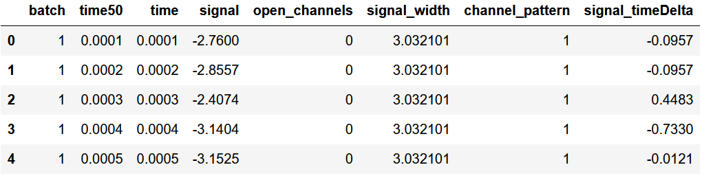
Data exploration - 3
Introduce new features

Slide 8
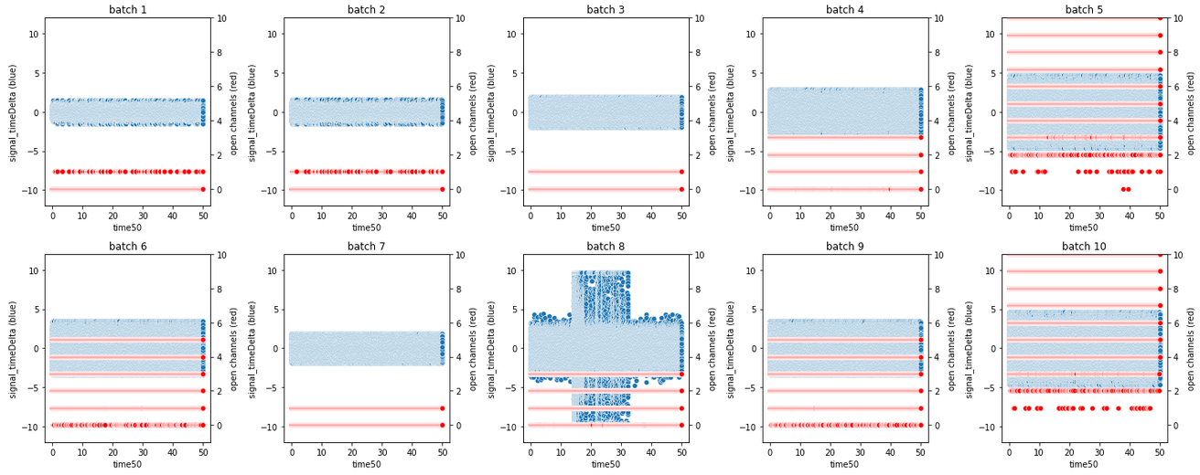
Data exploration – 4
Signal (blue) and open channels (red) per batch
- time series differentiated, 1% potential outliers eliminated -
no trend visible

Slide 9
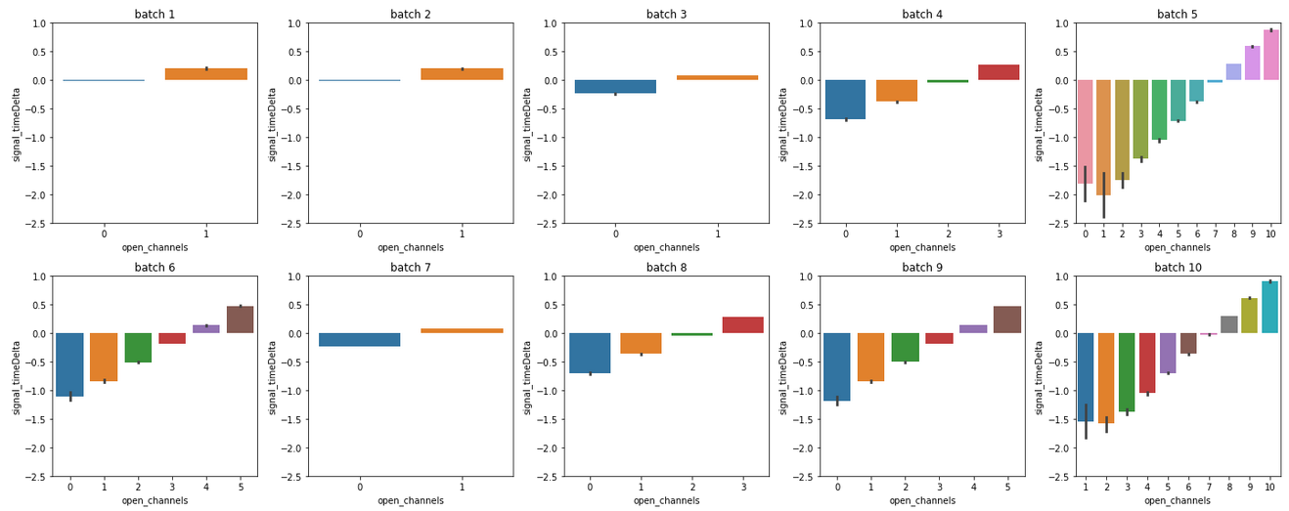
Data exploration - 5
Signal per number of open channels
- time series differentiated -
channel pattern: e.g. batches 5 & 10, batches 6 & 9, ...

Slide 10
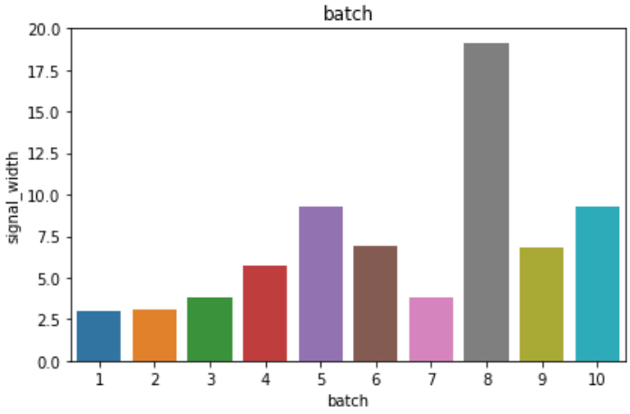
Data exploration - 6
Signal width per open channel
- Derived from differentiated time series -
Signal width: signal.max() – signal.min()

Slide 11
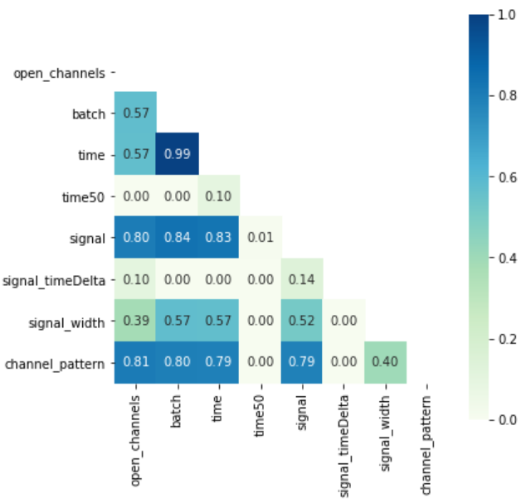
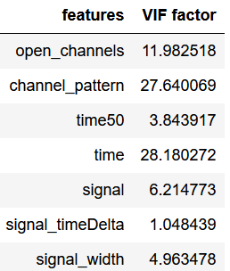
Data exploration - heatmap

Slide 12
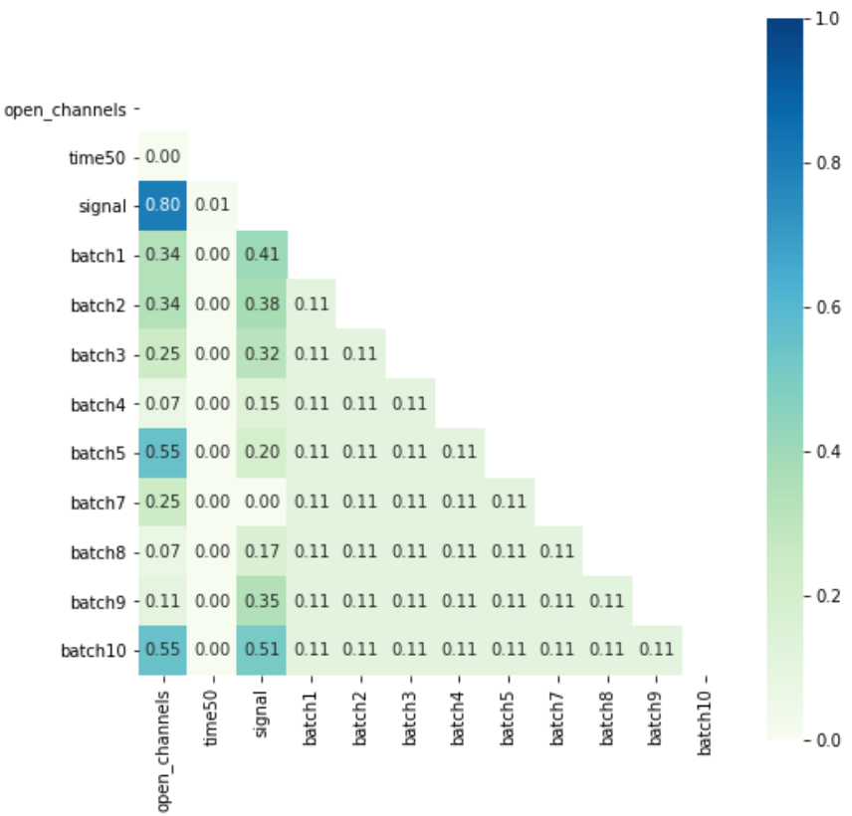
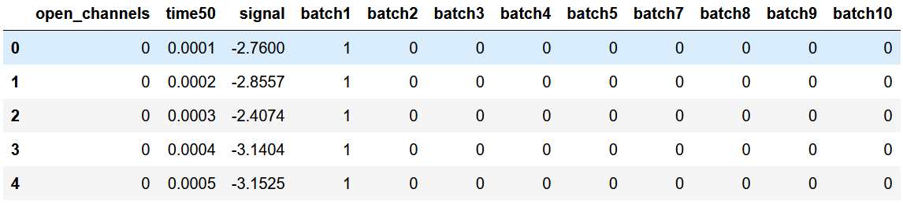
Data preparation for machine learning
only stay with time50, signal and batch (dummies) as independent variables
dependent variable

Slide 13
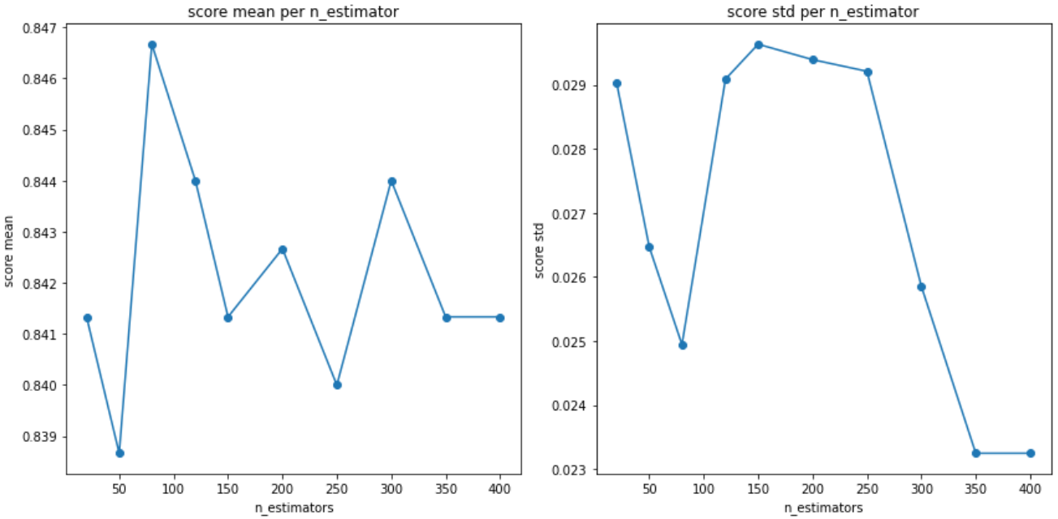
Evaluate best hyperparameters for models visually
Subset: 10’000 samples
- example: RandomForestClassifier, n_estimators -

Slide 14
Supervised machine learning (multiclass classification): Run python script
main
readData
Read data, one-hot-encode batch, create a random subset of 10’000 samples
assignData
assign x_train, y_train, x_test, y_test
assignModel
assign model (logR, RFC, SVC, KNC, MLPC) & hyperparameters to be screened for
evaluateBestParams
run GridSearchCV to evaluate the best hyperparameters per model
fit_predict
fit data and predict dependent variable
calculateScores
Calculate recall, precision, f1 score
compareDifferentModels
create plots for visual comparison of scores
getCodeDocumentation
print code documentation

Slide 15
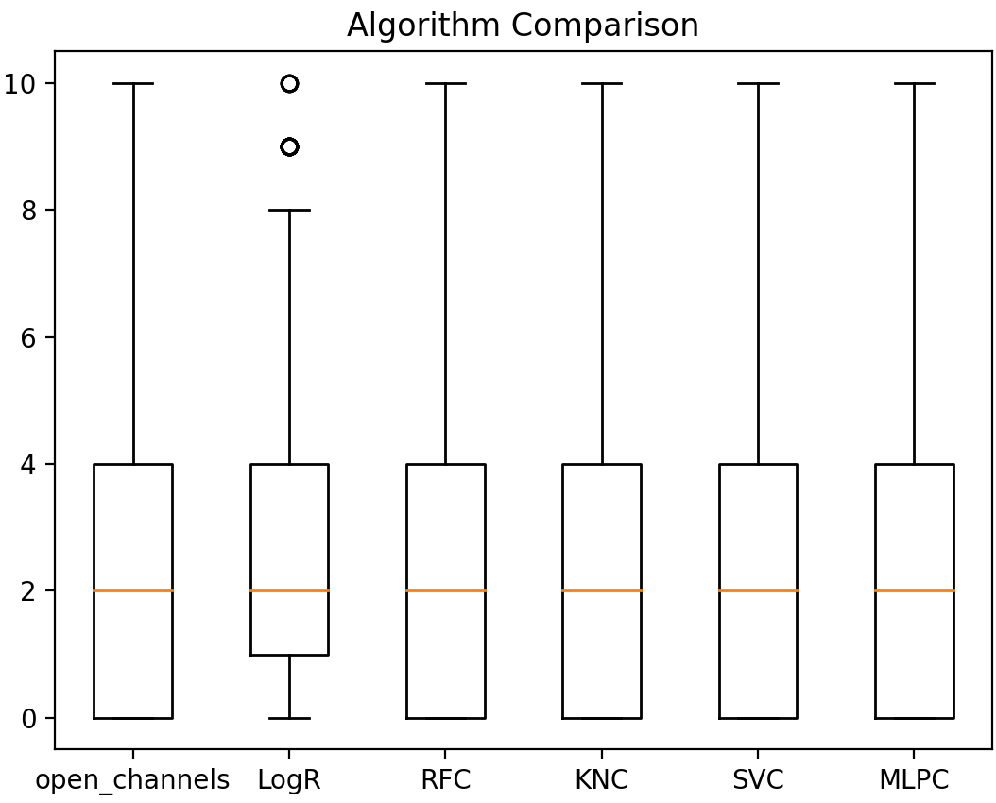
Model comparison: Show differences in y_pred
y_test
y_pred

Slide 16
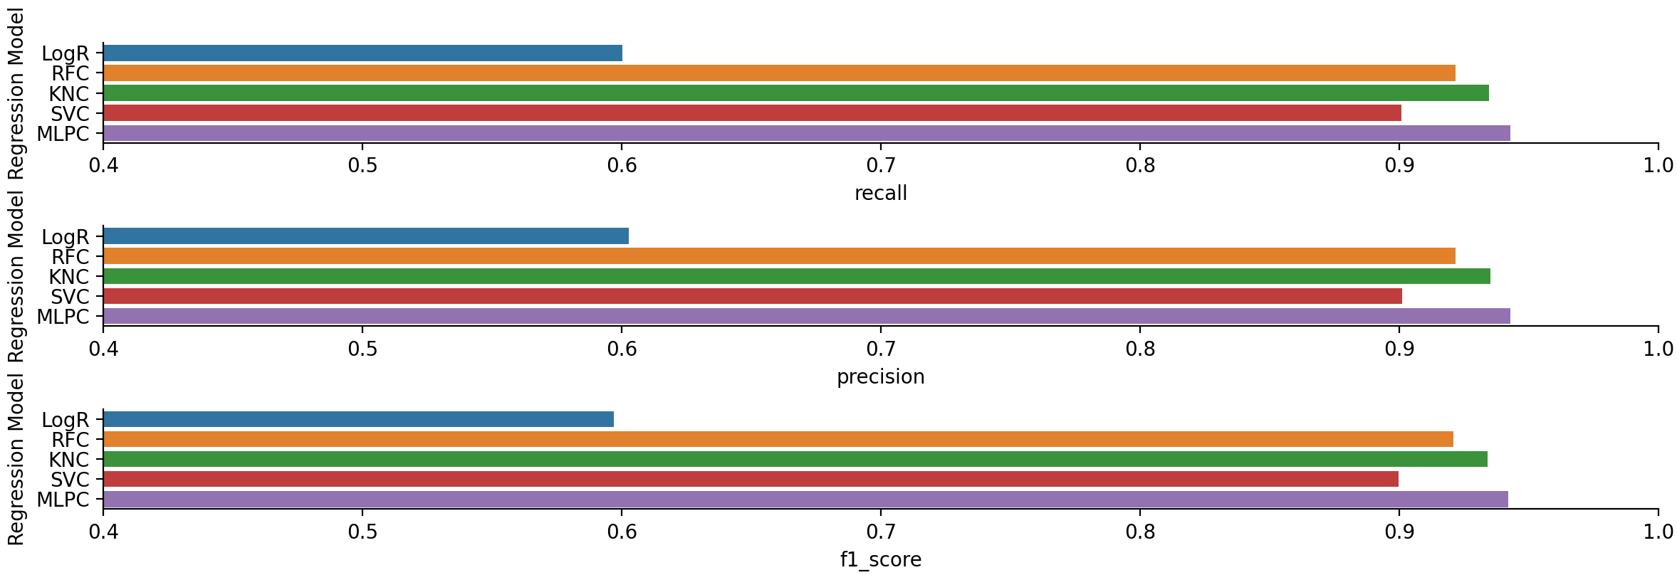
Model comparison: Recall, precision, f1 score

Slide 17
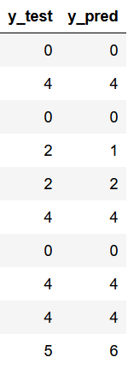


Calculate time-series dependent scores
Problem with classical recall / precision / f1 scores:
are defined for sets of independent observations
time-series specific characteristics cannot be captured (ordered collection of points), which might be meaningful for the application
Time-series → range-based / sequence
32nd Conference on Neural Information Processing Systems (NeurIPS 2018), Montréal, Canada.

Slide 18
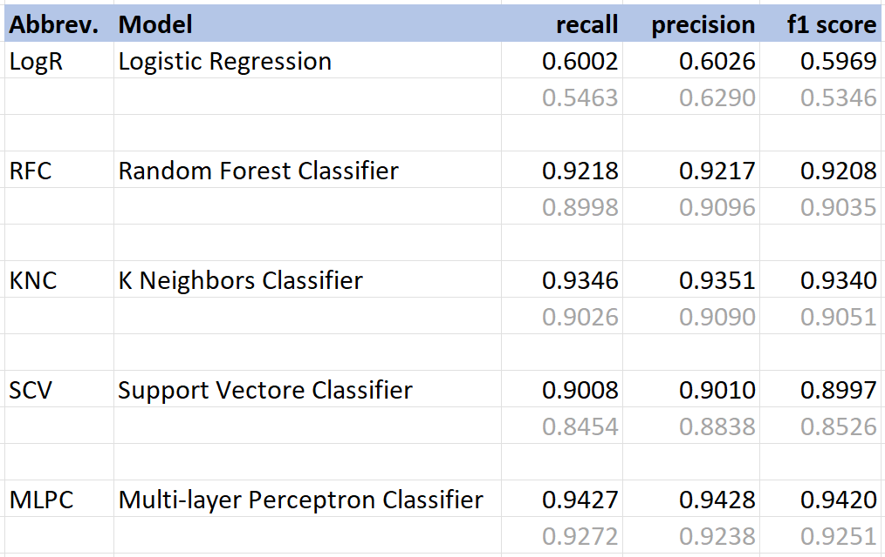
Scores: time-dependent vs classical
adapted to time series
not adapted to time series (usual approach)

Slide 19
Outlook
Run the code for all observations (not only a subset)
Apply Kaggle’s test dataset as well
Try recurrent neural net
Thank you very much for your attention!

