Slide 1
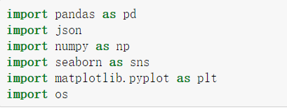
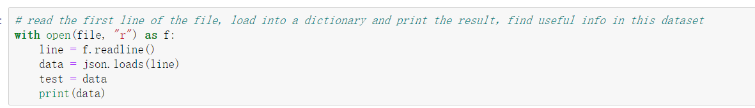
Step-1: read the data sets in JSON format 1. First find the useful field that needs to be extracted, and create an extraction function. 2. files are too large, it cannot be extracted at once (memory error). 3. Save the extracted JSON data as a PKL file for easy reading next time.

Slide 2
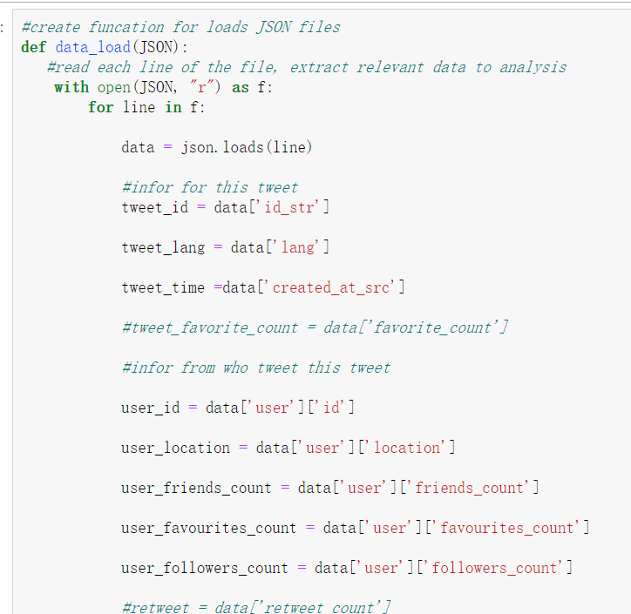
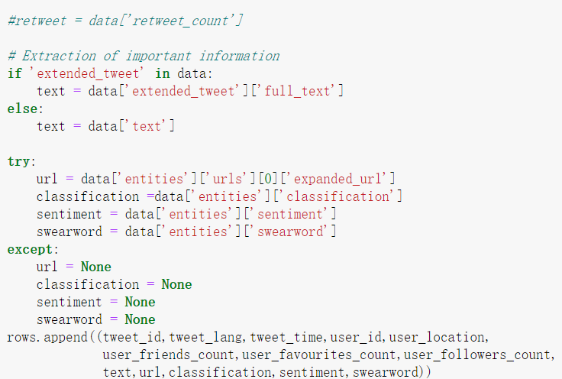

Slide 3
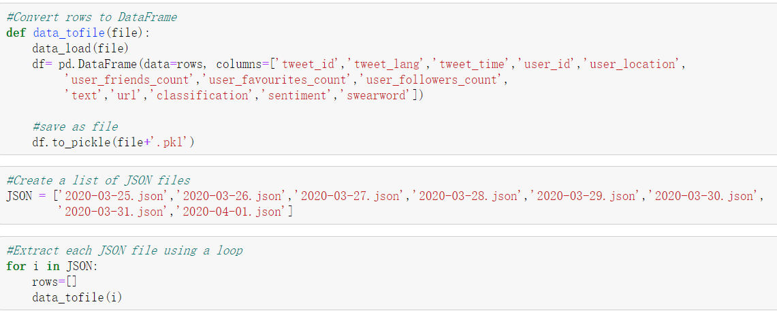
Multiple files use two functions together to complete data extraction and DataFrame reading and save them as PKL files.

Slide 4
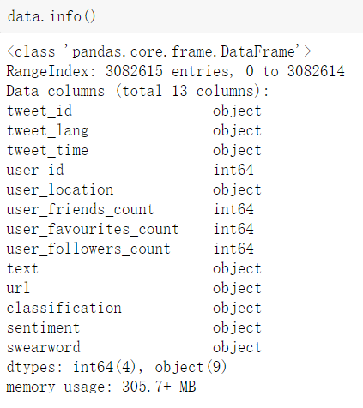
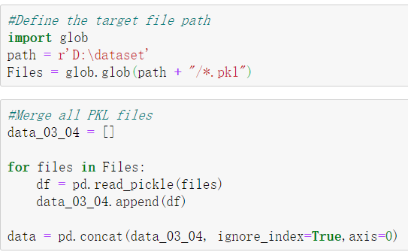
Step-2 Data preprocessing and cleaning
1. Combine PKL data into a DataFrame.
2. Pre-process the data and some necessary cleaning.

Slide 5
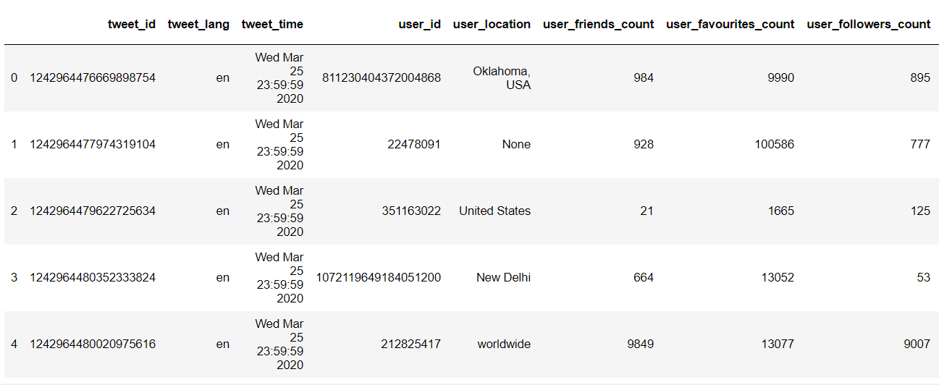
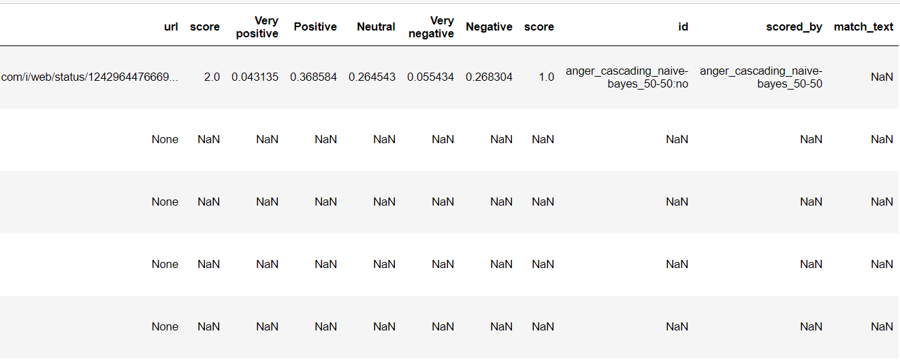
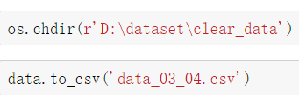
Convert paths to save cleaned data

Slide 6
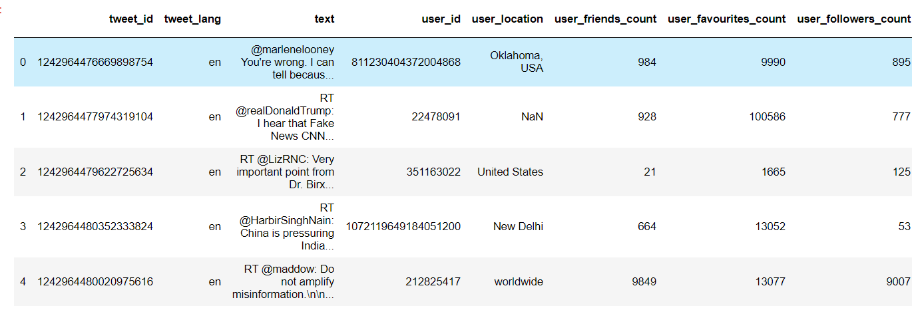
Step-3 Data Visualization of tweet information
1.Before more text mining, we will have a deeper understanding of tweet basic data.
2.Perform deeper cleaning for tweet data.
3.Extract more information through the visualization of tweet data.

Slide 7
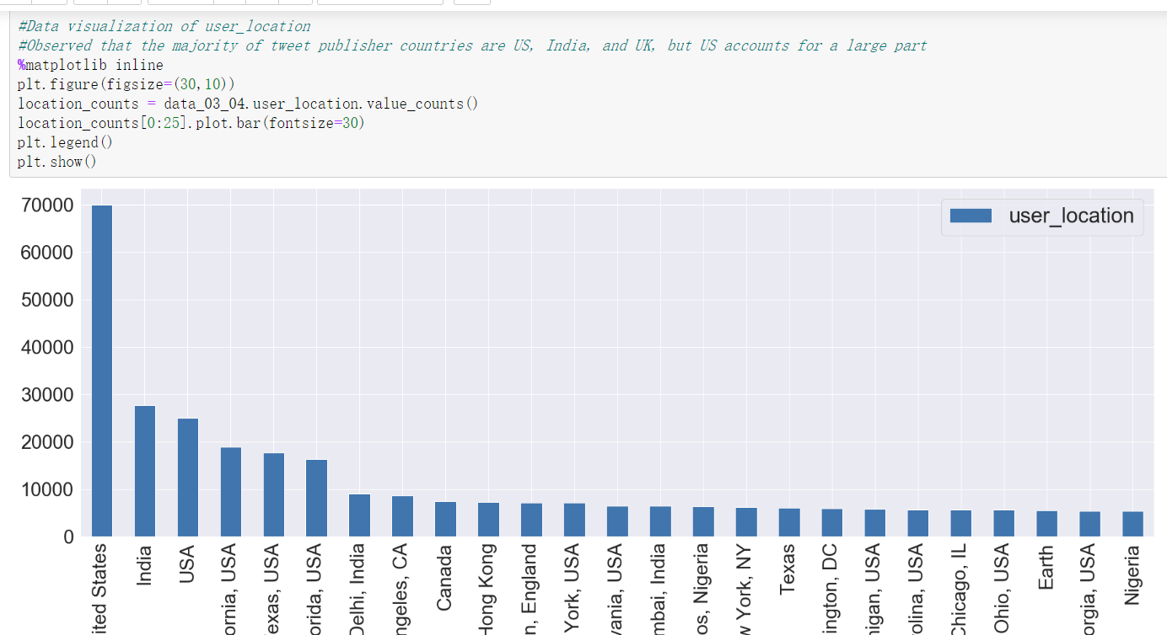
Counting about user location, Most users come from the United States, India, and the UK.

Slide 8
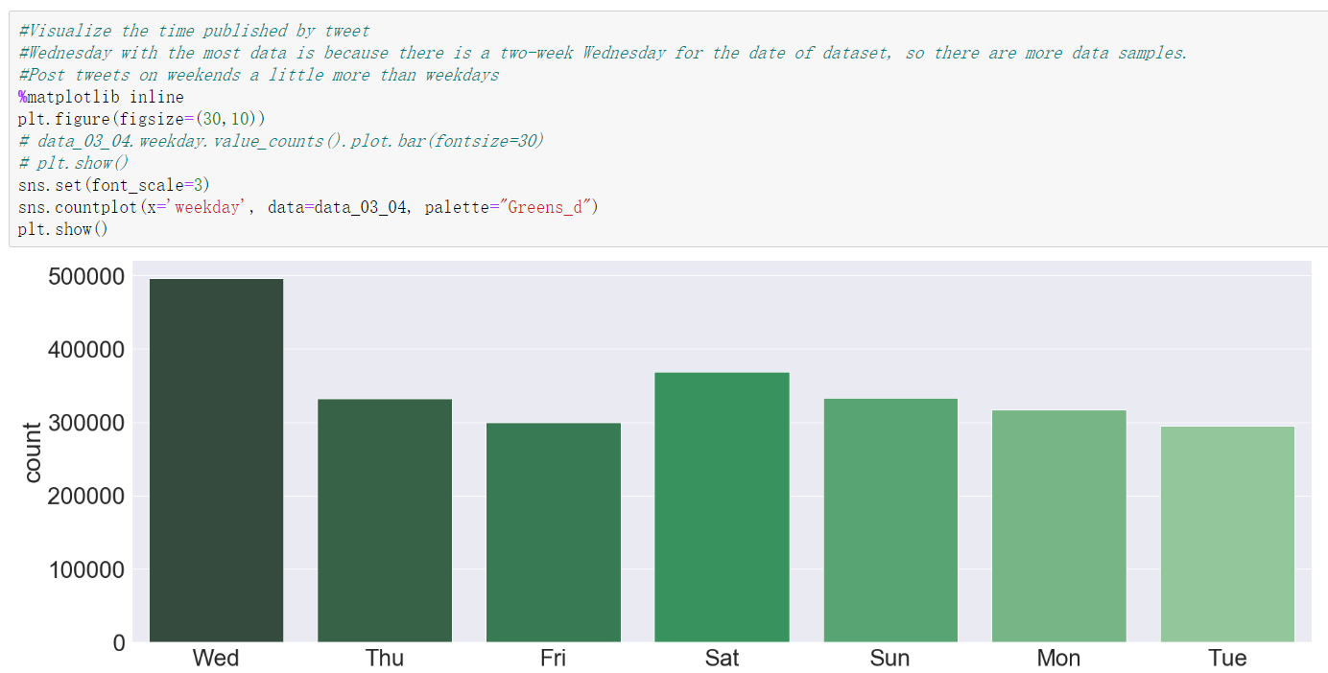
Wednesday is the highest here, because there are two Wednesdays in the data, in fact it should be the most on weekends.

Slide 9
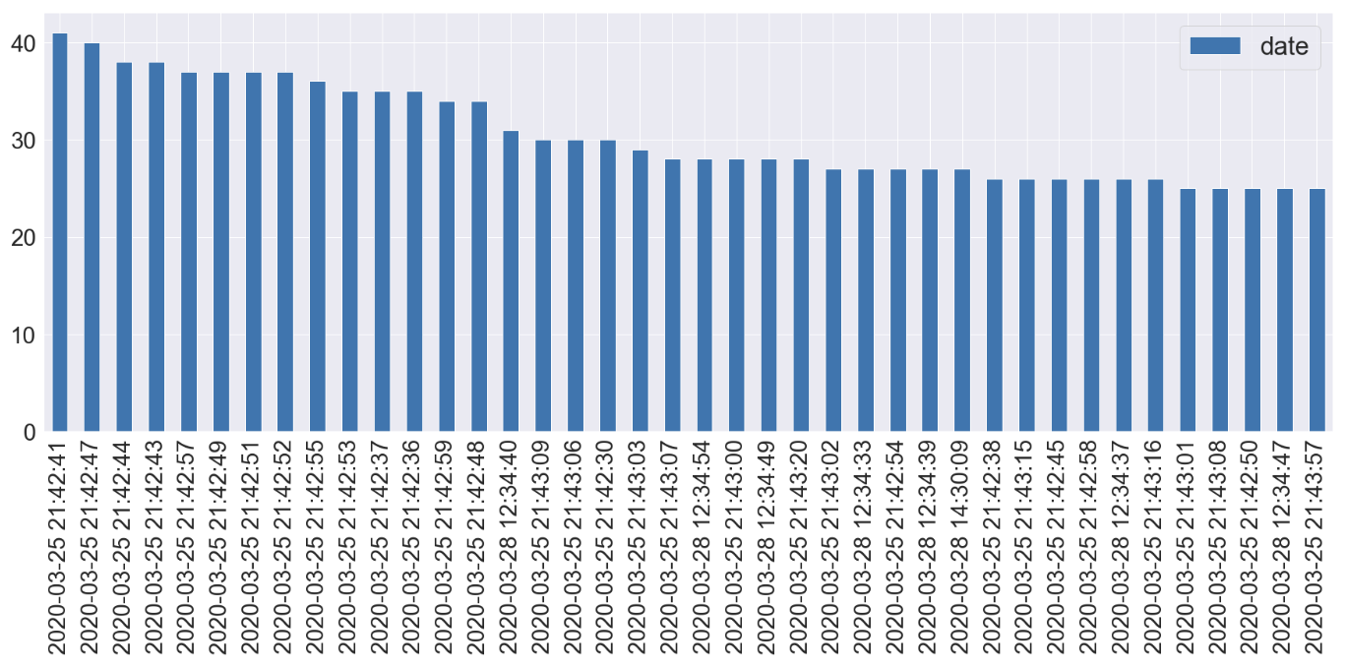
When users posted tweets,Mostly around 9pm

Slide 10
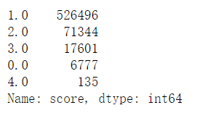
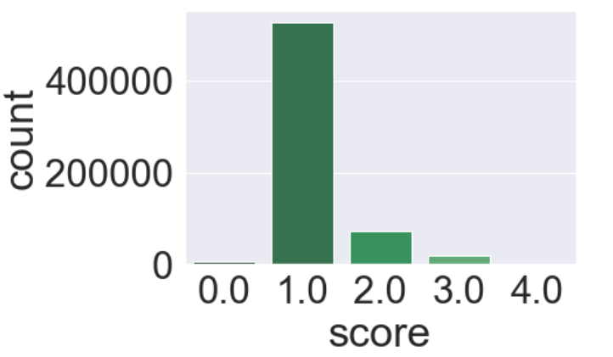
The number represents the emotion of the tweet, and the larger the number, the more negative

Slide 11
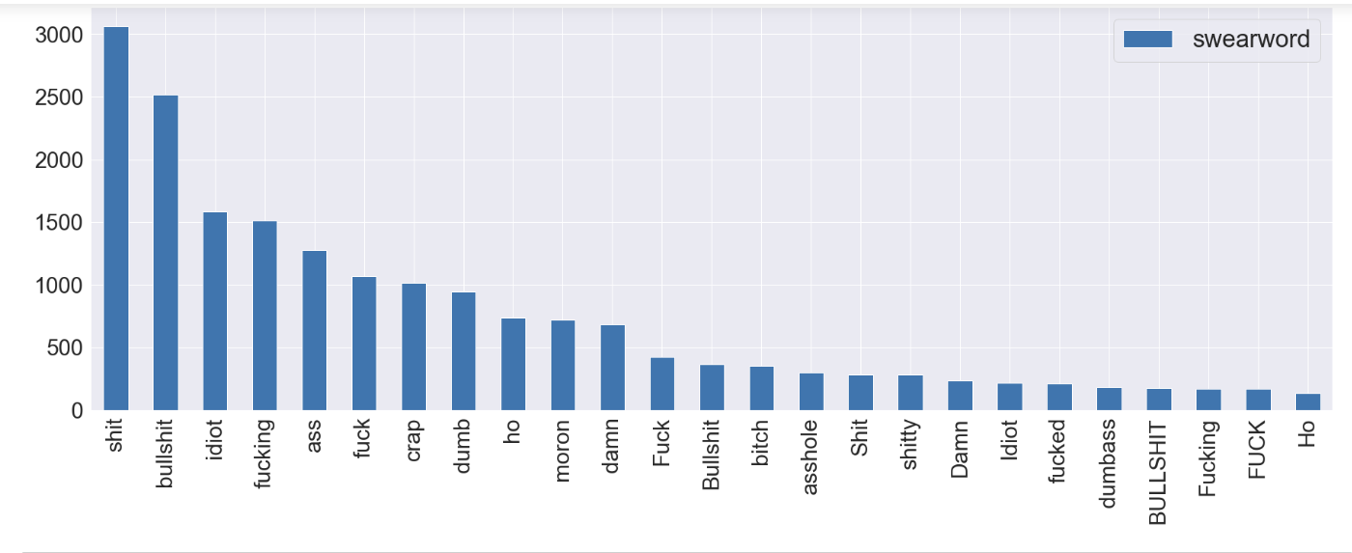
Here are the counts of swearwords

Slide 12
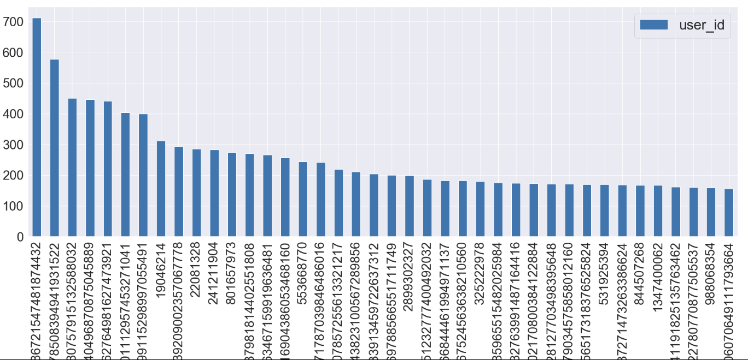
Count of tweets sent by a user

Slide 13
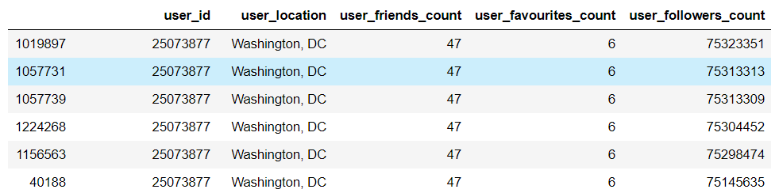
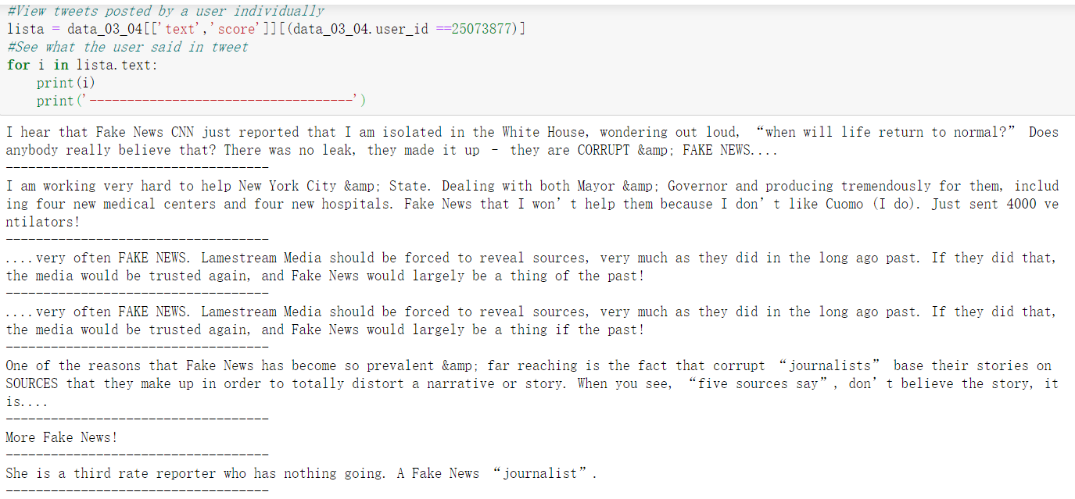
View tweet text posted by the user that have the most followers

Slide 14
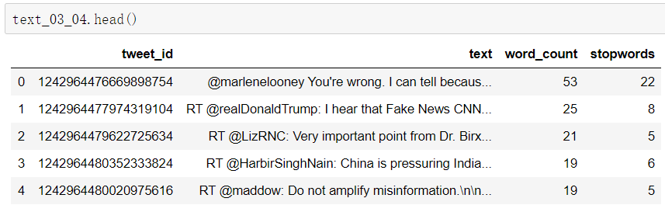
Step-4 Separate storage and processing of text data
1.Save the data after Pre-processing as a file, and use the new file directory (to avoid errors in the previous process when it is run next time)
2.Text processing in pandas dataset
3.After processing, the old text data CSV file is overwritten（Avoid repeated operations when opening the file next time）

Slide 15
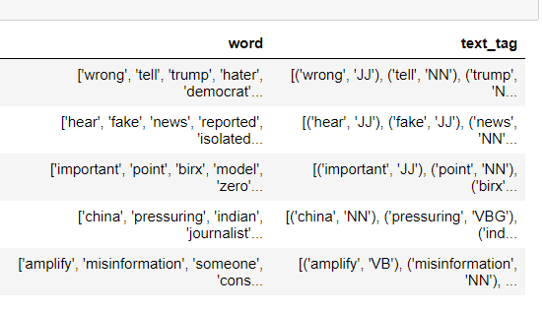
The processing of tweet text data includes：
1.the conversion of lowercase letters
2.deletion of @user and RT from each tweet
3.deletion of words with a length of less than 3
4.Delete punctuation
5.removal of stop words
6.The part of speech reduction
7. word segmentation and Part-of-speech tagging

