Slide 1
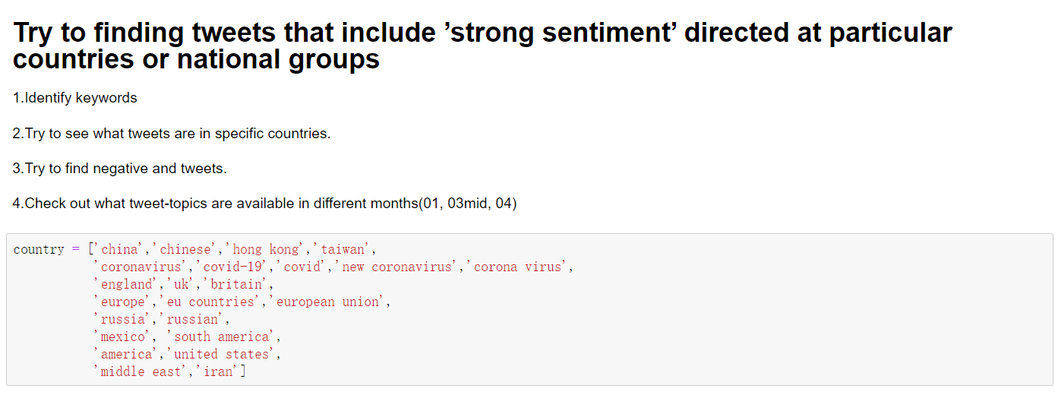

Slide 2
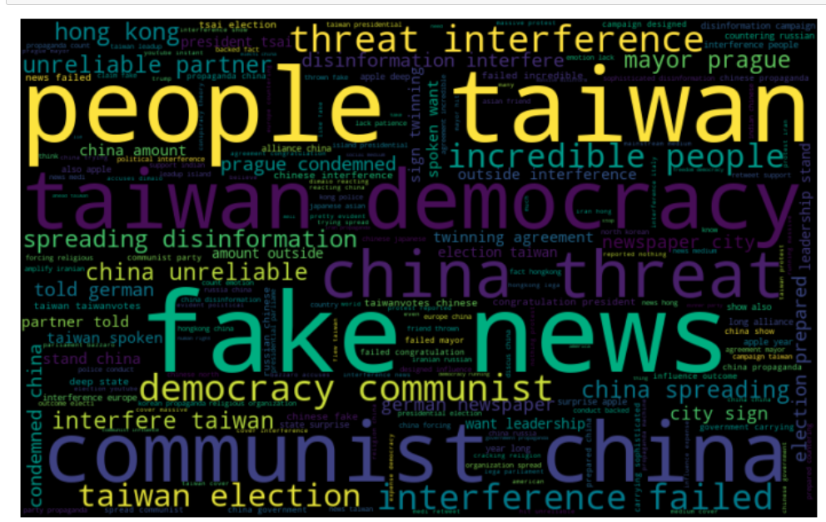
Use keywords about china
This is the use of word clouds to show the high frequency of words in tweet.
china government carrying sophisticated disinformation campaign designed influence outcome
beijing aggression influence disinformation target taiwan election
china forcing religious organization spread communist party propaganda

Slide 3
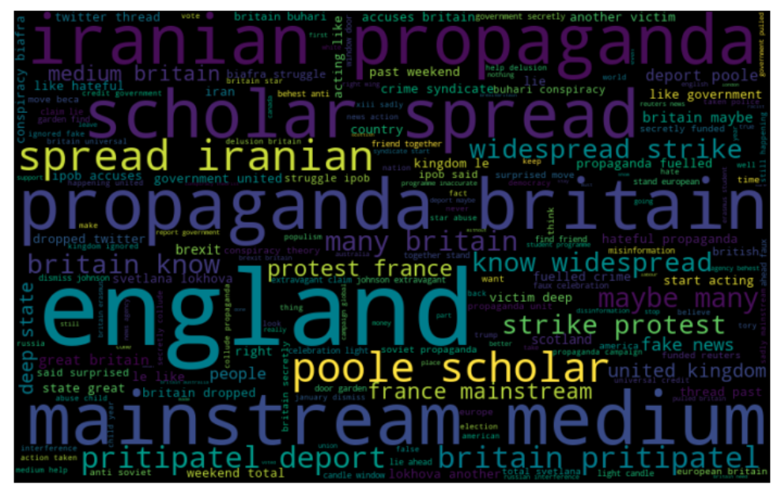
Tweet about UK
totally agree brexit disaster totally damaging britain decent government support fascism facilitated expense decent democratic people lie deception liarjohnson brexitleavesbritainnaked
poole scholar spread iranian propaganda britain pritipatel deport
maybe many britain know widespread strike protest france mainstream medium britain

Slide 4
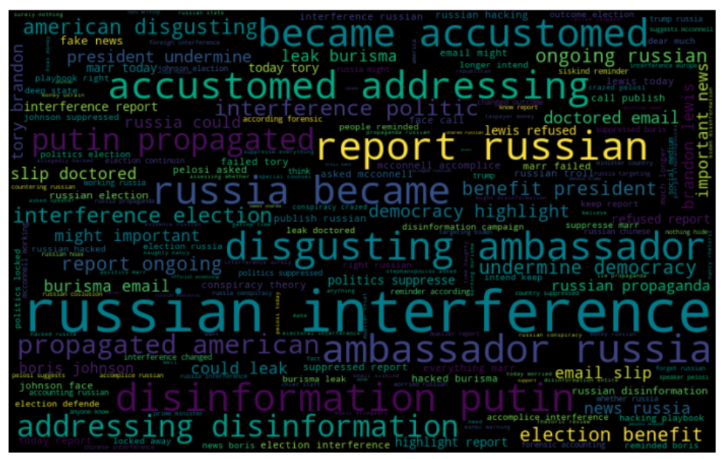
Tweet about Russia
reached year instead city europe lived liberated russian went back home wherever later went palestine british french american nazi conspiracy finish final solution
official investigating whether russia targeting biden election interference
testified help trump fabrication evidence blocking everything russia

