Slide 1
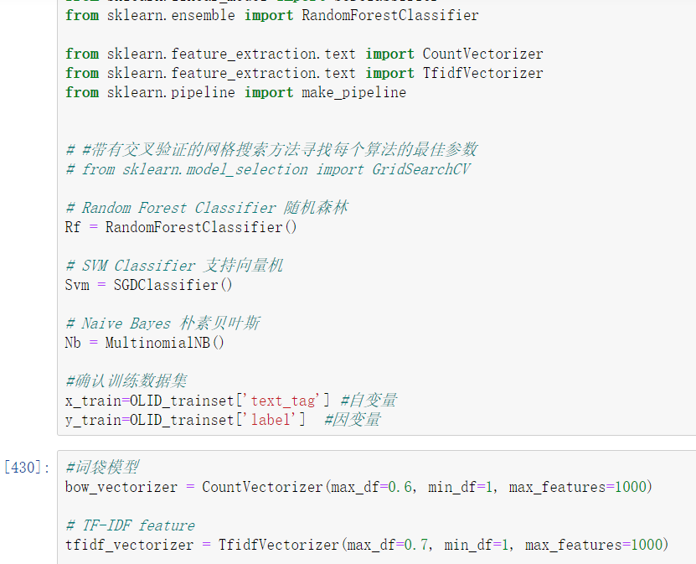
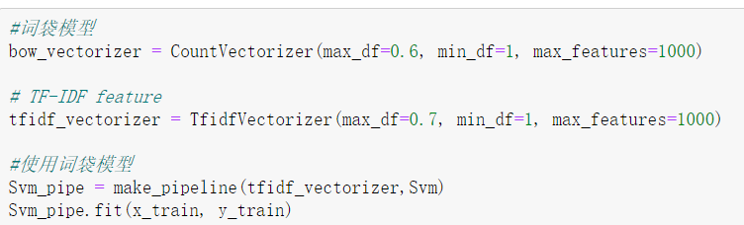

Slide 2
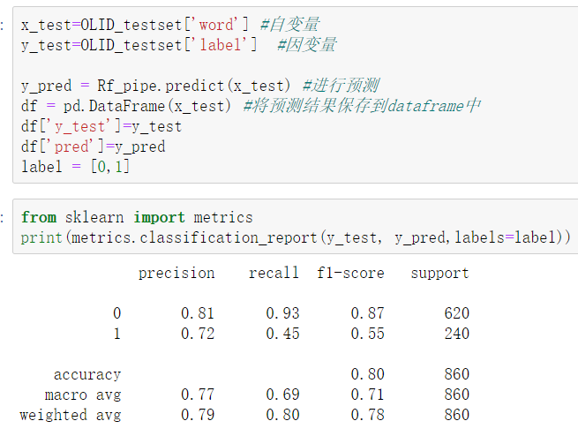
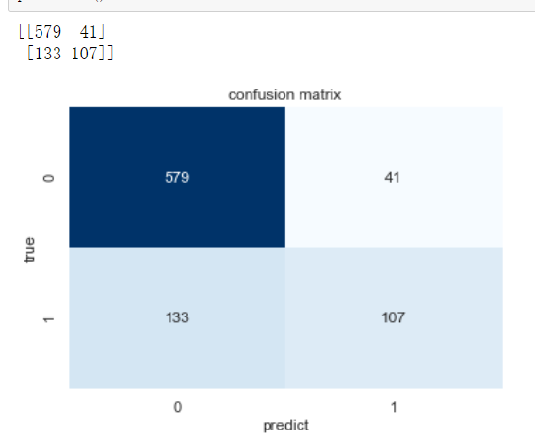
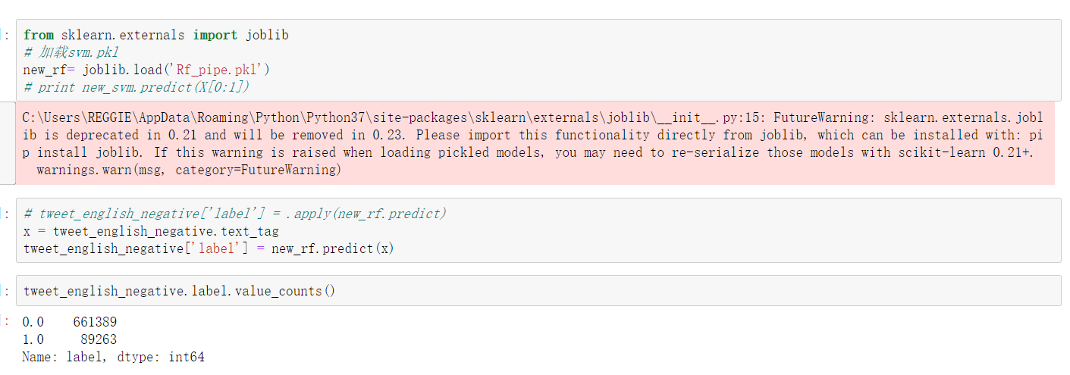
According to the above classification results, most of the tweets are classified as normal tweets.

Slide 3
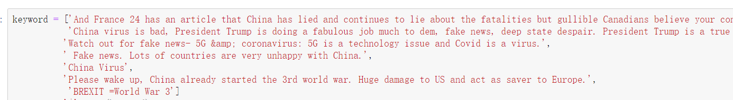
But by looking at the word cloud and looking at the details of some tweets, found that these tweets are also offensive and rumors. So this machine learning method is not suitable for use in this situation. Only use the method of emotional dictionary matching to filter negative tweets, and then conduct in-depth analysis.

Slide 4
