Slide 1


中国*****大学
FYP：Development of system to identify scam in online second-hand transactions
Researcher：HONGLANGLUO
Supervisor: David Trigg
Assessorr: Uchitha,JAYAWICKRAMA

Slide 2
Problem definition
Shopping online is developed，usually more convenient than going to a physical store shopping, the variety is more abundant and the price is cheaper. So most people like shopping on the Internet. But the actual situation of the goods buyers can not know. Many sellers directly sell second-hand goods with problems to consumers, and falsely claim that there is no problem with these goods. This is a fraud !
in the online shopping fraud, it is difficult to solve the problem. Many bad sellers will put the problem items with the normal items, even if they get bad feedback. Because most of it is good feedback from other buyers.Returns are difficult and incur additional costs. So I want to plan for a rainy day. Build a system to detect scams in the online shopping .
problem : how to dectect online shopping fraud(or improvement this area)

Slide 3
Major parts of the project
First part
Second part
Third part
Fourth part
Fifth part
Related work
Project management
System Specification
System design
modeling

Slide 4

Related work
There are many types of online scams, including fake websites, malware, or computer virus attacks. At the same time, these methods of fraud also have solutions, some online software can help detect the malware. But these are not my areas of research in this project
There are also some methods about solving online shopping fraud, among which the data mining method studied may be my research direction. With real data to tell consumers, through the analysis of real data to find the existence of the network may be fraudulent goods in the shopping website.
However, the fraud occurred in shopping is very difficult to solve, only some guidance about shopping is available on the Internet, such as the eBayhelp page.But there is no practical effect

Slide 5
Project management
project plan method
management software-- Trello.
project gantt chart
project logbook
crisp-dm
David and me discussed the gantt chart several times and finally made three different versions of the gantt chart. Every change is an improvement
There were 15 weeks of meetings in total. Because I used handwriting, I turned these logbook scans into pictures.

Slide 6
System Specification（Solution）
System development method
extreme programming VS waterfall
The choice of Database
SQL VS NoSQL
Data Collection Approach
web crawler VS API
Some useful software for this project
(Excel. MySQL Database, Pychram, PPT, microsoft project, wards)
The algorithm
K-means algorithm VS Decision tree algorithm

Slide 7
System design
01
02
03
use UML to show System structure((system component diagram)
System process(workflow diagram)
Fraud detection (use care diagram)
04
Data flow diagram

Slide 8
modeling
Data preprocessing
Data collection
The primary attribute

Slide 9

Output results and system limitations（Evaluation）

Slide 10
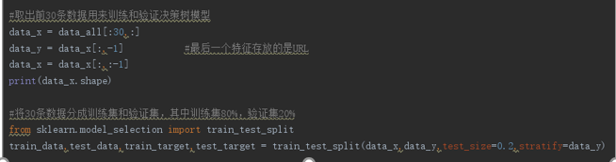
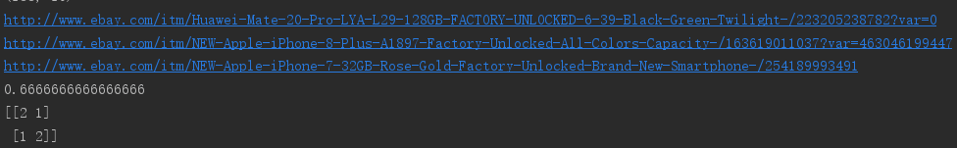
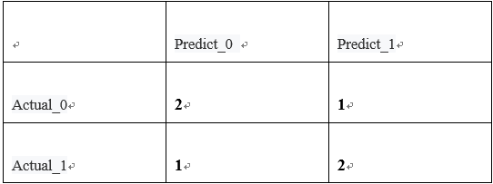

Slide 11
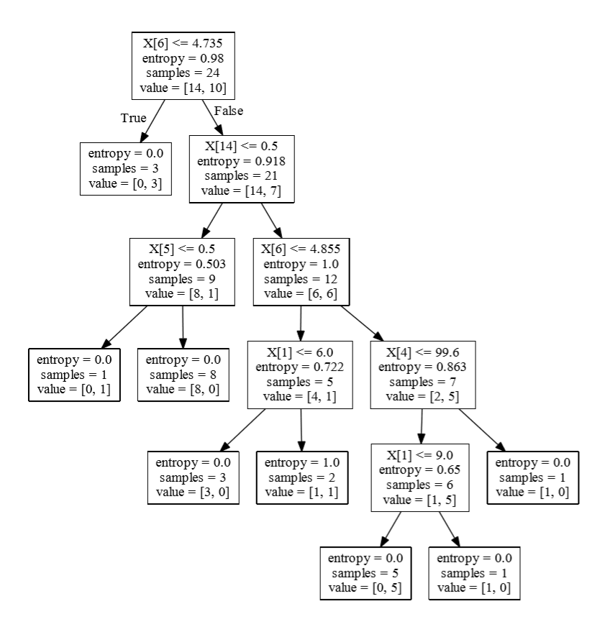
user rating
sellerbusinesstype
feedback
user rating
product conditon
positive feedback percent
product conditon

Slide 12
advice VS system
user rating
feedback
product description
product picture
user rating
feedback
product conditon
positive feedback percent
sellerbusinesstype
improvement
so this is an improved scheme and research direction to identify the possibility of network shopping fraud.

Slide 13
system limitations
Some of the selected attributes may be less important
the imbalance of data
the amount of sample data is not large enough
the instability of the training model
it is a pity that there is not enough time to complete a web page focus on the system

Slide 14
What have I learned
This is a very comprehensive and systematic project, which requires me to think from different perspectives.
Find the best one by comparing two different methods.
theoretical knowledge is important, but if there is no reasonable design and time arrangement can not be well completed.
Be patient when programming
By solving some practical problems in the real world, can make the knowledge I have learned become useful
Listen to the better advice of others

Slide 15
Thanks for listening!
Question?

Slide 16
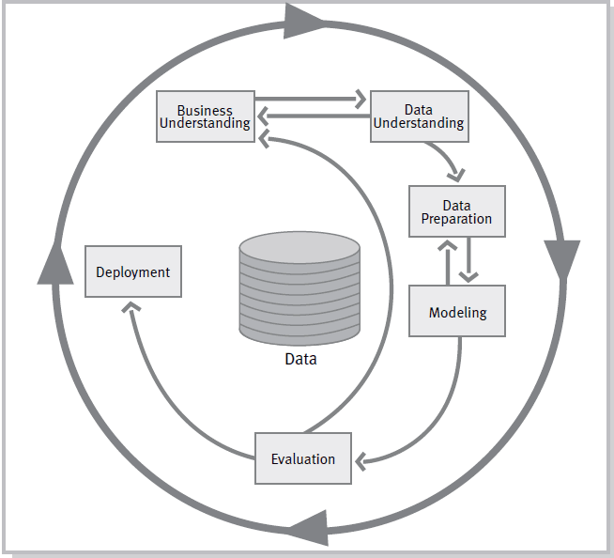

Slide 17
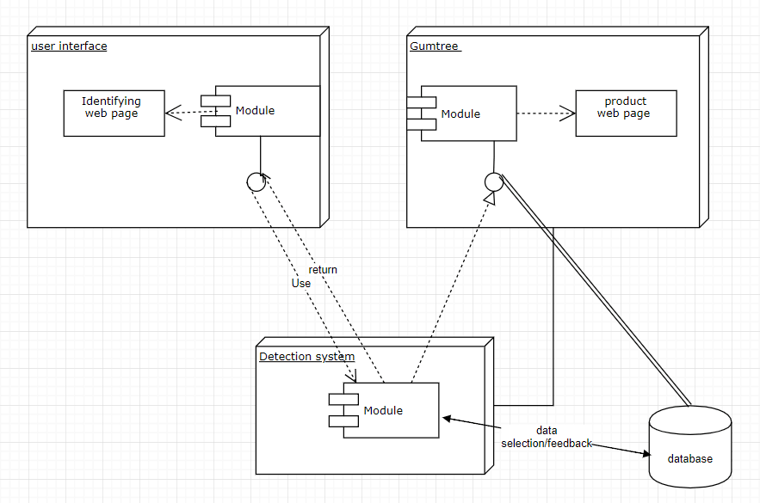

Slide 18
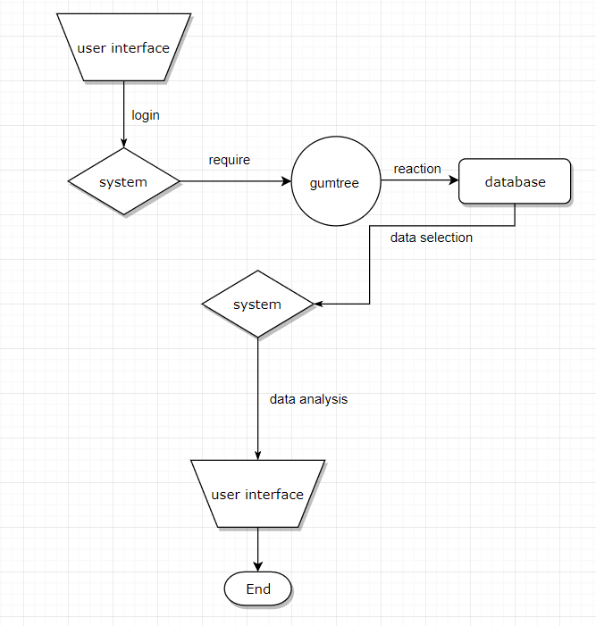

Slide 19
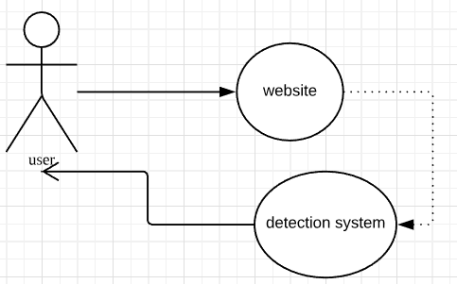

Slide 20
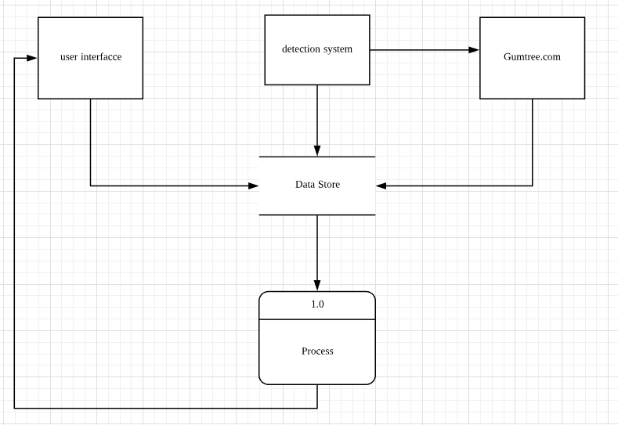

Slide 21
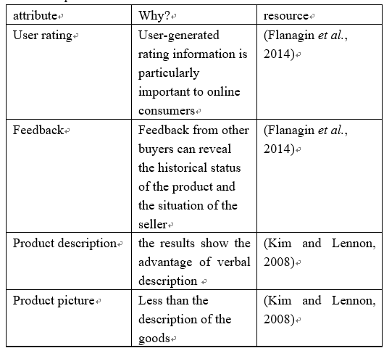

Slide 22
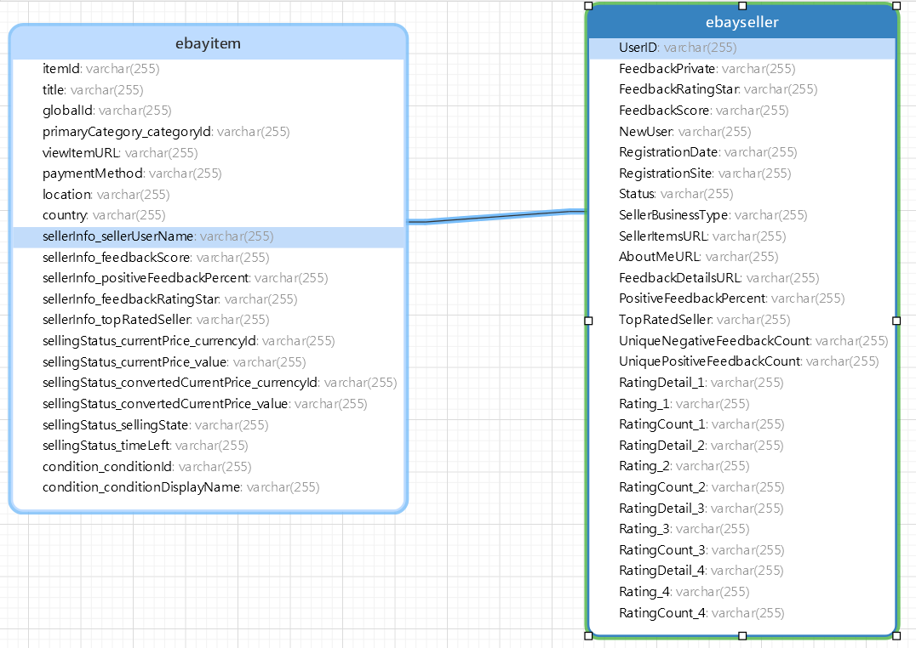

Slide 23
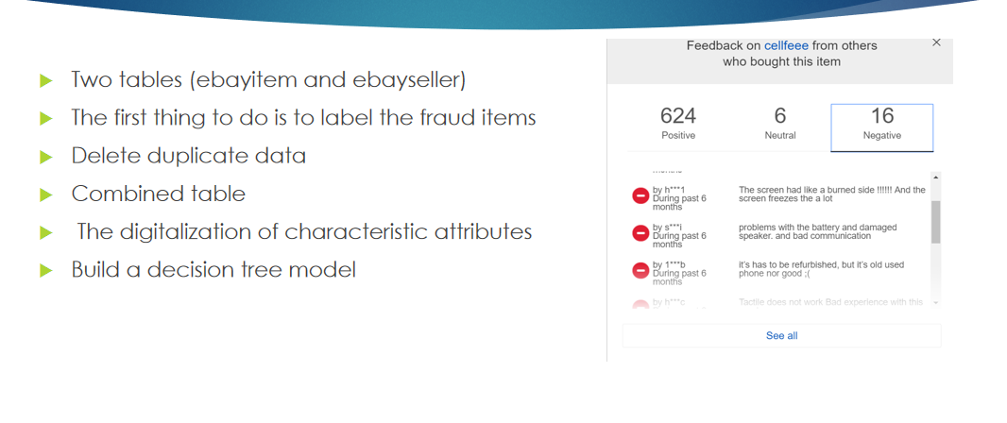

Slide 24
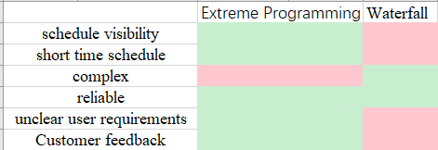
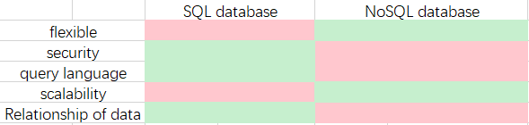

Slide 25
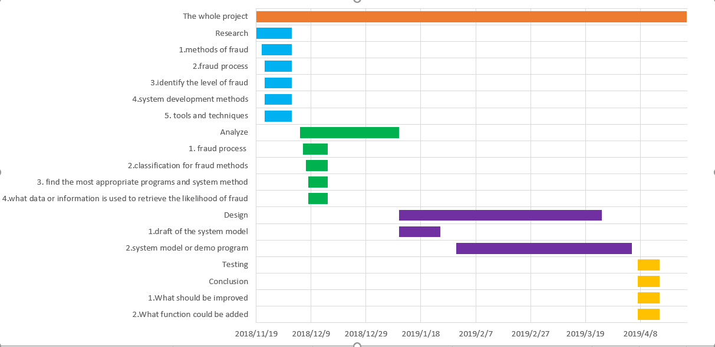

Slide 26
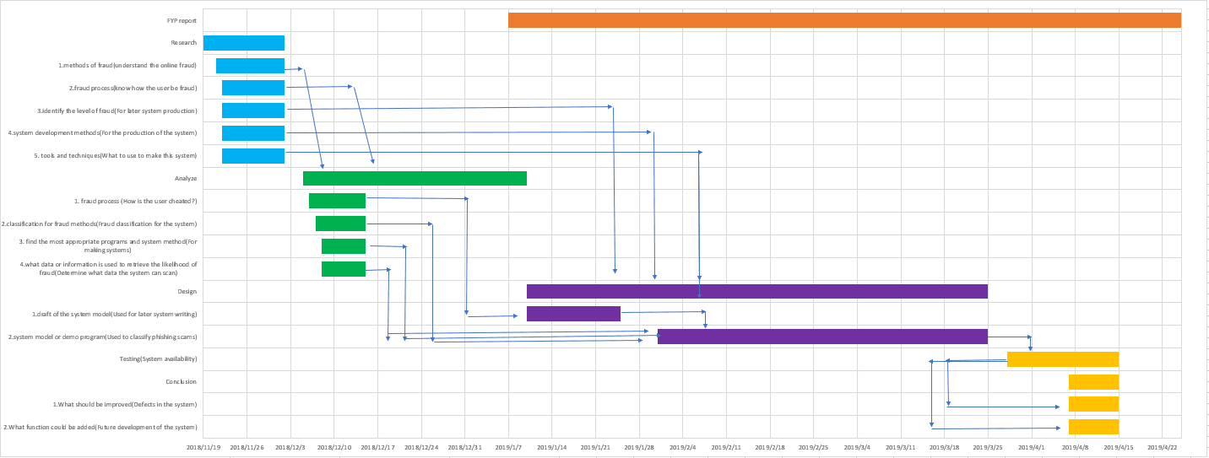

Slide 27
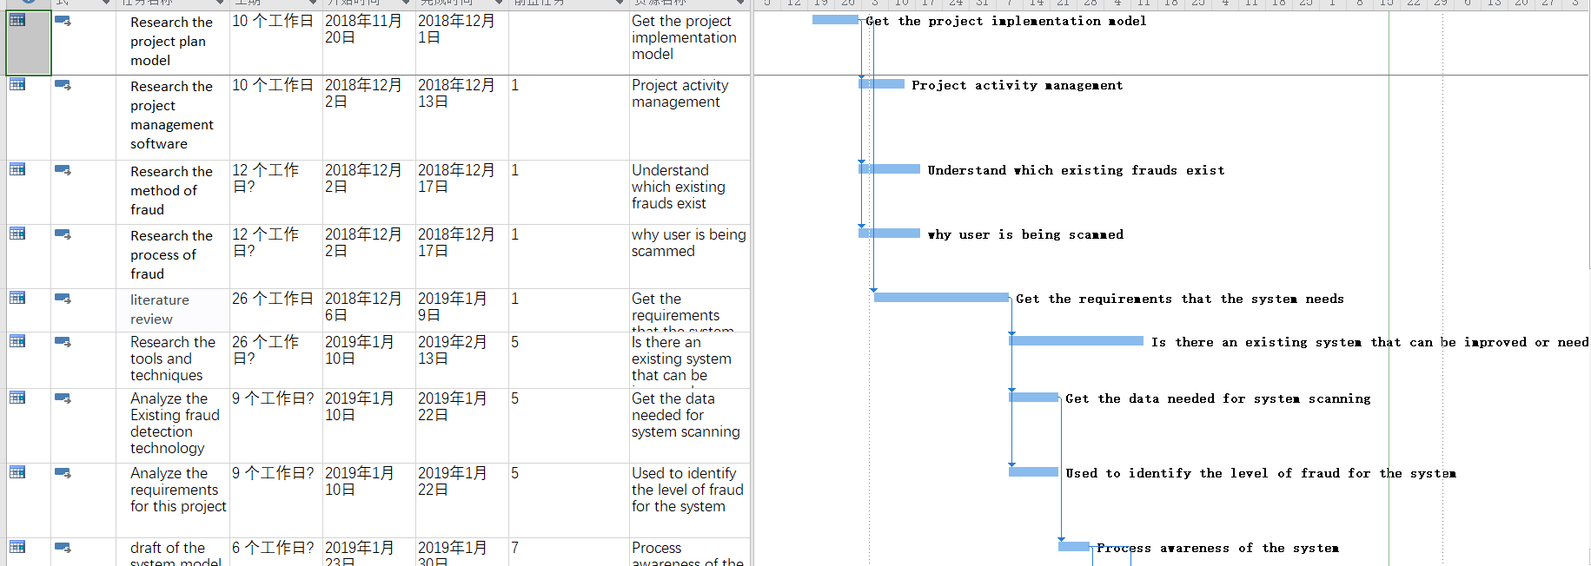

Slide 28
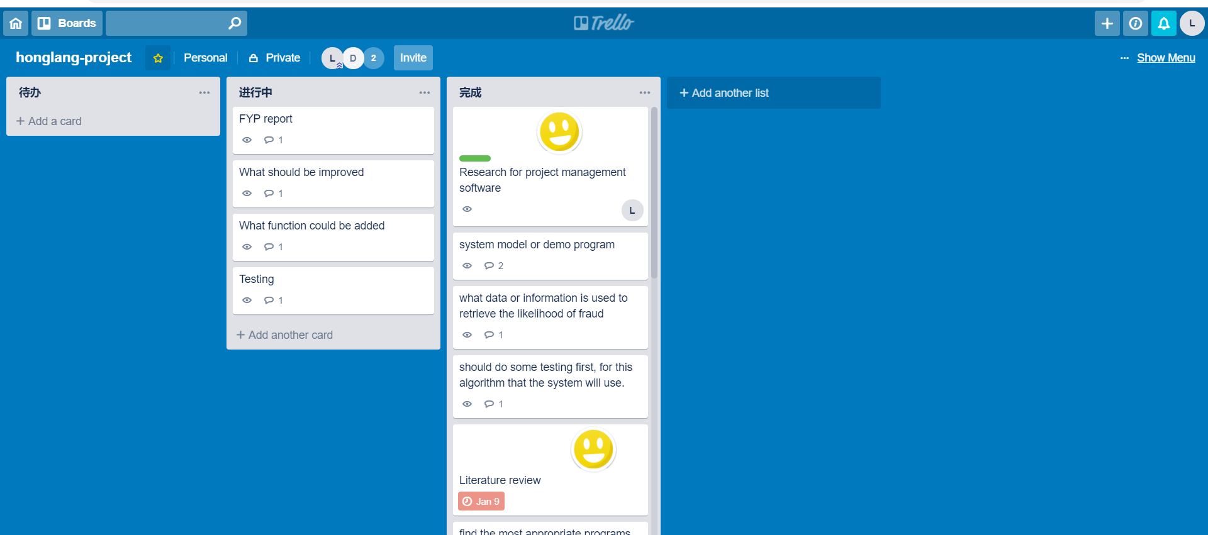

Slide 29
