Slide 1
Customer
What is Customer Retention?
Retention
What is this and Why is this required for every Organization?

Slide 2
What is Customer Retention?
Customer retention is the ability to keep customers coming back to your store or website to create repeat business and investment.
Keep your Customer engaged and Build Trust.
Customer Retention ensure customer loyalty.
It is the process of engaging existing customers to continue buying products or services from your business.
In Other Words Customer Retention means
to maintain existing customers”

Slide 3
It’s different from customer acquisition or lead generation because you have already converted the customer at least once.
Your probability of selling to an existing customer is at least 40 percent more likely than converting someone who has never bought from you before.

Slide 4
What are the benefits of CR?
Retained customer tend to buy other services from the same company
Retained customer are known to be less price/cost effective
Positive publicity - Free Marketing 24 x7
The probability of selling to an existing customer is 60 – 70%
While the probability of selling to a new customer is 5-20%
Decline Migration rate

Slide 5
Retention Tactics
Poor customer service brings 70% of customer loss
Always ask for feedback from customer
Listen first, understand and then talk
Bring your customers together
Give priority and importance to customers always
Find out what makes customer to stay or leave
Analyze customer feedback to gain valuable insights and ensure that right person hear it.

Slide 6
Analyzing customer feedback to gain some useful insights
What Data we have?
We have customers feedback for e-Commerce websites
> Total 269 customers reply over 70 questions each

Slide 7
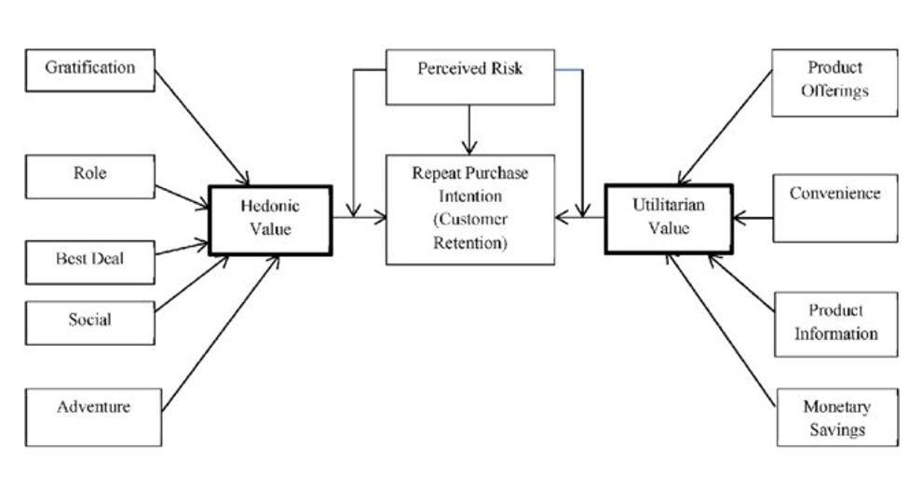
Some Key points to Retain Customers
We will analyze our data
In accounts to these key
points
Data is about to 5 Companies
Amazon
Flipkart
Myntra
Paytm
Snapdeal

Slide 8
Who is our potential customer?
21 – 50 Years are potential age who covers
85% sales
Females are the
Potential customer
67.29%

Slide 9
Top 10 Cities for e-commerce

Slide 10
Shopping Pattern

Slide 11
How they do shopping?

Slide 12
How Customer reached to online website?

Slide 13
Customer habit on ecommerce

Slide 14
Website content

Slide 16
Hedonic Values

Slide 17
Online retailer preferred:

Slide 18
Conclusion:
Amazon platform is first choice where online shopping is easy with speedy order delivery
Flipkart platform is second choice of customers
Myntra secured the 3rd place in customers choice
Snapdeal is on 4th position
Paytm is the 5th choice

Slide 19
Product Availability
Conclusion:
1. Amazon have variety of products with complete ,relevant information
2. Flipkart is on 2nd choice
3. Myntra is on 3rd Choice
4. Snapdeal secured 4th position
5. Paytm is on 5th position in Product availability category

Slide 20
Platform Technical performance
Conclusion:
Amazon is technically best platform as per customer choices
Flipkart is on the 2nd position in this category
Paytm secured 3rd position on platform stability
Myntra is on 4th position
Snapdeal is on 5th position

Slide 21
Privacy of Customer
Conclusion:
Amazon again on Top position in Customer privacy
Flipkart is on 2nd position
Myntra secured 3rd position on customer privacy matter
Snapdeal is on the 4th position
Paytm somehow not able to gain customers trust

Slide 22
Performance during promotion, sales period
Conclusion:
However, Amazon is most favorite and popular website for
ecommerce but during sales period time performance is not
much good.

Slide 23
Which of the Indian online retailer would you recommend to a friend?
Conclusion:
Clearly, Amazon is leading
In most of the categories to
Customers first recommendation

