Slide 1

Homework02
Scanner

Slide 2

Before you start!!!
Create
Please make sure that you have a package called as “homeworks”
Create
Please create a class called as “Homework02” under the homeworks package
Do
Do all tasks in the same class
Follow
Please follow the instructions carefully and understand requirements before starting coding
Let
Let TechGlobal Team if any of requirement is not clear or you have any questions related to given tasks below

Slide 3
Task-1
Requirement
-Write a program that asks user to enter their first name, last name, age, email address, phone number, and address in separate statements.
-Store these data given from user in proper data types
-And, then print the data provided by user as below example
NOTE: User will be asked by using Scanner
-Assume user enters below info
firstName = John
lastName = Doe
age = 45
emailAddress = johndoe@gmail.com
phoneNumber = (123) 123 1234
address = 123 St Chicago IL 12345
Expected output: (it should exactly be same as below paragraph)
User who joined this program is John Doe. John’s age is 45. John’s email address is johndoe@gmail.com, phone number (123) 123 1234, and address is 123 St Chicago IL 12345.

Slide 4
Task-2
Requirement
-Write a program that asks user their favorite book, color, and number in separate statements.
-Store those data in proper data types
-And, then print given data by user ONLY in one print statement but it should be in 3 separate lines as below
-Assume user enters below info
favBook = The Brothers Karamazov
favColor = Blue
favNumber = 7
Expected output:
User’s favorite book is: The Brothers Karamazov
User’s favorite color is: Blue
User’s favorite number is: 7

Slide 5
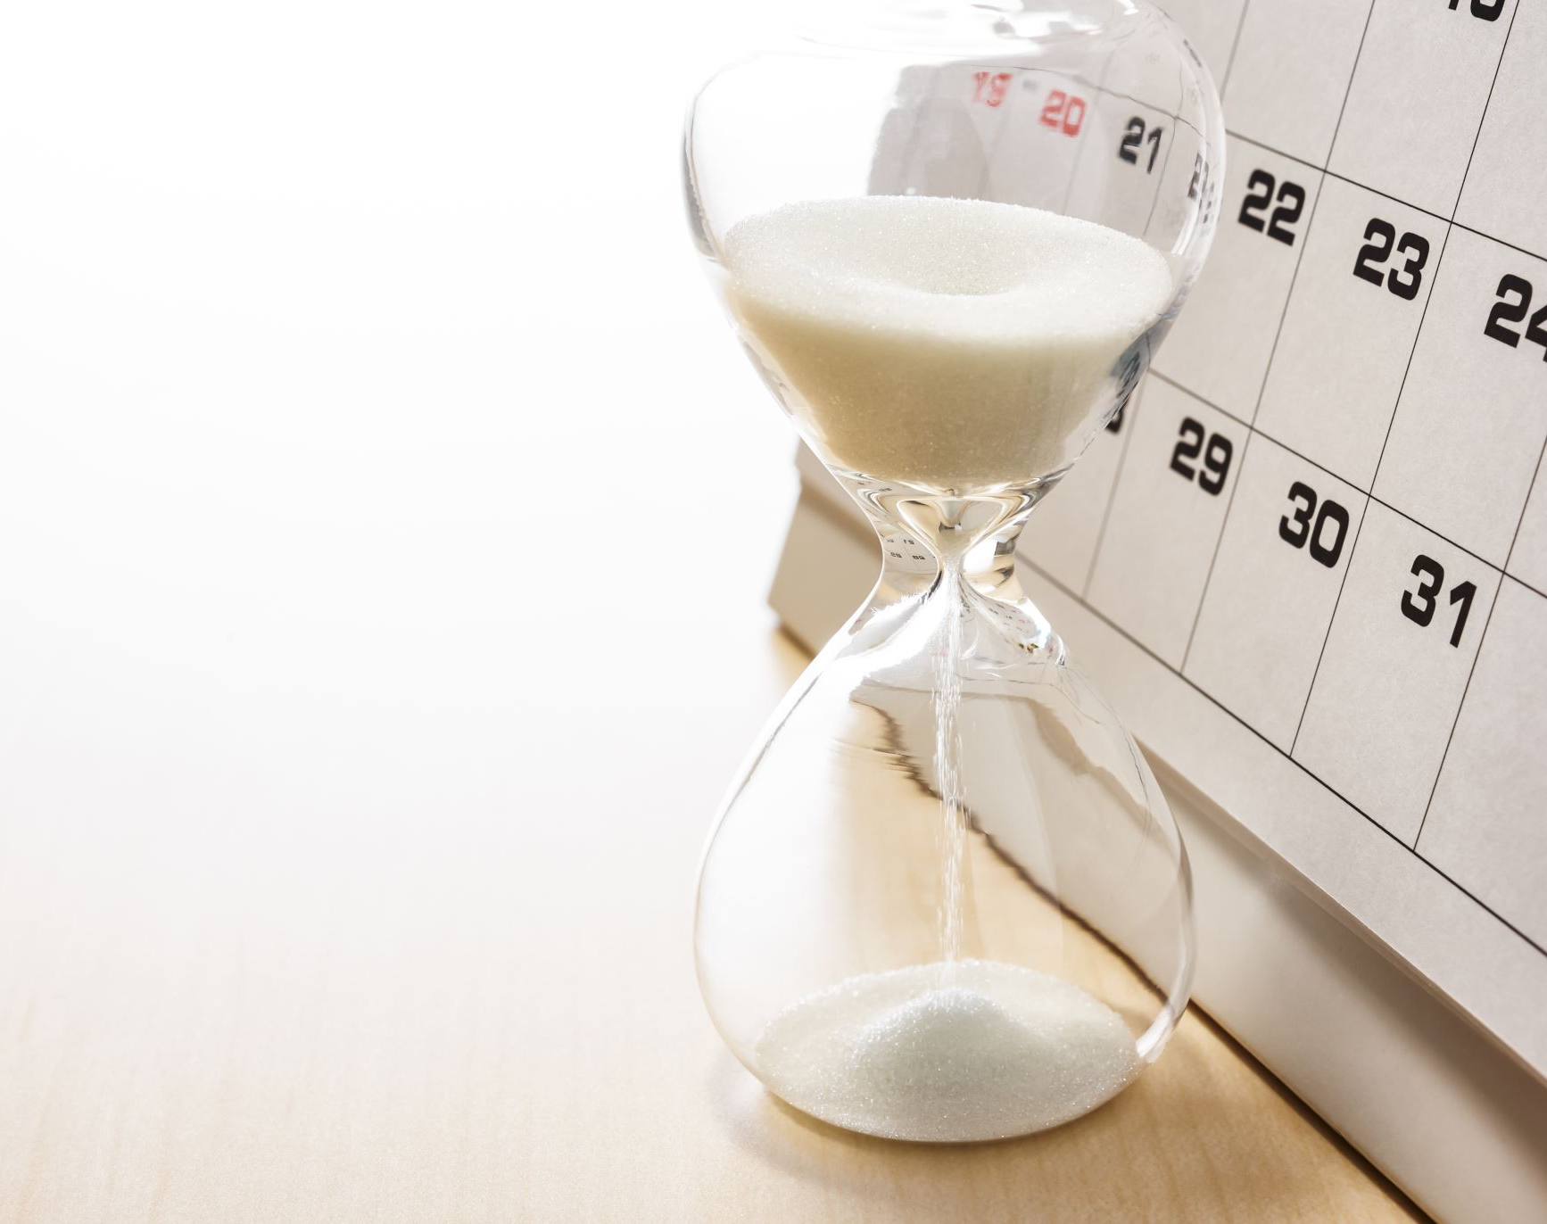
DUE DATE
02/12/2022 11:59 PM CST
Homework needs to be submitted to Akin on Slack in private

