Slide 1
Machine Learning
Final Presentation
BathSoap
By
Reginald Mordi

Slide 2
Problem Identification
CRISA is an Asian market research agency that specializes in tracking consumer purchase behavior in goods (both durable and nondurable)
By doing market segmentation: The market based on two key sets of variables more directly related to the purchase process and to brand loyalty.
we used R program to cluster our data using K Mean clustering method
This services is provided to advertising agencies and consumer goods manufacturers.

Slide 3
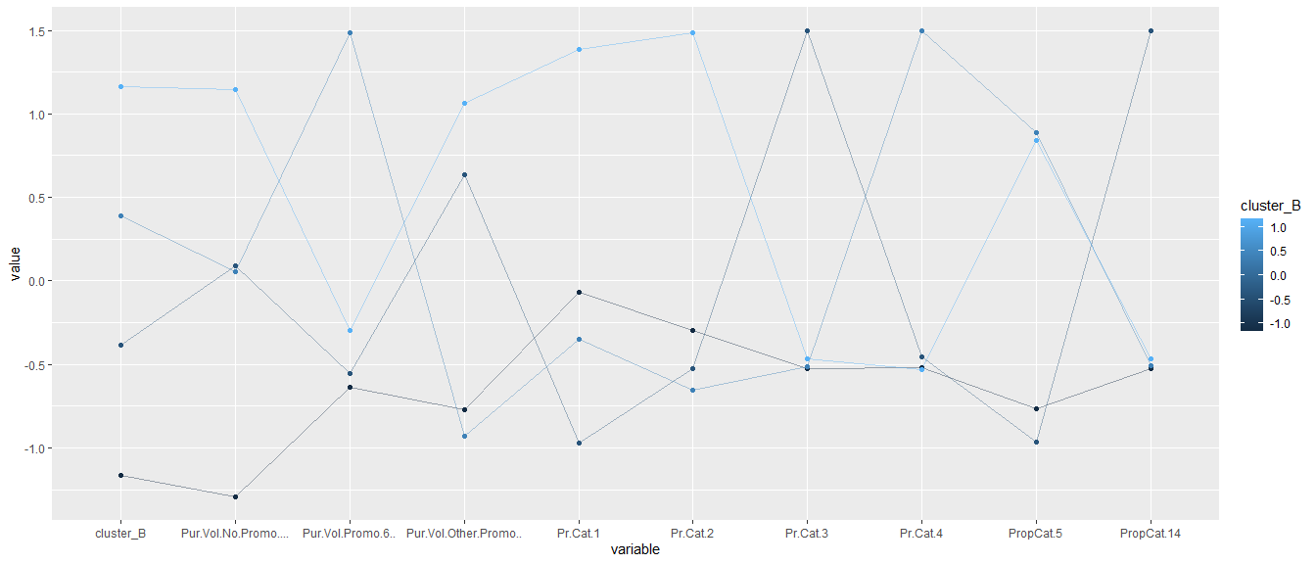
According to the analysis the market is been divided into 4 clusters as follows:

Slide 4
Several steps can be explored next to improve predictive performance: Some of the demographic categorical variables may not have much value being treated as is, as ordered categorical variables. They could be reviewed and turned into binary dummies. Instead of using a two-cluster model, a multi-cluster model could be used in hopes of deriving more distinguishable clusters. The non-success clusters could then be consolidated. For example, cluster #2 in the 4-cluster model is like our cluster 1 (“success”) in the 2-cluster model, only more sharply defined. In the real world, going beyond the parameters of this case study, CRISA would probably work with the client to add the client’s own purchase data to the model to improve it over time.

Slide 5
Summary & Conclusion
Regarding promotion and marketing aspects, To makewedeveloped a predictn help you in :
Setting promotion and advertising strategies
Choosing the target segment easily, which help in optimizing costs and time spent on not targetable sectors,
So, fore example if you have a client concerned with people who are either "value conscious" or not, depending on 2 clusters our model can predict the new observations depending on their socioeconomic and affluent data.
In conclusion: There is no single "right" approach to clustering; different approaches are feasible depending on different marketing purposes. We are a marketing agency and owns the data, which is collected at considerable expense, so we want to be able to use both the data and the segmentation analysis in different ways for different clients. And our model can help you in different situations as it has a high accuracy according to our high professional data analysis team.

