Slide 1

Project: Mining Machines Maintenance & Tracking System
Presenter: Regine Pacis Igihozo
Date: 21/12/2025
Institution: AUCA

Slide 2
Problem
Mining machine downtime leads to high costs and reduced productivity.
Current tracking is manual, error-prone, and inefficient.
Delayed maintenance increases repair expenses and shortens machine lifespan.
Target users: Technicians, Operations Managers, Supervisors, Finance.

Slide 3
SOLUTION
Objective: Automate machine tracking and maintenance scheduling
Scope: On-site tracking, mobile & desktop access, integration with inventory
Features: Preventive maintenance alerts, repair logging, operator tracking
Expected Outcome: Reduced downtime, optimized resources, enhanced productivity

Slide 4
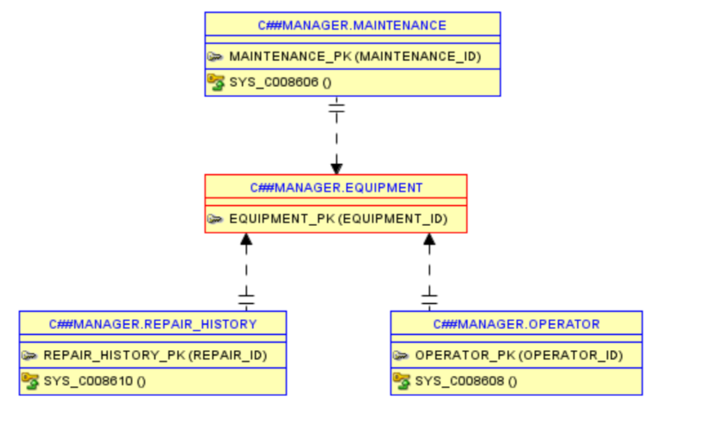
DATABASE
Core entities: Equipment, Maintenance, Repair History, Operator
Relationships: Equipment → Maintenance (1:N), Equipment → Repair History (1:N), Equipment → Operator (1:N)
ER diagram represents database structure and cardinalities
Enables accurate logging, reporting, and analytics

Slide 5
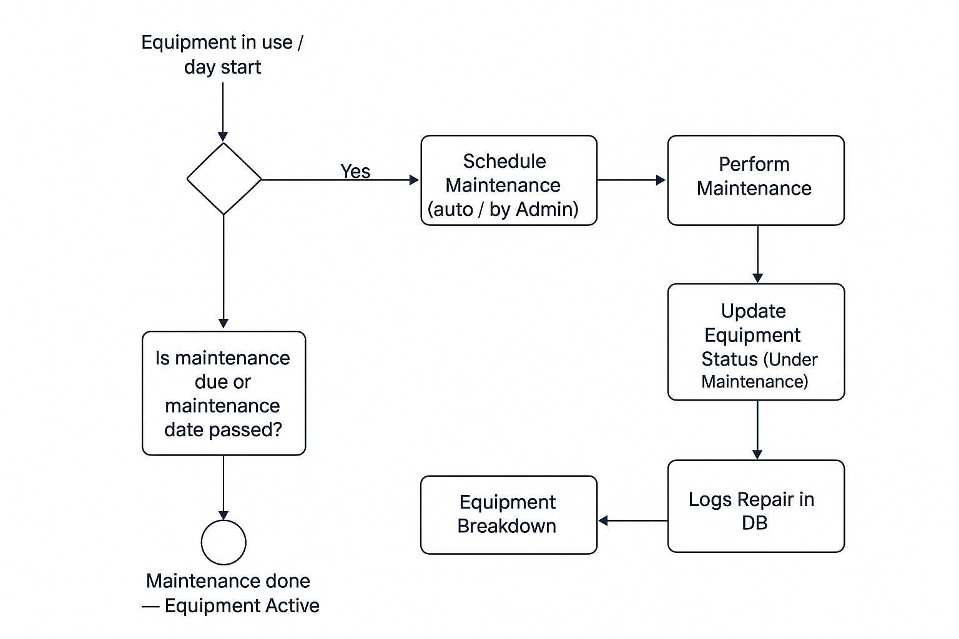
BUSINESS PROCESS
This Mining Equipment Maintenance and Tracking System integrates PL/SQL automation with structured business workflows, ensuring efficient asset management, operator accountability, and maintenance compliance. By centralizing equipment data and automating scheduling, managers gain real-time insights to optimize mining operations. Decision points and swimlanes clarify responsibilities, while BI reporting supports strategic decision-making and operational efficiency.
Maintenance request initiated by operator or system alert
Technician performs maintenance and logs repair details
Supervisor/Manager reviews logs and approves actions
Workflow ensures machines are always operational and tracked.

Slide 6
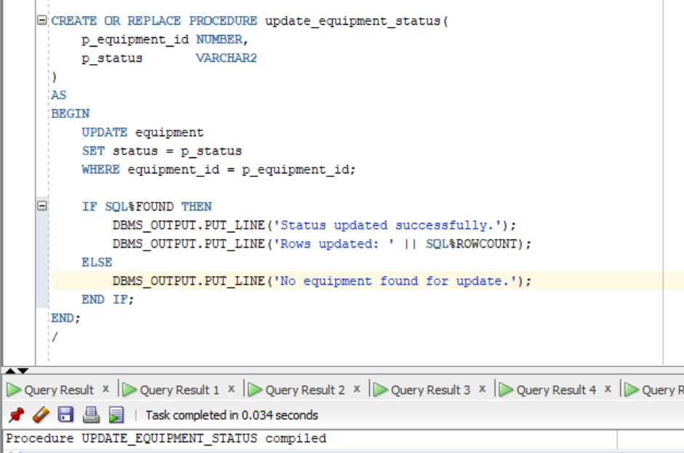
TECHNICAL
Backend: Oracle Database, PL/SQL for stored procedures and packages.
Frontend: Web interface / desktop app for maintenance logging.
Technologies: SQL queries, triggers, forms, reports.
Integrates with inventory and production systems.

Slide 7
ADVANCED FEATURES
Triggers automatically log maintenance and repair activities
Auditing: track changes, old vs new values for compliance
Security: role-based access for Operators, Technicians, Managers
Automated notifications for upcoming maintenance

Slide 8
BI & ANALTICS
Integrating Business Intelligence (BI) into the system allows for advanced analytics that can guide strategic decisions:
Predictive Maintenance: Use historical data to forecast potential failures before they occur.
Performance Analysis: Identify machines that are underperforming or consuming excessive resources.
Cost Optimization: Track maintenance spending and analyze which machines incur higher repair costs.
Downtime Trends: Visual dashboards can highlight patterns in machine failure by type, operator, or location.
Operational Planning: Correlate machine availability with production output to improve scheduling and reduce bottlenecks.

Slide 9
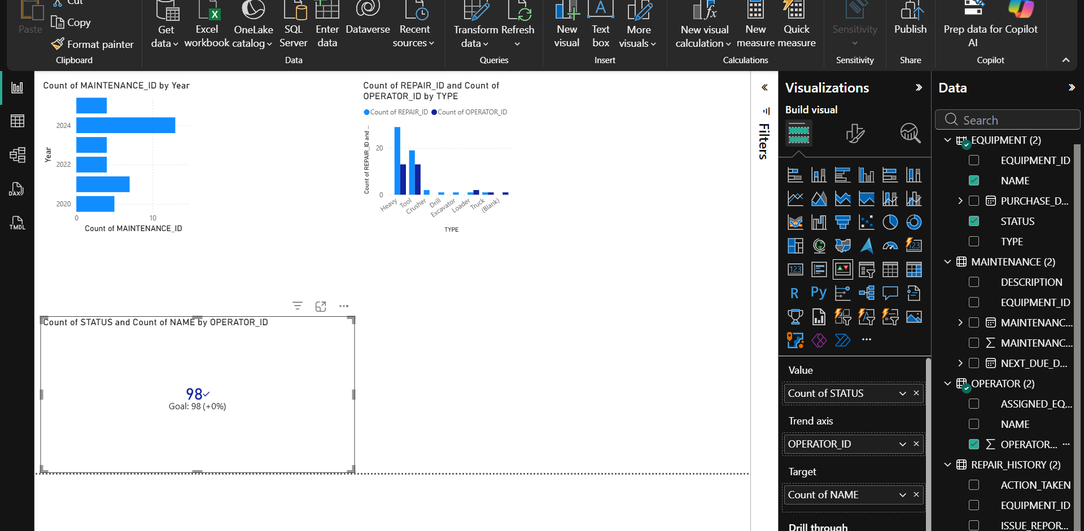
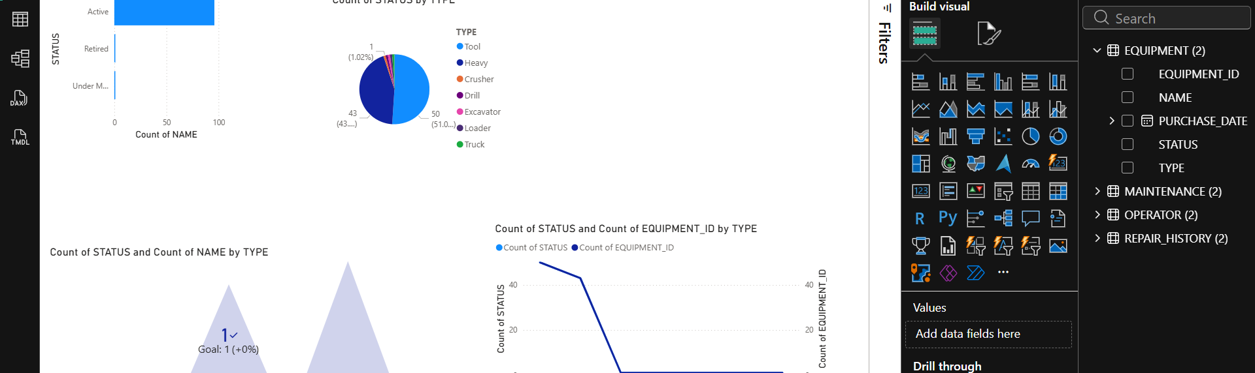
RESULTS
Sample data: 5+ machines, 10+ maintenance records.
Tests: Scheduled maintenance alerts triggered correctly, logs accurate.
Screenshots: Maintenance log form, repair history report, dashboard.
Outcome: Reduced unplanned downtime, better resource tracking.

Slide 10
CONCLUSION
Achievements: Automated tracking, maintenance scheduling, BI insights
Lessons learned: Importance of accurate data, role-based access, predictive analytics
System ready for deployment and scalable
Q&A: Open for questions from audience

