Slide 1
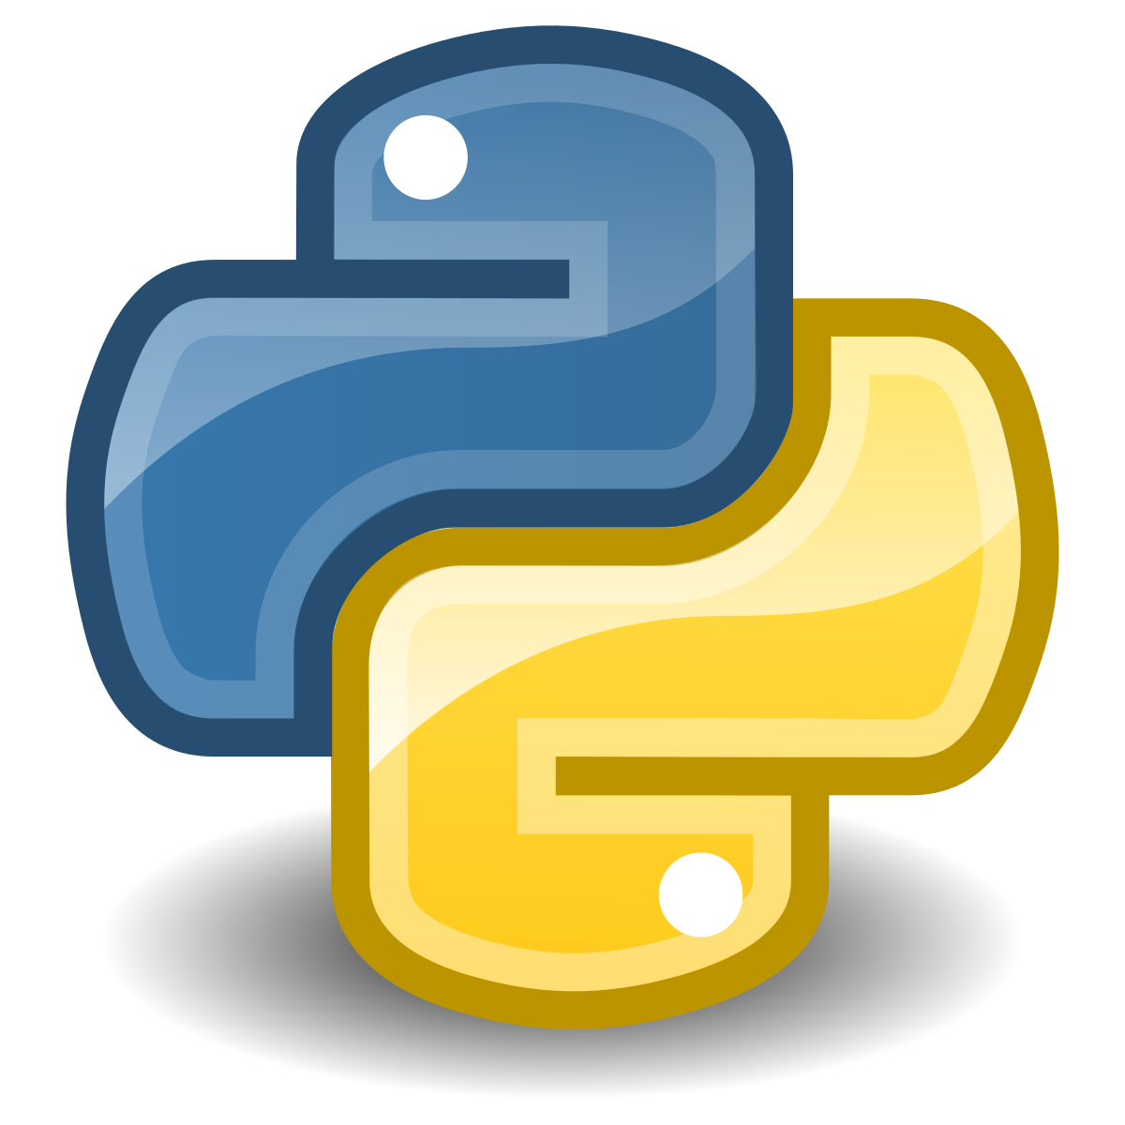
Python crash course

Slide 2
The plan
Why Python
Install Anaconda
Jupyter Notebook walkthrough
Q&A and support
Overview

Slide 3
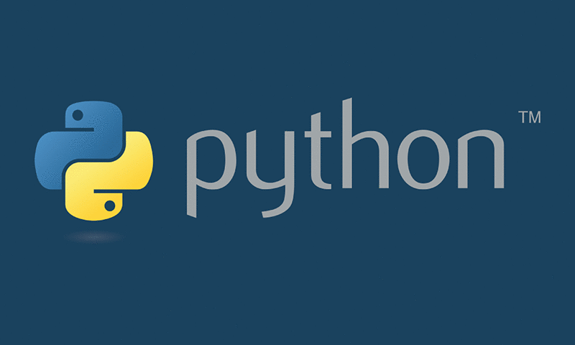
Why Python
Python is a top tool for data science
Many DS jobs require Python skills
Many DS tools built in Python
Network effects

Slide 4
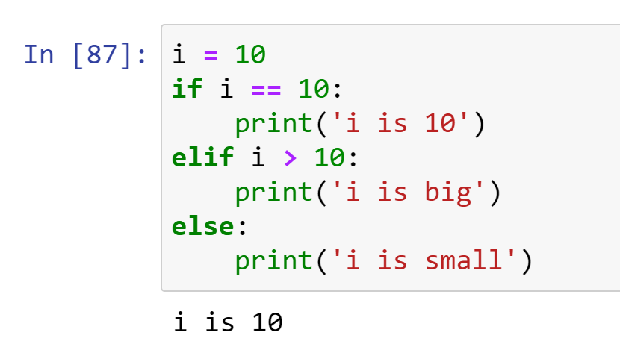
Python Philosiphy
Python is meant to be fun, simple, clear, and easy to use. There are some parts of “The Zen of Python” that describe this:
Beautiful is better than ugly.
Explicit is better than implicit.
Simple is better than complex.
Complex is better than complicated.
Readability counts.
"there should be one— and preferably only one —obvious way to do it"

Slide 5
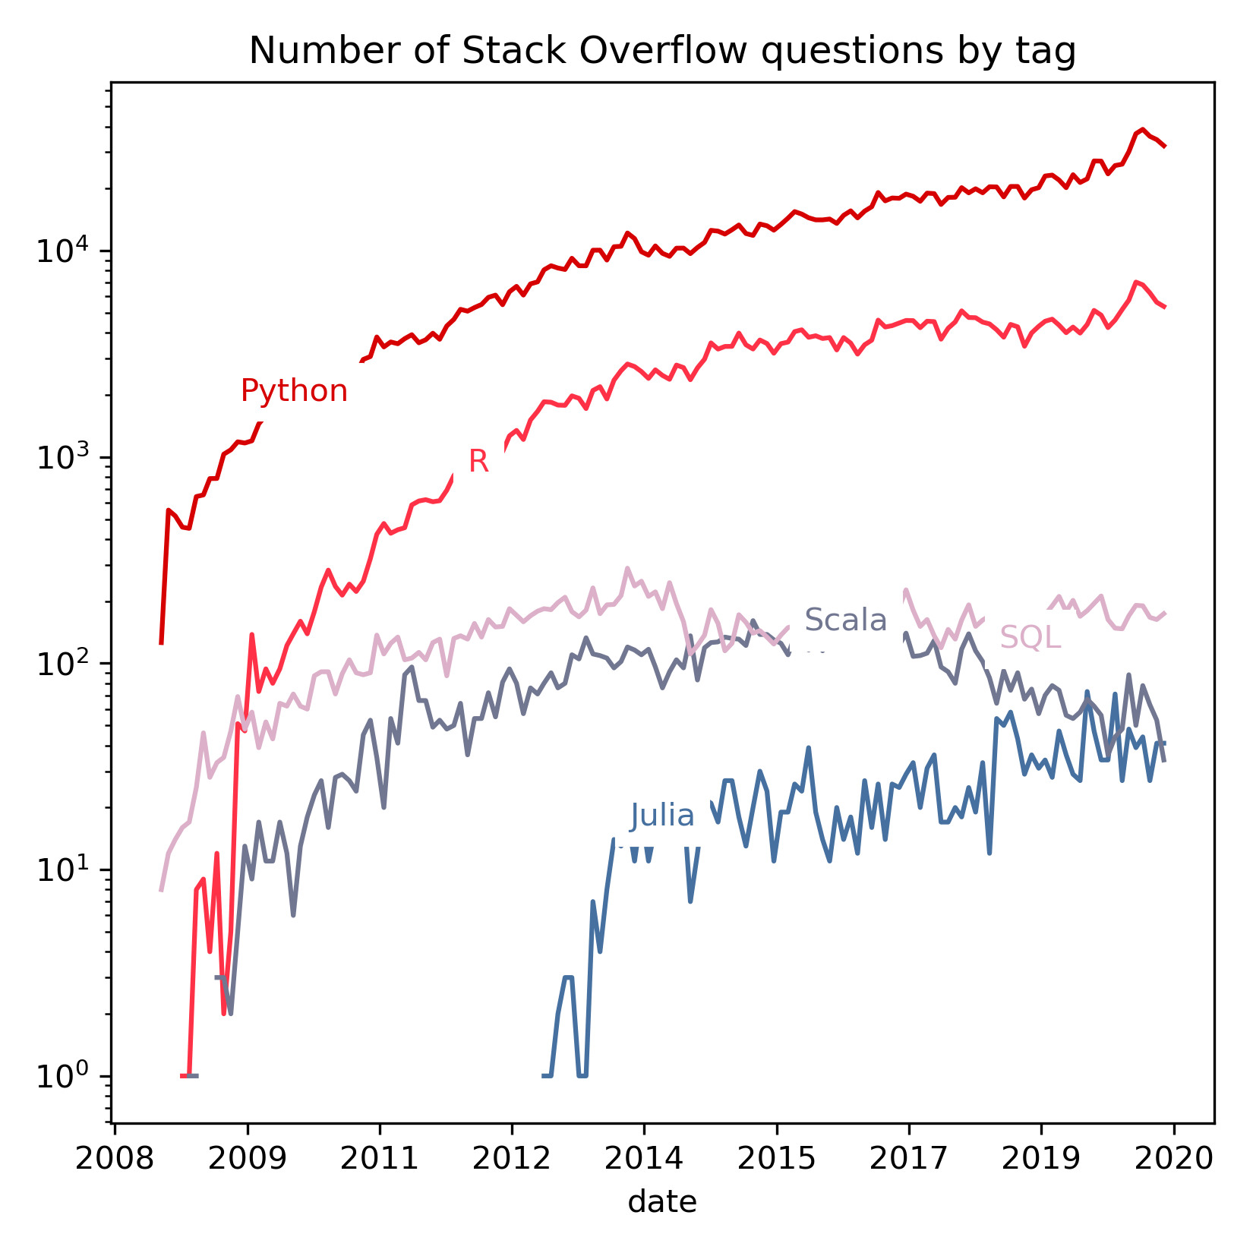
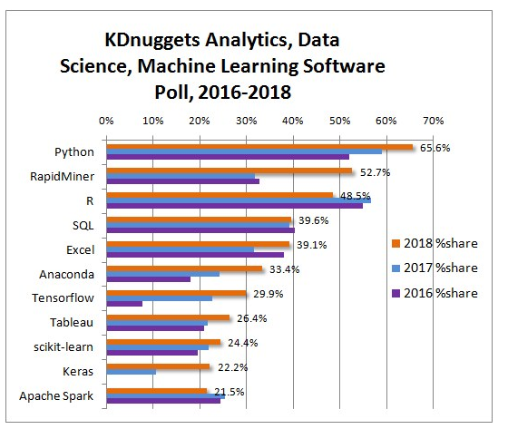
Network effects
The more users, the bigger the community and more support available. More tools are built.
Julia is a newer language and may be more viable as a top data science language in 5-10 years.
Many other tools out there to do data science with, including GUIs such as RapidMiner and Excel.
https://www.kdnuggets.com/2018/05/poll-tools-analytics-data-science-machine-learning-results.html

Slide 6
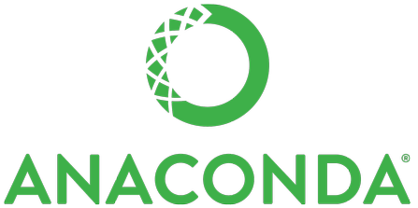
Python distributions and installations
Python distributions are one easy way to install Python, a package manager, and some Python packages
Anaconda is what we’ll use, although there are many others like Python(x,y) and more.
Download Anaconda and install.
On Windows, I like to check the box ‘add to path’ even though it’s not recommended.
I also use Windows Terminal, although Anaconda Prompt and Powershell work too. To use Terminal or another Powershell we should do ‘conda init powershell’ from Anaconda Powershell.
On Mac or Linux we can use Terminal for command line access.
We can open a Jupyter Notebook from Anaconda Navigator or through a Terminal or command prompt by typing ‘jupyter notebook’.
We can also use IPython (ipython from the command line) or Jupyter Lab to run Python code.
There is also a Python shell (by typing ‘python’ from a terminal) but it is limited.

Slide 7
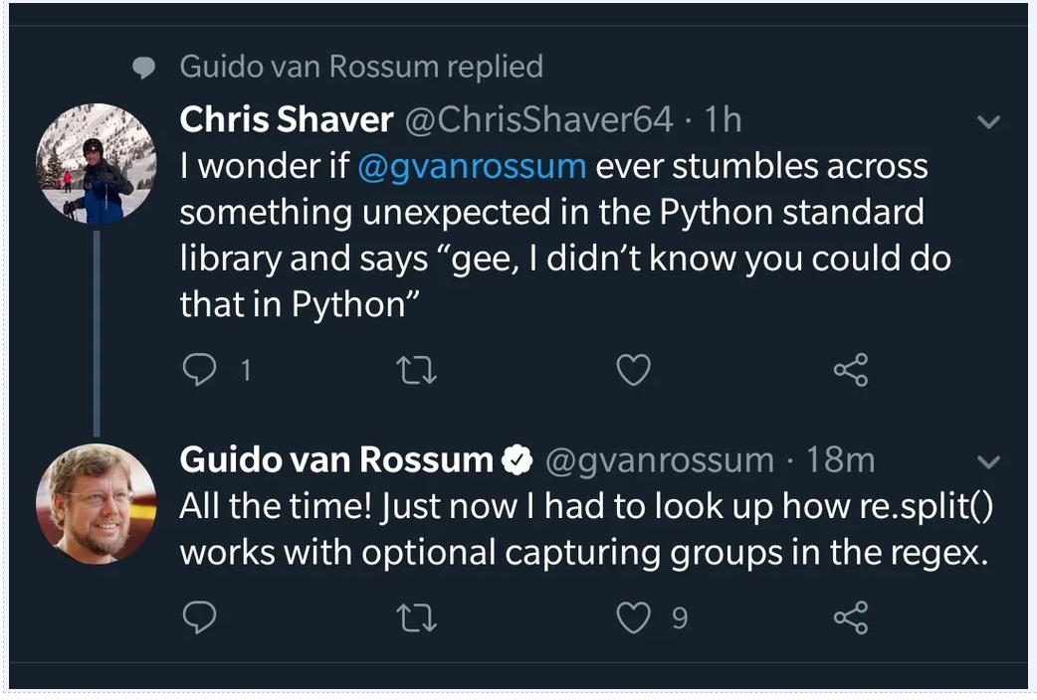
Resources for the program and Python/R
Your professor/instructor is here to help
Your advisor and success coach
Other students can help too (e.g. via discussions)
Regis Learning Commons
Writing Center and Tutoring
Documentation (e.g. docs.python.org)
Stack Overflow
Search engines (google, duckduckgo)
Archives for broken links (archive.is, archive.org)
Python benevolent dictator for life (Resigned in July 2018)

Slide 8
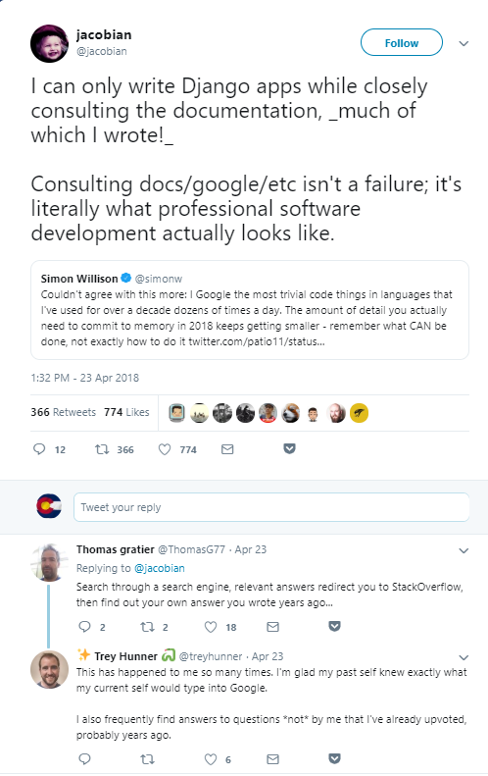
Docs and books
Using a search engine and stackoverflow is part of writing code and doing data science!
Books (e.g. through the library and O’Reilly Safari) are a good way to understand fundamentals of statistics, machine learning, and specialized topics.
ISLR (stats in R)
ESL (stats methods and math)
Python Machine Learning - Third Edition (Packt)
Clean code in Python – Second Edition (Packt)
R for Data Science

Slide 9
Extra Resources for Learning Python
Python is a foundational skill for much of modern data science. It is worth putting in some time to build solid Python skills.
If you are still learning Python or feeling shaky on the basics (even after doing the readings), consider doing the following:
Complete most of the Udacity Intro to Python Course.
Weeks 1 and 2: Lessons 1 and 2
Week 3 and 4: Lesson 3
Week 5 and 6: Lesson 4
Week 7 and 8: Lesson 5
If you are feeling relatively comfortable with Python, you might consider doing the Kaggle course on Python if you need a refresher: https://www.kaggle.com/learn/python
There are many other Python learning resources for all levels listed here: https://forums.fast.ai/t/recommended-python-learning-resources/26888

Slide 10
Ways to continue building your Python and R skills
DataCamp
DataQuest
Hackerrank
Reading the official Python documentation or documentation for other Python packages
Kaggle (participating in competitions, looking at what others are doing)
Codewars.com
Books (e.g. Clean Code with Python 2nd Edition by Mariano Anaya), Minimal Python by Noah Gift and Alfredo Deza, Python Data Science Essentials by Alberto Boschetti, etc)

