Slide 1
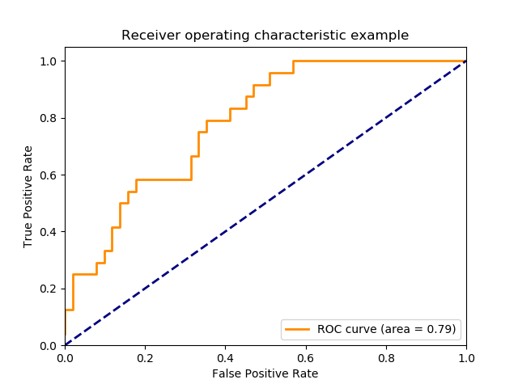
Week 7: Performance metrics
http://scikit-learn.org/stable/auto_examples/model_selection/plot_roc.html

Slide 2
Week 6 review: Clustering
What type of machine learning is this (supervised, unsupervised, reinforcement)?
What is the typical kmeans algorithm?
What can we do to reduce runtime if our data has too many features?
How is HCA different from kmeans?

Slide 3
Week 6 review: Clustering
What type of machine learning is this (supervised, unsupervised, reinforcement)?
  unsupervised
What is the typical kmeans algorithm?
  1. Pick cluster centers (kmeans++)
  2. Calculate distance from all points to all cluster centers
  3. Assign points to nearest cluster
  4. Calculate centroid of each cluster
  Repeat 3 and 4 until assignments don’t change
What can we do to reduce runtime if our data has too many features?
  Use PCA to reduce dimensions of features
How is HCA different from kmeans?
  HCA starts either as individual points or as one big cluster (agglomerative or divisive)
  With agglomerative, uses point-point or cluster-cluster distances to group points/clusters into bigger clusters
  3 linkages: single, complete, average

Slide 4
Week 6 review quiz
Cluster the data from auto.dt.nona.csv (week 2 content / data)
Find the optimal number of clusters with the elbow plot and explain the scree plot
Plot the mpg vs displacement, and color points by cluster
If you have time, calculate some summary stats of the different clusters and compare/discuss
Also could try scaling the data and comparing clusters to un-scaled
Drop assignment under assignments in “Week 6 review quiz: K-means clustering” folder, a .R file is sufficient

Slide 5
Regression performance metrics
What have we used so far?

Slide 6
Regression performance metrics
What have we used so far?
  Mainly root-mean-square error (RMSE) and R^2, which are good

Slide 7
Regression metrics
Mean absolute error (MAE)
Mean absolute percentage error (MAPE):
Root-mean-square-log error (RMSLE)
Can take other transforms of RMSE or MAE
  e.g. inverse hyperbolic tangent (arctan); like log but can handle 0 and negative values

Slide 8
Classification performance metrics
What have we used so far?

Slide 9
Classification performance metrics
What have we used so far?
  Accuracy (ok)
  Confusion matrix

Slide 10
Other classification metrics
Recall
Precision
F1
Log loss
  N = number of samples
  M = number of classes
  y_{ij} = binary indicator of class label
  p_{ij} = model probability of class j for sample I
  What are some problems with log loss?
http://www.exegetic.biz/blog/2015/12/making-sense-logarithmic-loss/

Slide 11
Other classification metrics
Recall
Precision
F1
Log loss
  N = number of samples
  M = number of classes
  y_{ij} = binary indicator of class label
  p_{ij} = model probability of class j for sample I
  What are some problems with log loss?
    No differentiation between false positives/false negatives
    High penalty for low probability of correct class, highly non-linear penalty with increasing probability
    No penalty for class label (y_{ij}) of 0, even if model is predicting significant probability for that class
http://www.exegetic.biz/blog/2015/12/making-sense-logarithmic-loss/

Slide 12
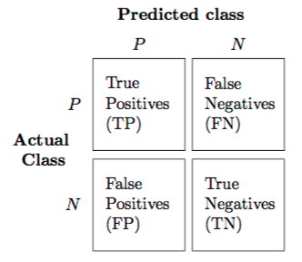
Confusion matrix
When do we want to avoid
  false negatives?
  false positive?
https://rasbt.github.io/mlxtend/user_guide/evaluate/confusion_matrix/

Slide 13
Confusion matrix
When do we want to avoid
  false negatives?
    Cancer (or other disease) detection
  false positive?
    Marketing
    Harsh treatments
      e.g. chemotherapy for cancer
https://rasbt.github.io/mlxtend/user_guide/evaluate/confusion_matrix/

Slide 14
Recall/precision/F1
Recall – TP / (TP + FN)
  TP / all actual positives
Precision – TP / (TP + FP)
  TP / all predicted positive
F1 = 2 * Pr * Re / (Pr + Re)
https://rasbt.github.io/mlxtend/user_guide/evaluate/confusion_matrix/

Slide 15
Clustering performance metrics
What did we use for determining goodness of kmeans clustering?

Slide 16
Clustering performance metrics
What did we use for determining goodness of kmeans clustering?
  Within sum of squares (WSS)
  Silhouette score

Slide 17
What are models we can use for regression?

Slide 18
What are models we can use for regression?
Linear/polynomial fits
KNN
Forest methods (random forest, xgboost, etc)
Neural networks
SVMs

Slide 19
Models for classification?

Slide 20
Models for classification?
KNN
Logistic regression
Forest models (random forest, xgboost, etc)
Neural nets
SVMs
Naive Bayes

Slide 21
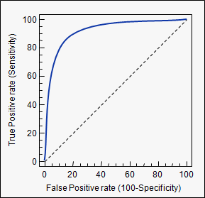
ROC curve & AUC
ROC – receiver operating characteristic
AUC – area under the curve
  1 means perfect classification, random guessing is the diagonal line (area of 0.5).

Slide 22
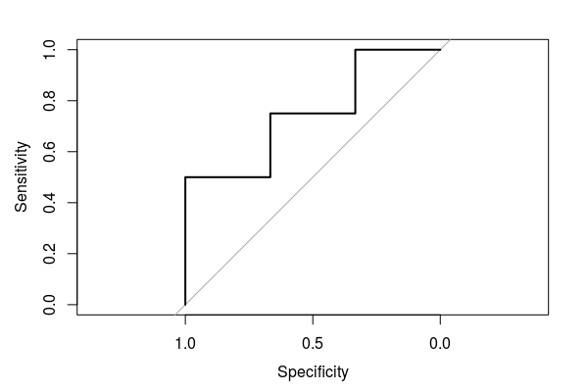
ROC curve & AUC
Generate ROC curve by taking every prediction and setting threshold equal to that value
roc.auc.demo.R under week 7
Predicted | Actual
0.15 | 0
0.23 | 1
0.45 | 0
0.55 | 1
0.67 | 0
0.88 | 1
0.97 | 1

Slide 23
Comparing models
Train on the same training set, evaluate on the same testing set
Alternatively (probably better), use cross-validation, and train/evaluate models on the same splits
Use the same metrics to compare them, of course
Pick a metric that makes sense
  For detecting a disease, maybe recall matters most, because we always want to be able to detect the disease. So optimize the model choice for that.

Slide 24
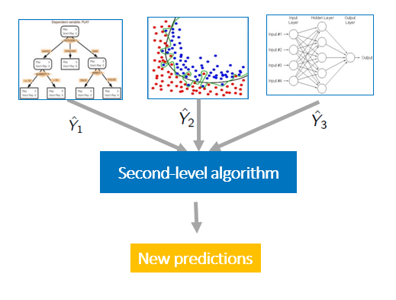
Ensembling models
We can combine predictions from models to get an averaged prediction
  Less bias like with random forests vs decision trees
We could also take the predictions from multiple models, and feed them into another model...and do this with lots of variations
Related: mixture of experts: https://en.wikipedia.org/wiki/Mixture_of_experts
https://blogs.sas.com/content/subconsciousmusings/2017/05/18/stacked-ensemble-models-win-data-science-competitions/

Slide 25
Demo (heart disease dataset)
model.comparison.demo.R
Compare different models’ performance on the same train/test splits
Procedure (one way to do it):
  Optimize model hyperparameters with cross-validation
  Fit model to full train set
  Score/compare models on test set
    Get accuracy, ROC curves/AUC score
    Plot ROC curves
Ensembling – averaging models

Slide 26
Neural Nets in R
Keras also available in R:
  https://keras.rstudio.com/
No major difference in performance expected between R and Python for this, because Keras should be using C libraries to do the computations.

Slide 27
Exercise (pair)
Try 3 different types of models to make classification predictions on the bank marketing dataset (in week 4 content)
  Try some different hyperparameters in an effort to get the best predictions from each model
  Don’t use more than 3 models, because fitting the other models is the individual part of the assignment
Calculate the AUC score as a comparison, and at least 2 other metrics (could be accuracy, F1 score, precision, recall, etc)
  Compare the models’ performance on the same train/test splits
Plot the ROC curve from the best model, choose what you think the best threshold value is for making predictions
Discuss the results in a .Rmd and post the .Rmd/exported PDF to the week 7 discussion

Slide 28
Rest of exercise (solo)
Use at least 2 other models (that you haven’t tried yet) on the dataset and compare to your existing results.
  Try some different hyperparameters for these to try to get the best result
Ensemble (average) some or all of the models
  You can also train a model to take in the predictions of all the other models and output a final prediction
Post as as response to your first post
Optional extra: make a profit curve and find the optimum prediction threshold and model with the profit curve
  Assume a profit of $4 for a TP and -$5 for a FP as in the book example here (pg 212):
  https://drive.google.com/file/d/0B1cm3fV8cnJwNDJFNmx2a2RBaTg/view
  Also assume unlimited resources (no cost constraint)
    If there was a cost constraint (choose a value), what would the optimum model and profit be?

