Slide 1
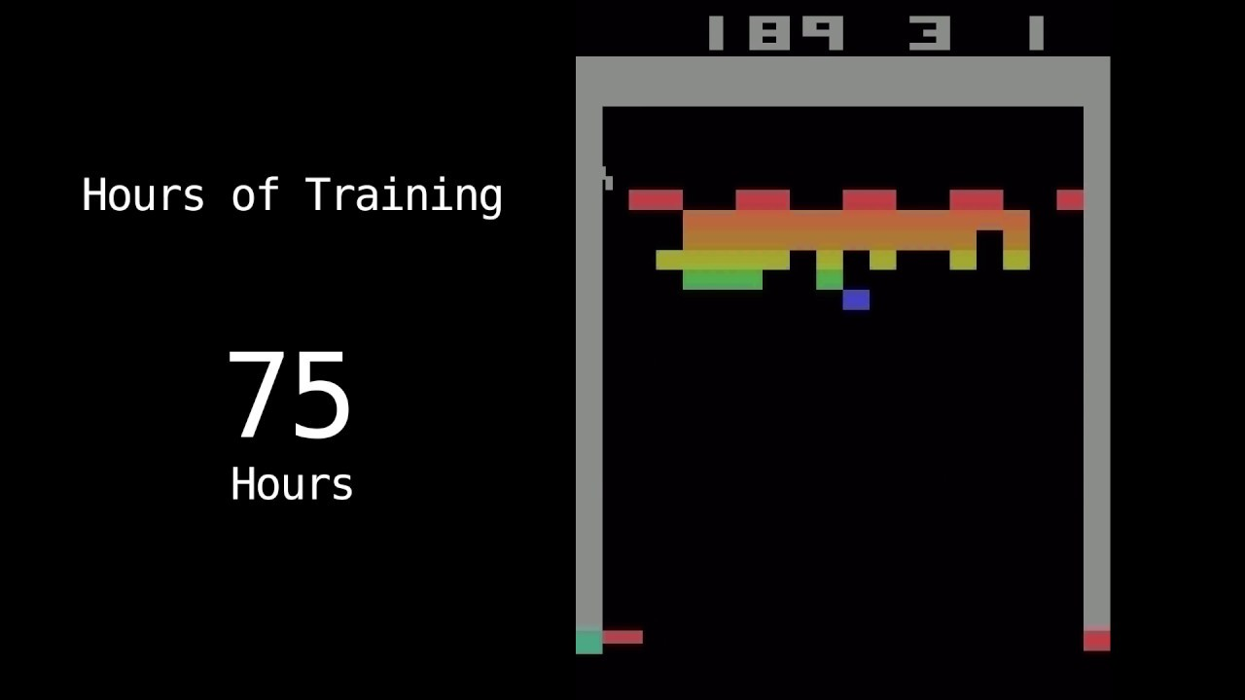
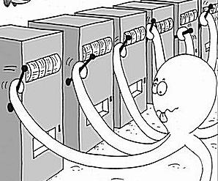
Week 8: Reinforcement Learning
http://stevehanov.ca/blog/index.php?id=132
https://www.youtube.com/watch?v=eG1Ed8PTJ18

Slide 2
Week 7 Review: Performance metrics
What are metrics for regression?
Classification?
Clustering?

Slide 3
Week 7 Review: Performance metrics
What are metrics for regression?
  MSE, MSLE, MAE, MAPE, R^2
Classification?
  Accuracy, precision, recall, F1, log loss
Clustering?
  WSS, silhoutte score, Calinski and Harabaz

Slide 4
Week 7 review quiz
Create at least 2 models to compare on the breast cancer dataset (under week 8)
  The V11 column is the target
  2 means no cancer (benign) 4 means cancer
  Other columns are various bio-measurements
Report at least 2 performance metrics, and choose the best model. Explain your choice and any caveats.

Slide 5
Types of reinforcement learning
Multi-armed bandit
Q-learning
Deep q-learning
  Policy gradient (PG)

Slide 6
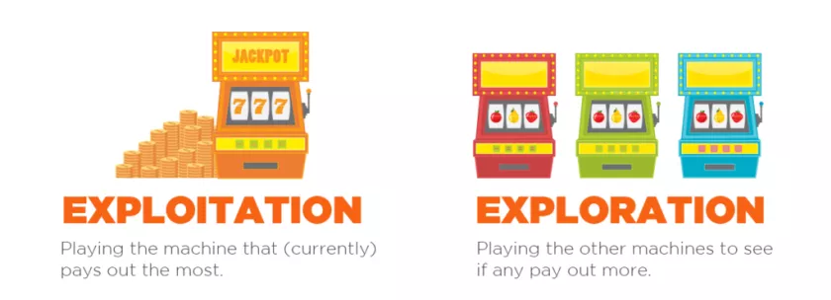
Multi-armed bandit
Exploration (try new things) vs exploitation (go with the best we know of at the time)
Exploration is epsilon (ε)
https://jeongyoonlee.com/2017/08/09/transition-from-exploration-to-exploitation/
http://www.plexure.com/plexure-blog/2016/9/21/multiworld-testing

Slide 7
Multi-armed bandit
Example: website with different designs, A, B, C
Epsilon-greedy example:
def choose():
if math.random() < 0.1:
# exploration!
# choose a random lever 10% of the time.
else:
# exploitation!
# for each lever,
# calculate the expectation of reward.
# This is the number of trials of the lever divided by the total reward
# given by that lever.
# choose the lever with the greatest expectation of reward.
# increment the number of times the chosen lever has been played.
# store test data in redis, choice in session key, etc..
def reward(choice, amount):
# add the reward to the total for the given lever.

Slide 8
Multi-armed bandit
Example: website with different designs, A, B, C
Epsilon-first example:
def choose():
For n rounds:
# choose a random lever
if math.random() < 0.1:
# exploration!
# choose a random lever 10% of the time.
else:
# exploitation!
# for each lever,
# calculate the expectation of reward.
# This is the number of trials of the lever divided by the total reward
# given by that lever.
# choose the lever with the greatest expectation of reward.
# increment the number of times the chosen lever has been played.
# store test data in redis, choice in session key, etc..
def reward(choice, amount):
# add the reward to the total for the given lever.

Slide 9
Multi-armed bandit
Example: website with different designs, A, B, C
Epsilon-decreasing example:
def choose():
epsilon = epsilon * 0.99 # choose whatever value you want to decrease epsilon by
if math.random() < epsilon:
# exploration!
# choose a random lever epsilon% of the time.
else:
# exploitation!
# for each lever,
# calculate the expectation of reward.
# This is the number of trials of the lever divided by the total reward
# given by that lever.
# choose the lever with the greatest expectation of reward.
# increment the number of times the chosen lever has been played.
# store test data in redis, choice in session key, etc..
def reward(choice, amount):
# add the reward to the total for the given lever.
http://stevehanov.ca/blog/index.php?id=132

Slide 10
Multi-armed bandit pair programming exercise (50% of project grade this week)
Example: website with different designs, A, B, C
Use the distribution from the site (A = 2.8%, B = 3.2%, C = 2.6%) and write a function that is an epsilon-decreasing strategy
def choose():
epsilon = epsilon * 0.99 # choose whatever value you want to decrease epsilon by
if math.random() < epsilon:
# exploration!
# choose a random lever epsilon% of the time.
else:
# exploitation!
# for each lever,
# calculate the expectation of reward.
# This is the number of trials of the lever divided by the total reward
# given by that lever.
# choose the lever with the greatest expectation of reward.
# increment the number of times the chosen lever has been played.
# store test data in redis, choice in session key, etc..
def reward(choice, amount):
# add the reward to the total for the given lever.
http://stevehanov.ca/blog/index.php?id=132

Slide 11
Q-learning
We are seeking a policy, pi, state S leads to agent taking action A
A policy has a value which is the sum of the reward at the current time, and the rewards in the future discounted by gamma:
Define function Q, which is value after executing action a at state s, plus the discounted value of the optimal policy thereafter
Vº is the optimum value from an optimum policy πº, s^{new} is the new state after action a
Our optimal policy at state s is the maximum Q-value over all possible actions

Slide 12
Q-learning
Substitute max(Q) for Vº
If we have an estimate of Q, and choose action a, end up in s^{new}, we will have this result if our estimate is correct:
But our estimate will probably not be correct, so we can update our estimate at iteration n by adding the difference to our current Q estimate:

Slide 13
Q-learning
This is our Q-learning equation. We start at a state s, try an action, a, iteration n
Example: tic-tac-toe
- Start with empty board
- Make a random move (all Q’s can be initialized randomly or to 0)
- No reward until we win (+1) or lose (-1)
- Epsilon-methods again, pick a random choice with probability epsilon, or choose action with highest Q-value
- One “episode” is when the game ends
- about 255k possible tic-tac-toe games, so need to train about that many times
https://www.cs.swarthmore.edu/~meeden/cs63/f11/ml-ch13.pdf

Slide 14
Tic-tac-toe example
Say we’re in this state, and it’s x’s turn
X picks the right spot to win, r = 1
r = 1, alpha = 1, new Q(s, a) is 1 (0 before)
x
x
x
x
x
o
o
o
o
Q(state on left, x in upper right)_{(n + 1)} = 0 + 1/1[1 + 0.9*0 – 0] = 1

Slide 15
Tic-tac-toe example
Now we’re in this state, and it’s x’s turn
Because we’ve been in this state before, it will update the Q-value for x in the top center, so that the action has a slightly higher Q-value
x
o

Slide 16
Tic-tac-toe example
This is the way Q-learning learns – backwards and slowly thought brute force.
Can you think of an improvement to the algorithm?
x
o

Slide 17
Tic-tac-toe example
This is the way Q-learning learns – backwards and slowly thought brute force.
Can you think of an improvement to the algorithm?
  Propagate rewards back through Q-values after game ends
x
o

Slide 18
Other Q-learning examples
http://ai.berkeley.edu/reinforcement.html
  https://github.com/gauthamvasan/Pacman-Reinforcement-Learning
http://amunategui.github.io/reinforcement-learning/
http://mnemstudio.org/path-finding-q-learning-tutorial.htm

Slide 19
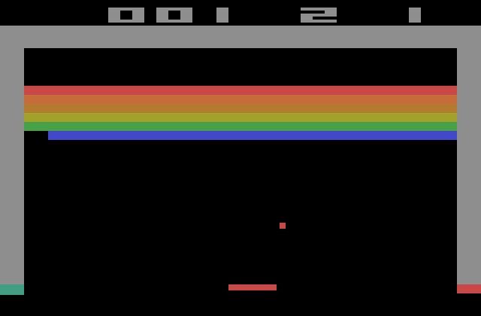
How many states are there for an image?

Slide 20
Deep Q-learning
~255k possible tic-tac-toe combinations
256^{3nm} for an RGB image
So if we are playing atari (160x192) we have 256⁹²¹⁶⁰ possible images (states)
  This is a very low resolution, 0.03MP
  Cell phone cameras are in the 1-20MP range
  Even with 1080p (1920*1080), we are at 256^{6,220,800} possible states
No way to explore (and save in memory) the full state-space with Q-learning
Instead, use convolutional neural network and some other tricks (policy gradient)

Slide 21
Deep Q-learning (DQN) examples
OpenAI gym
Mario
FlapPy bird (that one is python2 only)
Python3 FlapPy bird
  Try playing flapPy bird – it’s really hard
Space invaders
  No shortage of atari DQN/DQL videos out there
Pacman
Starcraft II

Slide 22
Project: Go through tic-tac-toe Q-learning code, and...
Code is here: https://github.com/khpeek/Q-learning-Tic-Tac-Toe
Name the function where the Q-learning is actually happening (where the long Q-learning equation is being used).
Show the two lines of code where the Q-learning update happens.
Change the default Q-value from 1 to 0, and train for 10k episodes. Play the agents a few times. Are the behaviors of the agents different with 1 or 0 as the default Q?
  Bonus: save each agent as a separate file, and play them against each other a number of times to see which one is smarter
  Double bonus: use the Mann-Whitney U test or KS test (from MSDS660) to see if the result is significant or not
  Triple Bonus: run the training through one step (make sure one of the agents has won), and print out the winning agent’s Q-dictionary. Can you explain the board’s notation, and the Q-values?

Slide 23

Woohoo! Done

Slide 24
Machine ethics
Can machines be taught right and wrong (ethical behavior)?
What sort of protections should we put in place to ensure ethical machine learning approaches?
What problems should we especially watch out for with machine learning ethics?
https://en.wikipedia.org/wiki/Machine_ethics
https://www.wired.com/story/artificial-intelligence-seeks-an-ethical-conscience/
https://theconversation.com/ethics-by-numbers-how-to-build-machine-learning-that-cares-85399
https://arstechnica.com/information-technology/2016/02/the-nsas-skynet-program-may-be-killing-thousands-of-innocent-people/

