Slide 1

Week 1 – Getting ready:
Preparing data for machine learning
MSDS680 Machine Learning
SW1 2018
Nathan George

Slide 2
First, how was everyone’s break / last 8 weeks?
Anything exciting?
Do anything with data science, or make any plans to?

Slide 3
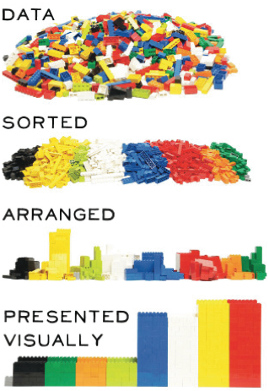
Course overview: week list
data preparation
K-nearest neighbors
Bayesian methods
Tree methods
Neural nets and SVMs
K-means and Hierarchical clustering
Performance Metrics
Reinforcement Learning

Slide 4
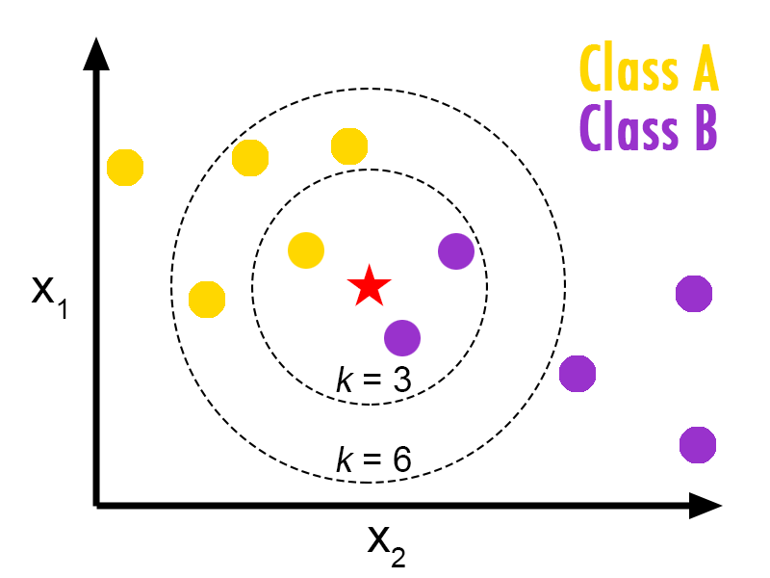
Course overview: week list
data preparation
K-nearest neighbors
Bayesian methods
Tree methods
Neural nets and SVMs
K-means and Hierarchical clustering
Performance Metrics
Reinforcement Learning

Slide 5
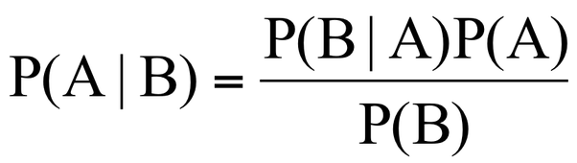
Course overview: week list
data preparation
K-nearest neighbors
Bayesian methods
Tree methods
Neural nets and SVMs
K-means and Hierarchical clustering
Performance Metrics
Reinforcement Learning

Slide 6
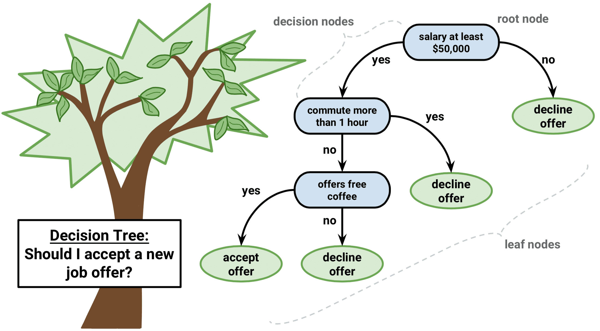
Course overview: week list
data preparation
K-nearest neighbors
Bayesian methods
Tree methods
Neural nets and SVMs
K-means and Hierarchical clustering
Performance Metrics
Reinforcement Learning

Slide 7

Course overview: week list
data preparation
K-nearest neighbors
Bayesian methods
Tree methods
Neural nets and SVMs
K-means and Hierarchical clustering
Performance Metrics
Reinforcement Learning

Slide 8
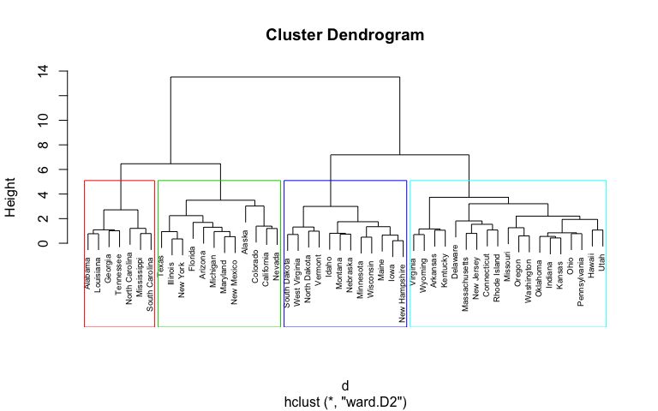
Course overview: week list
data preparation
K-nearest neighbors
Bayesian methods
Tree methods
Neural nets and SVMs
K-means and Hierarchical clustering
Performance Metrics
Reinforcement Learning

Slide 9
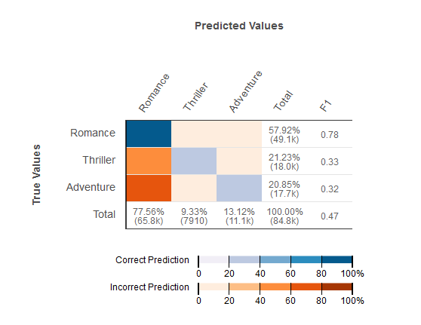
Course overview: week list
data preparation
K-nearest neighbors
Bayesian methods
Tree methods
Neural nets and SVMs
K-means and Hierarchical clustering
Performance Metrics
Reinforcement Learning

Slide 10
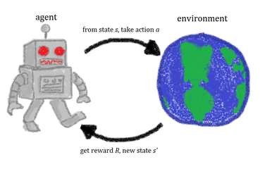
Course overview: week list
data preparation
K-nearest neighbors
Bayesian methods
Tree methods
Neural nets and SVMs
K-means and Hierarchical clustering
Performance Metrics
Reinforcement Learning

Slide 11
Essential data science skills

Slide 12
Essential data science skills
Comprehending new data
Programming (R and Python)
Math and statistics
Presentation skills!
  Format for the course will be:
    Review previous week / Introduce topics (30m presentation)
    Demo to learn skills (30m)
    Pair programming project (1h)
    Post results, a few groups present (30m)
    Individual programming skills quiz on last week’s topic (30m)

Slide 13
General pipeline for machine learning
Define a (good) problem
Collect data
Clean data
Transform data

Slide 14
General pipeline for machine learning
Define a (good) problem
Collect data
Clean data
  Deal with missing values – throwout, impute (median, mean, KNN)
  Deal with outliers – throwout, clip

Slide 15
General pipeline for machine learning (continued)
Transform data
  Dummy variables (R will handle this automatically for factors, mostly)
    Sometimes we may actually want a factor to be in sequential levels, like with education levels, so we have to order and convert the factor to an integer type
  Scale data
    Sometimes helps for SVM, usually necessary for neural networks and KNN
  (optional) Reduce dimensionality
    Principle component analysis (PCA)
    Chi-square (usually for text applications)
    TNSE (more often used for visualization)
    Variance/correlation filters
    Tree methods (e.g. random forest) feature selection

Slide 16
Good vs Bad Problems
Characteristics of a good problem?
Bad problem?

Slide 17
Good vs Bad Problems
Characteristics of a good problem?
  Objective target (e.g. has heart disease or not)
  Enough data (at least 100s of points, preferably thousands or more)
Bad problem?
  Subjective target (e.g. is a review “overenthusiastic”)
  Not much data/lots of missing data

Slide 18
Demo problem:
Car mpg – predict mpg from characteristics of a car
https://archive.ics.uci.edu/ml/datasets/auto+mpg

Slide 19
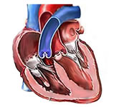
The problem we will start with: predicting heart disease
UCI Riverside Heart Disease dataset
We will use the heart.disease.data file, which has 14 attributes and 1 target variable
Objectives:
  Impute missing data (don’t just throw it away)
    -9 means missing
  Look at the data with EDA
  Throw away columns if needed
  Deal with outliers (maybe make a boxplot)
remove_outliers <- function(x) clamp(x, lower = boxplot.stats(x)$stats[1], upper = boxplot.stats(x)$stats[5])
https://stackoverflow.com/a/27109891/4549682
https://stackoverflow.com/a/4700136/4549682
http://archive.ics.uci.edu/ml/datasets/heart+Disease

Slide 20
Next week
Next week we will use this data prep to start, then use KNN to predict heart disease from the data.

