Slide 1
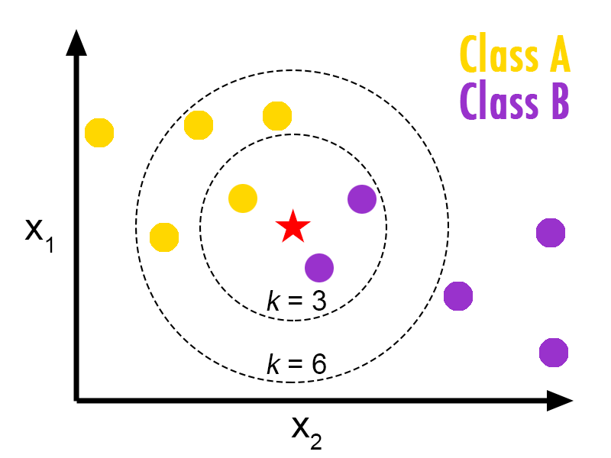
Week 2: K-nearest-neighbors

Slide 2
Week 1 review
Good vs bad problems
  Quantifiable/measurable
  Can collect the data
Preprocessing
  Impute missing values (mean, median, mode, KNN)
  EDA on data, throw out useless features (low variance, etc)
  Transform (scale data, dummy variables, etc)

Slide 3
Week 1 quick quiz
Use the AirQualityUCI.csv file under week 2, and the NO2(GT) column
  Impute missing values twice, once with KNN and once with the overall mean for each column
    Make 2 histograms of the column with KNN and mean-imputed
    Make a scatter plot of the imputed values (x-axis should be KNN-imputed, y-axis mean-imputed)
These are sensor data measure air quality in an Italian city from 2004-2005
http://archive.ics.uci.edu/ml/datasets/Air+Quality

Slide 4
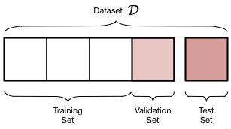
A little more data prep: train/validation/test
Should split data into training and test, at least
  Training data is for fitting model
  Testing is for scoring model
  Test/train data should not overlap
  Sometimes test is called ‘holdout’
Validation is another section we could create, but this is more often used for neural nets

Slide 5
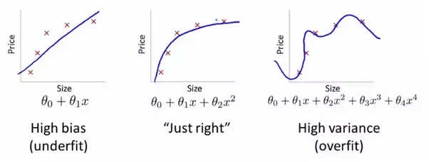
Bias-variance tradeoff and overfitting
We can use the validation and/or test sets to:
  check for overfitting
  Compare different models (KNN, linear model, etc)
https://www.quora.com/What-is-the-best-way-to-explain-the-bias-variance-trade-off-in-layman%E2%80%99s-terms

Slide 6
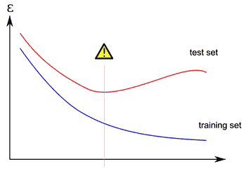
Bias-variance tradeoff and overfitting
We can use the validation and/or test sets to:
  check for overfitting
  Compare different models (KNN, linear model, etc)
http://mlwiki.org/index.php/Overfitting

Slide 7
Cross-validation
We go through a dataset and create train/test splits n times
  Each time we score our model on the test data, and average the scores
  This way we get to train on each part of the data, and test on each part separately, so it’s a bit more robust than just
This is often used to tune hyperparameters
  Difference between parameters and hyperparameters?

Slide 8
Cross-validation
This is often used to tune hyperparameters
  Difference between parameters and hyperparameters?
  Hyperparameters are set by us, parameters are set by the algorithm
    e.g. number of neighbors for KNN is a hyperparameter
    Coefficients from a linear fit are parameters, because the algorithm set those numbers by itself

Slide 9
KNN algorithm
Give the algorithm training data, and testing data
For each testing point:
  Calculate distance from each training point to the testing point
  Find the N closest points based on distance
  For classification, take the majority vote for most similar class
  For regression, take the average of the nearest k points

Slide 10
Distance metrics
What are some distance metrics?

Slide 11
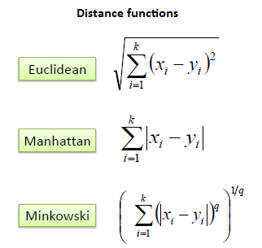
Distance metrics
What are some distance metrics? (at least 3)
  Euclidean
  Manhattan
  Minowski (general formula)
  Manhattan is best for large number of features, like TFIDF
  https://bib.dbvis.de/uploadedFiles/155.pdf
http://www.saedsayad.com/k_nearest_neighbors.htm

Slide 12
KNN runtime
Time complexity (computational complexity), also called big-O runtime
n training samples, d features, k neighbors
Either O(ndk) or O(nd + kn) depending on algorithm
Useful to understand how to reduce runtime if taking too long – either reduce number of samples, number of neighbors, and/or number of features
What are the runtimes for training and testing?
https://stats.stackexchange.com/a/219664/120921

Slide 13
Normalizing features
What happens if one feature is much larger than another? E.g. weight (1000s) and horsepower (100s)
How might we normalize the features?

Slide 14
Normalizing features
What happens if one feature is much larger than another? E.g. weight (1000s) and horsepower (100s)
How might we normalize the features?
  Min/max (0-1, -1 to 1, etc)
    Could be a problem with large outliers
  Z-scaling (set mean = 0 and stddev = 1)
    Outliers can still cause problems, but not as bad as min/max
  Normalize each vector (set total length to 1) https://www.khanacademy.org/computing/computer-programming/programming-natural-simulations/programming-vectors/a/vector-magnitude-normalization
  Normalize (norm) is not a great idea because the relative magnitudes of features won’t change

Slide 15
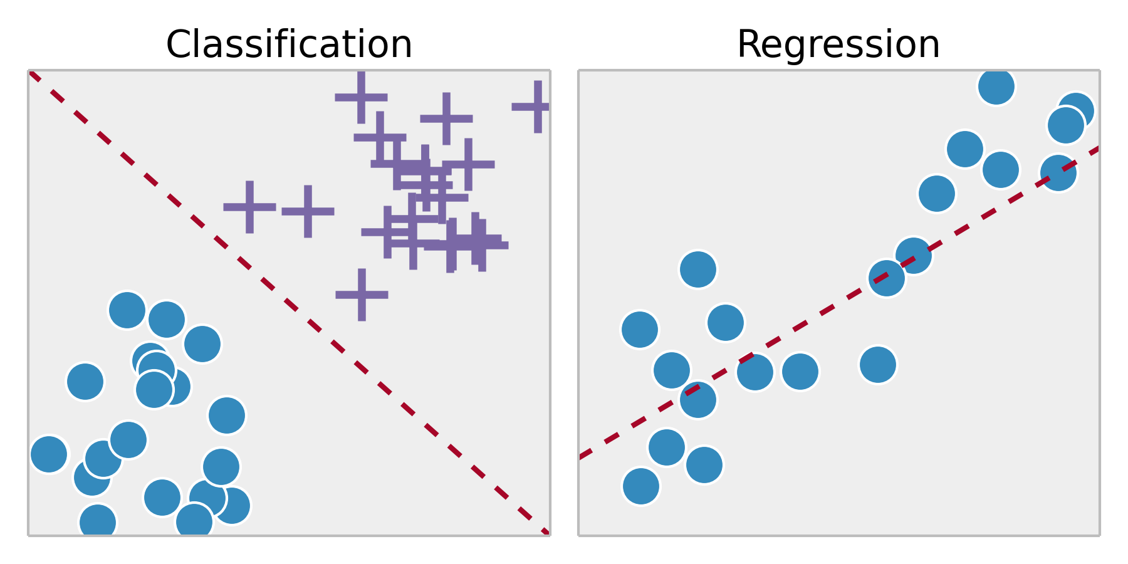
KNN difference for classification vs regression?
http://ipython-books.github.io/featured-04/

Slide 16
KNN difference for classification vs regression?
Classification takes majority vote of k nearest
  If a tie, could return NA or a random guess of the possibly classes
Regression takes average of k nearest points
  Could also weight by distance in different ways
http://ipython-books.github.io/featured-04/

Slide 17
Demo: auto mpg
We are going to predict miles per gallon from other car characteristics.
Is this classification or regression?
What are the parameters and hyperparameters in KNN?

Slide 18
Demo: auto mpg
We are going to predict miles per gallon from other car characteristics.
Is this classification or regression?
What are the parameters and hyperparameters in KNN?
  Hyperparameters are k (number neighbors), distance metric, weighting for predictions
  Parameters might be considered the nearest neighbors to a point we are trying to predict (debatable, usually parameters are things like coefficients in a linear fit)

Slide 19
Demo: auto mpg
We are going to predict miles per gallon from other car characteristics.
Is this classification or regression?
  Regression, because we are predicting a continuous variable, not a categorical variable
Use the auto.dt.nona.csv file (which has NAs replaced with KNN imputation)
Use the knn_demo.R and knn_demo.Rmd files
Also knn_demo.ipynb file for Python (jupyter notebook)

Slide 20
Project: heart disease prediction
Task – either predict the value of ‘num’ (how much blood vessels have narrowed due to plaque, 0 is not much and 4 is a lot). 4 is the worst case of heart disease (most plaque buildup in vessels)
Or predict if the ‘num’ column is 0 or >= 1. If >= 1, the person has heart disease.
Before you do KNN, you will need to answer the question and decide: are you doing classification or regression?
Tune the k hyperparameter to the optimal value and support it with data (elbow plot)
Report accuracy and/or other scoring metrics (confusion matrix, R^2, SSE, etc) on train and test data sets
Make at least 2 plots. Options:
  plot PCA dimensions of data (e.g. 1st and 2nd) and color points by classes
  Plot some of the variables on x and y and color by classes
  Color by errors/misclassifications
  More EDA

Slide 21
Ideas to try if you want more
Try classification instead of regression
  Any of the UCI classification datasets are good
Look more into PCA
Explore other R packages for KNN – there are many
Try using other distance and weighting settings for the KNN hyperparameters

