Slide 1
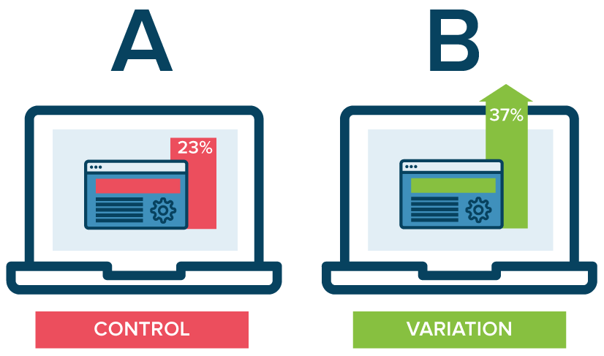
Bayesian A/B Testing
https://www.optimizely.com/optimization-glossary/ab-testing/

Slide 2
Bayes’ Law for A/B testing
We can do a t-test for A/B testing things like website design (e.g. red vs blue theme)
  What are some problems with t-tests for large amounts of data like web traffic?

Slide 3
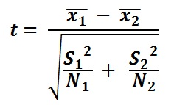
Bayes’ Law for A/B testing
We can do a t-test for A/B testing things like website design (e.g. red vs blue theme)
  What are some problems with t-tests for large amounts of data like web traffic?
    Everything looks significant because of the amount of data. t-tests were made for small data
    Also assumes t-distributions (similar to normal distributions, but with slightly fatter tails)
    t-stat inversely proportional to number of samples
  Check out t.test.example.R in worldclass
http://rpsychologist.com/d3/NHST/
https://www.optimizely.com/optimization-glossary/ab-testing/
https://ncalculators.com/math-worksheets/how-to-calculate-t-test.htm

Slide 4
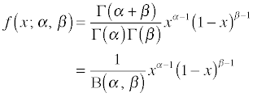
R t-test and Bayesian A/B testing example
gamma = (n – 1)!
Mean = alpha / (alpha + beta)
In R, dbeta(alpha, Beta)

Slide 5
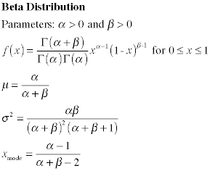
R t-test and Bayesian A/B testing example
Beta distribution good for A/B testing (binomial – 0 or 1 results)
distribution of probability after S successes and F failures is given by Beta(S+1, F+1)
  So assuming a 50/50 chance with 2 trials, we have Beta(2, 2). A completely blank prior would be Beta(1, 1), which would mean no trials

Slide 6
R t-test and Bayesian A/B testing example
We can add the alpha/beta parameters from a prior and from data to get a posterior distribution
  e.g. say we expect 30% conversion rate from a webpage for whatever reason, we could use beta(4, 8) as our prior distribution
  Say we then find that 50 out of 450 people sign up, our evidence is showing a distribution of beta(51, 451)
  We add the alpha/beta to get our posterior distribution, beta(55, 459). Then this becomes our prior the next time we re-evaluate the results

Slide 7
R t-test and Bayesian A/B testing example
If we have one version of a webpage (A) that gets 50/450 to sign up, and B gets 37/425, which one is better and by how much?
Add the data to our prior again, then randomly sample the two Beta distributions, divide the results of A by the results of B to get a distribution of how much better A is than B
See bayes.ab.test.example.R file in worldclass

