Slide 1
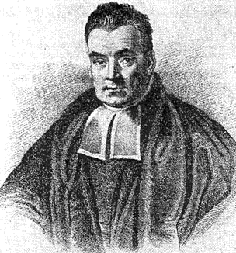
Week 3: Bayesian methods

Slide 2
Week 2 quiz review
NA’s were just missing rows at the end of the file
Real NA’s were -200 – after dropping fully NA rows, replace -200 with NA
Replace commas with periods
Convert times to seconds since epoch (seconds since 1-1-1970
May end up as the week 1 assignment next time I teach this – ended up being quite difficult, but useful skills

Slide 3
Week 2 Review
Train/test/validation split – why?
What is a high-bias model? High-variance?
Cross-validation
KNN algorithm

Slide 4
Week 2 Review
Train/test/validation split – why?
  We want to compare different models and hyperparameters to pick the best ones, so train on training and test on an unseen “holdout” test set (or validation set in some cases)
What is a high-bias model? High-variance?
  High bias means it is too general – e.g., predicting the mean for regression
  High variance means it is overfitting – fits the training perfectly, but does terribly on the test
Cross-validation
  Split data into x parts (say 3), train on 2, test on 1, and try all permutations
KNN algorithm
  Training saves all points
  Evaluation:
    Calculate distance from test point to all other points
    Find closest k points, take average for regression, majority vote for classification

Slide 5
R packages
A major difference between Python and R
  Python mainly has sklearn for ML
  R has many different packages; caret is the closest to sklearn in completeness
Anyone using ‘class’ package for KNN and not caret?

Slide 6

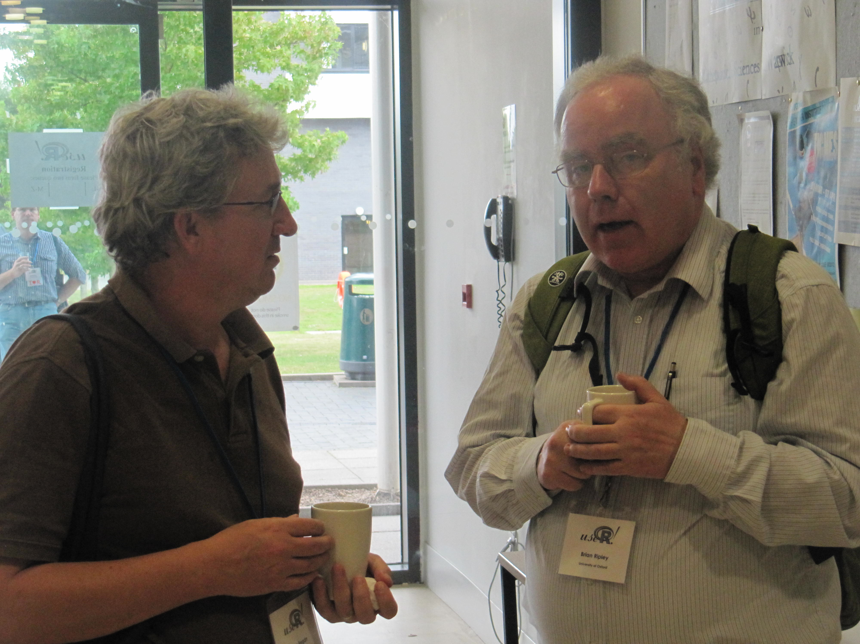
R packages
Who is the creator of caret and who made `class`?

Slide 7
R packages
Who is the creator of caret and who made `class`?
Author of class, Brian Ripley:
Author of caret, Max Kuhn

Slide 8
Week 2 review quiz
KNN classification on Iris dataset
Turn into Week 2 quiz folder under ‘assignments’ in worldclass
Participation grade, next week’s quiz will be graded

Slide 9
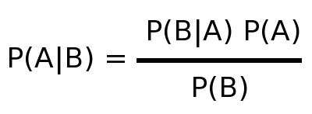
History of Bayes’ Law (Bayes Theorem)
Reverand Thomas Bayes introduced the idea in 1763
Predict the future based on our “priors” (prior known probabilities from data)
Posterier is P(A|B)
Pronounced ‘probability of A given B’

Slide 10
Bayes’ Law (Bayes Theorem)
Example: customer visiting webpage to sign up for subscription to a service
P(A|B) = probability of A given B
  e.g., probability of a customer signing up for a subscription if they spent > 1 minute on the page
P(B|A) = probability of B given A
  e.g. probability of customer spending > 1min on a webpage if they signed up for a subscription

Slide 11
Bayes’ Law (Bayes Theorem)
Example: customer visiting webpage to sign up for subscription to a service
P(A|B) = probability of A given B
  Thing we are predicting – might popup a ‘limited time offer’ if the person tries to exit before 1min
P(B|A) = probability of B given A
  e.g. measurable based on data – take conversion rate of customers that spent >1min on page

Slide 12
Bayes’ Law (Bayes Theorem)
Example: customer visiting webpage to sign up for subscription to a service
P(A) = probability of A
  Measurable by past data – overall conversion rate
P(B) = probability of B
  Measureable by past data – % of people spending > 1min on page

Slide 13
Bayes’ Law (Bayes Theorem)
Example: customer visiting webpage to sign up for subscription to a service
P(A) = 25%
  overall conversion rate
P(B) = 50%
  % of people spending > 1min on page
P(B|A) = 65%
  % of people that spend >1min on page and sign up

Slide 14
Bayes’ Law (Bayes Theorem)
Example: customer visiting webpage to sign up for subscription to a service
0.65*0.25/0.5 = 0.325
A better way would be to represent the “prior” data as a distribution
If interested in bio stuff like drug testing or for cancer or disease, check out wikipedia’s example

Slide 15
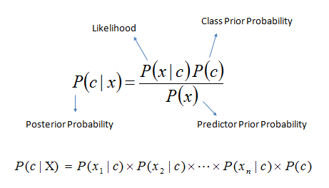
Bayes’ Law for classification
Classic example of machine learning - Naive Bayes classifier for email spam classification
  We use probability of each word for each class, multiply them to get overall probability for a class
http://www.saedsayad.com/naive_bayesian.htm

Slide 16
Example: Naive Bayes on the heart disease dataset

Slide 17
Bayesian Networks
Directed Acyclic Graph (DAG)
Probabilities and states of features effect probabilities of other features in Bayesian calculations
Improvement on Naive Bayes model because this is a bit more complex
Bayesian Network example (adapted from https://www.r-bloggers.com/bayesian-network-in-r-introduction/)

Slide 18
Exercise: Bayesian Network on heart disease data
Use bnlearn to create a Bayesian network model on the data.
Plot the model. Do the connections make sense? Remove any that don’t make sense.
Find some probabilities of events using cpquery and discuss/interpret them.

Slide 19
Project (Homework): Use NB Classifier for spam/ham dataset
Hint: take a sample (with sample() ) of the data to work through first so it runs quickly, then use the full dataset
Make a train/test set
Use cross-validation on the train set to try a few different hyperparameter settings for your Naive Bayes classifier, then report the performance results on the test set with a confusion matrix
Post the results to the week 3 discussion by next class

Slide 20
Taking it further
Play around with the tm package a bit more and tweak the termdocumentmatrix settings
Make wordclouds of most common words in spam/ham
Naive Bayes on other datasets
Trying it in Python
Try out Bayesian models on predicting email opens
Go through the

