Slide 1

Week 4 : Trees
http://cornins.com/tip-of-the-month/taking-care-trees/

Slide 2
Week 3 Bayes Review
What is Bayes’ Law?
What is a Bayesian Network?
How is Naive Bayes used to predict the class of text documents?

Slide 3
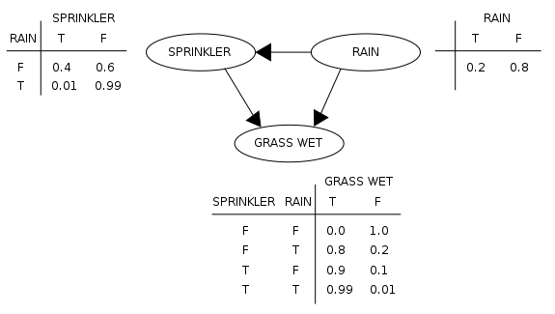
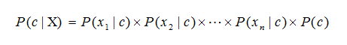
Week 3 Bayes Review
What is Bayes’ Law?
  P(A|B) = P(B|A) P(A) / P(B)
What is a Bayesian Network?
  A Directed Acyclic Graph (DAG) that can be used to calculate probabilities for any variable from any other set of variable conditions in a dataset
    Wikipedia example is fairly easy to understand
How is Naive Bayes used to predict the class of text documents?
  Multiply the probability of seeing each word in a doc for a given class, then multiply by the class probability. Take the highest probability as the predicted class

Slide 4
Refresh - basics
Supervised/unsupervised/reinforcement
Classification/regression

Slide 5
Refresh - basics
Supervised/unsupervised/reinforcement
  Supervised = we have targets we are trying to predict
  Unsupervised = just data, and we don’t know the classes they should be in
  Reinforcement = improving algorithm behavior over time by learning from feedback
Classification/regression
  Classification is for factor variables (limited number of classes), regression is for continuous (infinite range of numbers possible)

Slide 6
Week 3 review quiz
Use a Naive Bayes model to predict the iris classes
Create train/test sets with caret and data.table
Use expand.grid() to search a few hyperparameter settings
Show the best hyperparameter settings and use this model to predict on the test set
Display the confusion matrix and interpret the results
My solution was 24 lines with a few lines of comments
You can just use a .R file, don’t have to do .Rmd

Slide 7
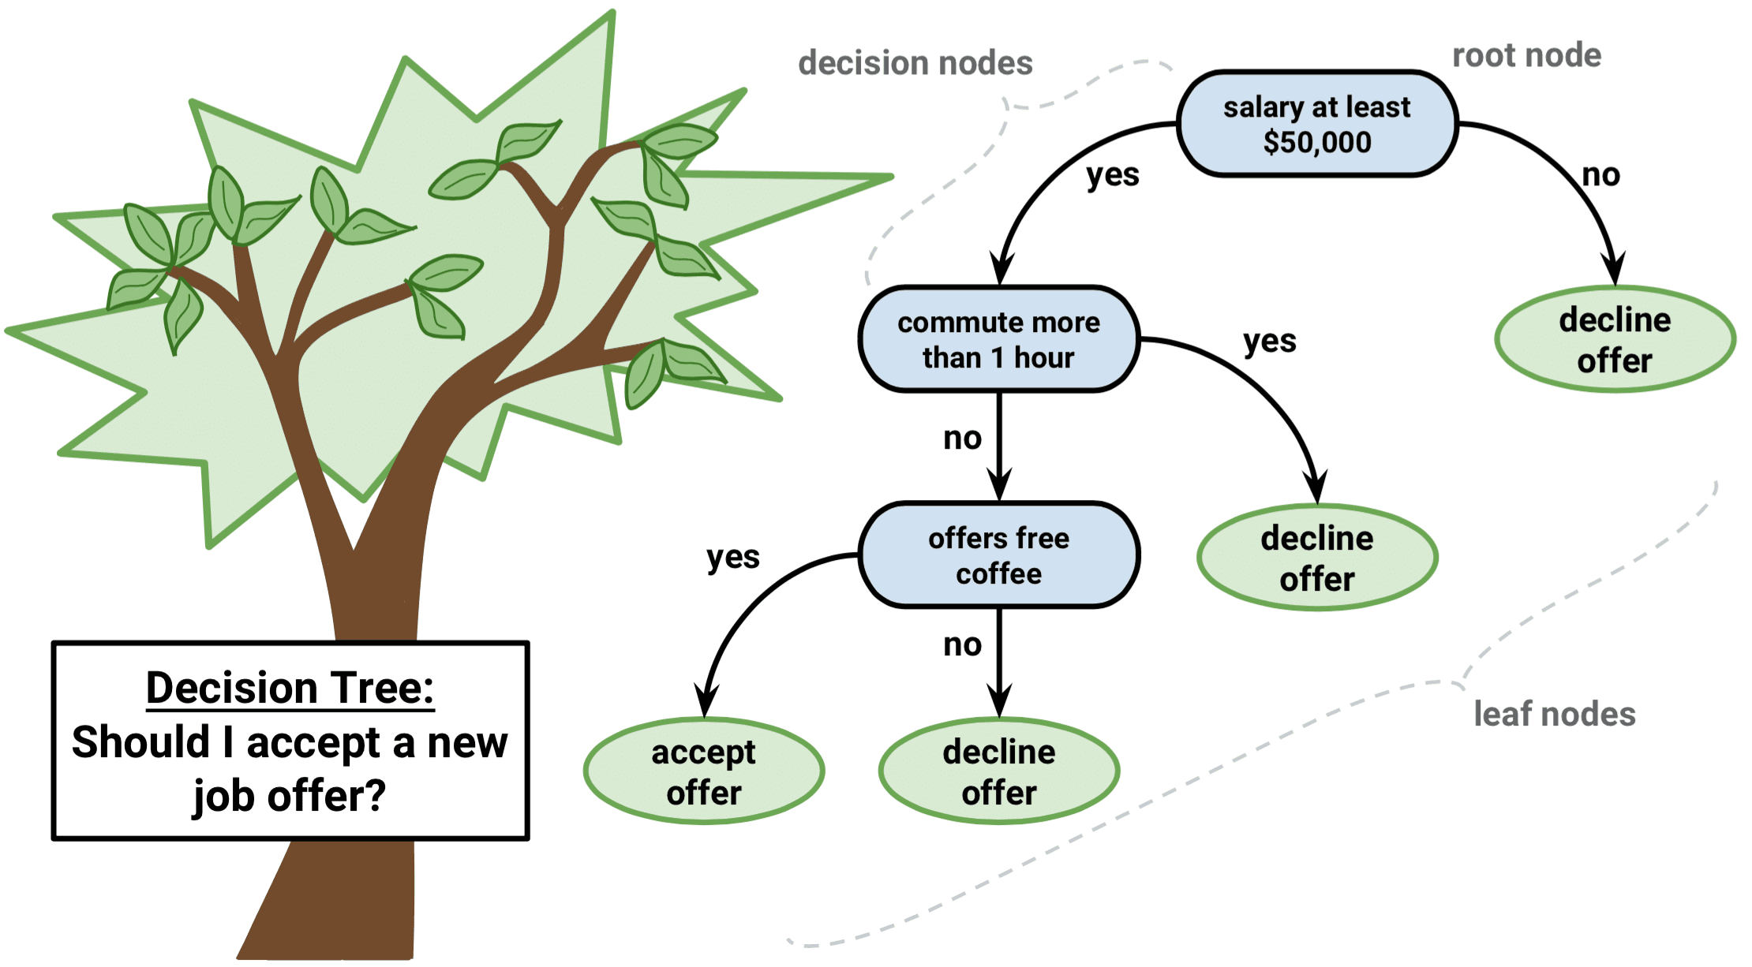
Decision trees
Simple idea, use thresholds to filter data left or right
http://dataaspirant.com/2017/01/30/how-decision-tree-algorithm-works/

Slide 8
Terminology
Starts at the root and ends with leaves
A stump is a 1-level decision tree (a single split)
  Each row in the tree is a level
But with real data, how do we decide what to split on?

Slide 9
Optimizing splitting
some algos for splitting: ID3, C4.5, CART (there are more...)
ID3/C4.5/C5.0 are used for classificitaion. C4.5 is an improvement on ID3, C5.0 is an improvement on C4.5, but C5.0 is not easy to use...(http://www.rulequest.com/)

Slide 10
Classification And Regression Trees (CART)
“Greedy” algorithm, meaning it picks the best choice ASAP
For regression, uses SSE = (y – y.hat)^2
y.hat (prediction) is average of samples in that leaf
For classification, uses Gini impurity (Gini index), which is basically class purity

Slide 11
Gini impurity (classification)
P_{i} is proportion of class i, so if we have all our data points in a leaf node as one class, G = 0.
If we have 2 classes and it is a 50/5 split, then
  1 – (0.5^2 + 0.5^2) = 0.5
3 classes and 1/3 1/3 1/3 split:
  1 – (0.33^2 + 0.33^2 + 0.33^2) = 2/3
For each split, try all splits of all features and pick the one that gives best Gini impurity measure (lowest number)
  Can settle in local minima with this “greedy” method, but could use backtracking to overcome this

Slide 12
Entropy/Information Gain (classification) (ID3/C4.5/C5.0)
H is entropy – 50/50 split is -1
  log_2() of anything < 1 is negative and increases as we approach 0
  If we have two classes (50/50) then split to 90%/10%, entropy is now -0.4689956, so IG is around 0.53. Higher IG is better
  H = 0 is perfect classification – log(1) = 0

Slide 13
Single decision tree problems
decision.tree.demo.R file under week 4
Single decision trees often overfit (high variance) because they are fitting the training exactly
We can combat this with hyperparameters
  Require minimum number of samples in each leaf node (minsplit in rpart)
  Require our scoring metric improves by a minimum threshold on each split (cp in rpart)
  maxdepth will limit the number of splits we can have

Slide 14
Bagging
Use bootstrapping to decrease variance
Sampling with replacement; build multiple trees on different bootstrapped samples
  Can score the model on the ‘out-of-bag’ (oob) samples; each model evaluates the oob samples separately, and the score is averaged

Slide 15
Random Forests
Bagging, but we also randomly subset the features for each split
Each tree is called a ‘weak learner’ because it has high bias, and didn’t learn much about the data
This allows us to tune the number of features we select from, so it can decrease variance of models
Lots of hyperparameters:
  Number of trees, max depth, min samples to split, number of features to use for each tree

Slide 16
Random Forests example
rf.trees.example.R file under week 4
  number of trees – more trees +variance or +bias?
  max depth – deeper +variance or +bias?
  min samples to split – +samples +var or +bias?
  number of features to use for each tree – more features +variance or +bias?
We are going to find out with the heart disease dataset

Slide 17
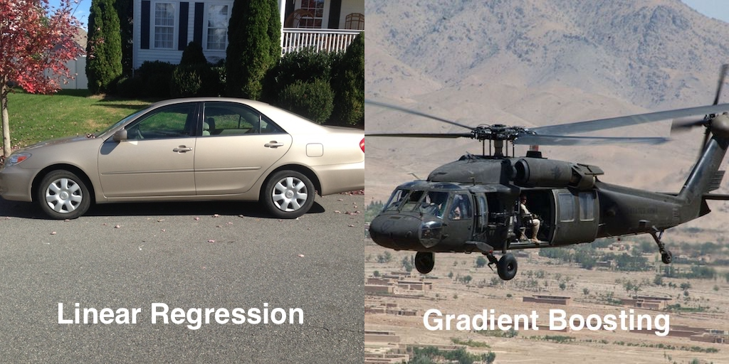
Boosting
Gradient boosting (xgboost) is probably the most powerful tree-based method
  Random forests are probably next in line
http://blog.kaggle.com/2017/01/23/a-kaggle-master-explains-gradient-boosting/

Slide 18
Boosting
Fit a tree model (weak learner) to the data, F_0
Then calculate the differences between the data and the predictions (residuals): h(x) = y – y.hat
Fit a model to the residuals ( h(x) ). Ideally, h(x) would equal y – y.hat, and we would be done, but of course this never happens
Then add the new model, F_1 ( h(x) ) to the current model with a learning rate, gamma. F(x) = F_0 + gamma * F_1 + …
Rinse and repeat until we decide to stop (hit a number of trees)
Adaboost does this with stumps, xgboost has lots more hyperparameters

Slide 19
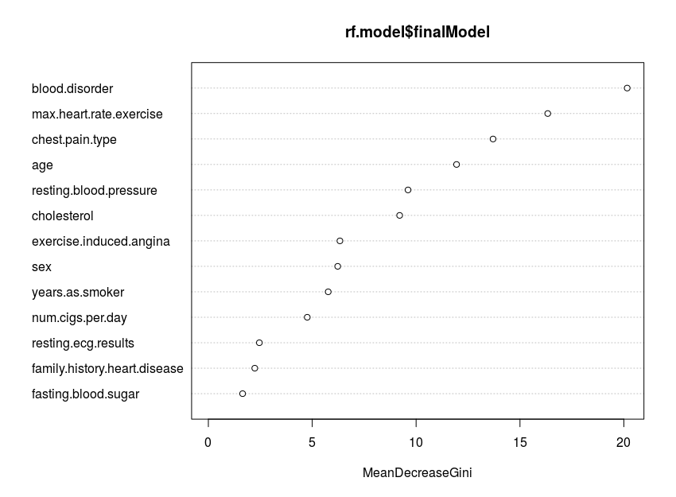
Feature importances
We can find on average which features give us the best splits (most information gain, or most reduction of Gini impurity, or most gain in R^2)
This allows us to see which features have more predictive power

Slide 20
Example: classification on heart disease dataset
Optional xgb.demo.R file under week 4 (xgboost)

Slide 21
Project: Trees on bank marketing dataset
Data is here: http://archive.ics.uci.edu/ml/datasets/Bank+Marketing
Or under week 4 (same as downloading from UCI)
Make at least 2 EDA plots and explain them.
Use either random forests and/or xgboost to fit a model to the data, predicting if someone signed up (or will sign up) for a term deposit or not. Provide any possible points of improvement on the model if you don't think the one you have is optimal.
Make a plot of the feature importances from your model and explain it.
Report at least 2 scoring metrics (e.g. accuracy, confusion matrix, ROC/AUC score and curve, etc) and explain them.

Slide 22
Taking it further
Go through the xgboost demo, and use xgboost on some data
Try the same things in Python
Try adaboost
Try getting out of bag (OOB) scores for random forests

