Slide 1

Week 5: Neural Nets & SVM
https://www.rambus.com/blogs/fpgas-take-on-convolutional-neural-networks/

Slide 2
Week 4 Review: Trees
What is the criterion for splitting classification? Regression?
What is a 1-layer tree called?
What is different about random forests compared with a single decision tree?
What are boosting methods fitting after the first tree?

Slide 3
Week 4 Review: Trees
What is the criterion for splitting classification? Regression?
  Classification – Gini or Entropy (info. Gain)
  Regression – R^2 or another SSE-like metric (MAE, MSE, etc)
What is a 1-layer tree called?
  A stump
What is different about random forests compared with a single decision tree?
  Random forests use many decision trees, using bootstrapping of samples and randomly sampling the features for each tree (mistake here, what is it?)
What are boosting methods fitting after the first tree?
  The residuals ( (predictions – actual)^2 )

Slide 4
Week 4 review quiz
Using the auto.dt.clean.csv dataset (under week 5), predict mpg from everything else with a random forest
Create train/test sets
Try 3 values for mtry, including the default
Evaluate performance on the train and test set, and check for overfitting
Plot the feature importances and explain them

Slide 5
SVM
Support vector machine
Invented in 1963 by Vladimir N. Vapnik and Alexey Ya. Chervonenkis
  Vlad and 2 others intro’d the ‘kernel trick’ in 1992
Works well for fewer data points (<20k) and large number of features

Slide 6
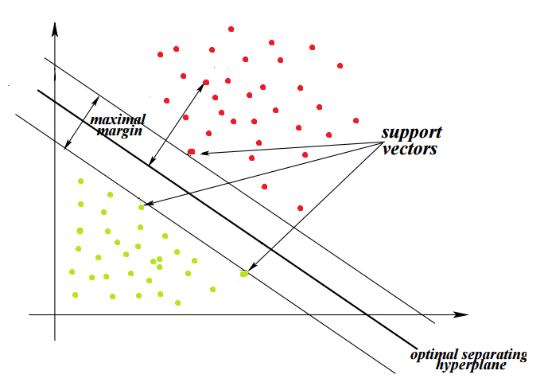
How SVMs work
Mathematically it finds the optimal separating hyperplane between classes
A hyperplane is a dot in 1D, a line in 2D, a plane in 3D, and a hyperplane in 4D+

Slide 7
How SVMs work
Finds the optimal by finding hyperplane with max distance between the 2 nearest points (called support vectors)

Slide 8
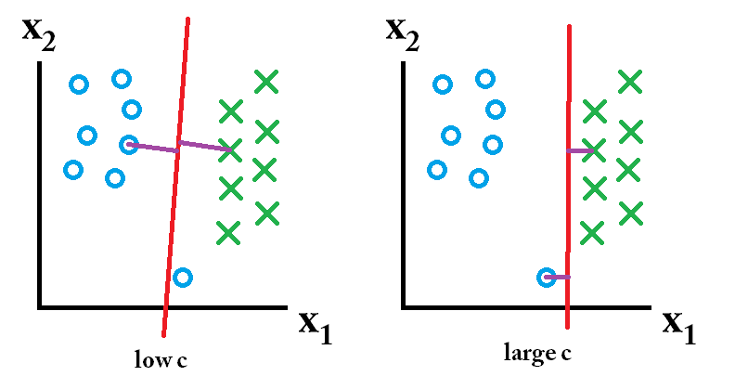
Overlapping points
If classes are overlapping, we can penalize the misclassification. The penalty is proportional to C, so a large C will avoid misclassification
C is a tunable hyperparameter
https://stats.stackexchange.com/a/159051/120921

Slide 9
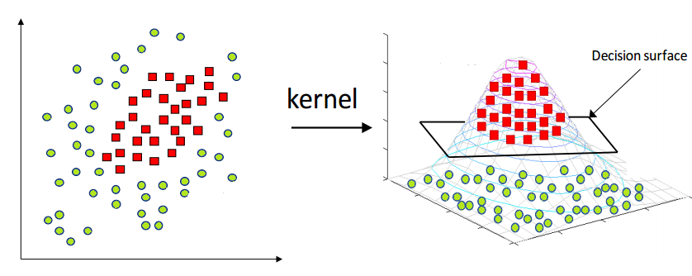
Kernel Trick
We can transform the data with a kernel so it is separable
http://blog.hackerearth.com/simple-tutorial-svm-parameter-tuning-python-r

Slide 10
Kernel Trick
Most common kernels are polynomial (degree of polynomial is a hyperparameter) and radial basis function (RBF, Gaussian)
These essentially map data from one space to another (it’s a bit more complicated than that, but gets into complex math)
http://web.mit.edu/6.034/wwwbob/svm-notes-long-08.pdf

Slide 11
Kernel Trick
Sigma is a tunable hyperparameter
https://www.youtube.com/watch?v=H_I0pYdzBSk
http://web.mit.edu/6.034/wwwbob/svm-notes-long-08.pdf

Slide 12
SVM Runtime
The runtime depends on the hyperparameter C
O(max(n,d) min (n,d)^2), n = number of samples, d = number of features
In general, n^2*d for RBF, and n*d for linear kernels
Low C (small misclassification penalty) usually decreases runtime
Chapelle, Olivier. "Training a support vector machine in the primal." Neural Computation 19.5 (2007): 1155-1178.

Slide 13
More SVM Resources
The SVM algorithm has a lot more math behind it, here are some follow-up resources
http://blog.hackerearth.com/simple-tutorial-svm-parameter-tuning-python-r
http://www.robots.ox.ac.uk/~cvrg/bennett00duality.pdf
https://www.svm-tutorial.com/
https://jakevdp.github.io/PythonDataScienceHandbook/05.07-support-vector-machines.html
http://scikit-learn.org/stable/auto_examples/svm/plot_rbf_parameters.html
https://github.com/eriklindernoren/ML-From-Scratch/blob/master/mlfromscratch/supervised_learning/support_vector_machine.py

Slide 14

Support vector machines (SVMs) can also be used for regression (SVR)
Similar (complicated) math
https://www.mathworks.com/help/stats/understanding-support-vector-machine-regression.html
http://www.svms.org/regression/SmSc98.pdf

Slide 15
SVM demo/exercise in R
On heart disease, using caret, kernlab, and e1071 packages

Slide 16
Neural networks
Can capture most any statistical pattern due to highly nonlinear behavior
Infinite possibilities for configurations (architecture/topology)
Requires GPUs (now Google’s TPU as well) to train big nets
Outperforms all other algorithms when set up correctly
Difficult to understand what the net is learning/doing

Slide 17
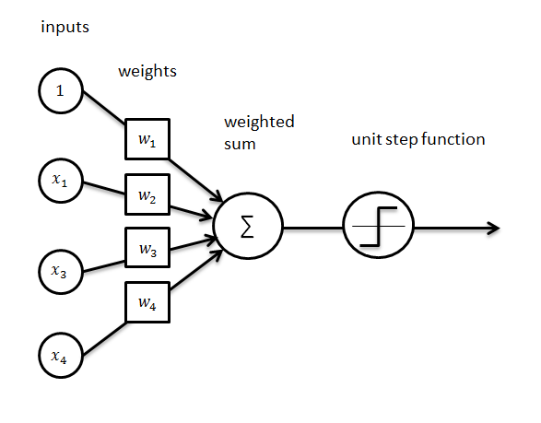
Perceptron
If the weighted sum is greater than 0, output 1, otherwise 0
http://ataspinar.com/2016/12/22/the-perceptron/

Slide 18
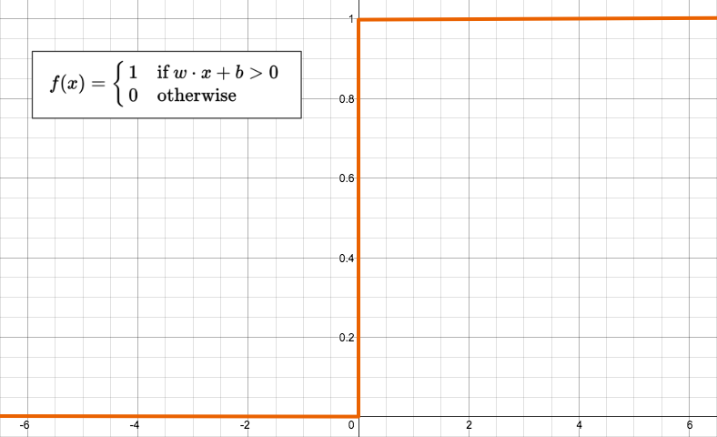
Perceptron
If the weighted sum is greater than 0, output 1, otherwise 0
https://appliedgo.net/perceptron/

Slide 19
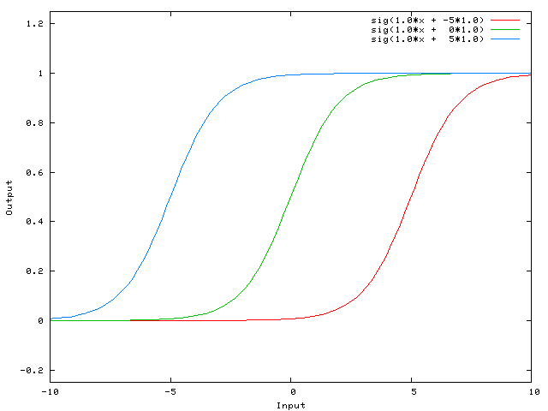
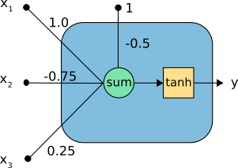
Activation functions and bias
Can add a bias to shift the output left or right on the x-axis
https://stackoverflow.com/a/2499936/4549682
https://www.neuraldesigner.com/blog/perceptron-the-main-component-of-neural-networks

Slide 20
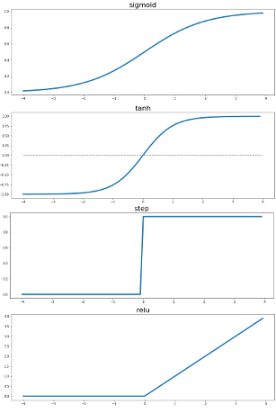
Activation functions and bias
Can add a bias to shift the output left or right on the x-axis
http://www.snee.com/bobdc.blog/2017/09/understanding-activation-funct.html
https://en.wikipedia.org/wiki/Activation_function#Comparison_of_activation_functions
https://www.neuraldesigner.com/blog/perceptron-the-main-component-of-neural-networks

Slide 21
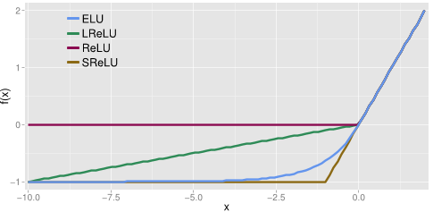
Activation functions and bias
ReLU (rectified linear unit) almost always used, although ELU sometimes works better
https://arxiv.org/abs/1511.07289
http://laid.delanover.com/activation-functions-in-deep-learning-sigmoid-relu-lrelu-prelu-rrelu-elu-softmax/
https://www.neuraldesigner.com/blog/perceptron-the-main-component-of-neural-networks

Slide 22
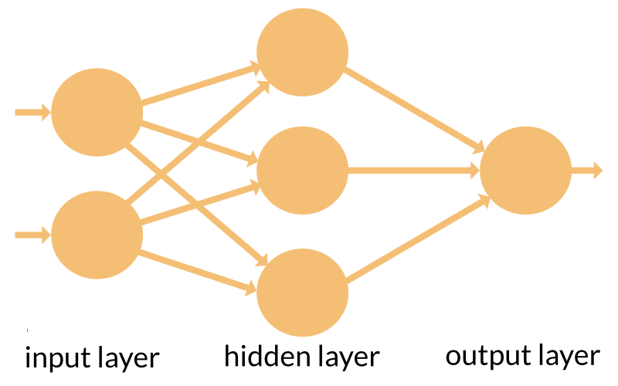
Matrix math – dense layers
Now we start stacking neurons on top of each other
When we have a lot of hidden layers, the network becomes ‘deep’ and we have “deep learning”
https://appliedgo.net/perceptron/

Slide 23
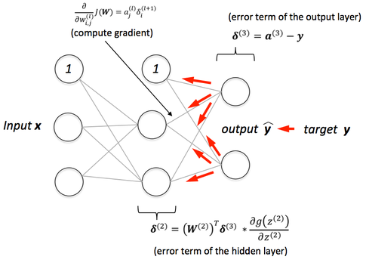
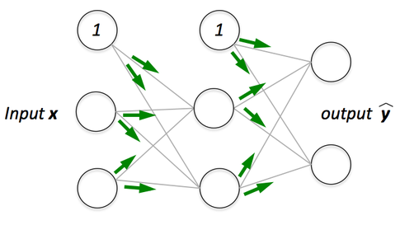
Loss functions and Backpropagation
We need a way to find the best weights in the network
Make a prediction, calculate error, and move the weights in the direction that minimizes error
https://sebastianraschka.com/faq/docs/visual-backpropagation.html

Slide 24
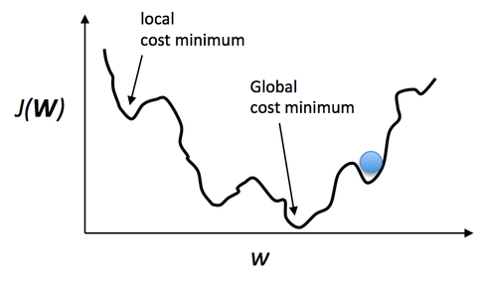
Loss functions and Backpropagation
Keep doing this until our weights stop moving much
Called gradient descent, because we are descending down the slope of the loss function
Link with the math:http://alexminnaar.com/deep-learning-basics-neural-networks-backpropagation-and-stochastic-gradient-descent.html
https://sebastianraschka.com/faq/docs/visual-backpropagation.html

Slide 25
Loss functions
For regression, we can use MSE, MAE, or any other custom equation
For classification, often categorical cross entropy (multiple classes) or binary cross entropy (2 classes)
https://keras.io/losses/
http://ml-cheatsheet.readthedocs.io/en/latest/loss_functions.html
https://en.wikipedia.org/wiki/Cross_entropy

Slide 26
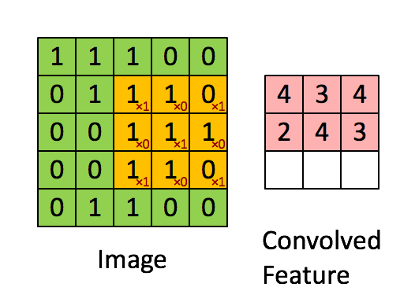
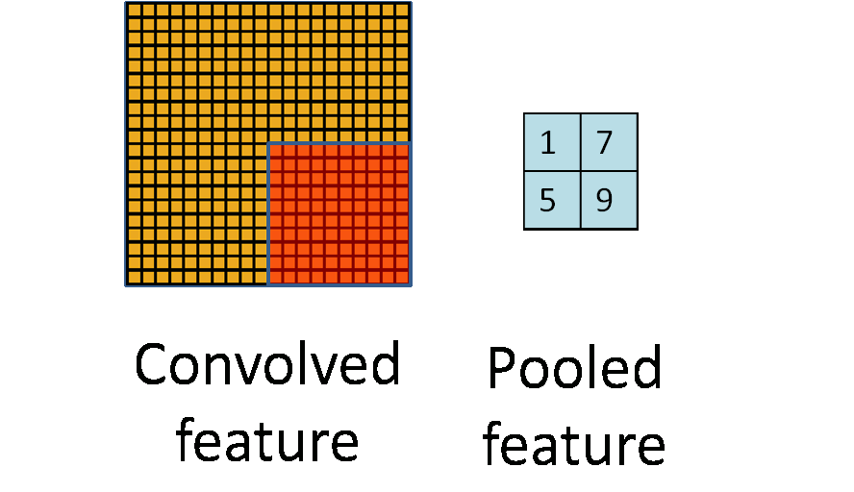
Convolutional and pooling layers
Used mostly for image recognition, but pattern recognition in general (i.e. for 1D time series)
http://ufldl.stanford.edu/tutorial/supervised/FeatureExtractionUsingConvolution/
http://ufldl.stanford.edu/tutorial/supervised/Pooling/

Slide 27

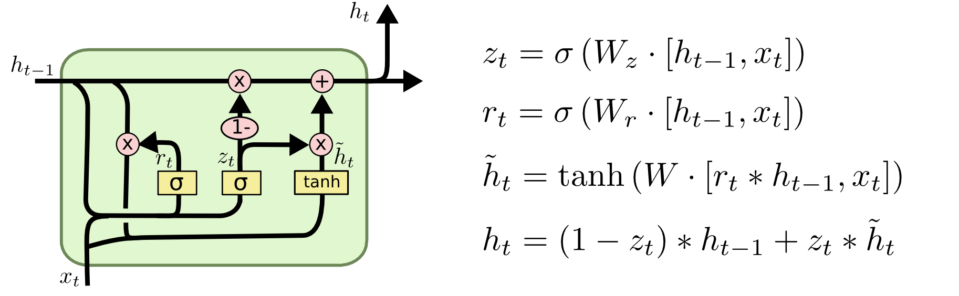
Recurrent networks
LSTM cell (long short term memory):
http://colah.github.io/posts/2015-08-Understanding-LSTMs/

Slide 28
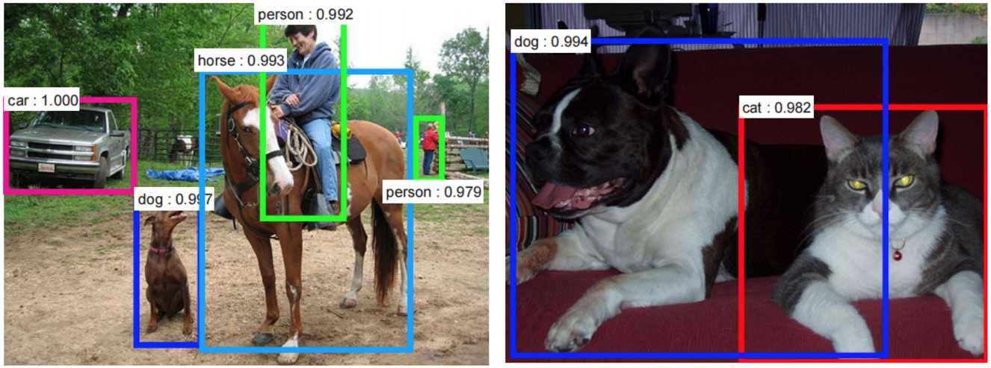
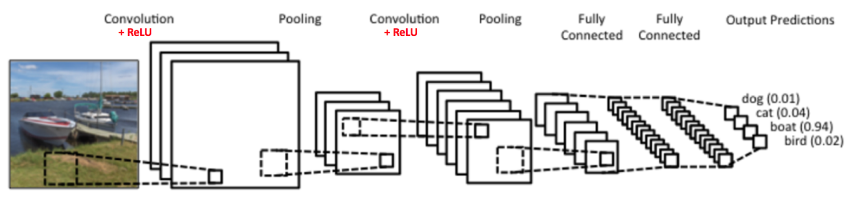
Image recognition
These networks are very large and expensive to train
https://ujjwalkarn.me/2016/08/11/intuitive-explanation-convnets/

Slide 29
Other applications
Time series analysis/prediction
  Finance (predicting future trends)
  Audio (voice recognition/speech generation, generating/recommending music, recognizing songs like Shazam)
  Electroencephelography (EEG) (brainwaves – predict if you want to move your arm, words you are imagining, etc)
  Business/commerce data (predicting customer trends or outcomes)
Generative adversarial networks (GANs)
Speech/writing generation (RNN/LSTMs)
Deep Q-learning (reinforcement learning with neural nets)

Slide 30
Interesting applications
Making art (deepart, deepdream)
Google’s speech generation improved by neural nets (wavenet)
Deep reinforcement learning beats Go world champ
Deep reinforcement learning playing video games, also going for general AI
Predicting what you are seeing from your brainwaves
Face recognition
Creating neural nets...with neural nets

Slide 31
Other neural network topics we didn’t cover
Embedding layers (and word2vec, etc)
Backpropagation for RNNs
Residual nets (e.g., ResNet50)
Transfer learning
Regularization
Early stopping
Optimizers
Other neural net libraries (lasagna, torch, theano, CNTK...)

Slide 32
Example/project: bike share neural net
Data from here: https://archive.ics.uci.edu/ml/datasets/bike+sharing+dataset
Train a regression neural net to predict the amount of bike rentals each hour
Try at least 5 different architectures, pick the best one and defend your choice
Post to the week 5 bike share exercise discussion

