Slide 1
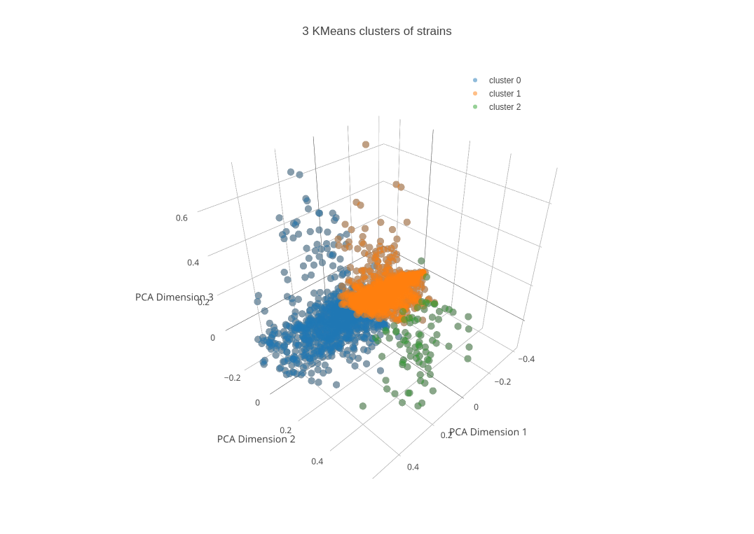
Week 6: K-means and clustering

Slide 2
Week 5 review
What size of data is SVM good for?
What is the trick we can use for overlapping data with SVMs?
What are some of the different neural net layers available?
How do we train a neural net?

Slide 3
Week 5 review
What size of data is SVM good for?
  Not large (< 20k or < 10k points usually, runtime is O(n*d) or O(n*d^2)
What is the trick we can use for overlapping data with SVMs?
  Kernel trick – takes the dot product in a higher-D space without knowing the transformation function
  RBF kernel transforms features into infinite-D space
What are some of the different neural net layers available?
  Dense, Convolutional, Maxpool, dropout, batchnormalization,
How do we train a neural net?
  Set up the architecture – input dimensions, number of layers, size of layers, type of layers, optimizer, loss function, compile it, then actually train it
  Data is passed forward (inference), then the errors are backpropagated through the net to update the weights in order to make better predictions

Slide 4
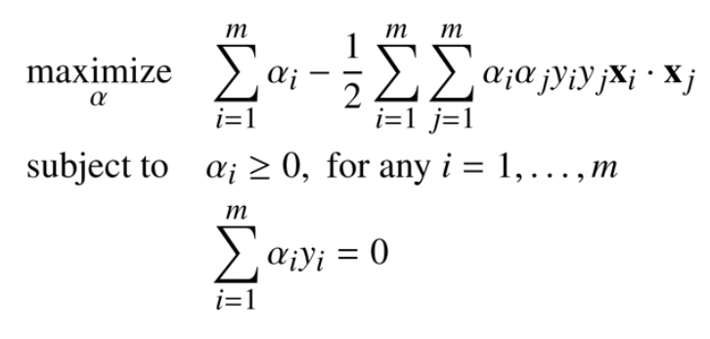
SVM optimization and kernel trick
After many pages of math (this is on page 57 of the ebook) we get to the Wolfe dual Langrangian problem, which is our algorithm for SVMs:

Slide 5
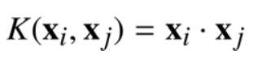
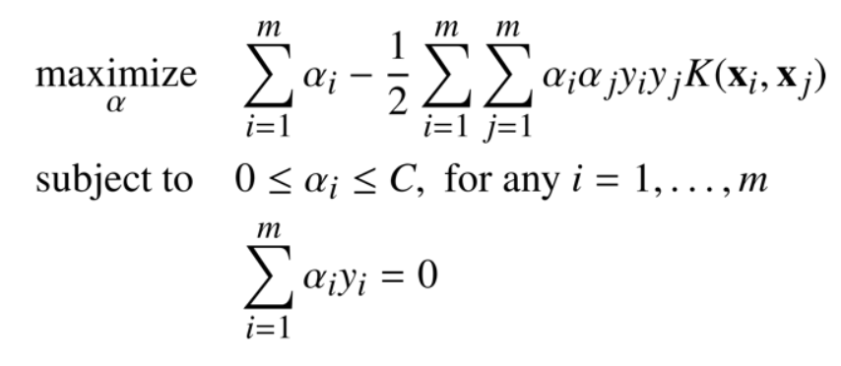
SVM optimization and kernel trick
(pg 57 of the ebook) Wolfe dual Langrangian
Kernel function is the dot product in a higher-D space (pg 75 in ebook):
The RBF kernel is in infinite-D space

Slide 6
Week 5 neural net review quiz (in Python)
Load heart.disease clean data csv with Pandas
  Data under week 2
  Use starter code (week5_neural_net_review_quiz.ipynb)
Split full dataset into train/test
Set up a neural net with some dense layers
Use ‘binary_crossentropy’ as a loss function
Report metrics (accuracy, etc) on train/test
Drop under assignments in “Week 5 review quiz: ANN/SVM”

Slide 7
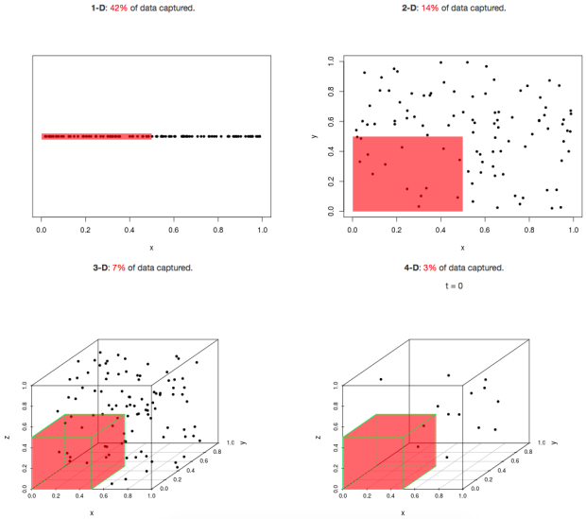
Curse of dimensionality
https://eranraviv.com/curse-of-dimensionality/
https://en.wikipedia.org/wiki/Curse_of_dimensionality
https://stats.stackexchange.com/questions/169156/explain-curse-of-dimensionality-to-a-child
https://www.quora.com/What-is-the-curse-of-dimensionality

Slide 8
Curse of dimensionality
As we add more dimensions (features), everything becomes more difficult
  Samples are more sparse/spaced out, and we need more to get a good distribution throughout the spaces
Example: looking for a penny in a 100-yard line
  Looking for the penny in 100 yards ^2
  In 100 yards ^3
  It takes exponentially longer to search the space for the penny
If we have 100 samples in 1d, we have a decent representation of their distribution
  In 2d, gets a lot more sparse
  In 3d, quite sparse, and even worse the higher we go
  Makes it hard to fit a meaningful ML model to the data

Slide 9
Unsupervised learning
Why would we do this?

Slide 10
Unsupervised learning
Why would we do this?
  If we don’t have target labels, but we want to understand the structure of our data
Examples?

Slide 11
Unsupervised learning
Why would we do this?
  If we don’t have target labels, but we want to understand the structure of our data
Examples?
  Youtube videos, news articles, websites – group into topics
  Medical data – find patients with similar conditions to understand/fix their problems
  Any text data – group into topics

Slide 12
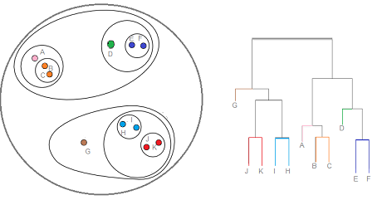
Clustering
Two primary clustering techniques (but there are others):
  Kmeans
  Hierarchical (dendrograms)

Slide 13
Kmeans algorithm
Similar to KNN
Most common algo: Lloyd’s algorithm (alternatives)
1. We set k (# of clusters, a hyperparameter)
2. Pick centers of clusters as points (kmeans++ picks centers that are distributed)
3. Calculate distance from each point to each cluster center
4. Assign each point to the closest cluster center
Repeat 3 and 4 until assignments no longer change

Slide 14
Kmeans runtime (Lloyd’s algo)
O(n * K * I * d)
n : number of points
K : number of clusters
I : number of iterations
d : number of attributes
How could we reduce the runtime, not removing any training points?

Slide 15
Kmeans runtime (Lloyd’s algo)
O(n * K * I * d)
n : number of points
K : number of clusters
I : number of iterations
d : number of attributes
How could we reduce the runtime, not removing any training points?
  Use PCA to reduce the dimensions of the features (d)

Slide 16
Should we do cross-validation with clustering?

Slide 17
Should we do cross-validation with clustering?
We can do this if we want
  https://arxiv.org/abs/0909.3052
Train the clustering algo on train data, then calculate stats on train and validation sets

Slide 18
Evaluating k-means performance
We want to optimize k
Scree (elbow) plot of within sum of squares (WSS)
Silhoutte score
Calinski and Harabaz score
Many other methods (link for R)
  link for Python

Slide 19
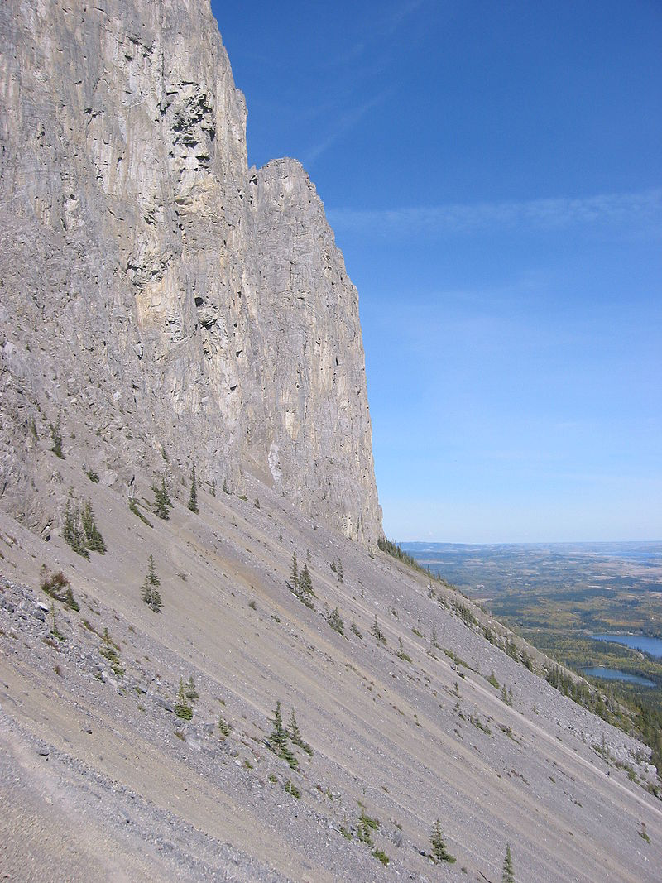
Scree plots
Scree is broken rock at the bottom of crags or mountain cliffs
Called a “scree plot” because it looks like this
https://en.wikipedia.org/wiki/Scree#/media/File:Yamnuska_bottom_cliff.jpg

Slide 20
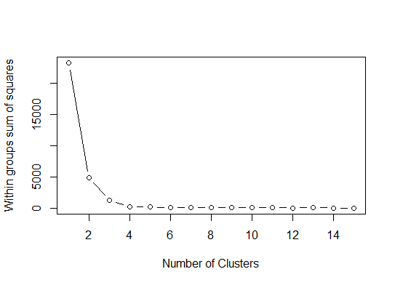
Scree plot
The WSS is the sum of squared distances between the points and their cluster centers
Best k is where the scree plot flattens out
https://stackoverflow.com/a/15376462/4549682

Slide 21
Silhouette score
Range of [-1, 1] (-1 is worst, 1 is best)
Silhouette score: mean intra-cluster distance (a) and the mean nearest-cluster distance (b) for each sample. The Silhouette Coefficient for a sample is (b - a) / max(a, b)
b is the distance between a sample and the nearest cluster that the sample is not a part of
If clusters are tightly packed and spaced out (good cluster structure), a is small, b is large, and the silhouette score will be close to 1 (approximately b/b).
Worse clustering means silhouette score moves towards -1
http://scikit-learn.org/stable/modules/generated/sklearn.metrics.silhouette_score.html

Slide 22
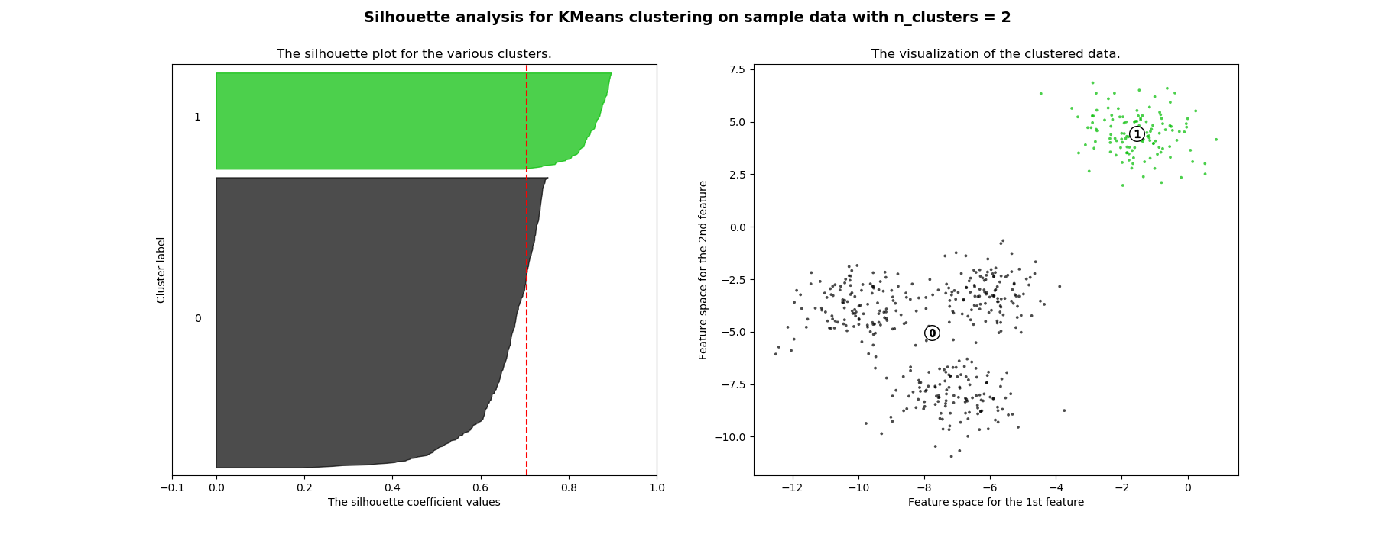
Silhouette score
Can calculate for each point, and get the average of all points
http://scikit-learn.org/stable/auto_examples/cluster/plot_kmeans_silhouette_analysis.html

Slide 23
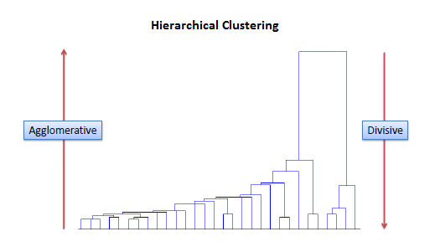
Hierarchical clustering
End up with a dendrogram – horizontal lines are clusters, y-axis is distance
Can start as single points (agglomerative) or as one cluster (divisive)
http://www.saedsayad.com/clustering_hierarchical.htm

Slide 24
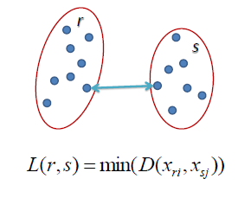
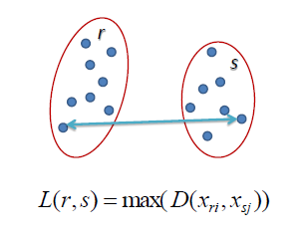
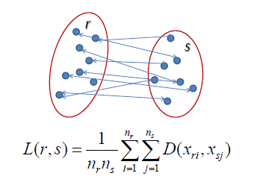
Agglomerative clustering
Calculate distance between all points
Nearest 2 points become a cluster
Repeat, treating clusters as points
Cluster distance can be single, complete, or average linkage
Single linkage – closest points in clusters
Complete linkage – furthest points in clusters
Average linkage – avg distance between clutsers
http://www.saedsayad.com/clustering_hierarchical.htm

Slide 25
How do we pick number of clusters with HCA?
No standard method, ongoing field of research
paper from 2017 proposed a method
  Compact-separate proportion (CSP) index
  (sd – cd) / (sd + cd), where sd is intercluster separation, and cd is intracluster compactness
  Complex math (minimum spanning trees with Dijkstra’s or Kruskal’s algorithm, etc)
We can cut the tree to get a specified number of groups
HCA and kmeans are more exploratory than objective

Slide 26
Example exercise (50% of exercise grade)
clustering.demo.exercise.R file under week 6
Student performance dataset from UCI, student-mat.csv under week 6
Cluster students to see if there are some natural groupings
Pair exercise:
  Try other hierarchical linkages
  Use the kmeans/hierarchical clusters to compare the groups of students and find commonalities
  If you have time, use PCA to plot the clusters

Slide 27
Assignment (other 50% of exercise grade)
Use kmeans and/or HCA on another dataset of your choice
If using kmeans, find optimum k, if HCA, pick a number of clusters you think seems to work best – support with some sort of evidence/argument
Explore some of the differences in the properties of the clusters
Make a scatter plot, with points colored by clusters
Write some interpretation of your results
Post to the “week 6 cluster assignment” discussion
Possible datasets: https://archive.ics.uci.edu/ml/datasets.html

