Slide 1
DSA &C++
Arrays

Slide 2
ARRAYS

Slide 3
2.0 Array
Suppose we wants to store the marks of 20 students. To get this goal, you have two options.
1) Construct 20 variables and use them to assign individual score for each of the 20 students.
int marks1, marks2, marks3, marks4, ….. Marks20;
/*Then initialise each variable */
marks1=16, marks2=20, marks3=15, marks4=14,.....marks20=10;
If you have 120 students, then you need 120 different variables
marks1=16, marks2=20, marks3=15, marks4=14……. Marks120;
/* and you initialise them as follow*/
marks1=16, marks2=20, marks3=15, marks4=14,.....marks120=10;

Slide 4
Second option
2) Create an array of 20 items and use them. To access the different marks we have to only change the index. Of course, the second approach is more convenient than the first approach.
Memory allocation
int marks, 1box of 4bytes
int marks[20]
20 boxes of 4bytes
To initialise an element of the array , marks[2]=15 => As the third element in the box. The value of each array element in this array MUST be an integer value. The number of values between braces {} shall not be greater than the number of elements in the array.
4 bytes
The last index is n-1
0 | 1 | 2 |  |  |  |  | 19
 |  | 15 | …………..
4bytes
The numbering in array start from 0

Slide 5
1D Array and Algorithms

Slide 6
2.1.What is an Array? What is one dimensional array?
The array is a collection of elements of the same type.
A one dimensional array is a group of contiguous memory locations identified by the same name for storing data the same type.
Array items are typically stored in a sequence of computer memory locations, but to discuss them, we need a convenient way to write them down on paper. We can just write the items in order, separated by commas and enclosed by square brackets. Array helps the programmer in minimizing the variables. For Instance
{52, 78, 75, 68, 88, 63, 75, 90,78}
is an example of an array of integers value for students’ score. If we call this array scores, we can write it as: scores = {52, 78, 75, 68, 88, 63, 75, 90,78}
This array score has 9 items, and hence we say that its size is 9. However, we work with arrays in programming, we more often start from 0. Thus, for our array score, its positions are 0, 1, 2, 3, . . , 7, 8. The score element in the 8th position is 78, and we use the notation score[8] to denote this element.
Last index is 8
First index is 0
0 | 1 | 2 | 3 | 4 | 5 | 6 | 7 | 8
52 | 78 | 75 | 68 | 88 | 63 | 75 | 90 | 78
The array score has a length of 9
First element is 52
9th element is 78

Slide 7
2.2 Declaration of Arrays
An array occupy space in memory. Therefore, declaring an array is the same as declaring other variables only that a computer reserves contiguous memory locations enough to store the number of elements.
The general syntax of declaring an array is:
Arrayname: Array [elements] of datatype
e.g.
Scores: Array[10] of integer;

Slide 8
4 factors on declaration one dimensional array
Regardless of language used to implement arrays, the following are factors that need to be considered.
Array name: Decide on a suitable array name that indicates several elements
are to be stored e.g. scores.
Data type of elements: An array can only hold elements of the same data type.
Size of array: The size of an array determines the maximum number of values
that an array will hold.
Dimension: An array can be one-dimensional list or multidimensional such as
a table (matrix).

Slide 9
2.3 Reading/Storing array elements
To access a particular element in an array, we specify the name of the array and the position number (index) of the element which is also called a subscript. The index is a position number that must be an integer or an integer expression.
To store (read) a value into an array, you need to know the name of the array and the index of the element. Then a READ function may be applied to the element.
For example READ Scores [4] stores a value in the fifth location of the score array. Multiple values may be read into several elements using a FOR loop.
BEGIN
SET scores=Array[10]of Integer
FOR index=0 TO 9 DO
READ scores[index];
index = index + 1
LOOP
END FOR
END
NOTE
The scores array is set to store 10 elements of integer type.
The for loop uses index as a counter to continously store ten elements 0 to 9.
The for loop is eliminated once the ten elements have been read into the array.

Slide 10
2.4 Writing/Printing Array Elements
To write (display) elements from an array, use a write function together with the
arrayname and location (index) of the element.
To display a single value of an array you must provide the array name and index to the write operation.
For example, the value in Scores [1] may be displayed by using PRINT Scores[1] .
To display multiple values such as the 10 elements in the Scores array, use the FOR loop by setting the initial value to 0 and the upper limit to 9
BEGIN
SET scores[9]={52, 78, 75, 68, 88, 63, 75, 90,78}
SET len=9
FOR index=0 TO len-1 DO
PRINT score[index]
index=index+1
END FOR
END

Slide 11
2.5 Insertion an element in array algorithm
1. BEGIN
2. SET scores[]={52, 78, 75, 68, 88, 63, 75, 90,78}
3. SET item=10, k=3, len=9, j=len-1
4. Repeat steps 5 and 6 while j>=k
5. SET scores[j+1]=scores[j]
6. SET J = J -1
7. SET scores[k]=item
8. FOR index=0 TO len+1 DO // FOR i← 1 TO len+1 DO
9. PRINT scores[index]
10. index=index=1
11. END FOR
12. END
Insert operation is to insert one or more data elements into an array. Based on the requirement, a new element can be added at the beginning, end, or any given index of array.
Here, we see a practical implementation of insertion operation, where we add data at the end of the array

Slide 12
2.6 Deletion of an element-Algorithm
Deletion refers to removing an existing element from the array and re-organizing all elements of an array.
Consider scores is a linear array with N elements and K is a positive integer such that K<N. Following is the algorithm to delete an element available at the Kth position of scores.
1. BEGIN
2. SET scores[9]={52, 78, 75, 68, 88, 63, 75, 90,78}
3. SET K=3, N=9, J = K
4. Repeat steps 5 and 6 while J < N-1
5. SET scores[J] = scores[J + 1]
6. SET J = J+1
7. SET N = N-1
8. END

Slide 13
2.7 Searching algorithms
Consider scores is a linear array with N elements and K is a positive integer such that K<=N. Following is the algorithm to find an element with a value of ITEM using sequential search.
1. BEGIN
2. Int K
3. SET scores[9]={52, 78, 75, 68, 88, 63, 75, 90,78}
4 SET ITEM=75, N=9, J = 0,
5. Repeat steps 6 and 7 while J < N
6. IF scores[J] is equal ITEM THEN GOTO STEP 8
7. SET J = J +1
8. SET K=J
9. PRINT K, ITEM
10. END

Slide 14
C++ implementation of one dimensional array

Slide 15
Declaration
Declaring an array is similar to declaration of simple data types only that square [ ] are used to instruct the computer to reserve enough memory locations to store array elements. The general syntax of declaring a one-dimensional array is:
type arrayName[number of elements];
Where type refers to data type to be stored in the array, followed by the arrayName and number of elements.
For example, the follow array named scores stores elements of integer type
int score[10];

Slide 16
Initialisation
Array initialization refers to assigning elements to default values at compile time. In C++, elements of an array can be initialised during array declaration by assigning the array to list of comma-separated values enclosed in {}braces. For example,
int scores[10]={15,10,19,14,20,20,16,18,15,17};
If there are fewer initialisers than the number of elements, the remaining elements
are automatically initialised to zero. For example, the elements of the house array
could have been initialized to zero as follows:
int scores[10] = {15, 17};
The statement initialises the first two element to 15 and 17, and the remaining
eight elements are initialised to two values followed by zeros as follows:
scores[10] = {15,17,0,0,0,0,0,0,0,0};

Slide 17
Initialisation(next)
It is important to note that, declaration of an array does not automatically initialise
elements to zero. To automatically initialise all elements to zero, use empty braces
or initialise at least the first element to zero as follows:
int scores [9]={0};
If the array size is omitted in the square bracket but elements initialised using
comma-separated list of initialisers, the compiler assigns the array size enough to
hold the number of elements in the list. For example, the definition below creates a five-element array:
int scores[ ]={16,12,13,16,15};
WIth C++, equal sign can be removed and initialisation is still valid
int scores[ ] {52, 78, 75, 68, 88, 63, 75, 90,78};
The initializer can even have no values, just the braces:
int scores[9]={};
0 | 1 | 2 | 3 | 4 | 5 | 6 | 7 | 8
0 | 0 | 0 | 0 | 0 | 0 | 0 | 0 | 0
The array score has a length of 9 and every element is zero by default.

Slide 18
Access: Reading values into Array Elements
To read values into a specific element of an array , use the following syntax:
cin>>name[n-1];
The statement uses the cin object to accept user input and stores the value into the element specified by n-1 offset.
int score[9] = {};
//use for loop to read values into score array
for (int i = 0; i<9; i++){
cout<<”Please enter score No:”<<i+1<<endl;
cin>>scores[i];
}

Slide 19
Access: Writing/Display/Print array elements
Similar to the syntax of reading values into array elements, you can display a single value from array using the cout object as follows:
cout<<scores[n-1]
For example, the following statement may be used to displays the fifth element from the scores array:
cout<<scores[4];
To display multiple values from array elements, use the cout object and the for loop.For example, the following for loop displays values from the scores array:
for(int i=0; i<10;i++){
cout<<i+1<<”:“<<scores[i]<< endl;
}

Slide 20
Implementation of insert a new element
#include<iostream>
using namespace std;
int main(){
int scores[]={52, 78, 75, 68, 88, 63, 75, 90,78};
int item=10, k=3, len=9, j=len-1;
while(j>=k){
scores[j+1]=scores[j];
j--;
}
scores[k]=item;
for (int index=0; index<len+1; index++){
cout<< scores[index]<<endl;
}
return 0;
}

Slide 21
Memory allocation
Array allocates contiguous memory. Thus if the address of the first element of an array of integers is X then the address of the second element will be X+4 (4 is the size of one integer) ) and third will be X+4+4 and so on. This means that the memories of all elements of an array are allocated together and are continuous.
Question: What is the size of the following array?
int marks[9]={12,5,18}

Slide 22
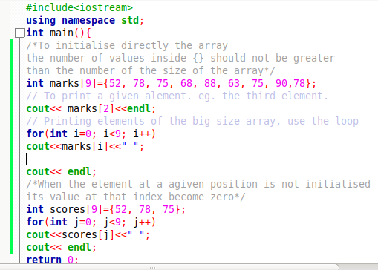

Example: one dimensional Array declaration, initialisation and access of its elements

Slide 23
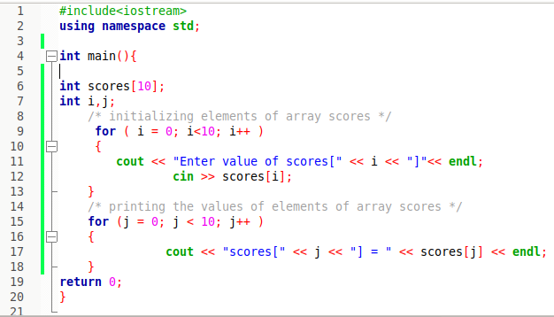
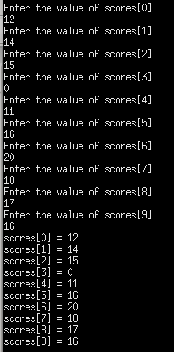
Example 2: Declare and initialise array after

Slide 24
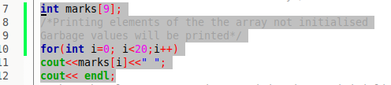
Example: Array Garbage values
If you access an array which is not initialised or with index beyond the size of the array, there is no warning or error. Instead the program will give you “garbage” data or it will crash.

Slide 25
Exercises
1a) Write a C++ program to calculate the sum and average of array scores. The size of the array should be provided as user input. Array elements also should be provided as user input.
b)Find the largest and smallest in the array.
c) Print the array in reverse(right to left)
d) Reverse the array

Slide 26
2. Array of characters
To easily handle strings, C++ Standard Library implements string data type that is
very useful in handling strings of characters. Because a string is made up of a group of characters, we can also represent them as arrays of char elements using the syntax:
char name[elements];
For example, to declare an array of characters called greetings, use the following
syntax:
char Greeting[10];
It is important to note that an array has few characters elements than its size because the last element must store a special character signals end of the string.This special character denoted by ‘\0’ (backslash and zero) is called null character.

Slide 27
Array of characters(next)
#include <iostream>
using namespace std;
int main(){
char Greeting[30];
cout << “Greet someone:”;
cin.get(Greeting, 30); //enter 29 characters
cout << “Greetings:”<<Greeting<< endl;
return 0;
}
It is important to note that an array has few characters elements than its size because the last element must store a special character signals at the end of the string.This special character denoted by ‘\0’ (backslash and zero) is called null character.
The program uses cin and get() function separated by a period to read characters and store a string of 29 characters. Note that in this case, the 30 th element is reserved for the null terminator \0 that denotes the end of a string.

Slide 28
Array of characters(next)
Here below example of character array:
Example:
char str[11]=”C++”;
The array size needs to be designated statically. More memory can’t be distributed at run time whenever required.
0 | 1 | 2 | 3 | 4 | 5 | 6 | 7 | 8 | 9 | 10
C | + | + | \0
The array str has a length of 11
1character=1byte
str[11]=>11bytes
Null character will terminate the array. If the null character is reached, reading stops there. If str[4]=’y’, the value of str array will still be C++ because e reached the null character. Then if we change str[3]=’x’ the char array will print C++XY output

Slide 29
Read and access character array: The loop is not necessary
Initialisation
Similar to the syntax of initialising array of numbers, we can initialise an array of characters with some predetermined sequence of characters within {} braces as follows:
char name[elements]={.,.,.,’\0’}; ex. char Greeting[6]={`H’,`e’,`l’,`l’,`o’,`\0’};
Note that, although Hello string has five characters, the sixth element is used to hold `\0’ that signals end of the string. However, instead of initialising an array with
comma-separated characters in {} braces, you can declare and initialise a string as follows:
char Greeting[]=“Hello”;

Slide 30
Reading and writing array of characters
The cin object consists of special function such as get() used to read a valid sequence of null-terminated characters from the input stream. Normally, cout statement and string library functions may be used to display a string, substring or characters.
#include <iostream>
using namespace std;
int main(){
char buffer[80];
cout << “Enter a string:”;
cin.get(buffer, 79); //enter 79 characters
cout << “String you typed is:”<<buffer<< endl;
return 0;
}
Question: What is the difference between cin, cin.get and cin.getline() when used to record array of characters?

Slide 31
Question 2: What is the output?
#include <iostream>
#include <cstring>
using namespace std;
int main() {
char String1[] = “Love your neighbour”;
char String2[80]= “Promote Peace”;
cout<< “String2 before copying: “ << String2 << endl;
strcpy(String2,String1);
cout<< “String1 is: “ << String1 << endl;
cout<< “String2 after copying: “ << String2 <<endl;
cout<< “String2 has: “ <<strlen (String2)<< “characters\n”;
return 0;
}

Slide 32
Note: Arrays
Since an array is a collection of homogeneous or same type elements, this means that an array can store all integers, all floating point numbers, all characters (array of character or strings) or any other complex data type, but all of the same type. Let’s see some important points to be pointed out about arrays.
1) An array is always stored in consecutive memory locations.
2) An Arrays can store multiple values which can be referenced by a single name, unlike a simple variable which stored one value at a time.
3) The array name is actually a pointer to the first location of the memory block allocated to the name of the array.
4) An array either be an integer, character or floating data type can be initialized only during declaration time and not afterwards.
5) There is no bound checking concept for arrays in C++. it means you can attempt to enter any number of values irrespective of the integer index specified inside square brackets, during the declaration of arrays. It is up to programmers to check upper bound or array.

Slide 33
2D Array
Structure and Algorithms

Slide 34
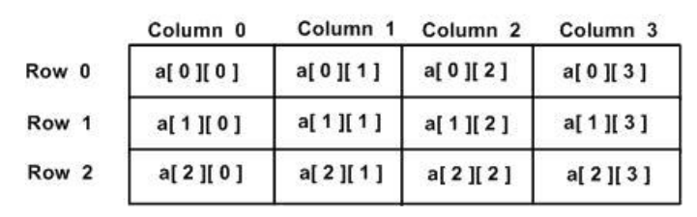
3.1 Introduction
A Two dimensional Array is a collection of a fixed number of elements (components) of the same type arranged in two dimensions.
The two dimensional array is also called a matrix or a table. The intersection of a
column and a row is called a cell. The numbering of rows and columns starts by 0
Example:
The array a[3][4] is an array of 3 rows and 4 columns. In matrix representation, it
looks like the following:
a[i][j] means that it is an element located at the intersection of row i and column
j each element is identified by its row and column

Slide 35
3. 2 Two dimensional array declaration
The syntax for declaring a two-dimensional array is:
SET Array name=Array [row size][column size] of Data type
Where row size and column size are expressions of positive integer values,
the two expressions row size and column size specify the number of rows and the
number of columns, respectively, in the array.
Examples:
1. SET marks=Array[2][7] of Integer
2. SET scores=Array[4][3] of Integer
Notice that the number of elements =row size*column size
The examples above defines respectively arrays named marks and scores with 14 (2*7) elements and 12 (4*3) elements. The expression marks [0] [0] will access the first element of the matrix marks and marks [1] [6] will access the last row and last column of array marks.

Slide 36
If the array marks[4][3] if filled with the elements 80, 75, 76, 75, 54, 72, 55, 70, 65, 85, 35 and 59, we get the following table.
 | Column 0 | Column 1 | Column2
Row 0 | 80 | 75 | 76
Row 1 | 75 | 54 | 72
Row 2 | 55 | 70 | 65
Row3 | 85 | 35 | 59

Slide 37
3.3Two dimensional array initialization
Two-Dimensional array is initialized by specifying bracketed values for each row. For the case of array of integers, the default values of each element is 0 while for others the default values for other types is not known.
For the case of an array of 3 rows and 4 columns, if the name is A and the type of elements is integer, the initialization is:
int A[3][4]={
{A[0][0], A[0][1], A[0][2], A[0][3]}, /* initializers for row indexed by 0 */
{A[1][0], A[1][1], A[1][2], A[1][3]}, /* initializers for row indexed by 1*/
{A[2][0], A[2][1], A[2][2], A[2][3]} /* initializers for row indexed by 2 */
};
The nested braces, which indicate the intended row, are optional The following
initialization is equivalent to the previous initialization.
int A[3][4]={A[0][0], A[0][1], A[0][2], A[0][3], A[1][0], A[1][1], A[1][2], A[1][3], A[2][0],A[2][1], A[2][2], A[2][3]};

Slide 38
An example of marks for 3 students in 4 courses. The array will look like this:
int marks[3][4]={
{80, 75, 76, 75},
{54, 72, 55, 70},
{65, 85, 35, 59}
};
Or
int marks[3][4]={80, 75, 76, 75,54, 72, 55, 70,65, 85, 35, 59};
If the table is called marks, marks [1][3]=70; where the row position is 1 and the
column position is 3. The expression marks [0] [0] will access the first element 80 of the matrix marks and marks [2] [3] will access the last row and last column.
 | Col0 | Col1 | Col2 | Col3
R0 | 80 | 75 | 76 | 75
R1 | 54 | 72 | 55 | 70
R2 | 65 | 85 | 35 | 59

Slide 39
Syntax to initializing two-dimensional arrays one by one
The two dimensional array marks which will hold 12 elements can be initialized like:
BEGIN
SET marks=Array[3] [4] of Integer
marks[0][0]=80
marks[0][1]=75
marks[0][2]=76
marks[0][3]=75
marks[1][0]=54
marks[1][1]=72
marks[1][2]=55
marks[1][3]=70
marks[2][0]=54
marks[2][1]=72
marks[2][2]=55
marks[2][3]=70
END

Slide 40
Q1: 1. Four secondary schools in RUHANGO District are displaying the number of students per year that they registered in 2015, 2016, 2017 and 2018.
a. How many rows and columns will be in the table that contains the
displayed data?
b. Declare an array called population to contain the needed data.
c. Initialize the array population with numbers of your choice

Slide 41
Q2: Given the array below
A[0][0] 1
A[0][1] 2
A[0][2] 3
A[0][3] 13
A[0][04] 17
A[0][5] 34
A[0][6] 19
A[1][0] 54
A[1][1] 23
A[1][2] 11
A[1][3] 45
A[1][04] 31
A[1][5] 65
A[1][6] 26
a. Give the size of the above array;
b. Declare array a;
c. Initialize the above array

Slide 42
3.4 Accessing two dimensional array element
Activity;
WRITE marks[1][2] ;
What are the meanings of the above statements
For example READ marks[1][2] stores a value in second row, third column
location of the array marks.
To store multiple values into array you must use a FOR loop.
Syntax:
FOR i=initial value TO upper limit DO
FOR j=initial value TO upper limit DO
READ array name[i][j]
i=i+1
j=j+1
END FOR
END FOR
Where i refers to the row position and j refers to the column position.
Initial value=lower limit

Slide 43
Example: Write an algorithm of a program that allows the user to enter (store) two
dimensional array elements
BEGIN
SET marks=Array [3] [8] of Integer
Use variable i as integer
Use variable j as integer
FOR i=0 TO 2 DO
FOR j=0 TO 7 DO
READ marks[i] [j]
i=i+1
j=j+1
END FOR
END FOR
END

Slide 44
Writing (displaying) two dimensional array elements
Writing (displaying) two dimensional array elements
To access two dimensional array elements’ values, we can also take the elements’
values of an array residing in the memory of the computer and write them in any
output device or a given file.
To write (display) elements from an array in an output device or other file, use a
WRITE function or other versions of it depending on the programming languages
used for programs writing together with the array name and location (index) of the
element. In that case the elements of a two dimensional array can be displayed by
the following syntax:
WRITE/PRINT ArrayName [i][j]
Where i refers to the row position and j refers to the column position.

Slide 45
Algorithm for reading and printing values in arrays:
Example: Write an algorithm that allows the user to enter(store) two dimensional
array elements and displays those stored elements.
BEGIN
SET scores=Array [3][8] of Integer
Use i As Integer
Use j As Integer
WRITE “ Enter two dimensional Arrays Elements”
FOR i=0 TO 2 DO
FOR j=0 TO 7 DO
READ Score[i][j]
i=i+1
j=j+1
END FOR
END FOR
Write two dimensional Arrays Elements
FOR i=0 TO 2 DO
FOR j=0 TO 7 DO
WRITE Score[i][j]
i=i+1
j=j+1
END FOR
END FOR
END

Slide 46
Exercise
1. Write an algorithm to do the following operations on a two dimensional
array A of size m x n.
Declare the array A;
Read the element ‘values into matrix of size m x n
Output the elements’ values of matrix of size m x n on the screen;
Calculate the sum of all elements’ values of matrix of size m x n;
Write a programme in C++ Language where you apply the above questions
Write a programme in C++ language that implements the above algorithm.

Slide 47
3 Consider a 2 by 3 array T
a. Write a declaration of T
b. How many rows does T have?
c. How many columns does T have?
d. How many elements does T have?
e. Write name of elements in second row
f. Write the name of element in third column
g. Write a single statement that sets the elements of T in row 1and column 2
to zero
h. Write a statement that inputs the values of T from keyboard
i.Write a statement that displays the elements of first row of T

Slide 48
How 2D is stored in Memory?
Suppose we want to store int marks[5][5].
In memory this 2D array will be stored as a 1D Array
How?
You have to skip=2rows+1 column
In each row, we have 5 elements; the number of cells to skip=2*5+1=11 cells. Then we insert in 12th cell at index 11
If R is rows and C columns, A[i][j] will be inserted at i*c+j index.
In a 2D array like int A[R][C], The formula for finding index for A[i][j]=i*C+j, That is why the value of C is mandatory. To create a 2 DImensional Array or pass a 2 Dimensional Array to a function, the number of columns is mandatory because our 2 Array is stored in memory as 1D Array and we have to find index using i*C+j.
marks[2][1]=7
 | 7
0 | 1 |  |  |  |  |  |  |  |  |  | 11 |  |  |  |  |  |  |  | 24
 |  |  |  |  |  |  |  |  |  |  | 7 |  |  |  |  |  |  |  | 24

Slide 49
Implementation using C++

Slide 50
How to create, Initialise Print a 2D MATRIX Row Wise
#include <iostream>
using namespace std;
int main(){
int marks[100][100];
int m, n; //How many Rows , How many Columns
cin>>m>>n;
for (int i=0;i<m;i++){ //Iterating over the rows
for (int j=0;j<n;j++){// Iterating over the columns
cin>> marks[i][j];
}
}
//Printing row wise
for (int k=0; k<m; k++){
for (int t=0; t<n;t++){
cout<<marks[k][t]<<" ";
}
cout<<endl;
}
return 0;
}
Print Row wise says: Loop over the rows and for each row print each column
Rows
 | Col1 | Col2 | Col3
R1 | 1 | 2 | 3
R2 | 4 | 5 | 6
Columns

Slide 51
How to create, Initialise and Print a 2D MATRIX:Column Wise
#include <iostream>
using namespace std;
int main(){
int marks[100][100];
int m, n; //How many Rows , How many Columns
cin>>m>>n;
for (int i=0;i<m;i++){ //Iterating over the rows
for (int j=0;j<n;j++){ // Iterating over the columns
cin>> marks[i][j];
}
}
//Printing column wise wise
for (int k=0; k<n; k++){
for (int t=0; t<m;t++){
cout<<marks[t][k]<<" ";
}
cout<<endl;
}
return 0;
}
Column wise says
Loop over the column and for each column, print each row
Columns
Rows
 | Col1 | Col2 | Col3
R1 | 1 | 2 | 3
R2 | 4 | 5 | 6

Slide 52
Initialising Two D Arrays
If we have 1D array int marks[4]. This can be initialised with int a [4]={1,3,4,6}
If we have 2D array int marks[2][3], this can be initialised by
Int marks[2][3]={{16,12,17},{15,11,19}};
Giving rows is optionally but giving columns is mandatory
Int marks[ ][3]={
{13,14,15}.
{16,17,13}.
{18,14,18}
};
This is valid

Slide 53
What will happen with the following?
Int marks[][3]={{12,14},{11,15,17},{18}};;
This is 3*3
Next if int A[3][4]={{16,15},{12,13}};
12 | 14 | 0
11 | 15 | 17
18 | 0 | 0
16 | 15 | 0 | 0
12 | 13 | 0 | 0
0 | 0 | 0 | 0

Slide 54
What is the output?
A
B
C
#include<iostream>
using namespace std;
void display(int marks[][], int r, int c)
{
for (int i=0; i<r;i++){
for (int j=0;j<c;j++){
cout<<marks[i][j]<<" ";
}
cout<<endl;
}
}
int main(){
int A[][2]={
{ 12,14},
{15,18}
};
display(A,2,2);
}
#include<iostream>
using namespace std;
void display(int marks[][2], int r, int c)
{
for (int i=0; i<r;i++){
for (int j=0;j<c;j++){
cout<<marks[i][j]<<" ";
}
cout<<endl;
}
}
int main(){
int A[][2]={
{ 12,14},
{15,18}
};
display(A,2,2);
}
#include<iostream>
using namespace std;
void display(int marks[][5], int r, int c)
{
for (int i=0; i<r;i++){
for (int j=0;j<c;j++){
cout<<marks[i][j]<<" ";
}
cout<<endl;
}
}
int main(){
int A[][5]={
{ 12,14},
{15,18}
};
display(A,2,5);
Int B[5][5]={{0}};
dispay(B,5,5}
}

Slide 55
Array functions
Array function are the functions that are used to perform operations on set of array. To access array elements, C++ provides various array functions like at(), get(), front(), back(), size(), max_size(), and many more where at() will access the array element using array index, front() will return first array element, back() will return last array element, size() will return the number of array elements, max_size() is used to show the maximum number of elements.

Slide 56
Array Size in C++
Basically, when we say the length of an array actually we refer to the total number of elements present in the corresponding array. For example, for an array as given below:
int array1[] = { 0, 1, 2, 3, 4 };
The size of the array or length of the array here is equal to the total number of elements in it. Which, in this case, is ‘5’.
There are different ways following which we can find the length of an array in C++, they are as follow:
Counting element-by-element,
begin() and end(),
sizeof() function,
size() function in STL,
Pointers.

Slide 57
Counting element-by-element
#include<iostream>
using namespace std;
int main()
{
int c;
int arr[]={1,2,3,4,5,6,7,8,9,0};
cout<<"The array is: ";
for(auto i: arr)
{
cout<<i<<" ";
c++;
}
cout<<"\nThe length of the given Array is: "<<c;
return 0;
}
Traversing throughout the given array and simultaneously counting the total number of elements we traversed can give us the length of the array right?
But for traversing we cannot use a for loop directly if we do not know the array length beforehand. This issue can be solved by using a simple for-each loop. Look at the code below carefully.
Note
1.The use of auto keyword. The auto keyword specifies that the type of the variable that is being declared will be automatically deducted from its initializer. In the case of functions, if their return type is auto then that will be evaluated by return type expression at runtime. Good use of auto is to avoid long initializations when creating iterators for containers.
2: For loop shortened for(auto i: arr) , for(int i: arr)
The array is: 1 2 3 4 5 6 7 8 9 0
The length of the given Array is: 10

Slide 58
Using begin() and end()
The length of an array can be calculated using the standard library’s begin() and end() functions. The two functions return iterators pointing to the start and the end of the corresponding array respectively. Take a close look at the given code,
#include<iostream>
#include<array>
using namespace std;
int main()
{
//Given Array
int arr[] = { 11, 22, 33, 44 };
cout<<"The Length of the Array is : "<<end(arr)-begin(arr); //length
return 0;
}

Slide 59
Using sizeof() function to Find Array Length in C++
The sizeof() operator in C++ returns the size of the passed variable or data in bytes. Similarly, it returns the total number of bytes required to store an array too. Hence, if we simply divide the size of the array by the size acquired by each element of the same, we can get the total number of elements present in the array.
using namespace std;
int main()
{ //Given array
int arr[] = {10 ,20 ,30};
//length calculation
int al = sizeof(arr)/sizeof(arr[0]); cout << "The length of the array is: " <<al;
return 0;
}
}

Slide 60
Array and Pointers

Slide 61
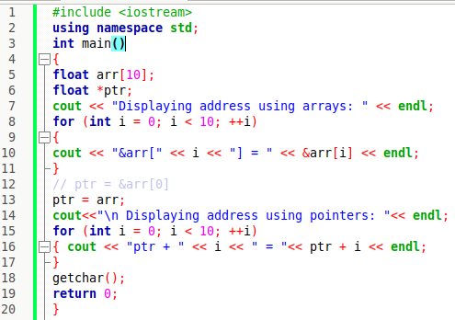
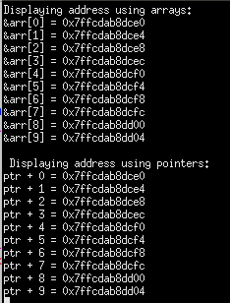
Arrays and pointers
int a[10];
int *aptr = a;
aptr = a ;// is equivalent to aptr = &a[0];
aptr+5;// is equivalent to &a[5]
*(aptr+5); // is equivalent to a[5]
The name of an array is a pointer to the first element in the array.

Slide 62
Array vs Pointer: Program to print the sum of array
#include <iostream>
using namespace std;
int main()
{
int sum,i;
int a[5]={10,20,30,40,50};
Int *p;
p=a;
for (sum = *a, p = a+1; p < a+5; p++)
sum += *p;
cout<<sum<<endl;
return 0;
}
#include <iostream>
using namespace std;
int main()
{
int sum,i;
int a[5]={10,20,30,40,50};
for (sum = *a, i = 1; i < 5; i++)
sum+= *(a + i);
cout<<sum<<endl;
return 0;
}

Slide 63
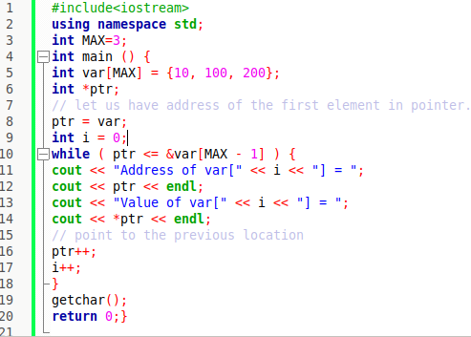

11 Comparison of pointers
Pointers may be compared by using relational operators, such as ==, <, and >.
The following program incrementing the variable pointer so long as the address to which it points is either less than or equal to the address of the last element of the array, which is &var[MAX - 1].

