Slide 1
JENKINS
CONTINUOUS INTEGRATION-JENKINS

Slide 2
CONTINUOUS INTEGRATION (CI): is the practice of automating the combination of code changes from multiple contributors into a single software project. It's a primary DevOps best practice, allowing developers to frequently merge code changes into a central repository where builds and tests then run.
How does CI works?
A development team is able to pull codes of software from repository(GitHub) modify and resubmit the codes updated into a continuous integration server and the server go on test and validate them, then pass it to the tester and tester checks functions of codes, if any errors found in codes Tester send it back to developer, if else deploys the software.

Slide 3
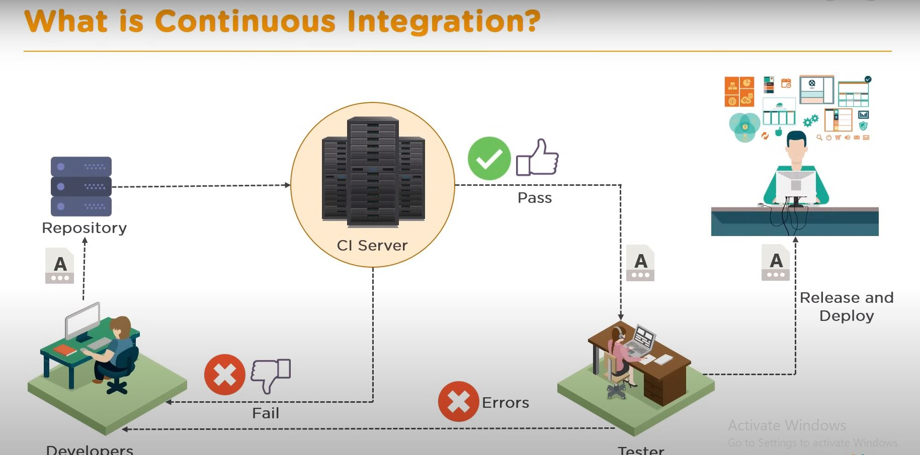
How Does Continuous Integration Work?

Slide 4
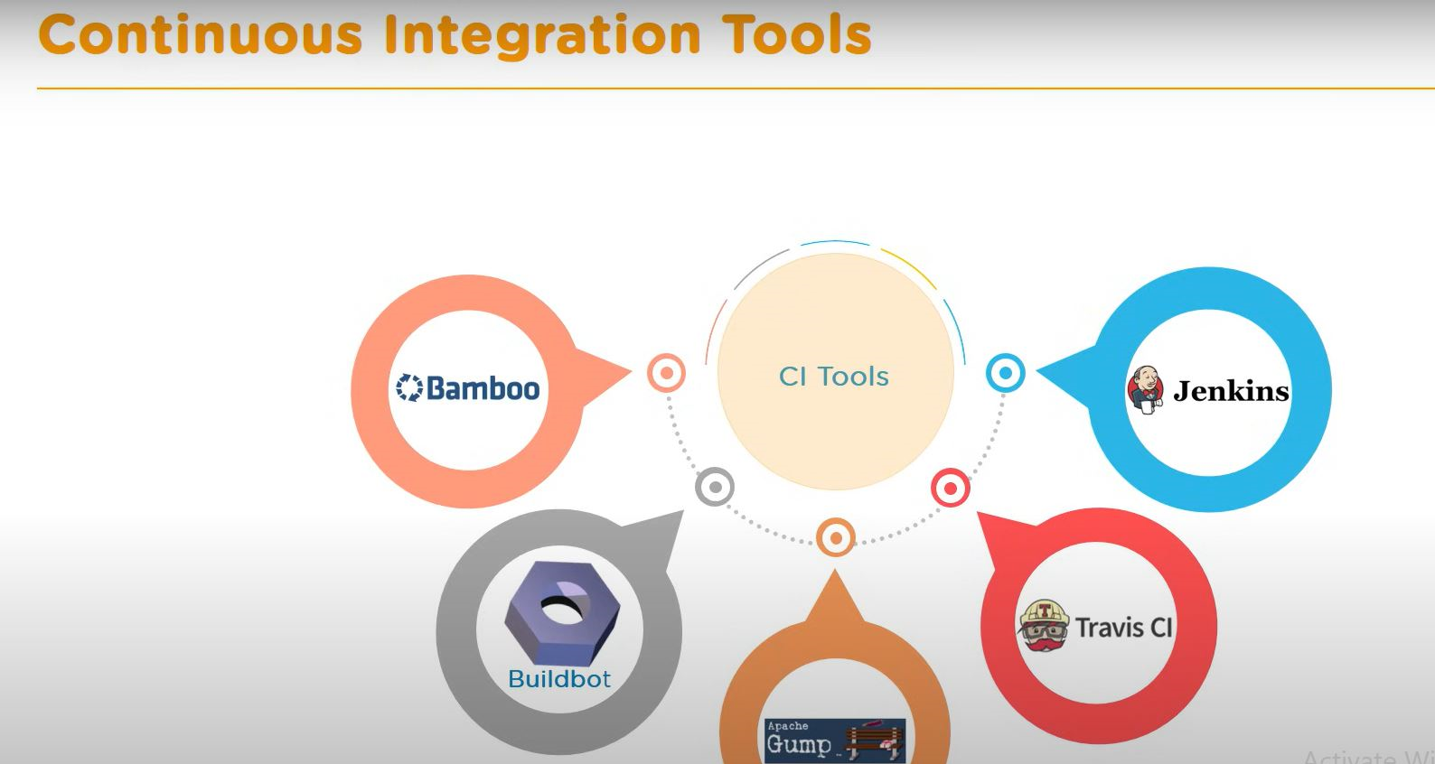
CONTINUOUS INTEGRATION Has many tools as shown below, but we will talk more on Jenkins:

Slide 5
Introduction for Jenkins:
Jenkins is a continuous integration tool that allows continuous development, test and deployment of newly created codes.
Jenkins is an open-source automation tool written in Java with plugins built for continuous integration. Jenkins is used to build and test your software projects continuously making it easier for developers to integrate changes to the project, and making it easier for users to obtain a fresh build.
With Jenkins, organizations can accelerate the software development process through automation. All the processes done through Jenkins pipeline.

Slide 6
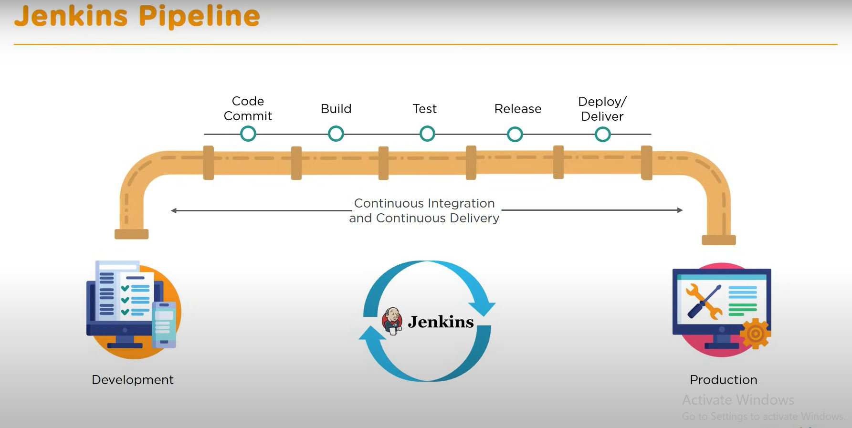

Slide 7
JENKINS PIPELINE
A Jenkins pipeline defines an entire application lifecycle, from building, testing, and deploying to post-production activities such as monitoring and feedback.
The pipeline can be version-controlled, allowing teams to have full control over the software delivery process and enabling easier collaboration and reproducibility.
The image below explain how Development team operates under Jenkin pipeline

Slide 8
FEATURE OF JENKINS TOOL
Adoption: Jenkins is widespread, with more than 147,000 active installations and over 1 million users around the world.
Plugins: Jenkins is interconnected with well over 1,000 plugins that allow it to integrate with most of the development, testing and deployment tools.
Security: Jenkins control access, manage user permissions and ensure the confidentiality and integrity of the CI/CD pipeline.
Automated build: allows the automation of process build, ensuring that data is compiled, packaged, and tested consistently. This reduce manual errors.

Slide 9
ADVANTAGES OF JENKINS
It is an open-source tool with great community support.
It is easy to install.
It is free of cost.
It is built with Java and hence, it is portable to all the major platforms.

Slide 10
What do you require to Use Jenkin Tool?
PREREQUISITES:
A machine with:
256 MB of RAM, although more than 2 GB is recommended
10 GB of drive space (for Jenkins and your Docker image)
2. The following software installed:
Java 11, 17, or 21
Docker (navigate to Get Docker site to access the Docker download that’s suitable for your platform)

Slide 11
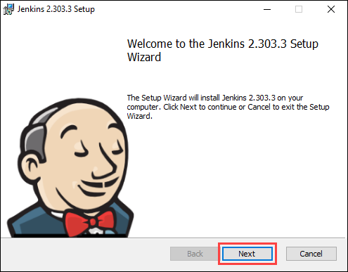
Steps To install Jenkins Tool on windows:
Step 1: Download Jenkins
Go to the Jenkins Download Page and download Jenkins for “Windows”.
Step 2: Local setup: Once the download is complete, run the jenkins.msi installation file.

Slide 12
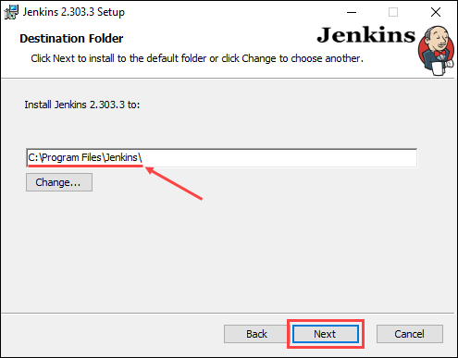
Step 3: Select the destination folder.

Slide 13
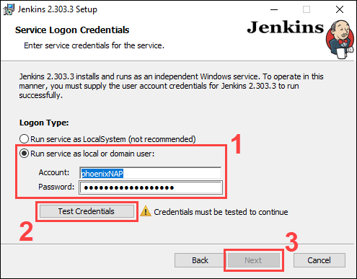
Step 4: Service login credentials

Slide 14
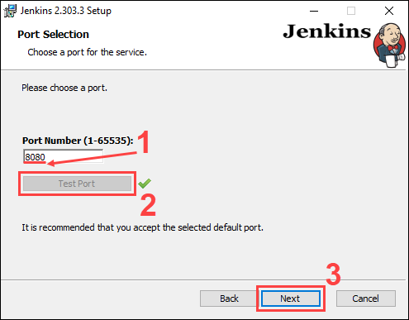
Step 5: Port selection

Slide 15
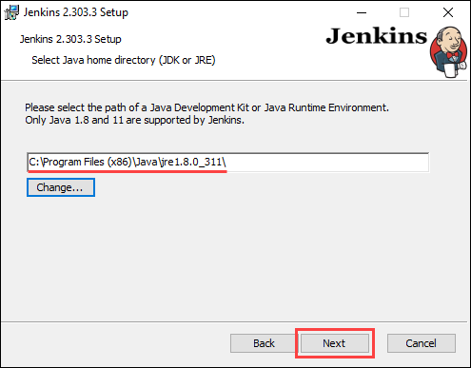
Step 6: Select the Java home directory

Slide 16
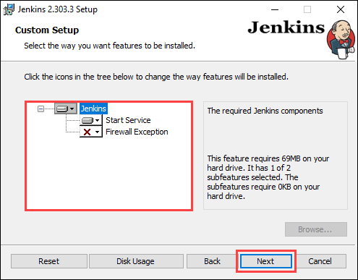
Step 7: Select the features

Slide 17
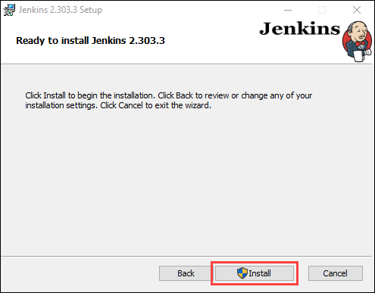
Step 8: Installation

Slide 18
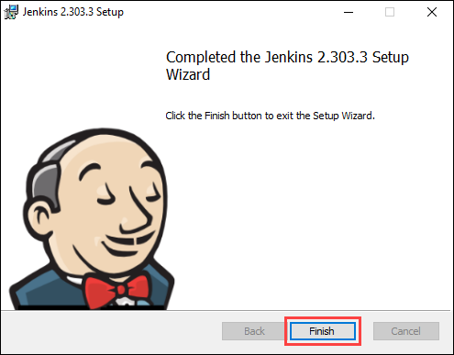
Step 8: Complete the Installation

