Slide 1
Merging In Git
Presented by
Prayas Pathak

Slide 2
Topics Covered
Merge
Types of Merge
Merge Conflict
Rebase
Aliases

Slide 3
Merge
Merge or Merging is git’s way of incorporating changes from other branches based on commits made in the branch.

Slide 4
Merging Process
Create a new branch from the main branch.
Checkout the newly created branch and perform some changes. Commit in the newly created branch.
Checkout main branch(receiving branch)
Merge the new branch into the main branch and delete the new branch.
git merge <branchName> merges the specified branch into the main branch.

Slide 5
Types of Merge
Fast Forward Merge
Three Way Merge

Slide 6
Fast Forward Merge
In this merge the HEAD pointer is simply moved from the main branch to the branch that is to be merged.
In this merge technique there are no further commits in the master branch after the creation of other branch.
There is no possibility of merge conflict in this merge technique.

Slide 7
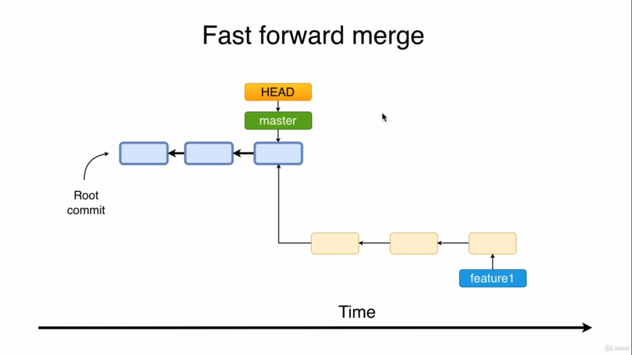

Slide 8
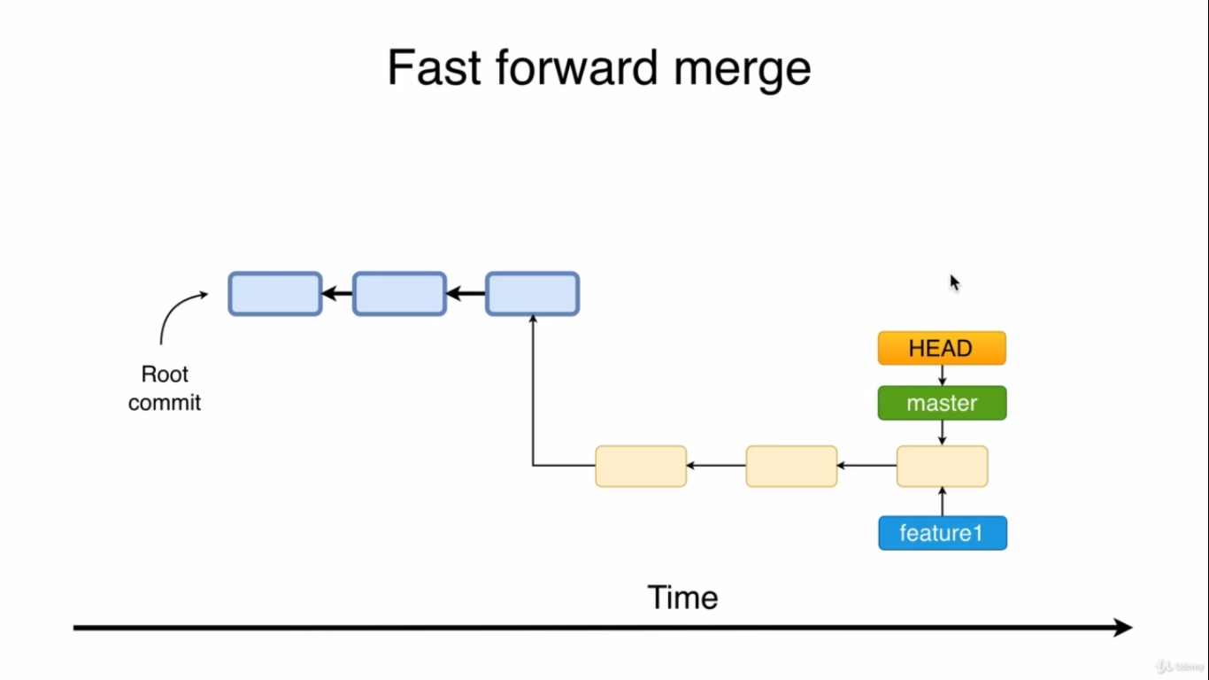

Slide 9
Three Way Merge
In this merge technique the merge is performed based on three commits.
1. Ancestor Commit
2. Last commit on main branch
3. Last commit on the currently checked out branch
A new commit is created on the main branch i.e the combination of the last commit on the main branch and the last commit on the other branch.

Slide 10
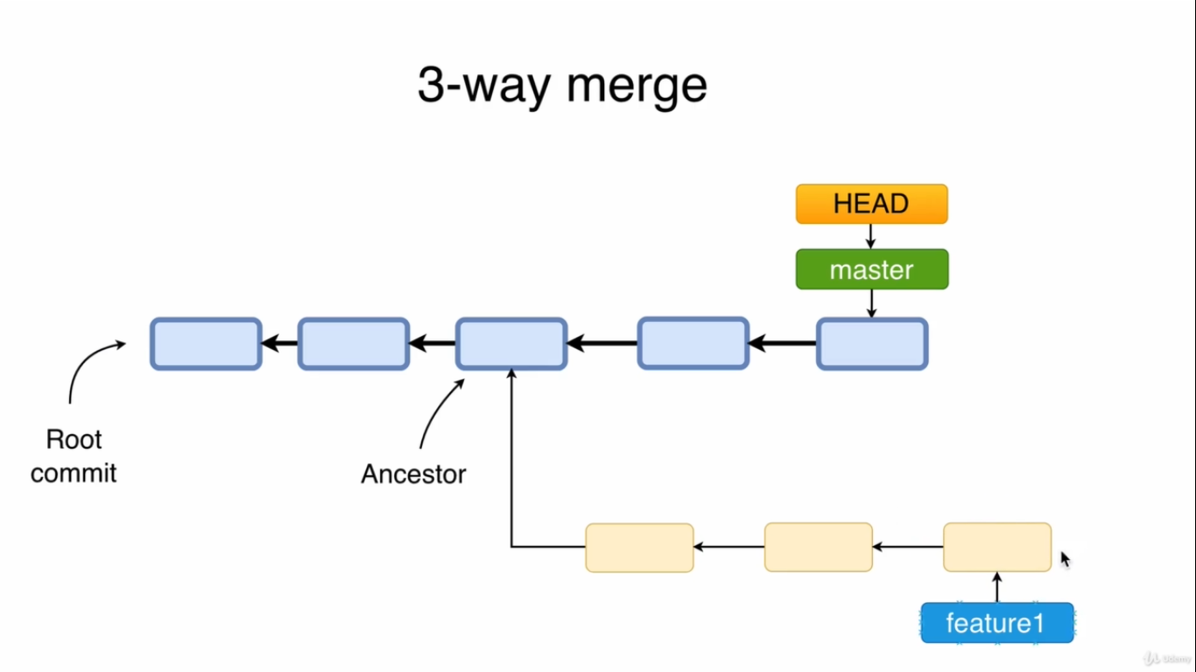

Slide 11
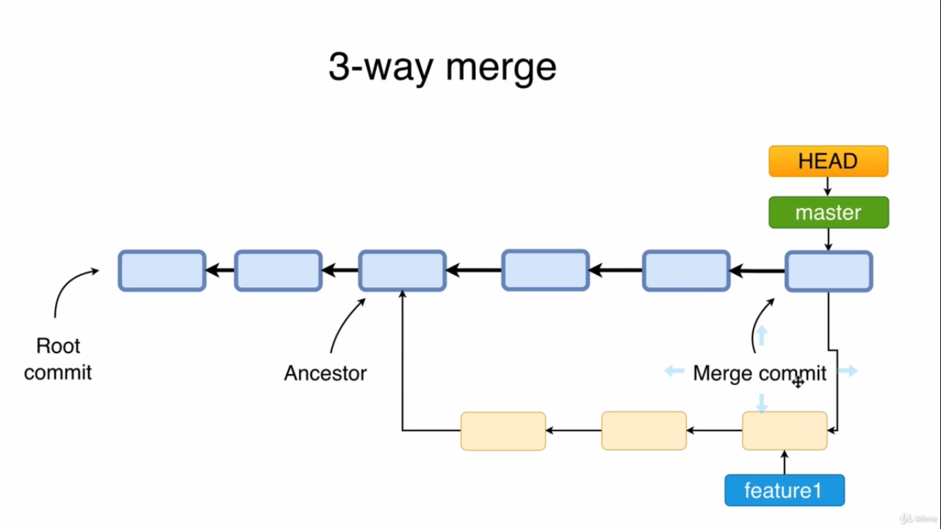

Slide 12
Merge Conflict
Merge conflicts occurs when the same file has been modified in different branches. The problem is git doesn't now which modification to apply when branches are merged.
Merge conflicts should be resolved manually.
Merge conflicts are only possible in three-way merge process.
During merge conflicts the staging area keeps three versions of the files that are affected by the conflict.
After resolving the conflicts add the files to the staging area using git add <fileName> command.
The path to the merge file is located at .git/MERGE_HEAD

Slide 13
Rebasing
Rebasing is performed on branches.
Rewrites history.
Makes history linear.
Doesn't keep the entire history of all commits.
Never use rebasing on main or master branch as it is a destructive operation.

Slide 14
Rebasing Process
Checkout the branch(feature-1) to be merged.(git checkout feature1)
Rebase the feature-1 branch on top of the base branch(main branch) (git rebase main)
Checkout base branch (git checkout main)
Merge the feature-1 branch into the base branch (git merge feature1)

Slide 15
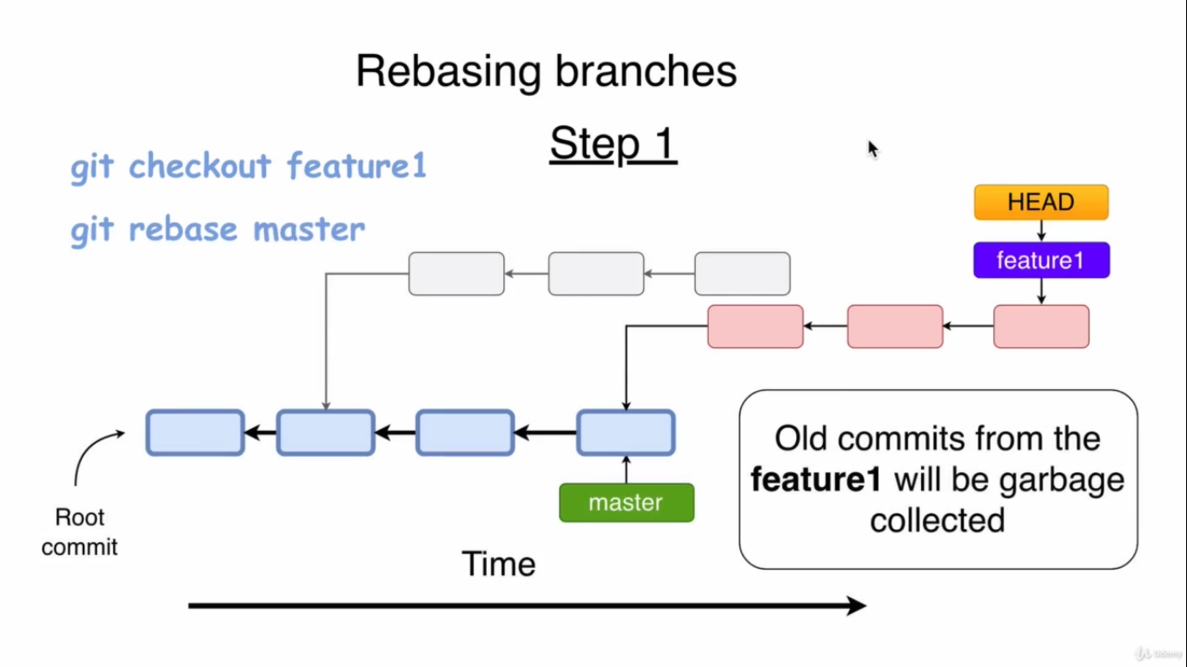

Slide 16
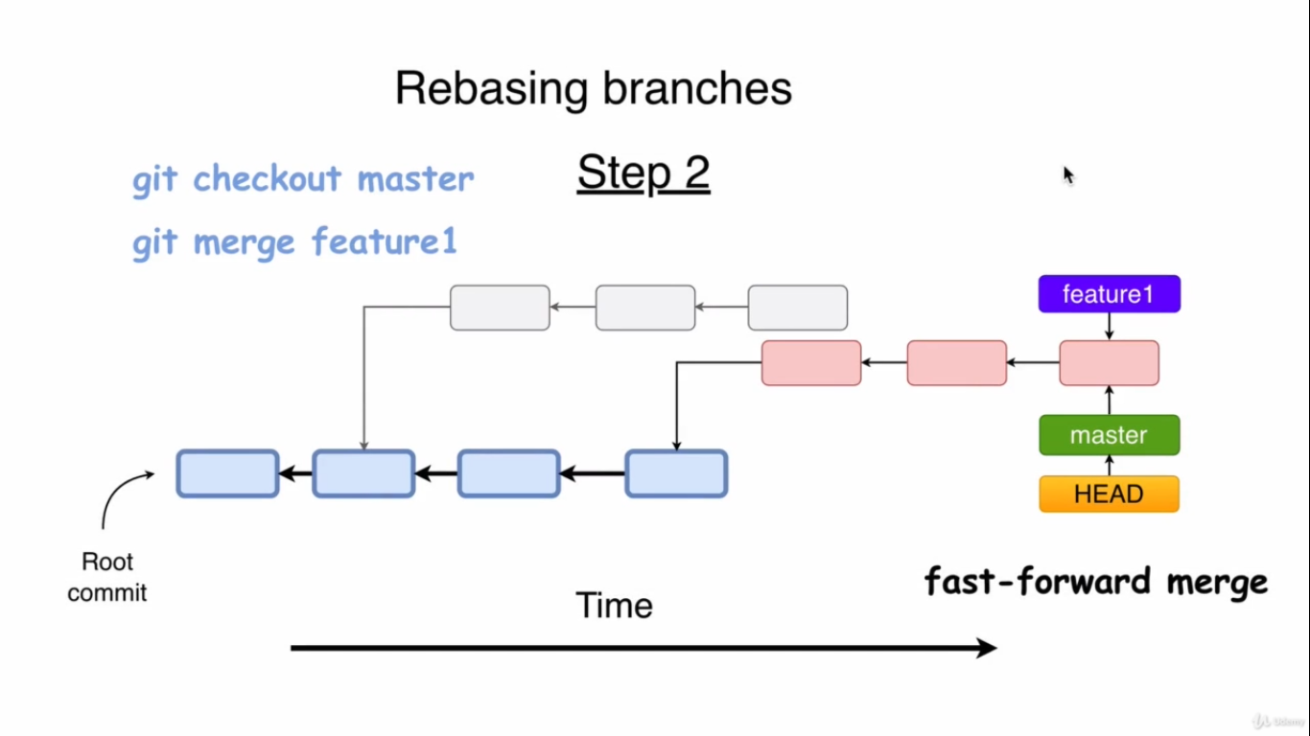

Slide 17
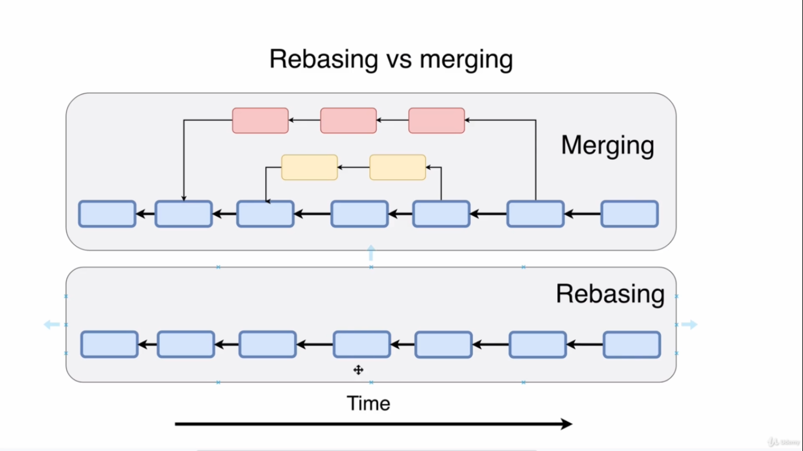

Slide 18
Alias
Git aliases are a powerful work flow tool that create shortcuts to frequently used Git commands.
Using Git aliases will make you a faster and more efficient developer.
Aliases can be used to wrap a sequence of Git commands into new faux(imitate/false) Git command.

Slide 19
Creating an alias
git config —global alias.st “status -s”
Configures the git to run ‘git status’ when ever git st command is issued by the user.
git config —global alias.lg “log —pretty=format:’%an committed %h.’”
Aliases in git are configured in the .gitconfig file at the [alias] section.

