Slide 1

GIT & GITHUB WORKSHOP
KBC IT CLUB PRESENTS

Slide 2

OVERVIEW
DAY 1 |  |  | Time
 | Chapters | Topic | (M)
 | Introduction 33min | Version Control System, What is VCS | 1
 |  | Why VCS is essential today? | 2
 |  | Why VCS is essential today?
 |  | Important of VCS and other VCS | 2
 |  | What is Git? | 5
 |  | Git vs GitHub | 3
 |  | Installing Git | 10
 |  | Quiz/task | 10
DAY 1 PART II
 | Know Your Terminal 25min | Introduction to Terminal | 10
 |  | Moving Between Directories | 5
 |  | Working with Files & Directories | 5
 |  | Other linux basic commands | 5

Slide 3
OVERVIEW
DAY 1 PART II
 | Git Basics 1hr 7min | The Git Workflow | 10
 |  | Creating a new Repository | 5
 |  | Adding & Removing Files | 5
 |  | Your First Commit | 2
 |  | Git Checkout | 7
 |  | Git Revert & Reset | 8
 |  | Types of Git Reset | 5
 |  | Creating a .gitignore | 5
 |  | Demonstration of git Nano, vim, notepad,vi | 10
 |  | Task | 10

Slide 4
OVERVIEW
DAY 2
 | Git Branches 1hr15min | What are Branches | 10
 |  | Importance of branching(master & main) | 5
 |  | Working with Branches | 15
 |  | Editing Branches | 10
 |  | Important commands | 10
 |  | Merge | 15
 |  | Types of merge | 10
 | Git Branches 50min | Detailed types of merge | 15
 |  | Merge conflict | 15
 |  | Rebase | 10
 |  | Alias | 10

Slide 5
OVERVIEW
DAY 3
 | Github 23min | What is GitHub? | 3
 |  | Creating a GitHub Account | 5
 |  | Creating our First GitHub Repository | 5
 |  | Viewing Other Repositories | 7
 |  | Download GitHub Repositories | 3
 | Git Remotely 47 | Creating a new Remote Repository | 7
 |  | The Push & Pull System | 10
 |  | Pushing & Pulling to & from a GitHub Repository | 10
 |  | Deleting Remote Branches | 5
 |  | What is SourceTree? | 15

Slide 6
SECTION 1: Introduction

Slide 7
What is a ‘version control system’ ?
a way to manage files and directories
track changes over time
recall previous versions
‘source control’ is a subset of a VCS.

Slide 8
What is a ‘version control system’ ?
A version control system (often called a source code control system) does these things:
Keeps multiple (older and newer) versions of everything (not just source code)
Requests comments regarding every change
Allows “check in” and “check out” of files so you know which files someone else is working on
Displays differences between versions

Slide 9
Why version control system?
Scenario 1:
Your program is working
You change “just one thing”
Your program breaks
You change it back
Your program is still broken--why?
Has this ever happened to you?

Slide 10
Why version control system?
Scenario 2:
Your program worked well enough yesterday
You made a lot of improvements last night...
...but you haven't gotten them to work yet
You need to turn in your program now
Has this ever happened to you?

Slide 11
Why version control system?
Scenario 3:
You change one part of a program--it works
Your co-worker changes another part--it works
You put them together--it doesn’t work
Some change in one part must have broken something in the other part
What were all the changes?
Has this ever happened to you?

Slide 12
Benefits of version control
For working by yourself:
Gives you a “time machine” for going back to earlier versions
Gives you great support for different versions (standalone, web app, etc.) of the same basic project
For working with others:
Allows developers to work simultaneously.
Does not allow overwriting each other’s changes.
Maintains a history of every version.

Slide 13
Other version control
(1972) Source Code Control System (SCCS) - closed source, part of UNIX
(1982) Revision Control System(RCS) - open source
(1986) Concurrent Versions System (CVS) - open source
(2000) Apache Subversion (SVN) - open source
(2000) BitKeeper SCM
- closed source, proprietary, used with source code management of Linux kernel
- free until 2005
- distributed version control

Slide 14
Types of version control system
Centralized version control system (CVCS).
Distributed/Decentralized version control system (DVCS).

Slide 15

What is git?
created by Linus Torvalds, April 2005
replacement for BitKeeper to manage Linux kernel changes
a command line version control program
uses checksums to ensure data integrity
distributed version control (like BitKeeper)
cross-platform (including Windows!)
open source, free
An acronym for Global Information Tracker, [not official]

Slide 16
Why is it useful?
Keep track of changes to files
Review and revert back to old versions
Synchronize files between different locations
Test changes without losing the original copy
Why Git and not some other software?
Performance
Flexibility
Popularity

Slide 17

Git vs GitHub
Git is a free and open source distributed version control system designed to handle everything from small to very large projects with speed and efficiency
GitHub is a web-based Git repository hosting service, which offers all of the distributed revision control and source code management (SCM) functionality of Git as well as adding its own features.

Slide 18
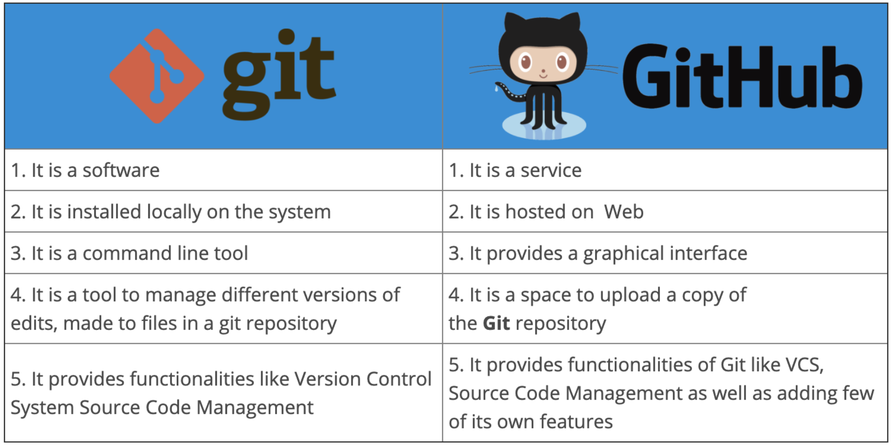
Git vs github

Slide 19
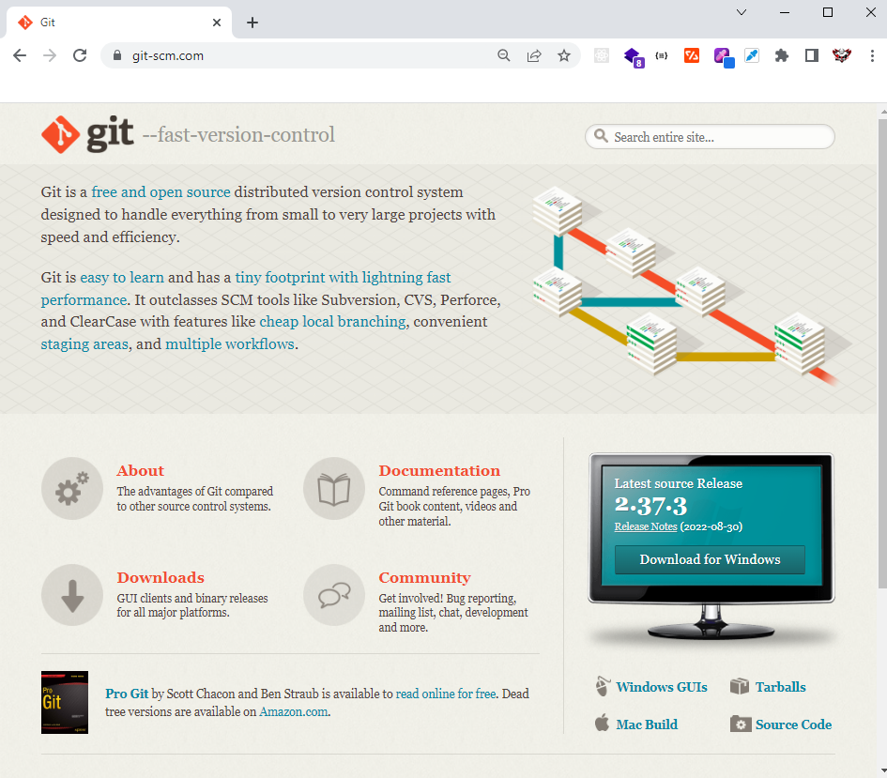
Installation and setup
Installing Git:
http://git-scm.com/download (try this first)
Or
Linux: apt-get install git-core
Mac:
http://code.google.com/p/git-osx-installer/

Slide 20
Installation and setup
Confirm that you have git:
Open your terminal and run ‘git’
If you see a ‘command not recognized’ error, you probably haven’t installed git yet.
We can solve your issue

Slide 21
SECTION 2: Know Your Terminal

Slide 22
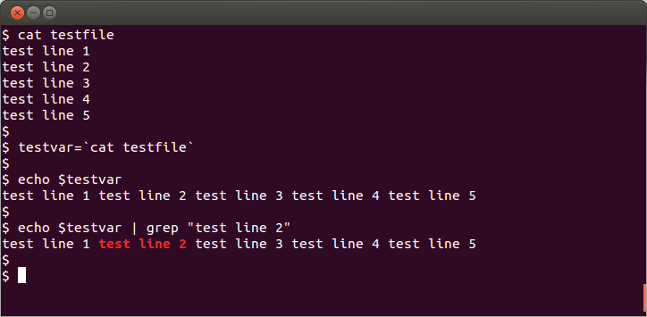
The Terminal
This section will completely focus on learning the terminal.
We will learn how to use the terminal from scratch, starting from opening the program.
The terminal is a required skill when using the raw version of Git.
All developers need to learn how to use the terminal at some point in their lives.

Slide 23

The terminal commands
Commands | description
pwd | prints the current working directory.
cd <directoryName> or <directoryPath> | changes to the specified directory
cd | allows the user to move back and forth between last working directory and present working directory.
logout or ctrl+ d or exit | exits the current terminal session
chsh –s | changes the shell for the current user.

Slide 24
The terminal commands
Commands | description
touch <fileName> | creates an empty file with the specified name.
mkdir <directoryName> | creates an empty directory with the specified name.
rm <fileName> | removes the file of the specified name from the system.
rmdir <directoryName> | removes the directory from the system. It only removesempty directories.
rm -r <directoryName> | removes the directory recursively from the fileSystem.
echo "Content to be stored" >> <fileName> | stores the specified content intothe specified file.
cat <fileName> | reads the content of the specified file.
grep "content to be searched" | shows the specified content from the output orfrom a file.

Slide 25
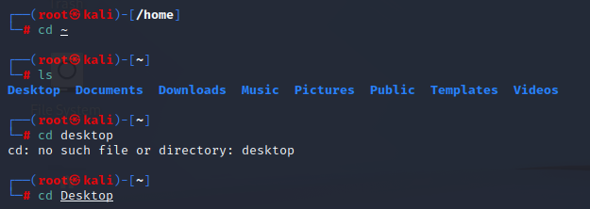
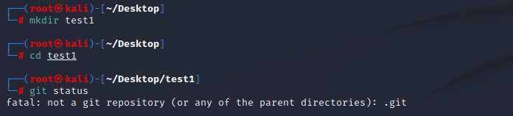
Terminal examples

Slide 26
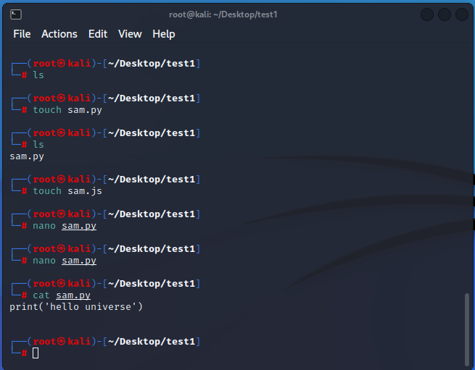
Terminal examples

Slide 27
SECTION 3: Git BASICS

Slide 28
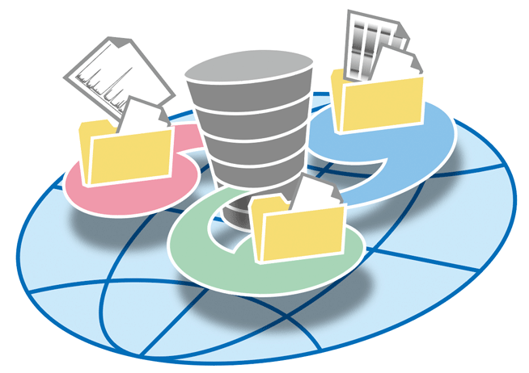
Repositories
Repositories, usually called ‘repos’, store the full history and source control of a project.
They can either be hosted locally, or on a shared server, such as GitHub.
Most repositories are stored on GitHub, while core contributors make copies of the repository on their machine and update the repository using the push/pull system.
Any repository stored somewhere other than locally is called a ‘remote repository’.

Slide 29
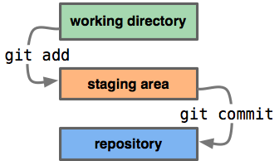
Repos vs Directories
Repositories are timelines of the entire project, including all
Directories, or ‘working directories’ are projects at their current state in time.
Any local directory interacting with a repository is technically a repository itself, however, it is better to call these directories ‘local repositories’, as they are instances of a remote repository.

Slide 30
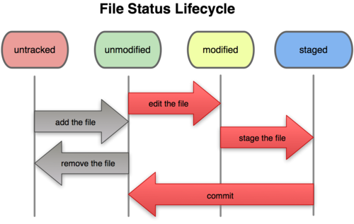
Workflow Diagram

Slide 31
Directory structure
Working Directory
The working directory is a single checkout of one version of the project. These files are pulled out of the git repository and placed on the disk for the user to modify.
Staging Area
The staging area is a file, generally contained in your Git directory, that stores information about what will go into your next commit. Its technical name in Git parlance is the “index”, but the phrase “staging area” works just as well.
Git Directory
The Git directory is where Git stores the metadata and object database for your project. This is the most important part of Git, and it is what is copied when you clone a repository from another computer

Slide 32
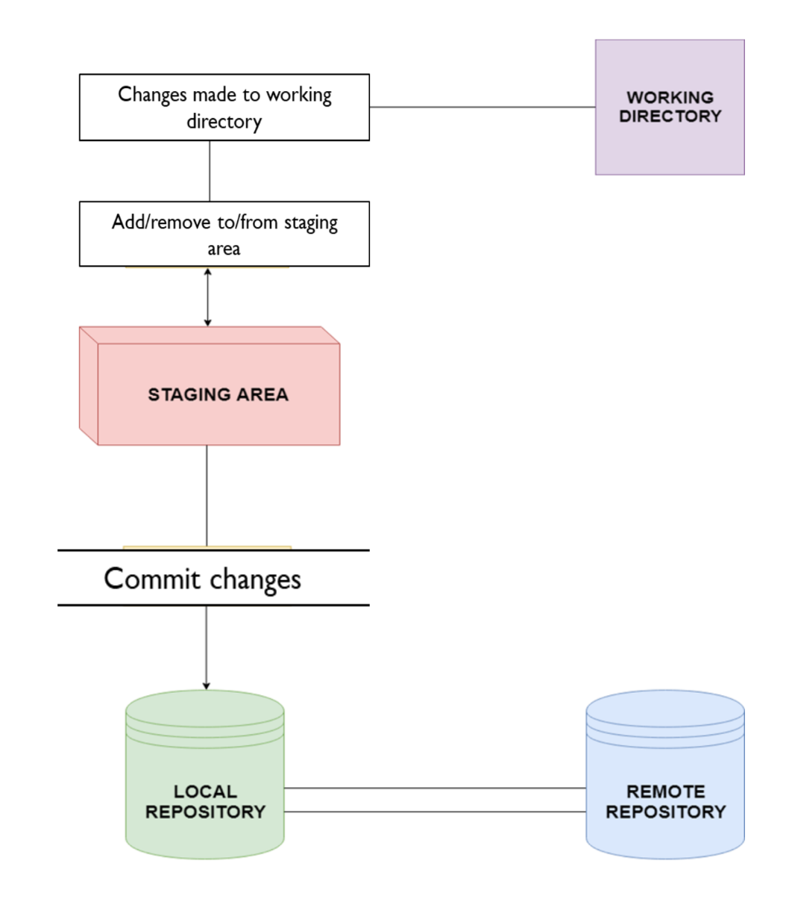
Workflow Diagram
This diagram shows a little bit about how the basic Git workflow process works
The staging area is the bundle of all the modifications to the project that are going to be committed.
A ‘commit’ is similar to taking a snapshot of the current state of the project, then storing it on a timeline.
Commit changes

Slide 33
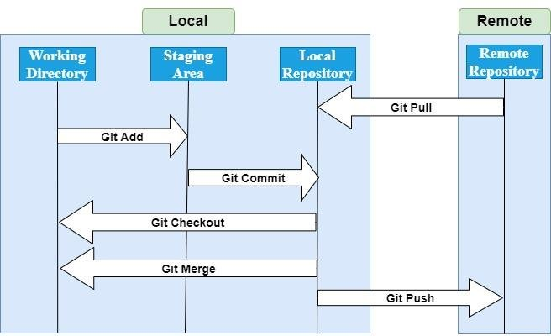
Workflow Diagram

Slide 34
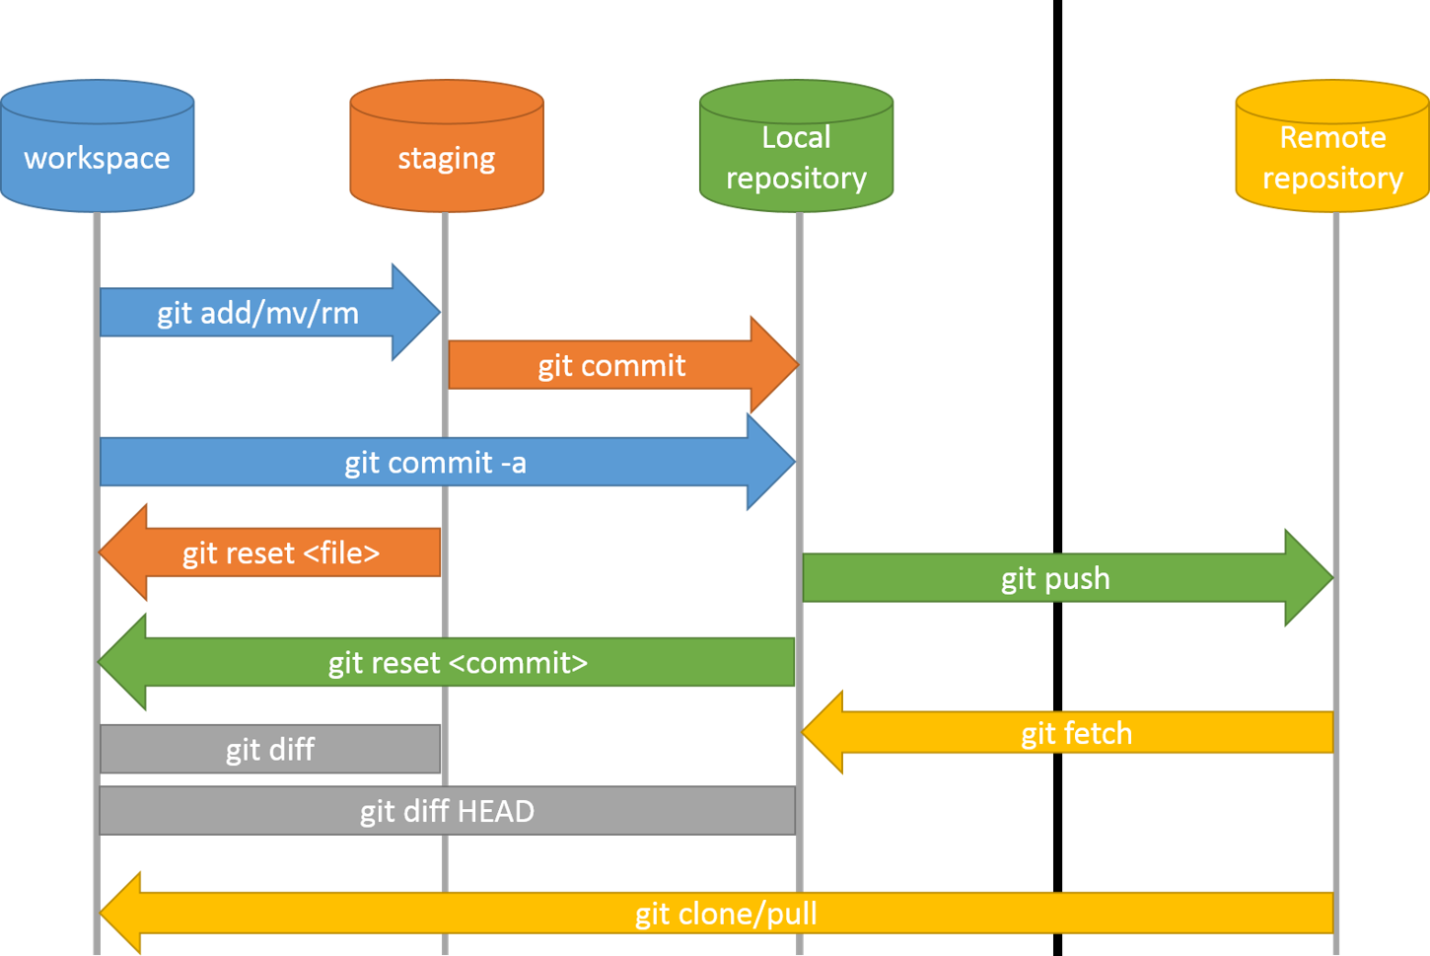
Workflow Diagram

Slide 35
Installation and setup
Configuring git:
Your commits will have your name and email attached to them. To confirm that this information is correct, run the following commands:
$ git config --global user.name
> should be your name, i.e. Jon Rosado
$ git config --global user.email
> should be your email, i.e. jon.rosado42@gmail.com
To fix either, just add the desired value in quotes after the command:
$ git config --global user.name “Jon Rosado”
$ git config --global user.email “jon.rodado42@gmail.com"

Slide 36
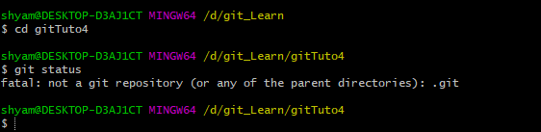
Initializing a new repository
Command: git init
command initializes a new repository on the specified location on the filesystem.
The new repository contains the .git sub-directory that stores the git objects.
Make Git start to “watch” for changes in the directory
Without “git init” command if we run git command we get errors

Slide 37
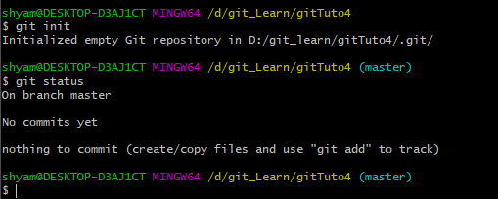
Initializing a new repository
After successful “git init” command if we get as below:

Slide 38
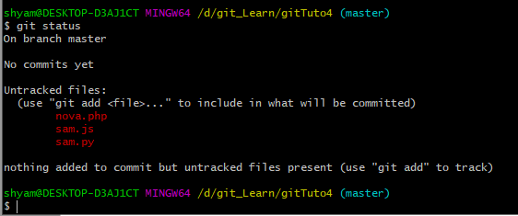
Initializing a new repository
After successful “git status” command to check status we get as below:

Slide 39
The Git commands for staging area
Commands | description
git add <fileName> or git add . | adds the specified files or the entire directory tothe git staging area.
git rm --cached <fileName> | removes the specified file from the staging area.
git status | shows the current status of the working directory.
git ls-files | shows the files present in the staging area.
git diff | command shows the changes made between in the file by comparing two versions of the same file(one from the working directory and the other from the staging area.)
git show <SHA1> hash or git show HEAD~[number of commits to be omitted from HEAD pointer] | displays the content of each file pointed by the specific commit.

Slide 40
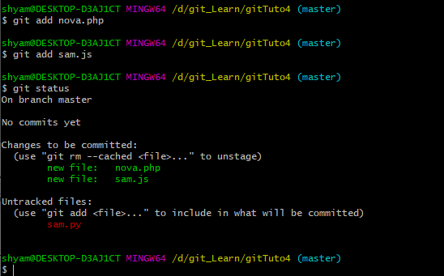
Working with Staging area
After successful “git add <filename> or git add . ” command to check status we get as below:

Slide 41
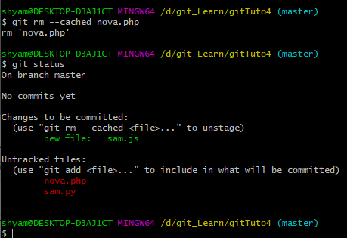
Working with Staging area
Files are removed from staging area with: git rm –cached <file>

Slide 42
The Git commands for committing and checkout
Commands | description
git commit -m "commit message" | commits the current state of the staging area to the .git repository.
git checkout <SHA1 hash> | checkout to the specific commit. The working directory is in DETACHED HEAD state.
git checkout <branchName> | checkout to the specific branch.
git commit --amend "New Commit message" | overwrites the last commit in the git database.
NOTE: In DETACHED HEAD state no commits should be made as they are not referenced by any other commits or branches. Any commits made in this state will be garbage collected by the git.

Slide 43
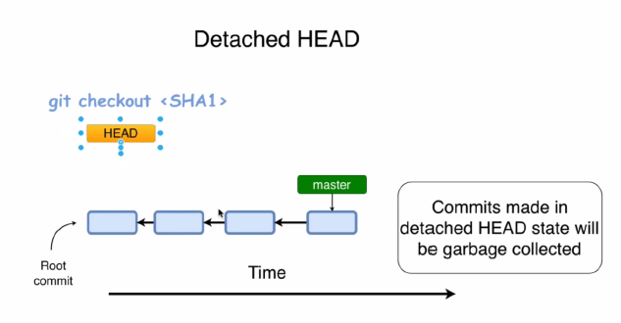
The Git checkout
Detached HEAD
When a commit is checked the status of the working directory is said to be detached head state.
Any commits made in the detached state will be lost if it is not attached to any branch.

Slide 44
Viewing Commit Logs
Commands | description
git log | shows the detailed description log of all commits made in the current git repositiory.
git log --oneline | shows the short description of log of all commits
git log --graph | shows the graph of commits.
git log --stat | shows the status of files for each commit.
git log -p | shows the actual change in each file for each commit.
git shortlog | shows the summary of all commits made in the repository. The output of this command will be sorted on the basis of author name.
git log --author="authorName" | filters the commits log and displays the commitsmade by the specified author.
git log --grep="word to be searched" | filters the commits log and displays thecommit logs that contains the specified word in the commit message.
git log --merges | shows only merge commits.

Slide 45

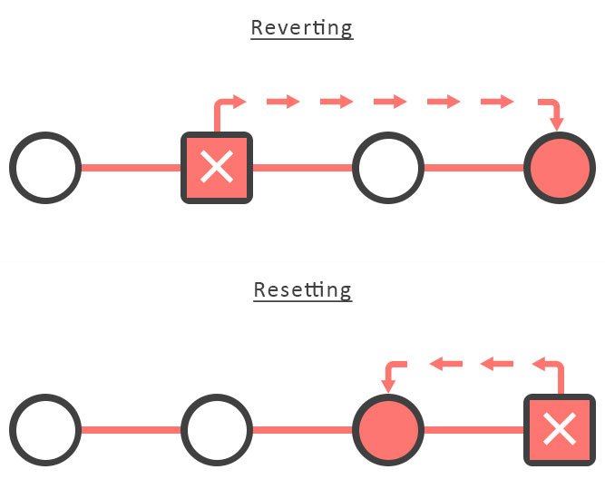
Git Revert
The purpose of the git revert command is to remove all the changes a single commit.
For example, if a past commit added a file named index.html to the repo, a git revert on that commit will remove the index.html file from the repo.
When you revert a Git commit, the changes from the targeted commit are removed from your local workspace. A new commit is also created to reflect the new state of your repository.
The git revert command is a simple way to remove a bug introduced to the version control system at some point in the past.

Slide 46
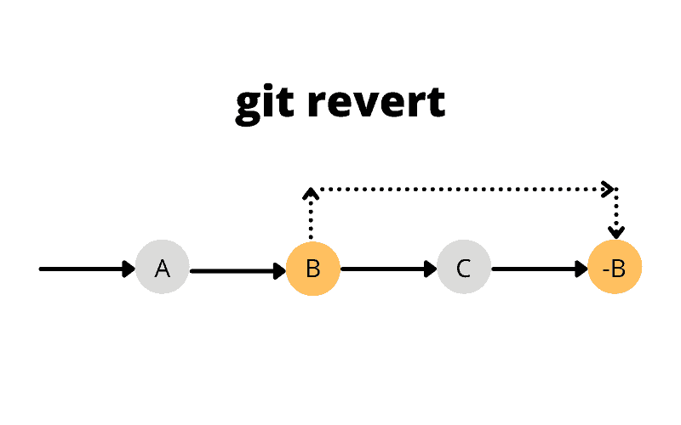
Steps to revert a Git commit
Steps to git revert a commit and undo unwanted changes are the following:
Locate the ID of the commit to revert with the git log or reflog command.
Issue the git revert command and provide the commit ID of interest.
Supply a meaningful Git commit message to describe why the revert was needed.

Slide 47
Git Reset
it reset is a powerful command that is used to undo local changes to the state of a Git repo.
Git reset operates on "The Three Trees of Git".
These trees are the Commit History (HEAD), the Staging Index, and the Working Directory.
There are three command line options that correspond to the three trees.
The options
--soft,
--mixed,
--hard
can be passed to git reset.

Slide 48
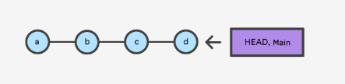
How it works
At a surface level, git reset is similar in behavior to git checkout.
Where git checkout solely operates on the HEAD ref pointer,
git reset will move the HEAD ref pointer and the current branch ref pointer.
Lets see an example for following commit

Slide 49
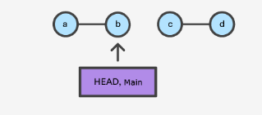
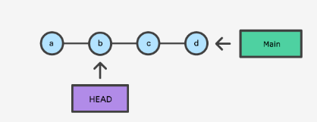
How it works
git checkout b
git reset b
With git reset, the main ref is pointing to b.
git reset, moves both the HEAD and branch refs to the specified commit.
With git checkout, the main ref is still pointing to d.
The HEAD ref has been moved, and now points at commit b.
The repo is now in a 'detached HEAD' state.

Slide 50
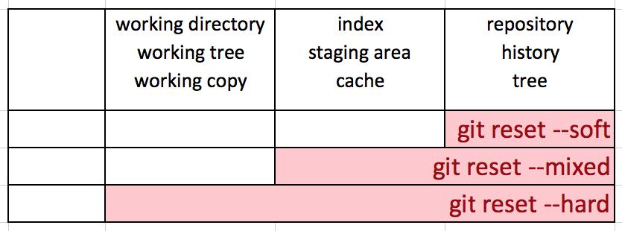
Types of Git Reset: --soft
When the --soft argument is passed, the ref pointers are updated and the reset stops there. Git reset operates on "The Three Trees of Git".
The Staging Index and the Working Directory are left untouched.
This behavior can be hard to clearly demonstrate.
For example, if you reset back one commit, your environment would be the same, but the commit you are on would be changed.
This is useful if you are trying to get rid of a problem with the commit (eg. Spelling error)

Slide 51
Types of Git Reset: --mixed
This is the default operating mode.
The ref pointers are updated. The Staging Index is reset to the state of the specified commit.
Any changes that have been undone from the Staging Index are moved to the Working Directory.
This doesn’t remove the files; they are still in the working directory. However, you have to commit them again if you want to re-include them.
This is primarily useful for when you want to remove a file you accidentally committed.

Slide 52
Types of Git Reset: --hard
This is the most direct, DANGEROUS, and frequently used option.
When passed --hard The Commit History ref pointers are updated to the specified commit.
Then, the Staging Index and Working Directory are reset to match that of the specified commit.
Any previously pending changes to the Staging Index and the Working Directory gets reset to match the state of the Commit Tree.
This means any pending work that was hanging out in the Staging Index and Working Directory will be lost.
This is mostly used when some irreversible error has been made, and cannot be removed manually without completely resetting the program.

Slide 53
How it works
git checkout b
git reset b
With git reset, the main ref is pointing to b.
git reset, moves both the HEAD and branch refs to the specified commit.
With git checkout, the main ref is still pointing to d.
The HEAD ref has been moved, and now points at commit b.
The repo is now in a 'detached HEAD' state.

Slide 54
Creating a .gitignore
Ignoring Files in Git
Files and directories that do not need to be tracked by git should be kept in the .gitignore file.
.gitignore file should be kept at the root of the repository.
.gitignore file must be committed.
git rm --cached 'filename’ deletes the file from the staging area. If the filename is placed in the .gitignore file then the file will be ignored even if it has been committed in the past.

Slide 55

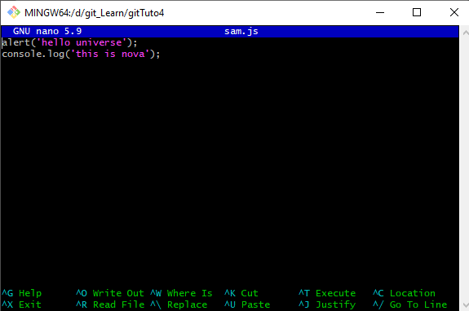
Text editor for git (nano, vim, vi, notepad)
NANO: command:- nano <filename>
With touch command we create empty files to edit those files we have to use one of above mentioned editor. Nano is one of the editor where we edit files.
To save : Ctrl+O
To exit : Ctrl +X

Slide 56
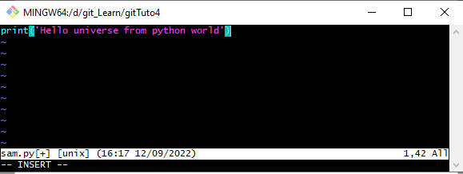
Text editor for git (nano, vim, vi, notepad)
NANO: command:- vim <filename>
With touch command we create empty files to edit those files we have to use one of above mentioned editor. Vim/Vi is one of the editor where we edit files.
To save and exit : Press Esc key than type ‘:wq’ and
Press enter

