Slide 1

GIT & GITHUB WORKSHOP
KBC IT CLUB PRESENTS

Slide 2
Table of contents
01
Github and its uses
02
Create Github Account
03
Create Repositories
04
Download Repositories

Slide 3

GITHUB ?
GitHub is an online software development platform allowing you to store and work with your repositories .

Slide 4
GitHub’s Uses
Enhanced collaboration
Easy file management
Social networking
Open source projects

Slide 5
02
Creating a GitHub account

Slide 6
Repositories
A directory or storage space where your projects can live. You can keep code files, text files, image files, you name it, inside a repository.

Slide 7
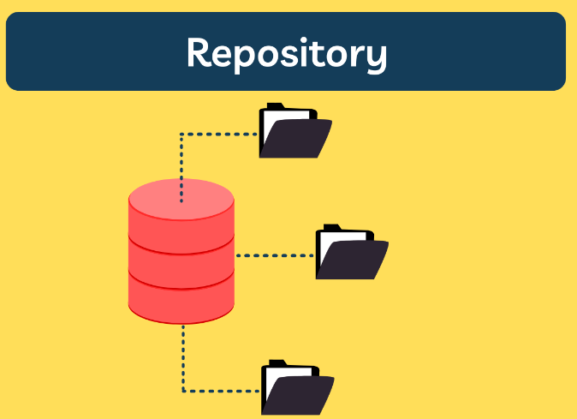

Slide 8
Thank you

