Slide 1
dashboard
400
professor
400
section
400
room
users
college
section
curriculum
Room assignment
Generate schedule
Audit logs

Slide 2
dashboard
400
professor
400
section
400
room
users
college
section
^
Department
Program
^
curriculum
Room assignment
Full Name | Specialization | Degree | Time Availability | Faculty Type | Position
Generate schedule
Audit logs

Slide 3
dashboard
400
professor
400
section
400
room
users
college
section
^
Department
Program
^
curriculum
Room assignment
Department | Program | Year and Section | Class Size
Generate schedule
Audit logs

Slide 4
dashboard
400
professor
400
section
400
room
users
college
section
CCS | BCH101 | BCH101 | BCH101
 | MAIN101 | MAIN101 | MAIN101
CAS | BCH101 | BCH101 | BCH101
 | MAIN101 | MAIN101 | MAIN101
CHAS | BCH101 | BCH101 | BCH101
 | MAIN101 | MAIN101 | MAIN101
CBAA | BCH101 | BCH101 | BCH101
 | MAIN101 | MAIN101 | MAIN101
COED | BCH101 | BCH101 | BCH101
 | MAIN101 | MAIN101 | MAIN101
COE | BCH101 | BCH101 | BCH101
 | MAIN101 | MAIN101 | MAIN101
curriculum
Room assignment
Generate schedule
Audit logs

Slide 5
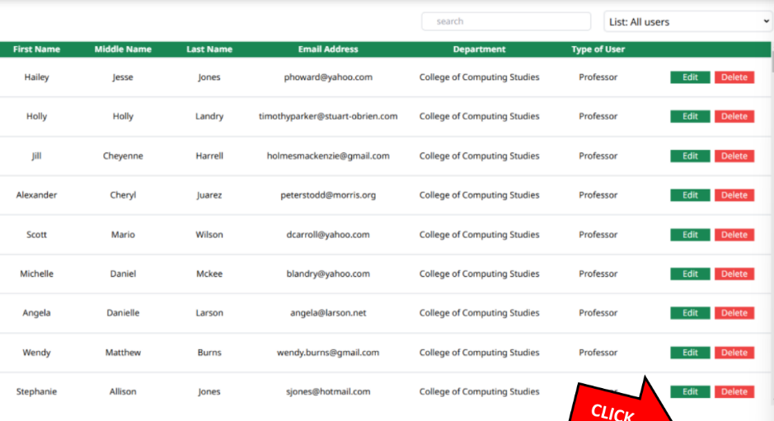
Add user
dashboard
users
college
section
curriculum
Room assignment
Generate schedule
Audit logs
NOTE: SAME STYLE SA QLESS NA ALTERNATE COLOR WHITE AND GREEN
NOTE: PAGINATION DAPAT

Slide 6
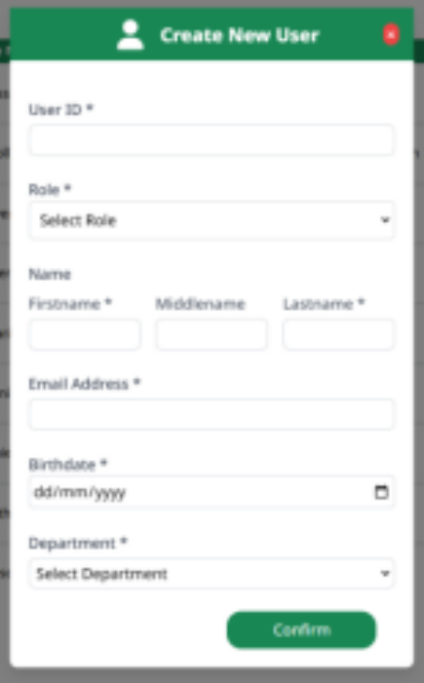
Create New User
Add user
dashboard
users
First Name
college
Middle Name
section
curriculum
Last Name
Room assignment
Faculty Position
Generate schedule
^
Select Position
Audit logs
Email Address
Password
Department
^
Select Department
confirm
NOTE: SAME STYLE PERO IBA LAMAN

Slide 7
ADD COLLEGE
dashboard
users
College Name | College Code | Action
COLLE OF COMPUTING STUDIES | CCS
COLLE OF COMPUTING STUDIES | CBAA
COLLE OF COMPUTING STUDIES | CAS
COLLE OF COMPUTING STUDIES | COE
COLLE OF COMPUTING STUDIES | CHAS
college
EDIT
DELETE
section
VIEW DETAILS
curriculum
EDIT
DELETE
Room assignment
VIEW DETAILS
Generate schedule
Audit logs
EDIT
DELETE
VIEW DETAILS
EDIT
DELETE
VIEW DETAILS
EDIT
DELETE
VIEW DETAILS
NOTE: SAME STYLE SA QLESS NA ALTERNATE COLOR WHITE AND GREEN
NOTE: PAGINATION DAPAT

Slide 8
ADD COLLEGE
dashboard
users
Department Name (Program Name) | Acronym | Action
COLLE OF COMPUTING STUDIES | CCS
Bachelor of Science in Information Technology | BSIT
Bachelor of Science in Computing Studies | BSCS
COLLE OF COMPUTING STUDIES | CCS
Bachelor of Science in Information Technology | BSIT
Bachelor of Science in Computing Studies | BSCS
college
EDIT
DELETE
section
VIEW DETAILS
curriculum
Room assignment
Generate schedule
Audit logs
EDIT
DELETE
VIEW DETAILS
NOTE: SAME STYLE SA QLESS NA ALTERNATE COLOR WHITE AND GREEN
NOTE: PAGINATION DAPAT

Slide 9
ADD COLLEGE
ADD COLLEGE X
dashboard
onm
users
Department Name (Program Name) | Acronym | Action
COLLE OF COMPUTING STUDIES | CCS
Bachelor of Science in Information Technology | BSIT
Bachelor of Science in Computing Studies | BSCS
COLLE OF COMPUTING STUDIES | CCS
Bachelor of Science in Information Technology | BSIT
Bachelor of Science in Computing Studies | BSCS
College Name
college
EDIT
DELETE
section
College Acronym
VIEW DETAILS
curriculum
Room assignment
Add program
Generate schedule
Program Name
Audit logs
Disabled by default
Program Acronym
EDIT
DELETE
Disabled by default
VIEW DETAILS
SAVE
NOTE: SAME STYLE SA QLESS NA ALTERNATE COLOR WHITE AND GREEN
NOTE: PAGINATION DAPAT

Slide 10
ADD COLLEGE
EDIT COLLEGE AND PROGRAM X
dashboard
onm
users
Department Name (Program Name) | Acronym | Action
COLLE OF COMPUTING STUDIES | CCS
Bachelor of Science in Information Technology | BSIT
Bachelor of Science in Computing Studies | BSCS
COLLE OF COMPUTING STUDIES | CCS
Bachelor of Science in Information Technology | BSIT
Bachelor of Science in Computing Studies | BSCS
College Name
college
EDIT
DELETE
section
College Acronym
VIEW DETAILS
curriculum
Room assignment
Add program
Generate schedule
Program Name
Delete
Audit logs
Disabled by default
Program Acronym
EDIT
DELETE
Disabled by default
VIEW DETAILS
SAVE
NOTE: SAME STYLE SA QLESS NA ALTERNATE COLOR WHITE AND GREEN
NOTE: PAGINATION DAPAT

Slide 11

dashboard
users
college
section
curriculum
Room assignment
Generate schedule
Audit logs
Upload a file

Slide 12
First Year
dashboard
^
users
college
First semester
Course Code | Course Title | Units |  |  | Pre/Co-Requisite
 |  | Lec | Lab | Total
mat101 | Math | 3 | 0 | 3 | none
mat101 | Math | 3 | 0 | 3 | none
Second Semester
Course Code | Course Title | Units |  |  | Pre/Co-Requisite
 |  | Lec | Lab | Total
mat101 | Math | 3 | 0 | 3 | none
mat101 | Math | 3 | 0 | 3 | none
Summer
section
curriculum
Room assignment
Generate schedule
Audit logs

