Slide 1
CSH3J3 SISTEM PARALEL DAN TERDISTRIBUSI
MATERI 2: Model Sistem Terdistribusi

Slide 2
Outline Today
Chapter 2 – System Models
Review Minggu lalu
System Model
Physical Model
Architectural Model
Fundamental Model
Asesmen

Slide 3

System Models
Prof. Robert E. Shannon
By a model we mean a representation of a group of objects or ideas in some form other than that of the entity itself.
By a system we mean a group or collection of interrelated elements that cooperate to accomplish some stated objective.

Slide 4
Difficulties and Threats
Widely varying modes of use
have special requirements
Wide range of system environments
accommodate heterogeneous hardware
Internal problems
Non-synchronized clocks
External threats
denial of service attacks
Notes:
Here are some of the problems that the designers of distributed systems face.

Slide 5
System Models in DS
should be designed to function correctly in the widest possible range of circumstances and in the face of many possible difficulties and threats.
How the properties and design issues of distributed systems can be captured and discussed through the use of descriptive models ?
Each type of model is intended to provide an abstract, simplified but consistent description of a relevant aspect of distributed system design.

Slide 6
DS Models
Physical Models
types of computers and devices that constitute a system and their interconnectivity, without details of specific technologies
Architectural Models
the computational and communication tasks performed by its computational elements
Fundamental Models
describe solutions to individual issues faced by most distributed systems

Slide 7
1. Physical Models
A physical model is a representation of the underlying hardware elements of a distributed system that abstracts away from specific details of the computer and networking technologies employed
Baseline physical model: from definition - set of computer nodes interconnected by a computer network for the required passing of messages
Generation:
Early DS : ‘70s-’80s → LAN
Internet-scale DS : ’90 → Internet
Contemporary DS : Now → Mobile Computing

Slide 8
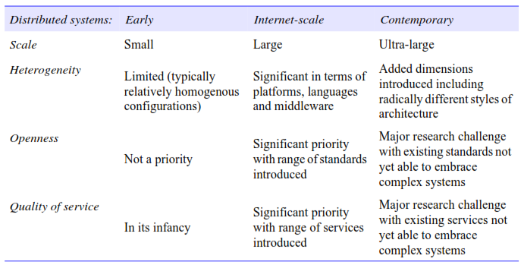
Generation of DS

Slide 9
2. Architectural Models
Its structure in terms of separately specified components and their interrelationships
The overall goal is to ensure that the structure will meet present and likely future demands on it.
Major concerns are to make the system reliable, manageable, adaptable and cost-effective
The section adopts a three-stage approach:
Architectural elements : looking at the core
Architectural patterns : examining composite architectural
considering middleware platforms

Slide 10
a. Architectural Elements
Communicating entities : Objects, Components, and Web services.
Communication paradigms : interprocess communication, remote invocation, and indirect communication.
Roles and responsibilities : Client-server, Peer-to-peer
Placement : mapping of services to multiple servers, caching (Chace server), mobile code (stockbroker), and mobile agents (accessing individual database).

Slide 11
Communicating Entities
What is communicating? Processes
Nodes
Threads

Slide 12
Programming Perspective
Object: a computation consists of a number of interacting objects representing natural units of decomposition for the given problem domain
Component: specify not only their interfaces but also the assumptions they make in terms of other components/interfaces that must be present for a component to fulfill its function
Web service: web services are intrinsically integrated into the World Wide Web, using web standards to represent and discover services

Slide 13
Communication Paradigms
Interprocess Communication: relatively low-level support for communication between processes in distributed systems
Remote Invocation: techniques based on a two-way exchange between communicating entities in a distributed system and resulting in the calling of a remote operation, procedure or method
Indirect Communication

Slide 14
Interprocess Communication
Message passing
Socket: Combination of IP and Port
Multicast: send to group

Slide 15
Remote Invocation
Request-reply: pairwise exchange of messages from client to server and then from server back to client, with the first message containing an encoding of the operation to be executed at the server and also an array of bytes holding associated arguments and the second message containing any results of the operation, again encoded as an array of bytes
RPC: procedures in processes on remote computers can be called as if they are procedures in the local address space
RMI: strongly resembles remote procedure calls but in a world of distributed objects

Slide 16
Indirect Communication
Group communication
Publish-subscribe
Message queue
Tuple space
DSM

Slide 17
Roles
Client-server
Peer-to-peer

Slide 18
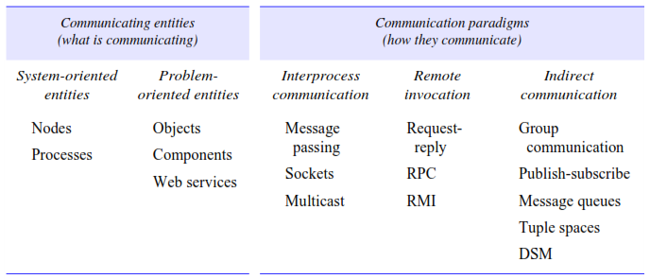
Entities and Paradigms

Slide 19
b. Architectural Patterns
Layering : a complex system is partitioned into a number of layers, with a given layer making use of the services offered by the layer below.
Tiered architecture : a technique to organize functionality of a given layer and place this functionality into appropriate servers and, as a secondary consideration, on to physical nodes.
Other commonly occurring patterns : proxy, brokerage, reflection

Slide 20
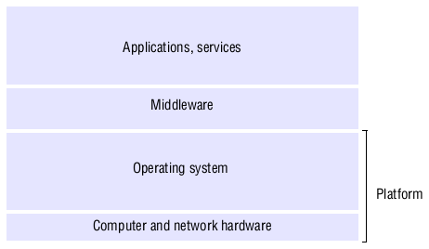
SW and HW Service Layers

Slide 21
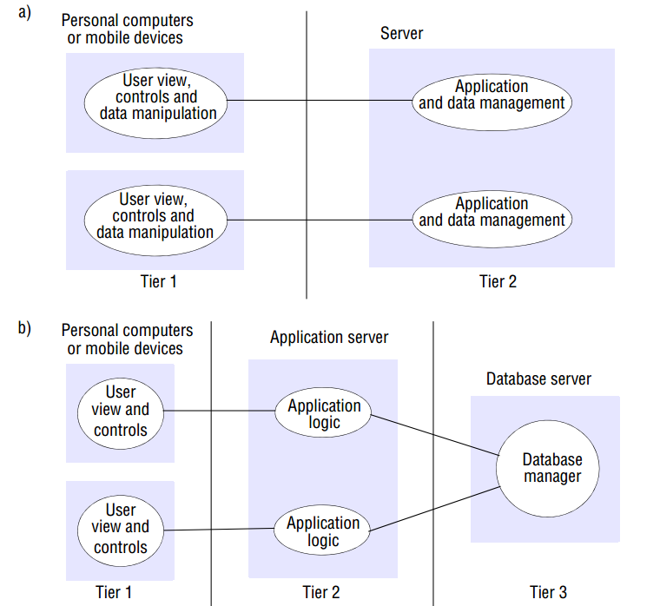

Slide 22
Other
Proxy: to support location transparency in remote procedure calls or remote method invocation. With this approach, a proxy is created in the local address space to represent the remote object. This proxy offers exactly the same interface as the remote object, and the programmer makes calls on this proxy object and hence does not need to be aware of the distributed nature of the interaction
Brokerage: supporting interoperability in potentially complex distributed infrastructures
Reflection: supporting both introspection (the dynamic discovery of properties of the system) and intercession (the ability to dynamically modify structure or behaviour)

Slide 23
c. Associated Middleware
The task of middleware :
to provide a higher-level programming abstraction for the development of distributed systems and,
through layering, to abstract over heterogeneity in the underlying infrastructure to promote interoperability and portability.
Categories of middleware (SunRPC)
Limitations of middleware (a database of names and addresses)

Slide 24
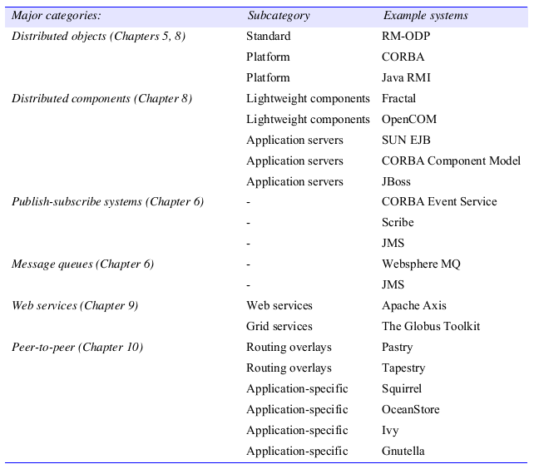
Categories of Middleware

Slide 25
3. Fundamental Models
The purpose of such a model is:
To make explicit all the relevant assumptions about the systems we are modelling.
To make generalizations concerning what is possible or impossible, given those assumptions.
Model:
Interaction: Computation occurs within processes;
Failure: a fault occurs in any of the computers;
Security: to attack by both external and internal agents.

Slide 26
a. Interaction model
two significant factors affecting interacting processes in a distributed system:
Communication performance is often a limiting characteristic.
It is impossible to maintain a single global notion of time.
Performance of communication channels : Delay, bandwidth, and jitter.
Computer clocks and timing events : NTP with GPS
Two variants of the interaction model : Synchronous DS and Asynchronous DS.
Event ordering : sending or receiving a message

Slide 27
Interaction
Synchronous
Bounded time to execute
Bounded delay
Bounded clock drift
Asynchronous
Undetermined time to execute
Undetermined delay
Undetermined clock drift

Slide 28
b. Failure model
the ways in which failure may occur in order to provide an understanding of the effects of failures.
Omission failures : Process omission failures and Communication omission failures
Arbitrary failures : takes unintended processing steps
Timing failures : process execution time
Masking failures : hiding it altogether
Reliability of one-to-one communication : validity and integrity

Slide 29
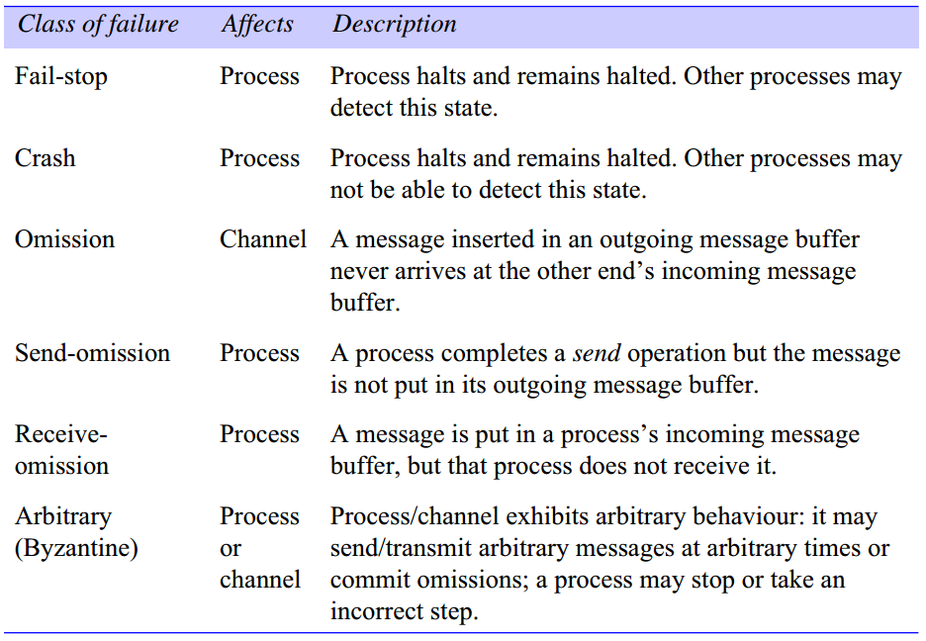

Slide 30
Reliable Channel
Validity: Any message in the outgoing message buffer is eventually delivered to the incoming message buffer.
Integrity: The message received is identical to one sent, and no messages are delivered twice

Slide 31
c. Security model
securing the processes and the channels used for their interactions and by protecting the objects that they encapsulate against unauthorized access.
Protecting objects : manages a collection of objects.
Securing processes and their interactions : handle financial transactions, confidential or classified information.
The enemy : capable of sending, reading, and copying.
Defeating security threats : Cryptography and Authentication.
Other possible threats from an enemy : DoS

