Slide 1
CSH3J3 SISTEM PARALEL DAN TERDISTRIBUSI
MATERI 4: Interprocess Communication

Slide 2
Outline Today
Chapter 4– Inter Process Communication
Tugas

Slide 3
Introduction
Chapter 3 discussed the Internet transport-level protocols UDP and TCP without saying how middleware and application programs could use these protocols.
The next section of this chapter introduces
the characteristics of interprocess communication and then discusses UDP and TCP from a programmer’s point of view,
presenting the Java interface to each of these two protocols, together with a discussion of their failure models Figure 4.1 Middleware layers Applications,
services Middleware layers Underlying interprocess communication primitives: UDP and TCP.

Slide 4
1. API for IP
The general characteristics of interprocess communication and then discuss the Internet protocols as an example, explaining how programmers can use them, either by means of UDP messages or through TCP streams.
The characteristics of interprocess communication
Sockets
UDP datagram communication
TCP stream communication

Slide 5
a. Characteristics of Inter.Comm.
Message passing between a pair of processes can be supported by two message communication operations, send and receive, defined in terms of destinations and messages.
Synchronous and asynchronous: block and non-block.
Message destinations : Internet address and local port.
Reliability : validity and integrity
Ordering : sender order

Slide 6
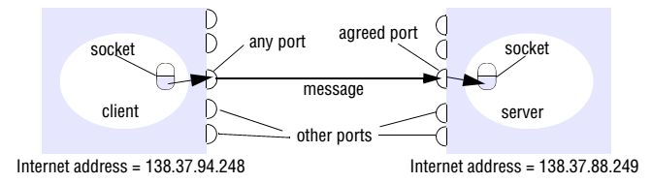
b. Sockets
Both forms of communication (UDP and TCP) use the socket abstraction, which provides an end point for communication between processes.

Slide 7
Socket Module Python
Class method | Description
Socket | Low-level networking interface (import)
socket.socket(family, type) | Create and return a new socket object
socket.getfqdn(name) | Convert a string quad dotted IP address to a fully qualified domain name
socket.gethostbyname(hostname) | Resolve a hostname to a string quad dotted IP address
socket.fromfd(fd, family, type) | Create a socket object from an existing file descriptor

Slide 9
sock.bind( (adrs, port) ) | Bind the socket to the address and port
sock.accept() | Return a client socket (with peer address information)
sock.listen(backlog) | Place the socket into the listening state, able to pend backlogoutstanding connection requests
sock.connect( (adrs, port) ) | Connect the socket to the defined host and port
sock.recv( buflen[, flags] ) | Receive data from the socket, up to buflen bytes

Slide 10
sock.recvfrom( buflen[, flags] ) | Receive data from the socket, up to buflen bytes, returning also the remote host and port from which the data came
sock.send( data[, flags] ) | Send the data through the socket
sock.sendto( data[, flags], addr ) | Send the data through the socket
sock.close() | Close the socket
sock.getsockopt( lvl, optname ) | Get the value for the specified socket option
sock.setsockopt( lvl, optname, val ) | Set the value for the specified socket option

Slide 11

c. UDP Datagram Comm.
a sending process to a receiving process without acknowledgement or retries
Failure model for UDP datagrams : checksum error or because no buffer space
Use of UDP : DNS and VoIP

Slide 12
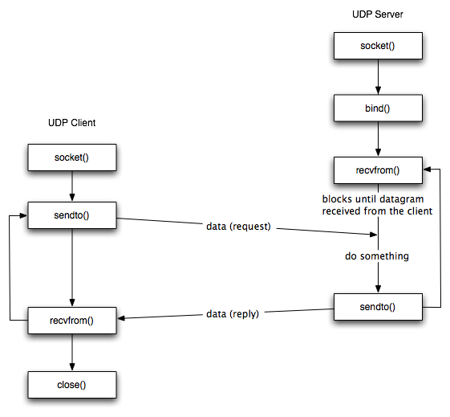

Slide 13
Ex : UDP client

Slide 14
Ex : UDP Server

Slide 15
d. TCP Stream Comm.
Stream communication assumes that when a pair of processes are establishing a connection, one of them plays the client role and the other plays the server role, but thereafter they could be peers.
Failure model : use checksums to detect and reject corrupt packets and sequence numbers to detect and reject duplicate packets.
Use of TCP : HTTP, FTP, and SSH
Java API for TCP streams

Slide 16
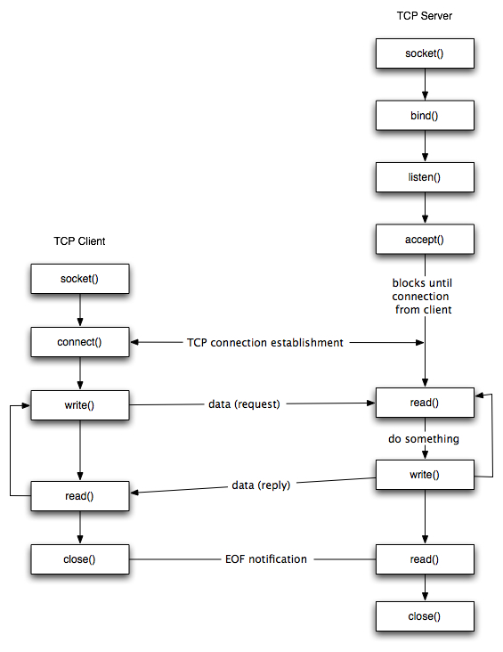

Slide 17
Ex : TCP client

Slide 18
Ex : TCP Server

Slide 19
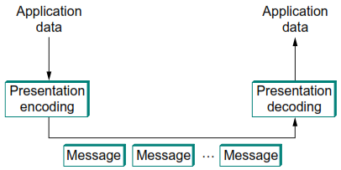
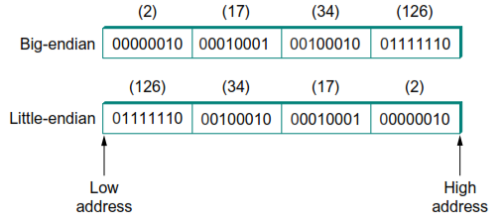
2. External Data Representation [PET]
Marshalling Unmarshalling
Notes:
Examples (XDR, ASN.1, NDR)

Slide 20
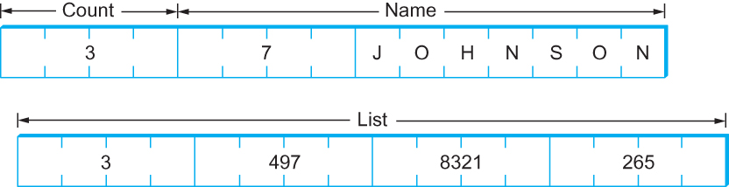
Ex : Presentation Formating [PET]
XDR
ASN.1 BER
NDR

Slide 21
2. External Data Representation (con’t)
Three alternative approaches to external data representation and marshalling:
CORBA’s common data representation, which is concerned with an external representation for the structured and primitive types
Java’s object serialization, which is concerned with the flattening and external data representation of any single object or tree of objects
XML (Extensible Markup Language), which defines a textual format for representing structured data.

Slide 22
a. CORBA
CORBA’s Common Data Representation (CDR)
These consist of 15 primitive types, which include short (16-bit), long (32-bit), unsigned short, unsigned long, float (32-bit), double (64-bit), char, boolean (TRUE, FALSE), octet (8-bit), and any (which can represent any basic or constructed type)
Marshalling in CORBA
struct Person {
string name;
string place;
unsigned long year;
};

Slide 23
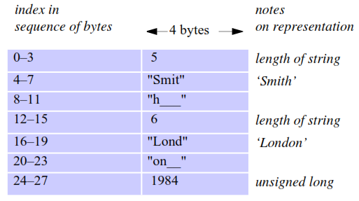
Ex: CORBA CDR Message
Contains the three fields of a struct whose respective types are
string, string and unsigned long

Slide 24
b. Java Object Serialization
In Java RMI, both objects and primitive data values may be passed as arguments and results of method invocations.
An object is an instance of a Java class
public class Person implements Serializable {
private String name;
private String place;
private int year;
public Person(String aName, String aPlace, int aYear) {
name = aName;
place = aPlace;
year = aYear;
}
// followed by methods for accessing the instance variables
}

Slide 25
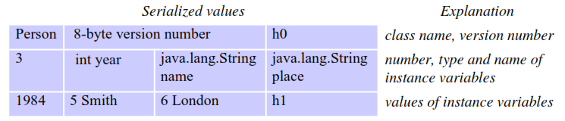
Ex : Java Serialized Form
As an example, consider the serialization of the following object:
Person p = new Person("Smith", "London", 1984);

Slide 26
c. Extensible Markup Language (XML)
XML is a markup language that was defined by the World Wide Web Consortium (W3C) for general use on the Web.
Both XML and HTML were derived from SGML (Standardized Generalized Markup Language) [ISO 8879]
XML data items are tagged with ‘markup’ strings.
<person id="123456789">
<name>Smith</name>
<place>London</place>
<year>1984</year>
<!-- a comment -->
</person >

Slide 27
3. Multicast Communication
A multicast operation is more appropriate – this is an operation that sends a single message from one process to each of the members of a group of processes, usually in such a way that the membership of the group is transparent to the sender.
Multicast messages characteristics:
Fault tolerance based on replicated services: a group of servers
Discovering services in spontaneous networking: to locate available services
Better performance through replicated data: managing the replicas
Propagation of event notifications: be used to notify processes

Slide 28
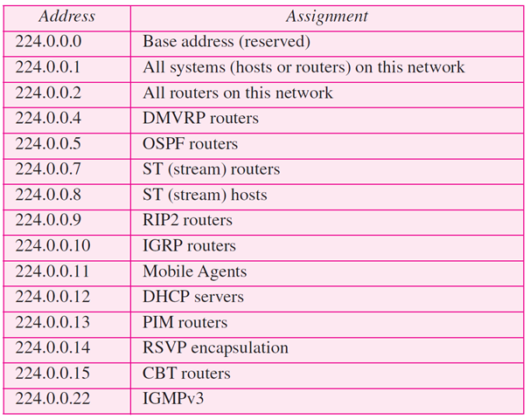
a. IP Multicast
IP multicast is built on top of the Internet Protocol (IP).
A multicast group is specified by a Class D Internet address (the range 224.0.0.0 to 239.255.255.255).

Slide 29
b. Reliability and Ordering
Some applications require a multicast protocol that is more reliable than IP multicast.
There is a need for reliable multicast, in which any message transmitted is either received by all members of a group or by none of them.
The examples also suggest that some applications have strong requirements for ordering, the strictest of which is called totally ordered multicast.
Notes:
in which all of the messages transmitted to a group reach all of the members in the same order.

Slide 30
4. Network Virtualization
Network virtualization is concerned with the construction of many different virtual networks over an existing network such as the Internet.
Each virtual network can be designed to support a particular distributed application.
Each virtual network has its own particular addressing scheme, protocols and routing algorithms, but redefined to meet the needs of particular application classes.

Slide 31
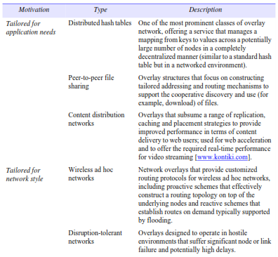
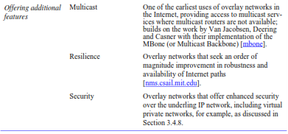
Types of Overlay

Slide 32
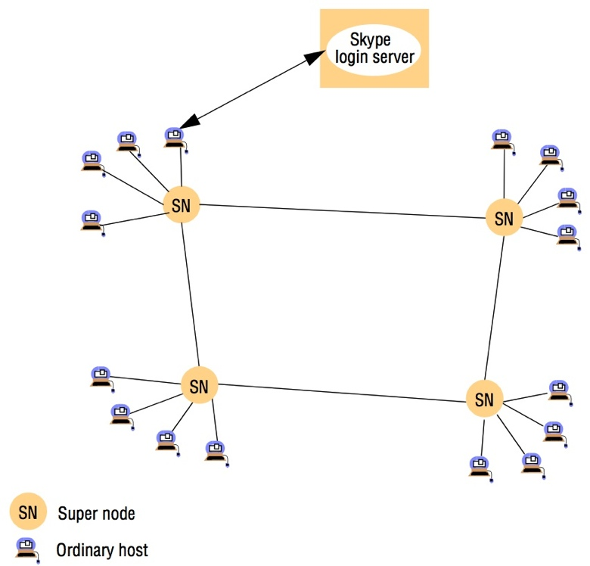
Skype Overlay Architecture

