Slide 1
CSH3J3 SISTEM PARALEL DAN TERDISTRIBUSI
MATERI 5: Remote Invocation

Slide 2
Outline Today
Chapter 5 – Remote Invocation.
Request-Reply Protocols
RPC
Remote Method Invocation

Slide 3
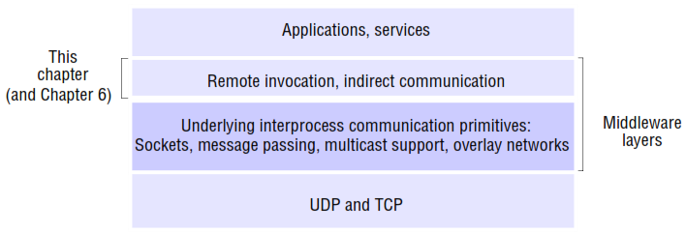
Introduction

Slide 4
1. Request-Reply Protocols
Request-Reply Communication is synchronous because the client process blocks until the reply arrives from the server.
It can also be Reliable because the reply from the server is effectively an acknowledgement to the client.
The client-server exchanges are described in the following paragraphs in terms of the send and receive operations in the Java API for UDP datagrams, although many current implementations use TCP streams.

Slide 5
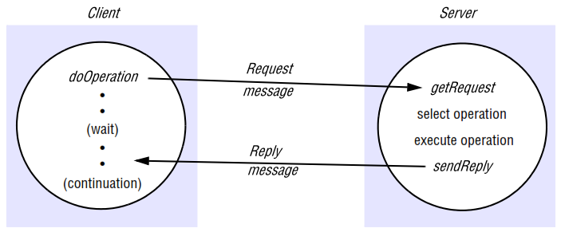
Request-Reply Communication

Slide 6
1. Request-Reply Protocols (con’t)
The Request-Reply Protocol : doOperation, getRequest and sendReply
Message identifiers : requestId and identifier
Failure model : omission failures
Timeouts : return immediately
Discarding duplicate request messages : receive it more than once
Lost reply messages : has already sent
History : contains a record
Styles of exchange protocols : R-RR-RRA
Use of TCP streams to implement the request-reply protocol : reliably
HTTP : An example of a request-reply protocol
Message contents : message body

Slide 7
2. RPC
The concept of a Remote Procedure Call (RPC) represents a major intellectual breakthrough in distributed computing, with the goal of making the programming of distributed systems look similar, if not identical, to conventional programming.
That is, achieving a high level of distribution transparency.
in RPC, procedures on remote machines can be called as if they are procedures in the local address space.

Slide 8
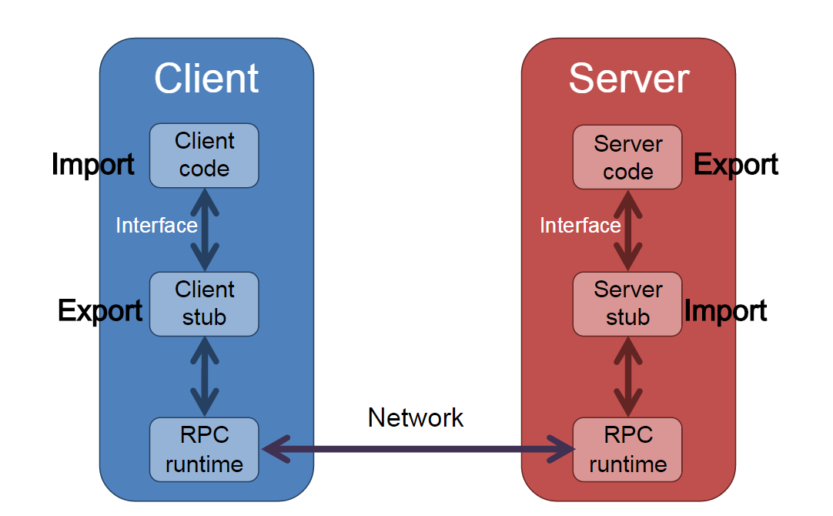

Slide 9
Sequence of event
The client calls the client stub. The call is a local procedure call, with parameters pushed on to the stack in the normal way.
The client stub packs the parameters into a message and makes a system call to send the message. Packing the parameters is called marshalling.
The client's local operating system sends the message from the client machine to the server machine.
The local operating system on the server machine passes the incoming packets to the server stub.
The server stub unpacks the parameters from the message. Unpacking the parameters is called unmarshalling.
Finally, the server stub calls the server procedure. The reply traces the same steps in the reverse direction.

Slide 10
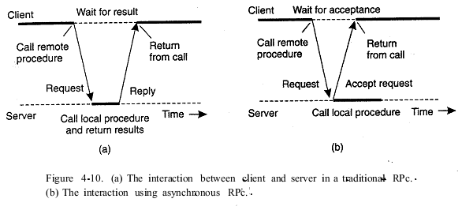
A client and server through two asynchronous RPCs

Slide 11
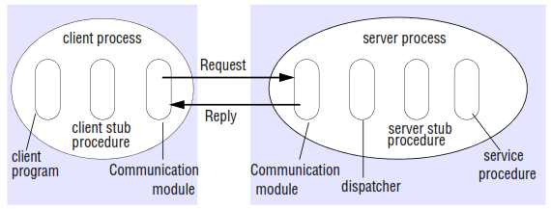
Role of Client and Server stub Procedures in RPC

Slide 12
Marshalling
Process of transforming the memory representation of an object to a data format suitable for storage or transmission, and it is typically used when data must be moved between different parts of a computer program or from one program to another.

Slide 13
a. Design issues for RPC
Three issues that are important in understanding this concept:
Programming with interfaces :
Interfaces in distributed systems : modular programming, Extrapolating to distributed systems, software evolution
Interface definition languages: allow procedures implemented in different languages to invoke one another
RPC call semantics (Retry request message, Duplicate filtering, and Retransmission of results)
Maybe semantics
At-least-once semantics
At-most-once semantics
Transparency

Slide 14
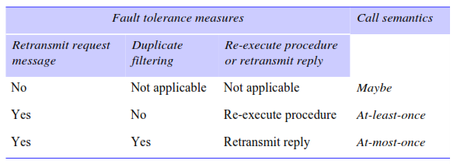
Call Semantics

Slide 15
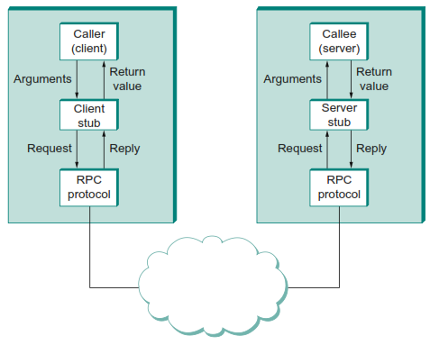
b. Implementation of RPC
We focus on “RPC Protocol (stack)” [PET’12]
fragments and reassembles large messages (by BLAST)
synchronizes request and reply messages (by CHAN)
dispatches request to the correct process/procedure (by SELECT)

Slide 16
c. Case study: Sun RPC
RFC 1831 [Srinivasan 1995a] describes Sun RPC, which was designed for client-server communication in the Sun Network File System (NFS).
Sun RPC is sometimes called ONC (Open Network Computing) RPC.
The Sun RPC system provides an interface language called XDR and an interface compiler called rpcgen, which is intended for use with the C programming language.

Slide 17
c. Case study: Sun RPC
Sun RPC details :
Interface definition language : The Sun XDR language
Binding : a local binding service called the port mapper (well-known)
Authentication : request and reply messages
Client and server programs : www.cdk5.net/rmi

Slide 18
3. Remote Method Invocation
RMI vs RPC
Commonalities | Differences
support programming with interfaces | full expressive power of object-oriented programming in the development of distributed systems software
constructed on top of request-reply protocols and can offer a range of call semantics | all objects in an RMI-based system have unique object references
similar level of transparency

Slide 19
a. Design issues for RMI
The key added design issue relates to the object model and, in particular, achieving the transition from objects to distributed objects.
The object model : Object references, Interfaces, Actions, Exceptions, and Garbage collection
Distributed objects : The state of an object consists of the values of its instance variables
The distributed object model : extensions to the object model to make it applicable to distributed objects
Actions in a distributed object system : is initiated by a method invocation, which may result in further invocations on methods in other objects.
Notes:
Object references: Objects can be accessed via object references.
Interfaces: An interface provides a definition of the signatures of a set of methods
Actions : Action in an object-oriented program is initiated by an object invoking a method in another object.
Exceptions : Programs can encounter many sorts of errors and unexpected conditions of varying seriousness.
Garbage collection : It is necessary to provide a means of freeing the space occupied by objects when they are no longer needed.

Slide 20
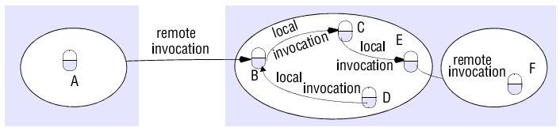
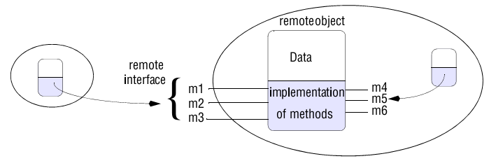
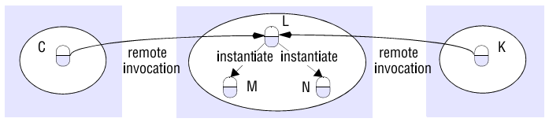
objects are accessed
Remote and local method invocations
A remote object and its remote interface
Instantiation of remote objects

Slide 21
b. Implementation of RMI
Communication module : the message type, its requestId and the remote reference of the object to be invoked.
Remote reference module : responsible for translating between local and remote object references and for creating remote object references.
Servants : is an instance of a class that provides the body of a remote object
The RMI software : Proxy, Dispatcher, and Skeleton.
Dynamic invocation : An alternative to proxies
Server and client programs : java.sun.com

