Slide 1
CSH3J3 SISTEM PARALEL DAN TERDISTRIBUSI
MATERI 6: Indirect Communication

Slide 2
Outline Today
Chapter 6– Indirect Communication.
Introduction
Group Communication
Publish Subscribe
Message Queue
Shared Memory

Slide 3
Indirect Communication
Indirect communication is defined as communication between entities in a distributed system through an intermediary with no direct coupling between the sender and the receiver(s).

Slide 4
Jim Gray
There is no performance problem that cannot be solved by eliminating a level of indirection.

Slide 5
Couplings
Space uncoupling, in which the sender does not know or need to know the identity of the receiver(s), and vice versa
Time uncoupling, in which the sender and receiver(s) can have independent lifetimes. In other words, the sender and receiver(s) do not need to exist at the same time to communicate.

Slide 6
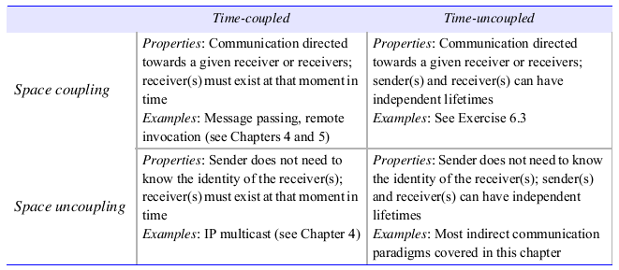
Relationship

Slide 7
Group Communication
Group communication provides our first example of an indirect communication paradigm.
Group communication offers a service whereby a message is sent to a group and then this message is delivered to all members of the group.
In this action, the sender is not aware of the identities of the receivers.
Group communication represents an abstraction over multicast communication and may be implemented over IP multicast or an equivalent overlay network, adding significant extra value in terms of managing group membership, detecting failures and providing reliability and ordering guarantees.

Slide 8
a. The programming model
In group communication, the central concept is that of a group with associated group membership, whereby processes may join or leave the group.
Process groups and object groups : groups where the communicating entities are processes
Other key distinctions :Closed and open groups

Slide 9
b. Implementation Issues
The properties of the underlying multicast service in terms of reliability and ordering and also the key role of group membership management in dynamic environments, where processes can join and leave or fail at any time.
Reliability and ordering in multicast : delivery guarantees and scheduling
Group membership management : Providing an interface for group membership changes, Failure detection, Notifying members of group membership changes, and Performing group address expansion

Slide 10
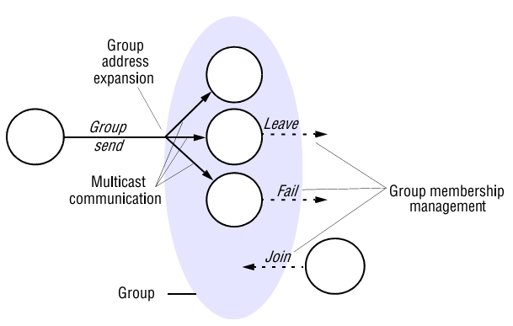
The role of group membership management

Slide 11
Publish-Subscribe
A publish-subscribe system is a system where publishers publish structured events to an event service and subscribers express interest in particular events through subscriptions which can be arbitrary patterns over the structured events.
The task of the publish-subscribe system is to match subscriptions against published events and ensure the correct delivery of event notifications

Slide 12
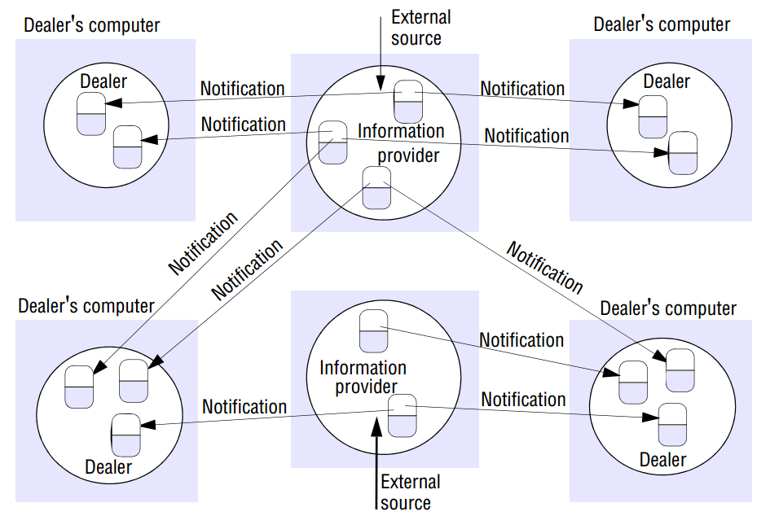

Slide 13
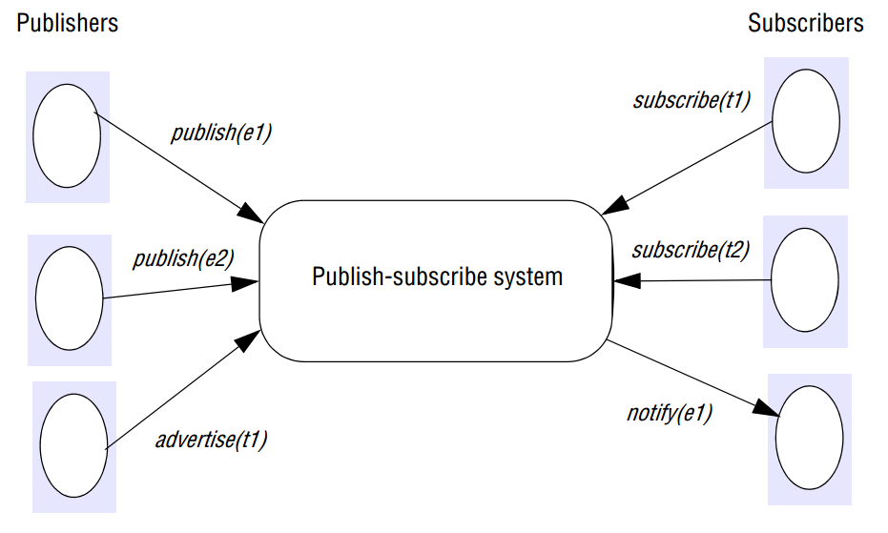
a. The Programming Model

Slide 14
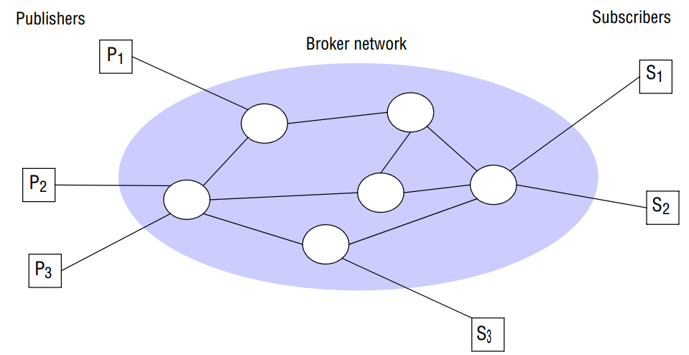
b. Implementation
Decentralized

Slide 15
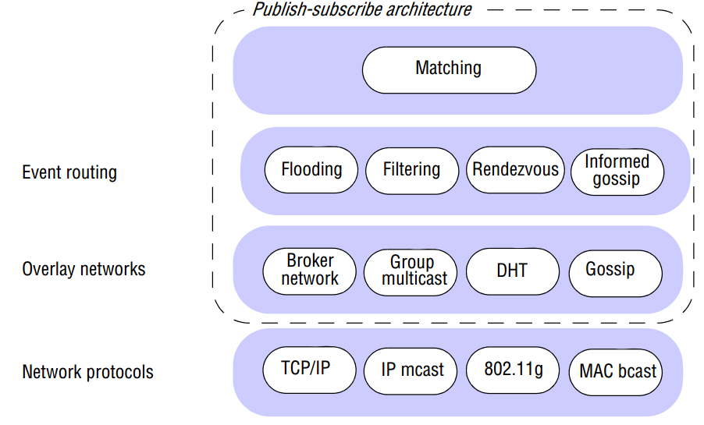
Architecture

Slide 16
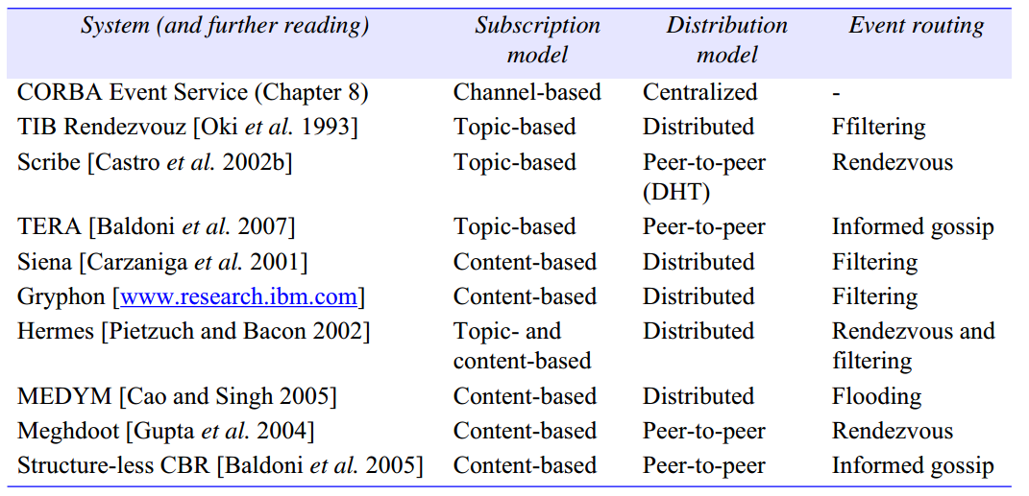
Example

Slide 17
Message Queue
Whereas groups and publish-subscribe provide a one-to-many style of communication, message queues provide a point-to-point service using the concept of a message queue as an indirection, thus achieving the desired properties of space and time uncoupling
They are point-to-point in that the sender places the message into a queue, and it is then removed by a single process. Message queues are also referred to as Message-Oriented Middleware

Slide 18
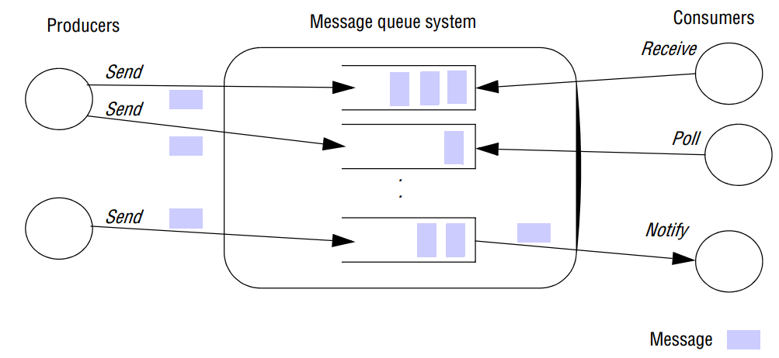
a. The Programming Model

Slide 19
b. Implementation
Centralized = bottleneck, single point of failure
Decentralized

Slide 20
Shared Memory Approaches
Distributed shared memory techniques that were developed principally for parallel computing before moving on to tuple space communication, an approach that allows programmers to read and write tuples from a shared tuple space.
Whereas distributed shared memory operates at the level of reading and writing bytes, tuple spaces offer a higher-level perspective in the form of semi-structured data.

Slide 21
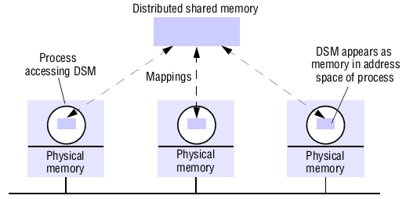
Distributed Shared Memory
Distributed shared memory (DSM) is an abstraction used for sharing data between computers that do not share physical memory.
Processes access DSM by reads and updates to what appears to be ordinary memory within their address space.

Slide 22
b. Tuple Space Communication
In this approach, processes communicate indirectly by placing tuples in a tuple space, from which other processes can read or remove them.
Tuples do not have an address but are accessed by pattern matching on content
Tuples are immutable

Slide 23
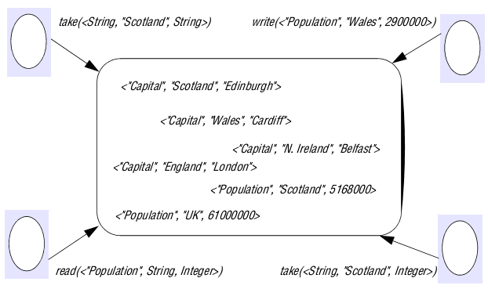

Slide 24
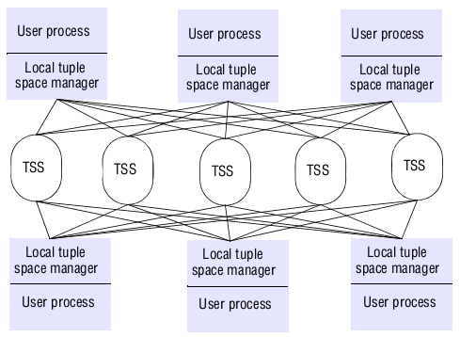
Partitioning in the York Linda Kernel

Slide 25
References
[COU’12] Coulouris, G. Dollimore, J., Kindberg, T., Blair, G., DISTRIBUTED SYSTEMS :Concepts and Design Fifth Edition, Pearson Education, Inc., United States of America, 2012.
[TAN’07] Tanenbaum, A.S., Steen, M.V., DISTRIBUTED SYSTEMS : Principles and Paradigms Second Edition, Pearson Education, Inc., United States of America, 2007.
[PET’12] Peterson, L.L., and Davie, B.S., Computer Networks: A Systems Approach Fifth Edition, Morgan Kaufmann, Burlington USA, 2012.

