Slide 1
CSH3J3 SISTEM PARALEL DAN TERDISTRIBUSI
MATERI 8: Pengantar Sistem Paralel

Slide 2
Outline Today
Introduction to Parallel Computing
Introduction
Concept
Architecture
Limitation

Slide 3
What is Parallel Computing?

Slide 4
Serial Computing
Traditionally, software has been written for serial computation:
A problem is broken into a discrete series of instructions
Instructions are executed sequentially one after another
Executed on a single processor
Only one instruction may execute at any moment in time

Slide 5
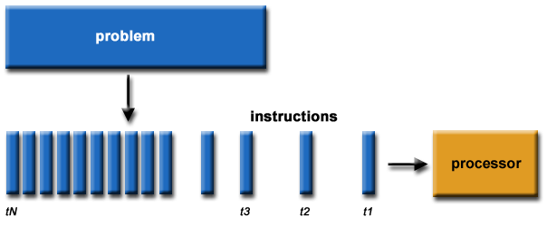

Slide 6
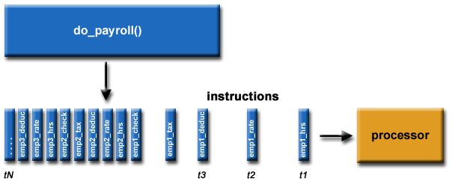

Slide 7
Parallel Computing
In the simplest sense, parallel computing is the simultaneous use of multiple compute resources to solve a computational problem:
A problem is broken into discrete parts that can be solved concurrently
Each part is further broken down to a series of instructions
Instructions from each part execute simultaneously on different processors
An overall control/coordination mechanism is employed

Slide 8
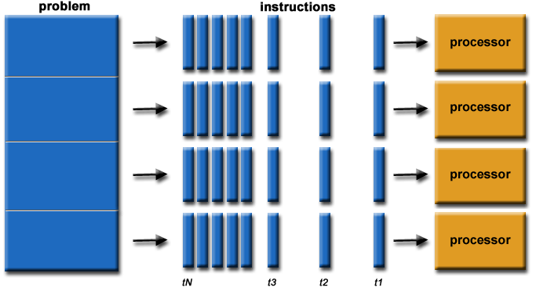

Slide 9
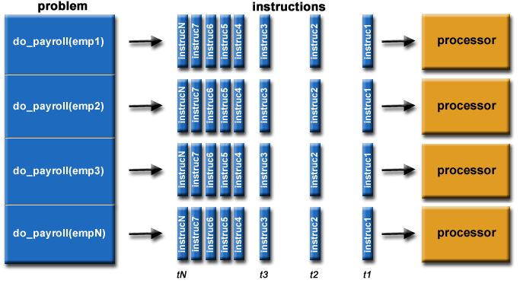

Slide 10
The computational problem should be able to:
Be broken apart into discrete pieces of work that can be solved simultaneously;
Execute multiple program instructions at any moment in time;
Be solved in less time with multiple compute resources than with a single compute resource.

Slide 11
The Compute Resource
A single computer with multiple processors/cores
An arbitrary number of such computers connected by a network

Slide 12
Parallel Computers
Virtually all stand-alone computers today are parallel from a hardware perspective:
Multiple functional units (L1 cache, L2 cache, branch, prefetch, decode, floating-point, graphics processing (GPU), integer, etc.)
Multiple execution units/cores
Multiple hardware threads

Slide 13
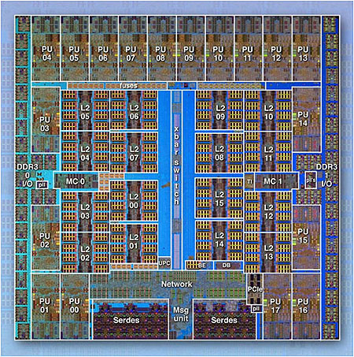

Slide 14
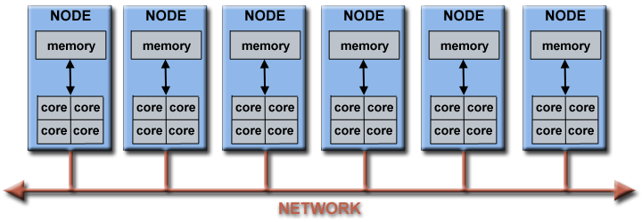
Networked computers
Networks connect multiple stand-alone computers (nodes) to make larger parallel computer clusters

Slide 15
LLNL parallel computer cluster
Each compute node is a multi-processor parallel computer in itself
Multiple compute nodes are networked together with an Infiniband network
Special purpose nodes, also multi-processor, are used for other purposes

Slide 16
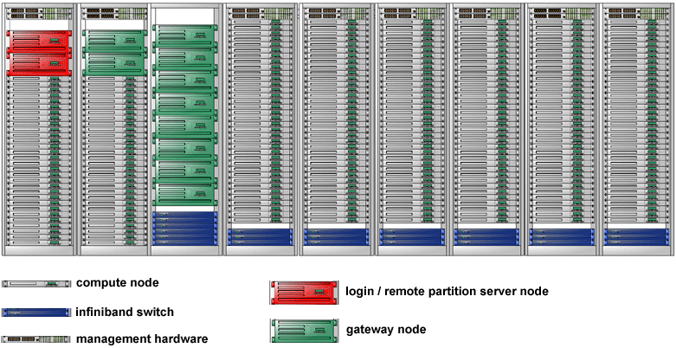

Slide 17
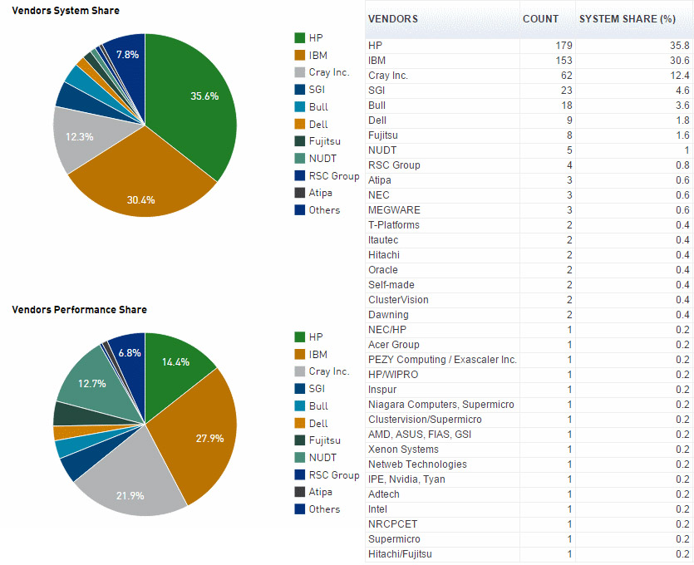
Vendors

Slide 18
Why Use Parallel Computing?

Slide 19
The Real World is Massively Parallel
In the natural world, many complex, interrelated events are happening at the same time, yet within a temporal sequence.
Compared to serial computing, parallel computing is much better suited for modeling, simulating and understanding complex, real world phenomena.

Slide 20

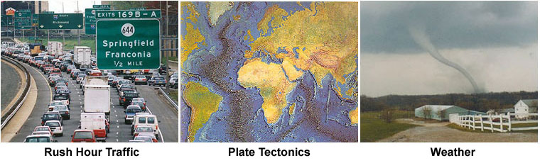
Imagine modeling these serially

Slide 21
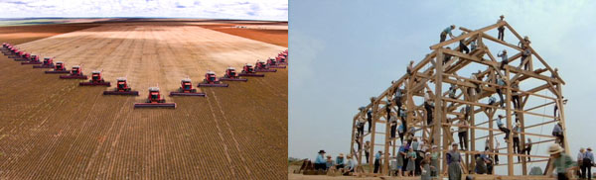
SAVE TIME AND/OR MONEY
In theory, throwing more resources at a task will shorten its time to completion, with potential cost savings.
Parallel computers can be built from cheap, commodity components.

Slide 22
SOLVE LARGER / MORE COMPLEX PROBLEMS
Many problems are so large and/or complex that it is impractical or impossible to solve them on a single computer, especially given limited computer memory.
Example: "Grand Challenge Problems" (en.wikipedia.org/wiki/Grand_Challenge) requiring PetaFLOPS and PetaBytes of computing resources.
Example: Web search engines/databases processing millions of transactions every second

Slide 23
PROVIDE CONCURRENCY
A single compute resource can only do one thing at a time. Multiple compute resources can do many things simultaneously.
Example: Collaborative Networks provide a global venue where people from around the world can meet and conduct work "virtually".

Slide 24
TAKE ADVANTAGE OF NON-LOCAL RESOURCES
Using compute resources on a wide area network, or even the Internet when local compute resources are scarce or insufficient.
Example: SETI@home (setiathome.berkeley.edu) over 1.5 million users in nearly every country in the world. Source: www.boincsynergy.com/stats/ (June, 2015).
Example: Folding@home (folding.stanford.edu) uses over 160,000 computers globally (June, 2015)

Slide 25
MAKE BETTER USE OF UNDERLYING PARALLEL HARDWARE
Modern computers, even laptops, are parallel in architecture with multiple processors/cores.
Parallel software is specifically intended for parallel hardware with multiple cores, threads, etc.
In most cases, serial programs run on modern computers "waste" potential computing power

Slide 26
The Future
During the past 20+ years, the trends indicated by ever faster networks, distributed systems, and multi-processor computer architectures (even at the desktop level) clearly show that parallelism is the future of computing.
In this same time period, there has been a greater than 500,000x increase in supercomputer performance, with no end currently in sight.
The race is already on for Exascale Computing!
Exaflop = 10¹⁸ calculations per second

Slide 27
Who is Using Parallel Computing?

Slide 28
Science and Engineering
Historically, parallel computing has been considered to be "the high end of computing", and has been used to model difficult problems in many areas of science and engineering:
Atmosphere, Earth, Environment
Physics - applied, nuclear, particle, condensed matter, high pressure, fusion, photonics
Bioscience, Biotechnology, Genetics
Chemistry, Molecular Sciences
Geology, Seismology

Slide 29
Industrial and Commercial
Today, commercial applications provide an equal or greater driving force in the development of faster computers. These applications require the processing of large amounts of data in sophisticated ways. For example:
"Big Data", databases, data mining
Oil exploration
Web search engines, web based business services
Medical imaging and diagnosis
Pharmaceutical design

Slide 30
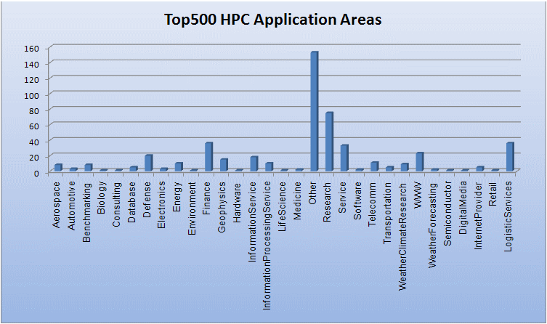
Global Application

Slide 31
Concepts and Terminology

Slide 32
Von Neumann Architecture

Slide 33
von Neumann Architecture(1)
Named after the Hungarian mathematician/genius John von Neumann who first authored the general requirements for an electronic computer in his 1945 papers.
Also known as "stored-program computer" - both program instructions and data are kept in electronic memory. Differs from earlier computers which were programmed through "hard wiring".

Slide 34
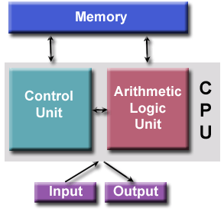
von Neumann Architecture(2)
Since then, virtually all computers have followed this basic design:
Comprised of four main components:
Memory
Control Unit
Arithmetic Logic Unit
Input/Output
Well, parallel computers still follow this basic design, just multiplied in units. The basic, fundamental architecture remains the same.

Slide 35
Flynn’s taxonomy

Slide 36
Flynn's Classical Taxonomy
Flynn's taxonomy distinguishes multi-processor computer architectures according to how they can be classified along the two independent dimensions of Instruction Stream and Data Stream. Each of these dimensions can have only one of two possible states:Single or Multiple.

Slide 37
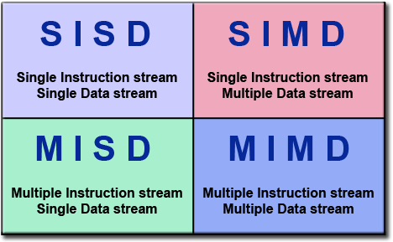

Slide 38
Single Instruction, Single Data (SISD)
A serial (non-parallel) computer
Single Instruction: Only one instruction stream is being acted on by the CPU during any one clock cycle
Single Data: Only one data stream is being used as input during any one clock cycle
Deterministic execution
This is the oldest type of computer
Examples: older generation mainframes, minicomputers, workstations and single processor/core PCs.

Slide 39
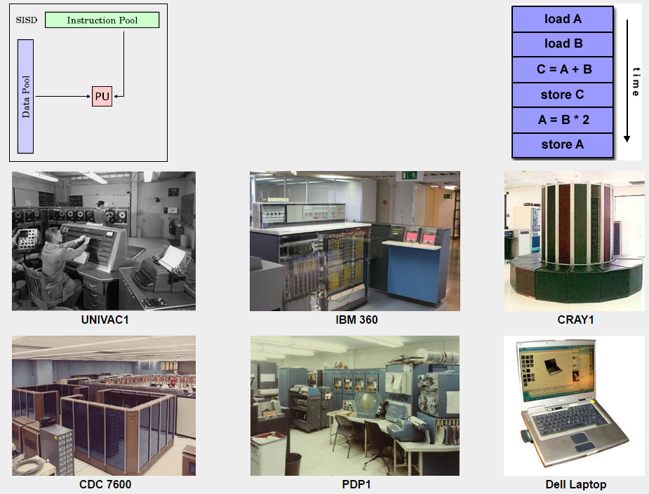

Slide 40
Single Instruction, Multiple Data (SIMD)
A type of parallel computer
Single Instruction: All processing units execute the same instruction at any given clock cycle
Multiple Data: Each processing unit can operate on a different data element
Best suited for specialized problems characterized by a high degree of regularity, such as graphics/image processing.
Synchronous (lockstep) and deterministic execution
Two varieties: Processor Arrays and Vector Pipelines
Examples:
Processor Arrays: Thinking Machines CM-2, MasPar MP-1 & MP-2, ILLIAC IV
Vector Pipelines: IBM 9000, Cray X-MP, Y-MP & C90, Fujitsu VP, NEC SX-2, Hitachi S820, ETA10
Most modern computers, particularly those with graphics processor units (GPUs) employ SIMD instructions and execution units

Slide 41
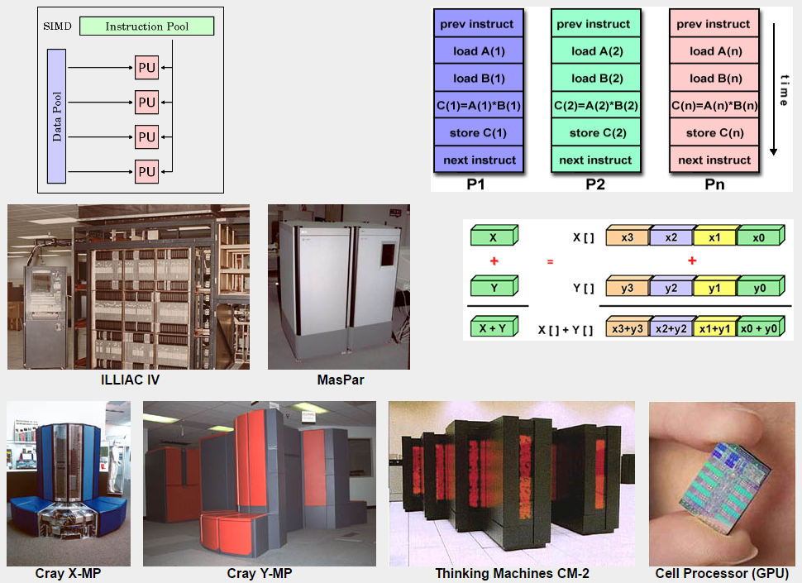

Slide 42
Multiple Instruction, Single Data (MISD)
A type of parallel computer
Multiple Instruction: Each processing unit operates on the data independently via separate instruction streams.
Single Data: A single data stream is fed into multiple processing units.
Few (if any) actual examples of this class of parallel computer have ever existed.
Some conceivable uses might be:
multiple frequency filters operating on a single signal stream
multiple cryptography algorithms attempting to crack a single coded message.

Slide 43
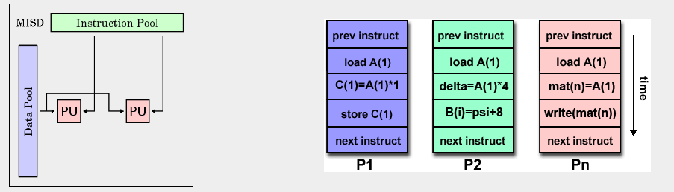

Slide 44
Multiple Instruction, Multiple Data (MIMD)
A type of parallel computer
Multiple Instruction: Every processor may be executing a different instruction stream
Multiple Data: Every processor may be working with a different data stream
Execution can be synchronous or asynchronous, deterministic or non-deterministic
Currently, the most common type of parallel computer - most modern supercomputers fall into this category.
Examples: most current supercomputers, networked parallel computer clusters and "grids", multi-processor SMP computers, multi-core PCs.
Note: many MIMD architectures also include SIMD execution sub-components

Slide 45
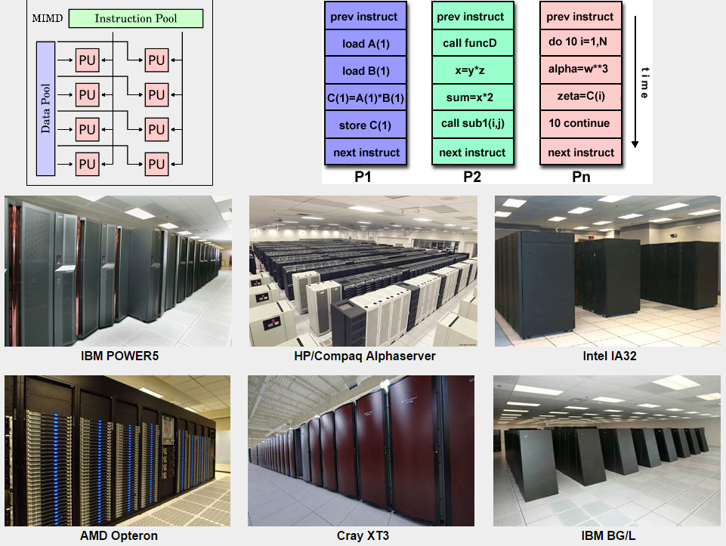

Slide 46
Parallel computer memory architecture

Slide 47
Shared memory architecture

Slide 48
General Characteristics
Shared memory parallel computers vary widely, but generally have in common the ability for all processors to access all memory as global address space.
Multiple processors can operate independently but share the same memory resources.
Changes in a memory location effected by one processor are visible to all other processors.
Historically, shared memory machines have been classified as UMA and NUMA, based upon memory access times.

Slide 49
Uniform Memory Access (UMA)
Most commonly represented today by Symmetric Multiprocessor (SMP) machines
Identical processors
Equal access and access times to memory
Sometimes called CC-UMA - Cache Coherent UMA. Cache coherent means if one processor updates a location in shared memory, all the other processors know about the update. Cache coherency is accomplished at the hardware level.

Slide 50
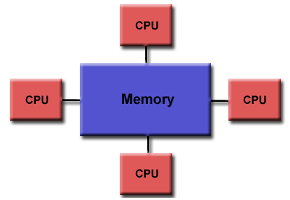

Slide 51
Non-Uniform Memory Access (NUMA)
Often made by physically linking two or more SMPs
One SMP can directly access memory of another SMP
Not all processors have equal access time to all memories
Memory access across link is slower
If cache coherency is maintained, then may also be called CC-NUMA - Cache Coherent NUMA

Slide 52
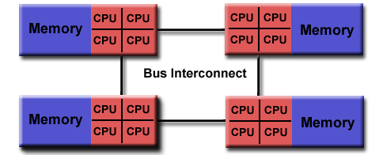

Slide 53
Advantages and Disadvantages
Advantages:
Global address space provides a user-friendly programming perspective to memory
Data sharing between tasks is both fast and uniform due to the proximity of memory to CPUs
Disadvantages:
Primary disadvantage is the lack of scalability between memory and CPUs. Adding more CPUs can geometrically increases traffic on the shared memory-CPU path, and for cache coherent systems, geometrically increase traffic associated with cache/memory management.
Programmer responsibility for synchronization constructs that ensure "correct" access of global memory.

Slide 54
Distributed memory architecture

Slide 55
General Characteristics
Like shared memory systems, distributed memory systems vary widely but share a common characteristic. Distributed memory systems require a communication network to connect inter-processor memory.
Processors have their own local memory. Memory addresses in one processor do not map to another processor, so there is no concept of global address space across all processors.
Because each processor has its own local memory, it operates independently. Changes it makes to its local memory have no effect on the memory of other processors. Hence, the concept of cache coherency does not apply.
When a processor needs access to data in another processor, it is usually the task of the programmer to explicitly define how and when data is communicated. Synchronization between tasks is likewise the programmer's responsibility.
The network "fabric" used for data transfer varies widely, though it can be as simple as Ethernet.

Slide 56
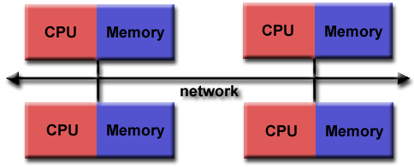

Slide 57
Advantages
Memory is scalable with the number of processors. Increase the number of processors and the size of memory increases proportionately.
Each processor can rapidly access its own memory without interference and without the overhead incurred with trying to maintain global cache coherency.
Cost effectiveness: can use commodity, off-the-shelf processors and networking.

Slide 58
Disadvantages
The programmer is responsible for many of the details associated with data communication between processors.
It may be difficult to map existing data structures, based on global memory, to this memory organization.
Non-uniform memory access times - data residing on a remote node takes longer to access than node local data

Slide 59
Hybrid

Slide 60
General Characteristics
The largest and fastest computers in the world today employ both shared and distributed memory architectures.
The shared memory component can be a shared memory machine and/or graphics processing units (GPU).
The distributed memory component is the networking of multiple shared memory/GPU machines, which know only about their own memory - not the memory on another machine. Therefore, network communications are required to move data from one machine to another.
Current trends seem to indicate that this type of memory architecture will continue to prevail and increase at the high end of computing for the foreseeable future.

Slide 61
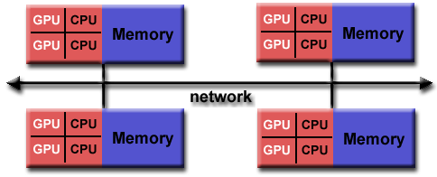

Slide 62
Advantages and Disadvantages
Whatever is common to both shared and distributed memory architectures.
Increased scalability is an important advantage
Increased programmer complexity is an important disadvantage

Slide 63
Amdahl’s law

Slide 64
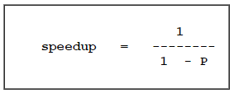
Amdahl's Law (1)
Amdahl's Law states that potential program speedup is defined by the fraction of code (P) that can be parallelized:
If none of the code can be parallelized, P = 0 and the speedup = 1 (no speedup).
If all of the code is parallelized, P = 1 and the speedup is infinite (in theory).
If 50% of the code can be parallelized, maximum speedup = 2, meaning the code will run twice as fast.

Slide 65
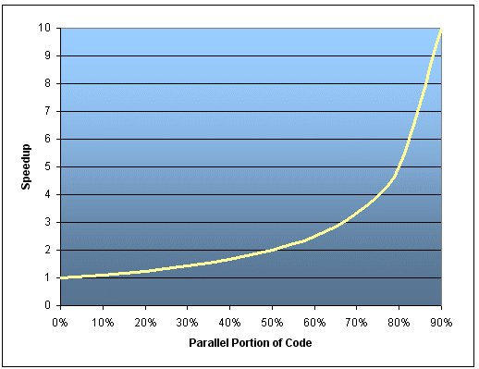
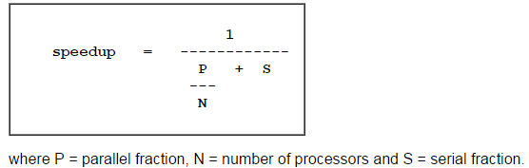
Amdahl's Law (2)
Introducing the number of processors performing the parallel fraction of work, the relationship can be modeled by

Slide 66
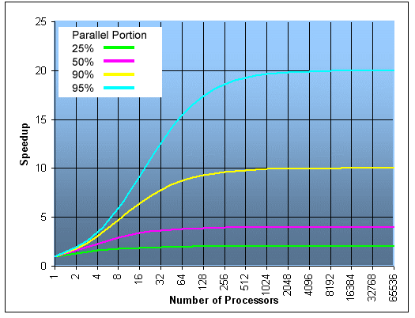
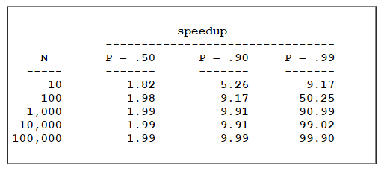
It soon becomes obvious that there are limits to the scalability of parallelism

Slide 67
Limits and Costs of Parallel Programming

Slide 68
Complexity
In general, parallel applications are much more complex than corresponding serial applications, perhaps an order of magnitude. Not only do you have multiple instruction streams executing at the same time, but you also have data flowing between them.
The costs of complexity are measured in programmer time in virtually every aspect of the software development cycle:
Design
Coding
Debugging
Tuning
Maintenance
Adhering to "good" software development practices is essential when working with parallel applications - especially if somebody besides you will have to work with the software

Slide 69
Portability
Thanks to standardization in several APIs, such as MPI, POSIX threads, and OpenMP, portability issues with parallel programs are not as serious as in years past. However...
All of the usual portability issues associated with serial programs apply to parallel programs. For example, if you use vendor "enhancements" to Fortran, C or C++, portability will be a problem.
Even though standards exist for several APIs, implementations will differ in a number of details, sometimes to the point of requiring code modifications in order to effect portability.
Operating systems can play a key role in code portability issues.
Hardware architectures are characteristically highly variable and can affect portability.

Slide 70
Resource Requirements
The primary intent of parallel programming is to decrease execution wall clock time, however in order to accomplish this, more CPU time is required. For example, a parallel code that runs in 1 hour on 8 processors actually uses 8 hours of CPU time.
The amount of memory required can be greater for parallel codes than serial codes, due to the need to replicate data and for overheads associated with parallel support libraries and subsystems.
For short running parallel programs, there can actually be a decrease in performance compared to a similar serial implementation. The overhead costs associated with setting up the parallel environment, task creation, communications and task termination can comprise a significant portion of the total execution time for short runs

Slide 71
Scalability
Two types of scaling based on time to solution:
Strong scaling: The total problem size stays fixed as more processors are added.
Weak scaling: The problem size per processor stays fixed as more processors are added.
The ability of a parallel program's performance to scale is a result of a number of interrelated factors. Simply adding more processors is rarely the answer.
The algorithm may have inherent limits to scalability. At some point, adding more resources causes performance to decrease. Many parallel solutions demonstrate this characteristic at some point.
Hardware factors play a significant role in scalability. Examples:
Memory-cpu bus bandwidth on an SMP machine
Communications network bandwidth
Amount of memory available on any given machine or set of machines
Processor clock speed
Parallel support libraries and subsystems software can limit scalability independent of your application.

Slide 72
References
Blaise Barney, Lawrence Livermore National Laboratory
https://computing.llnl.gov/tutorials/parallel_comp/

