Slide 1
CSH3J3 SISTEM PARALEL DAN TERDISTRIBUSI
MATERI 9: Paralel Programming Model

Slide 2
Outline Today
Parallel Programming Model
Programming model

Slide 3
Parallel programming model

Slide 4
Parallel programming models
Shared Memory (without threads)
Threads
Distributed Memory / Message Passing
Data Parallel
Hybrid
Single Program Multiple Data (SPMD)
Multiple Program Multiple Data (MPMD)

Slide 5
Cont.
Parallel programming models exist as an abstraction above hardware and memory architectures.
Although it might not seem apparent, these models are NOT specific to a particular type of machine or memory architecture. In fact, any of these models can (theoretically) be implemented on any underlying hardware.

Slide 6
SHARED memory model on a DISTRIBUTED memory machine
Kendall Square Research (KSR) ALLCACHE approach. Machine memory was physically distributed across networked machines, but appeared to the user as a single shared memory global address space. Generically, this approach is referred to as "virtual shared memory"

Slide 7
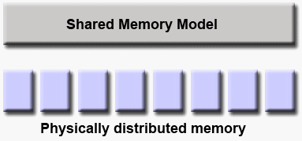

Slide 8
DISTRIBUTED memory model on a SHARED memory machine
Message Passing Interface (MPI) on SGI Origin 2000. The SGI Origin 2000 employed the CC-NUMA type of shared memory architecture, where every task has direct access to global address space spread across all machines. However, the ability to send and receive messages using MPI, as is commonly done over a network of distributed memory machines, was implemented and commonly used.

Slide 9
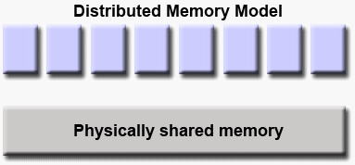

Slide 10
Which model to use?
This is often a combination of what is available and personal choice. There is no "best" model, although there certainly are better implementations of some models over others

Slide 11
Shared Memory Model (without threads)
In this programming model, processes/tasks share a common address space, which they read and write to asynchronously.
Various mechanisms such as locks / semaphores are used to control access to the shared memory, resolve contentions and to prevent race conditions and deadlocks.
This is perhaps the simplest parallel programming model.

Slide 12
Cont.
An advantage of this model from the programmer's point of view is that the notion of data "ownership" is lacking, so there is no need to specify explicitly the communication of data between tasks. All processes see and have equal access to shared memory. Program development can often be simplified.
An important disadvantage in terms of performance is that it becomes more difficult to understand and manage data locality:
Keeping data local to the process that works on it conserves memory accesses, cache refreshes and bus traffic that occurs when multiple processes use the same data.
Unfortunately, controlling data locality is hard to understand and may be beyond the control of the average user.

Slide 13
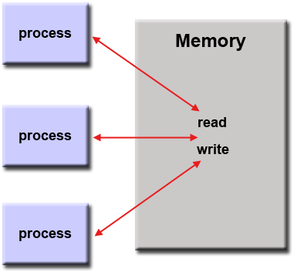

Slide 14
Implementations
On stand-alone shared memory machines, native operating systems, compilers and/or hardware provide support for shared memory programming. For example, the POSIX standard provides an API for using shared memory, and UNIX provides shared memory segments (shmget, shmat, shmctl, etc).
On distributed memory machines, memory is physically distributed across a network of machines, but made global through specialized hardware and software. A variety of SHMEM implementations are available: http://en.wikipedia.org/wiki/SHMEM.

Slide 15
Threads Model
This programming model is a type of shared memory programming.
In the threads model of parallel programming, a single "heavy weight" process can have multiple "light weight", concurrent execution paths.

Slide 16
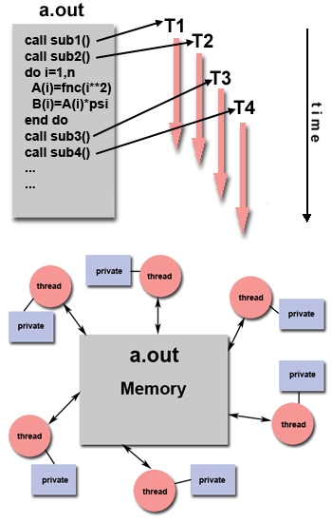

Slide 17
The main program a.out is scheduled to run by the native operating system. a.out loads and acquires all of the necessary system and user resources to run. This is the "heavy weight" process.
a.out performs some serial work, and then creates a number of tasks (threads) that can be scheduled and run by the operating system concurrently.
Each thread has local data, but also, shares the entire resources of a.out. This saves the overhead associated with replicating a program's resources for each thread ("light weight"). Each thread also benefits from a global memory view because it shares the memory space of a.out.

Slide 18
A thread's work may best be described as a subroutine within the main program. Any thread can execute any subroutine at the same time as other threads.
Threads communicate with each other through global memory (updating address locations). This requires synchronization constructs to ensure that more than one thread is not updating the same global address at any time.
Threads can come and go, but a.out remains present to provide the necessary shared resources until the application has completed.

Slide 19
Implementation
From a programming perspective, threads implementations commonly comprise:
A library of subroutines that are called from within parallel source code
A set of compiler directives imbedded in either serial or parallel source code
In both cases, the programmer is responsible for determining the parallelism (although compilers can sometimes help).
Threaded implementations are not new in computing. Historically, hardware vendors have implemented their own proprietary versions of threads. These implementations differed substantially from each other making it difficult for programmers to develop portable threaded applications.
Unrelated standardization efforts have resulted in two very different implementations of threads: POSIX Threads and OpenMP.

Slide 20
POSIX Threads
Specified by the IEEE POSIX 1003.1c standard (1995). C Language only.
Part of Unix/Linux operating systems
Library based
Commonly referred to as Pthreads.
Very explicit parallelism; requires significant programmer attention to detail.

Slide 21
OpenMP
Industry standard, jointly defined and endorsed by a group of major computer hardware and software vendors, organizations and individuals.
Compiler directive based
Portable / multi-platform, including Unix and Windows platforms
Available in C/C++ and Fortran implementations
Can be very easy and simple to use - provides for "incremental parallelism". Can begin with serial code.

Slide 22
Distributed Memory / Message Passing Model
A set of tasks that use their own local memory during computation. Multiple tasks can reside on the same physical machine and/or across an arbitrary number of machines.
Tasks exchange data through communications by sending and receiving messages.
Data transfer usually requires cooperative operations to be performed by each process. For example, a send operation must have a matching receive operation.

Slide 23
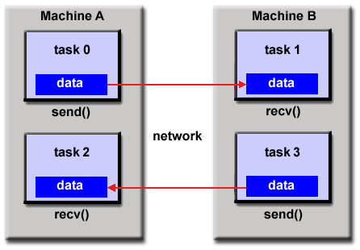

Slide 24
Implementations
From a programming perspective, message passing implementations usually comprise a library of subroutines. Calls to these subroutines are imbedded in source code. The programmer is responsible for determining all parallelism.
Historically, a variety of message passing libraries have been available since the 1980s. These implementations differed substantially from each other making it difficult for programmers to develop portable applications.
In 1992, the MPI Forum was formed with the primary goal of establishing a standard interface for message passing implementations.

Slide 25
Cont.
Part 1 of the Message Passing Interface (MPI) was released in 1994. Part 2 (MPI-2) was released in 1996 and MPI-3 in 2012. All MPI specifications are available on the web at http://www.mpi-forum.org/docs/.
MPI is the "de facto" industry standard for message passing, replacing virtually all other message passing implementations used for production work. MPI implementations exist for virtually all popular parallel computing platforms. Not all implementations include everything in MPI-1, MPI-2 or MPI-3.

Slide 26
Data Parallel Model
May also be referred to as the Partitioned Global Address Space (PGAS) model.
The data parallel model demonstrates the following characteristics:
Address space is treated globally
Most of the parallel work focuses on performing operations on a data set. The data set is typically organized into a common structure, such as an array or cube.
A set of tasks work collectively on the same data structure, however, each task works on a different partition of the same data structure.
Tasks perform the same operation on their partition of work, for example, "add 4 to every array element".

Slide 27
Cont.
On shared memory architectures, all tasks may have access to the data structure through global memory.
On distributed memory architectures the data structure is split up and resides as "chunks" in the local memory of each task.

Slide 28
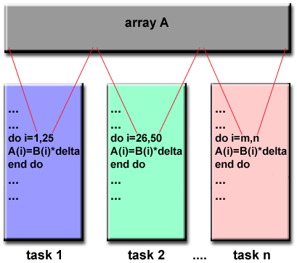

Slide 29
Implementations
Currently, there are several relatively popular, and sometimes developmental, parallel programming implementations based on the Data Parallel / PGAS model.
Coarray Fortran: a small set of extensions to Fortran 95 for SPMD parallel programming. Compiler dependent. More information: https://en.wikipedia.org/wiki/Coarray_Fortran
Unified Parallel C (UPC): an extension to the C programming language for SPMD parallel programming. Compiler dependent. More information: http://upc.lbl.gov/

Slide 30
Cont.
Global Arrays: provides a shared memory style programming environment in the context of distributed array data structures. Public domain library with C and Fortran77 bindings. More information: https://en.wikipedia.org/wiki/Global_Arrays
X10: a PGAS based parallel programming language being developed by IBM at the Thomas J. Watson Research Center. More information: http://x10-lang.org/
Chapel: an open source parallel programming language project being led by Cray. More information: http://chapel.cray.com/

Slide 31
Hybrid Model
A hybrid model combines more than one of the previously described programming models.
Currently, a common example of a hybrid model is the combination of the message passing model (MPI) with the threads model (OpenMP).
Threads perform computationally intensive kernels using local, on-node data
Communications between processes on different nodes occurs over the network using MPI
This hybrid model lends itself well to the most popular (currently) hardware environment of clustered multi/many-core machines.

Slide 32
Cont.
Another similar and increasingly popular example of a hybrid model is using MPI with CPU-GPU (Graphics Processing Unit) programming.
MPI tasks run on CPUs using local memory and communicating with each other over a network.
Computationally intensive kernels are off-loaded to GPUs on-node.
Data exchange between node-local memory and GPUs uses CUDA (or something equivalent).
Other hybrid models are common:
MPI with Pthreads
MPI with non-GPU accelerators

Slide 33
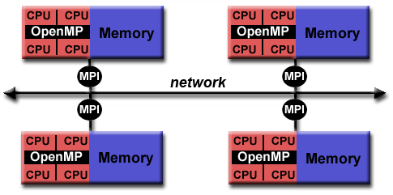

Slide 34
Single Program Multiple Data (SPMD)
SPMD is actually a "high level" programming model that can be built upon any combination of the previously mentioned parallel programming models.
SINGLE PROGRAM: All tasks execute their copy of the same program simultaneously. This program can be threads, message passing, data parallel or hybrid.
MULTIPLE DATA: All tasks may use different data
SPMD programs usually have the necessary logic programmed into them to allow different tasks to branch or conditionally execute only those parts of the program they are designed to execute. That is, tasks do not necessarily have to execute the entire program - perhaps only a portion of it.
The SPMD model, using message passing or hybrid programming, is probably the most commonly used parallel programming model for multi-node clusters.

Slide 35
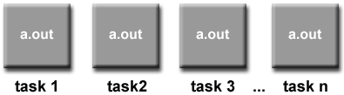

Slide 36
Multiple Program Multiple Data (MPMD)
Like SPMD, MPMD is actually a "high level" programming model that can be built upon any combination of the previously mentioned parallel programming models.
MULTIPLE PROGRAM: Tasks may execute different programs simultaneously. The programs can be threads, message passing, data parallel or hybrid.
MULTIPLE DATA: All tasks may use different data
MPMD applications are not as common as SPMD applications, but may be better suited for certain types of problems, particularly those that lend themselves better to functional decomposition than domain decomposition (discussed later under Partioning).

Slide 37
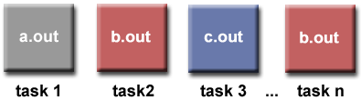

Slide 38
References
Blaise Barney, Lawrence Livermore National Laboratory
https://computing.llnl.gov/tutorials/parallel_comp/

