Slide 1



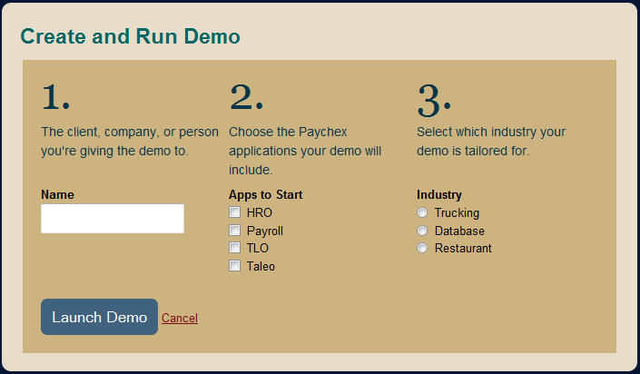
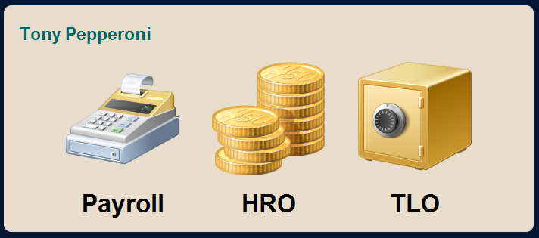
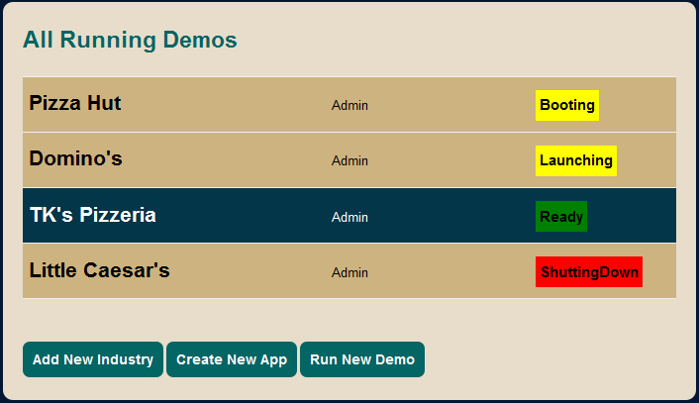
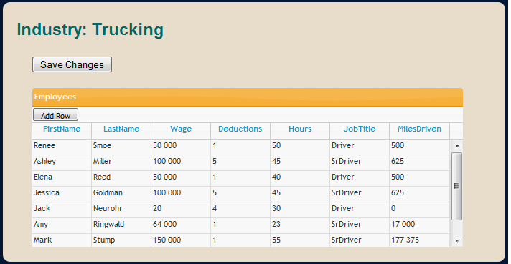





AMAZON CLOUD DEMONSTRATION ENVIRONMENT
Anne Markis, Jennifer Goldbach, Robert Jones, Nicholas Quaranto, Christopher White
Sponsors: Duane Gosley, Michael Mosley Faculty Advisor: Tom Reichlmayr
TEAM SENTINEL PRIME
2010
BACKGROUND
Paychex sales staff give live demonstrations of various Human Resources and Payroll products to potential clients.
Sales representatives collaborate with system administrators to rig up demos tailored to individual corporations.
The demonstration process is difficult to set up for sales representatives
Data integration between applications is hard to demonstrate live
Customizing data for specific demos is a time consuming and laborious process
Fast setup of applications to demo using Amazon EC2
Easy data customization for clients
Monitoring of EC2 instances
Real-time data integration across applications
FEATURES
Web Application
Setup and customize demos
EC2 instance management
Job Queue
Spawn EC2 instances
Data generation for applications
Windows Services
Queue watchdog
Periodic instance actions
MOTIVATION
COMPONENTS
USER INTERFACE
ARCHITECTURE
DEMO CREATION
AMAZON CLOUD
BOOT
Boot EC2 Instance
Single Sign On
Demo Mode
Start Apps, DB
SETUP
Choose Industry
Choose Apps
DEMO
EC2 INSTANCE
LAUNCHING A DEMO
DEMONSTRATION MODE
Payroll
Construction
Time & Labor
ADMIN DEMO DASHBOARD
INDUSTRY DATA EDITOR
APPLICATIONS
DATABASE
7 sprints, 2 weeks each
User stories as acceptance tests
Planned sprints with sponsors
Test driven development
PROCESS: SCRUM
TECHNOLOGY
FUTURE PLANS
Amazon Elastic Compute Cloud (EC2)
Hudson
Continuous Integration Server
ASP.NET MVC 2, SQL Server 2008
Project Management and Collaboration
R&D department to hook in real applications
Proprietary database integration
Enhanced EC2 instance management
Deployment to sales representatives
Unit/Acceptance Testing Framework
Scrum Backlog Organizer

