Slide 1

CRS Score Predictor - Empowering Your Express Entry Journey
A Capstone Project Redefining Immigration Strategy
Done By
Regunanthan Kumaravel – 100920917
Akshaya Bhalikha Dhanasekaran - 100936892
Manikandan Ganesan – 100921793
Sai siddhartha Mothe - 100947571

Slide 2
Introduction
Welcome to CRS Score Predictor the final product of our capstone project. We, as future experts in Data Analytics and Machine Learning, introduce a ground-breaking application that aims to completely transform the Canadian Express Entry process. Come along on an innovative and data-driven adventure that will empower people to pursue Canadian residence like never before.
Project Focus: Express Entry Enhancement
Our capstone project is centered around building an intelligent tool that goes beyond conventional approaches. CRS Score Predictor is not just an application; it is a strategic ally, harnessing data-driven insights to navigate the intricacies of the Express Entry system.

Slide 3
Key Features
CRS Score Precision: Dive into the heart of Express Entry with our advanced algorithm, offering precise Comprehensive Ranking System (CRS) score predictions. Witness the power of predictive analytics in steering your profile towards success.
Invitation Projections: Anticipate the future with confidence. CRS Score Predictor provides projections on the number of invitations for upcoming draws. Uncover strategic advantages by understanding draw categories and historical patterns.
Technical Highlights
Data Analysis: Our project leverages state-of-the-art data analysis techniques, incorporating historical data, draw trends, and the latest updates to ensure accurate predictions.
User Interface Design: A user-friendly interface ensures seamless navigation, making Express Entry complexities accessible to all.

Slide 4
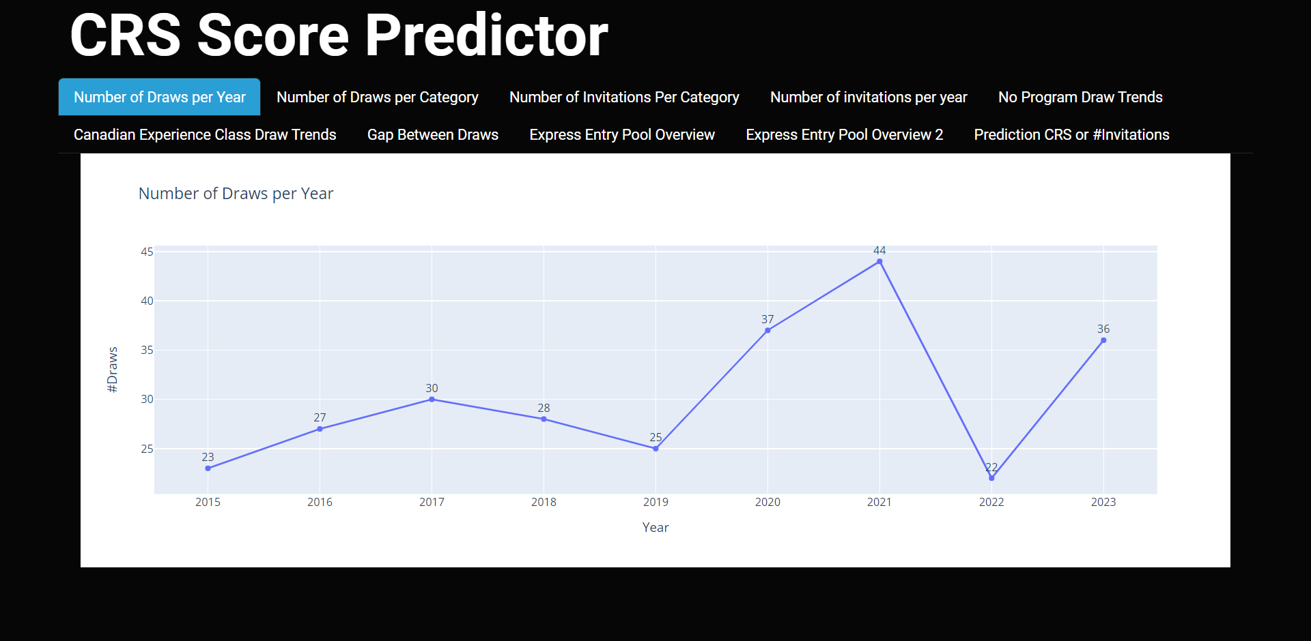
Number of Draws per Year
Peak in 2021: The highest draw frequency recorded in that year points to either a possible spike in the demand for skilled immigration or a calculated change to the Canadian immigration laws during that time.
Trough in 2022: On the other hand, the trough in 2022 suggests that immigration policies may change or be adjusted, which could result in a brief decrease in the frequency of draws.
Fluctuating Trend: The graph effectively illustrates how annual draw events vary, highlighting how the Express Entry system is sensitive to outside influences including the state of the economy, governmental regulations, and world events.

Slide 5
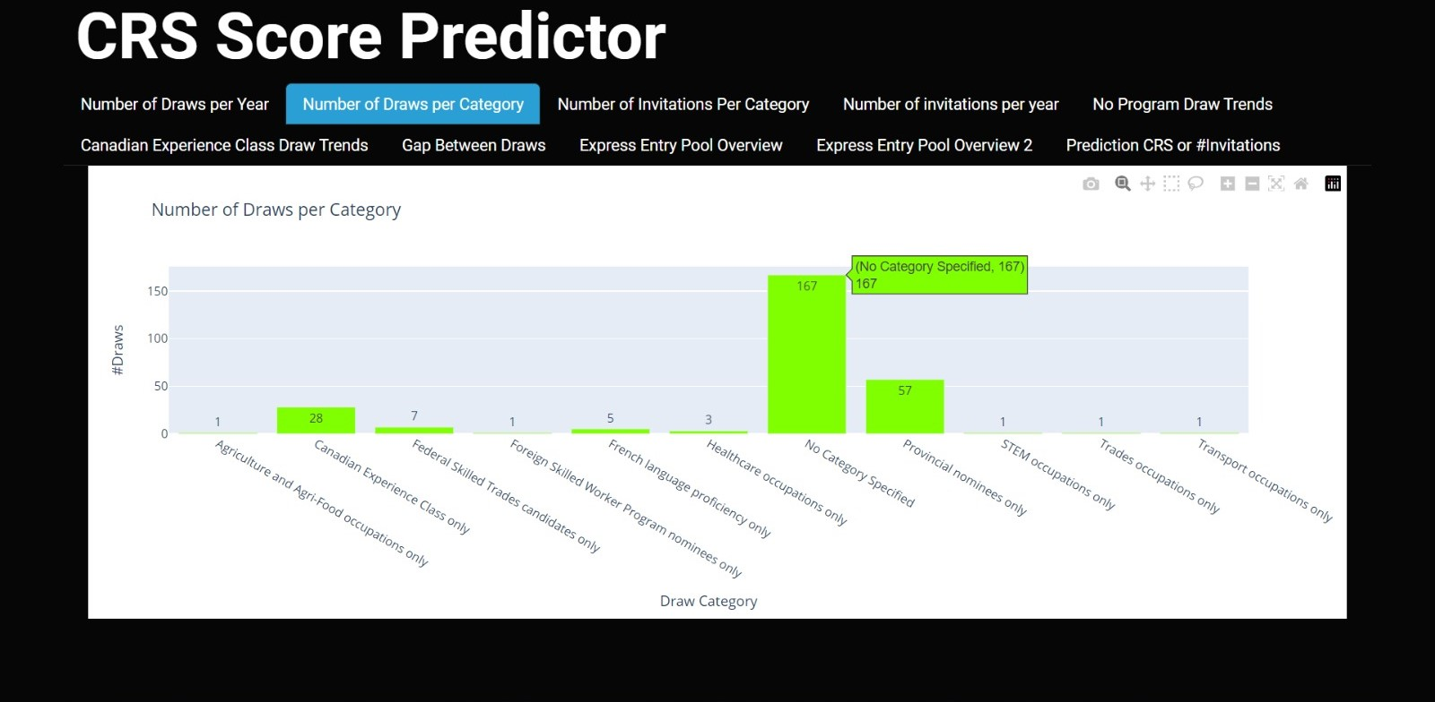
Number of Draws per Category
Prominence of 'No Category Specified': The graph highlights a significant 'No Category Specified' segment with a dominant green bar, totaling 167 draws.
Varied Distribution: The disparity in draw frequencies among categories, especially with "Canadian Experience Class" and "Federal Skilled Trades" registering fewer draws, suggests a strategic diversity in Canada's immigration approach. Understanding the nuances of each category becomes pivotal for applicants aiming to optimize their chances within the Express Entry system.
Implications for Applicants: For prospective immigrants, comprehending the draw distribution per category is crucial. This insight can inform tailored application strategies, aligning individual profiles with the categories more likely to witness draws, thereby enhancing the overall success rate.

Slide 6
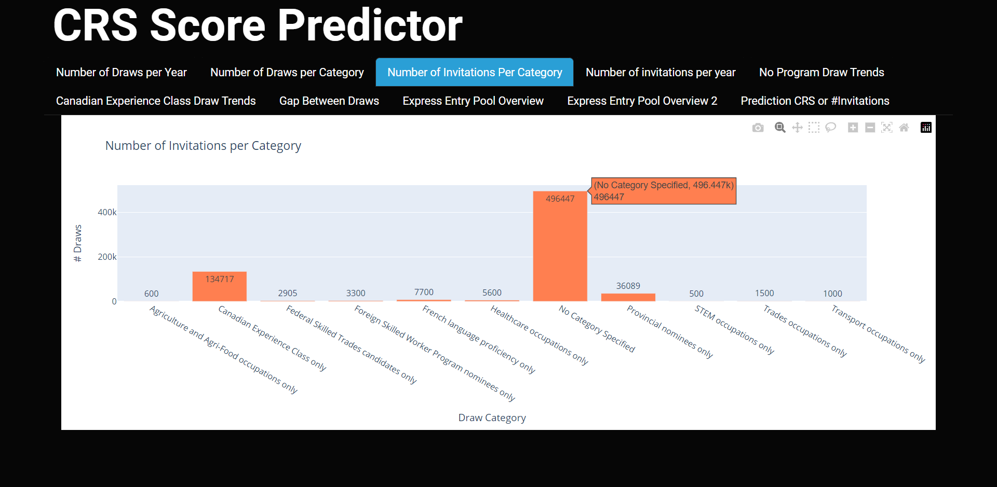
Number of Invitations per Category
Dominance of 'No Category Specified': The graph underscores the overwhelming prominence of the 'No Category Specified' segment, symbolized by a prominent green bar and a staggering 494,417 invitations.
Significant Disparity: The considerable difference in invitation counts between the 'No Category Specified' segment and other categories implies a unique position within the Express Entry landscape
Strategic Implications: The prevalence of the 'No Category Specified' category with a vast number of invitations suggests strategic considerations in the Canadian immigration framework. For individuals aspiring to migrate, deciphering the specifics of this category can be pivotal for optimizing their approach within the Express Entry system.

Slide 7
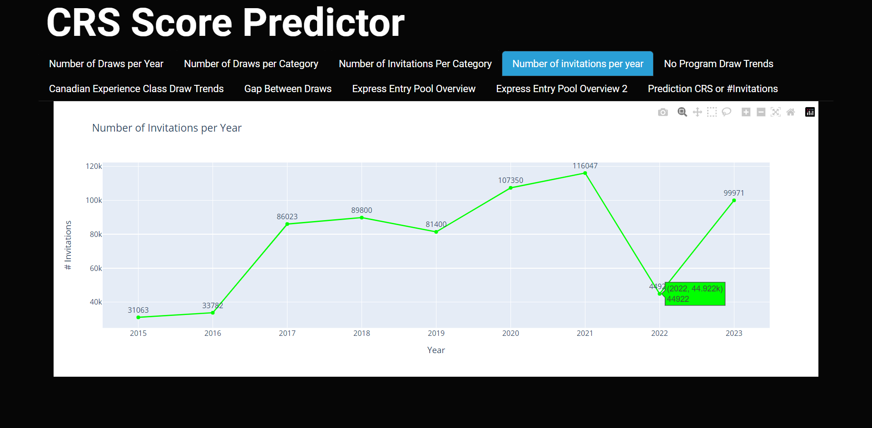
Number of Invitations per Year
Historical Surge (2015-2017): The graph illuminates a significant surge in invitations from 2015 to 2017, indicative of a period of heightened demand for skilled immigration or strategic shifts in Canadian immigration policies. This historical context sets the stage for understanding subsequent trends.
Fluctuations (2018-2020): Post-2017, the line graph reflects a series of fluctuations, signifying a dynamic and responsive nature within the Express Entry system.
Peak in 2021: With the graph showing more than 110,000 invitations, 2021 marks the peak of the trend. This peak points to a combination of factors that either strategically adjusted the Canadian immigration framework that year or contributed to a spike in the demand for skilled immigrants.

Slide 8
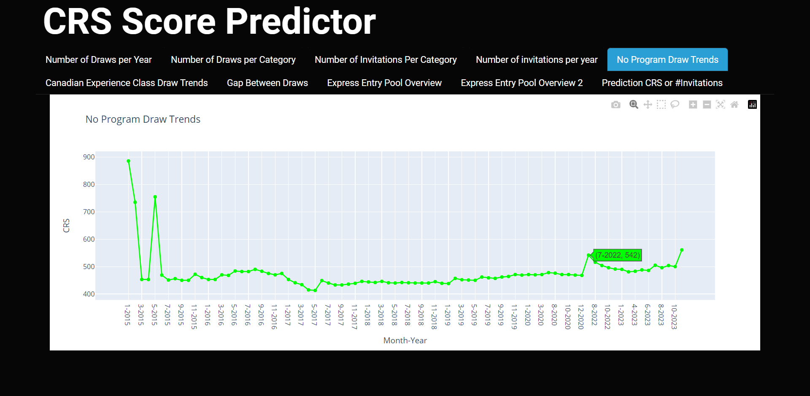
No Program Specified Draws Trend
Initial Spike: The graph unveils an initial surge in CRS scores, indicative of a period characterized by higher eligibility thresholds for invitation. This could signify a competitive landscape or specific policy adjustments influencing the minimum CRS scores required for successful draws.
Consistent Low Trend: Following the initial spike, the graph maintains a steady low trend in CRS scores over time. This sustained low level may reflect a period of relative accessibility for applicants, potentially driven by strategic changes in immigration policies or a deliberate effort to broaden the pool of eligible candidates.
Subtle Upward Trend: Towards the end of the graph, there is a discernible, albeit slight, increase in CRS scores. This shift suggests a nuanced change in draw dynamics, potentially reflecting evolving immigration strategies, shifts in demand for specific skills, or adjustments in the Express Entry system to meet changing societal needs.

Slide 9
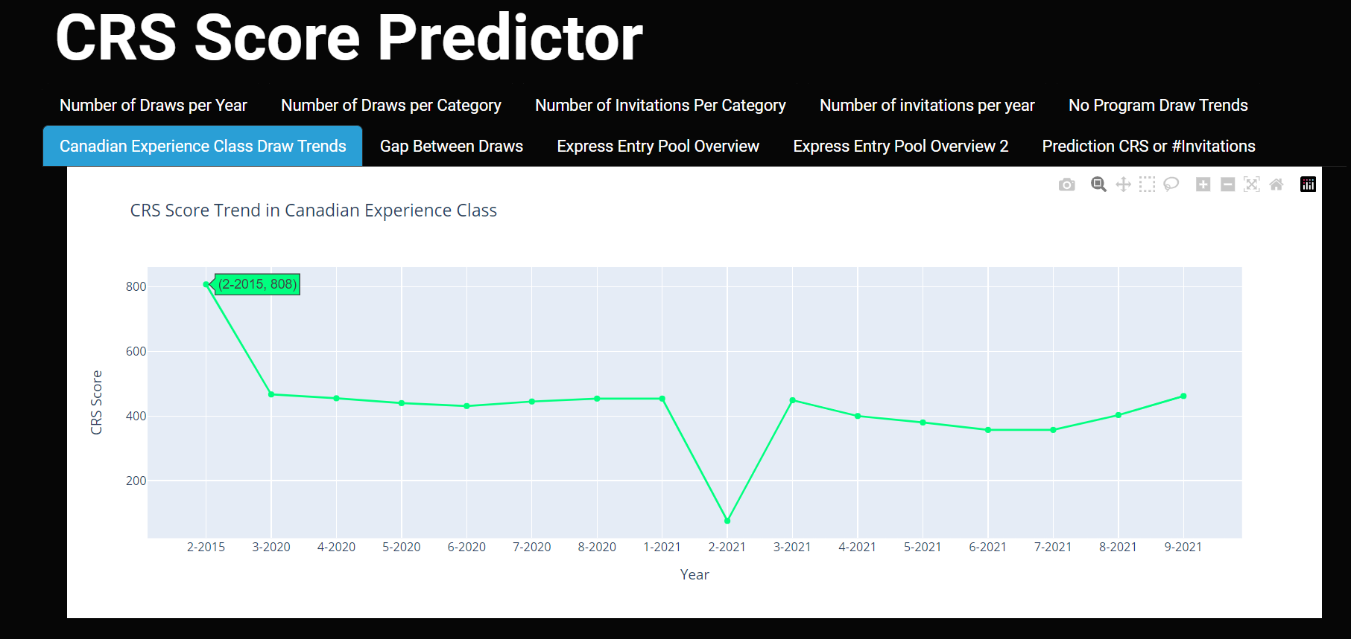
CRS Score Trend in Canadian Experience Class
Mid-2020 Decline: The graph depicts a significant CRS score decrease in mid-2020 for the Canadian Experience Class. This decline may signal a purposeful adjustment to lower eligibility thresholds, responding to shifts in immigration priorities or external factors influencing demand for skilled individuals in specific fields.
Recovery Phase: Post-mid-2020 decline, the graph shows a strategic recovery in the Canadian Experience Class, signaling a renewed emphasis on attracting skilled immigrants through targeted policies and leading to an increase in CRS scores.
Implications for Applicants: For prospective immigrants, comprehending the draw distribution per category is crucial. This insight can inform tailored application strategies, aligning individual profiles with the categories more likely to witness draws, thereby enhancing the overall success rate.

Slide 10
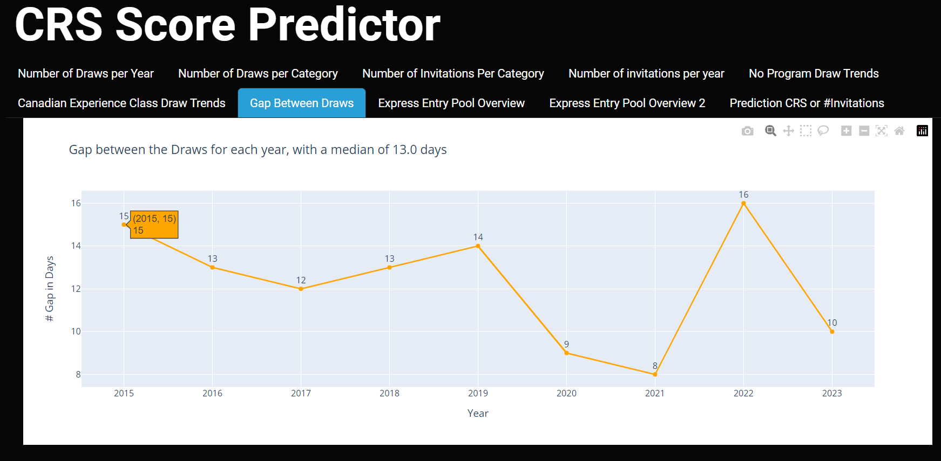
Gap between the Draws for each year
Temporal Fluctuations: The graph highlights changing gaps between draws, reflecting the dynamic nature of Express Entry draw scheduling. These fluctuations may stem from administrative adjustments, policy changes, or external factors shaping the immigration landscape.
Increased Gap in 2021: A notable feature is the substantial increase in the gap between draws observed in 2021. This deviation from previous years suggests a deliberate shift in draw dynamics during that period.
Median Draw Interval of 13.0 Days: The graph highlights a median draw interval of 13.0 days, providing a benchmark for understanding the typical temporal spacing between draws. This information is crucial for prospective applicants, enabling them to anticipate the frequency of invitation rounds within a given year.

Slide 11
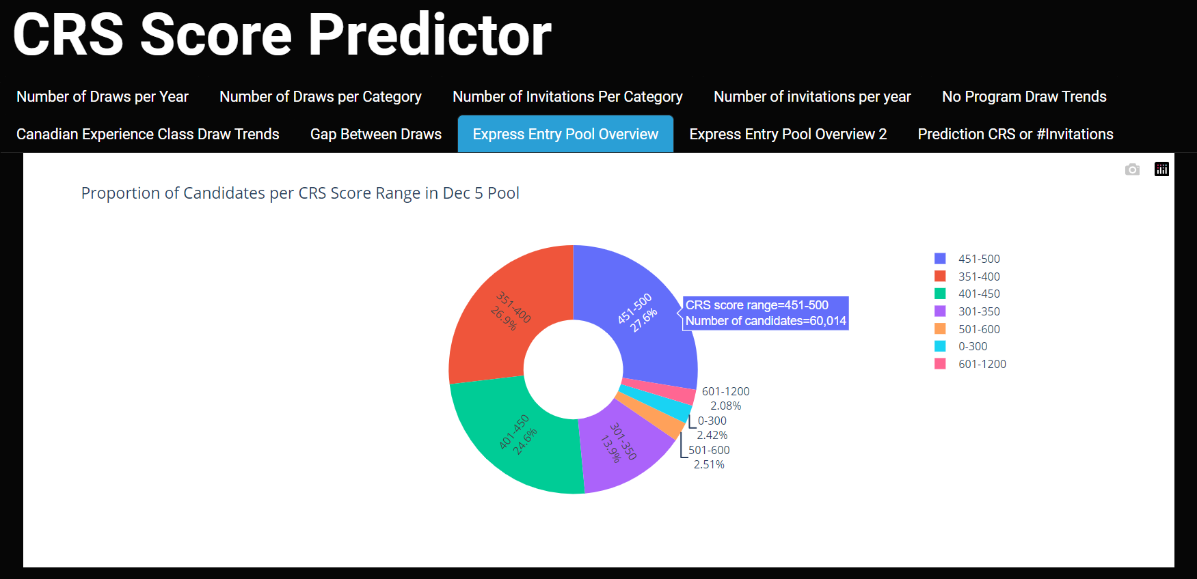
Proportion Of Candidates per CRS Score Range in Dec’s Pool
Distribution in Other Score Ranges:
0-300 (2.08%): Limited presence in the lower range, indicating fewer candidates with lower CRS scores.
301-350 (4.32%): Moderately represented in the mid-range category.
351-400 (20.49%): Significantly present, showcasing a diverse group of candidates.
401-450 (22.51%): Substantial portion with moderately competitive scores.
Dominance in 451-600 Range (50.01%): The pie chart underscores a prominent cluster of candidates, with half of the pool (50.01%) holding CRS scores in the range of 451-600. This concentration suggests a substantial portion of candidates in the pool possess competitive scores, potentially reflecting a high demand for skilled individuals in this range.

Slide 12
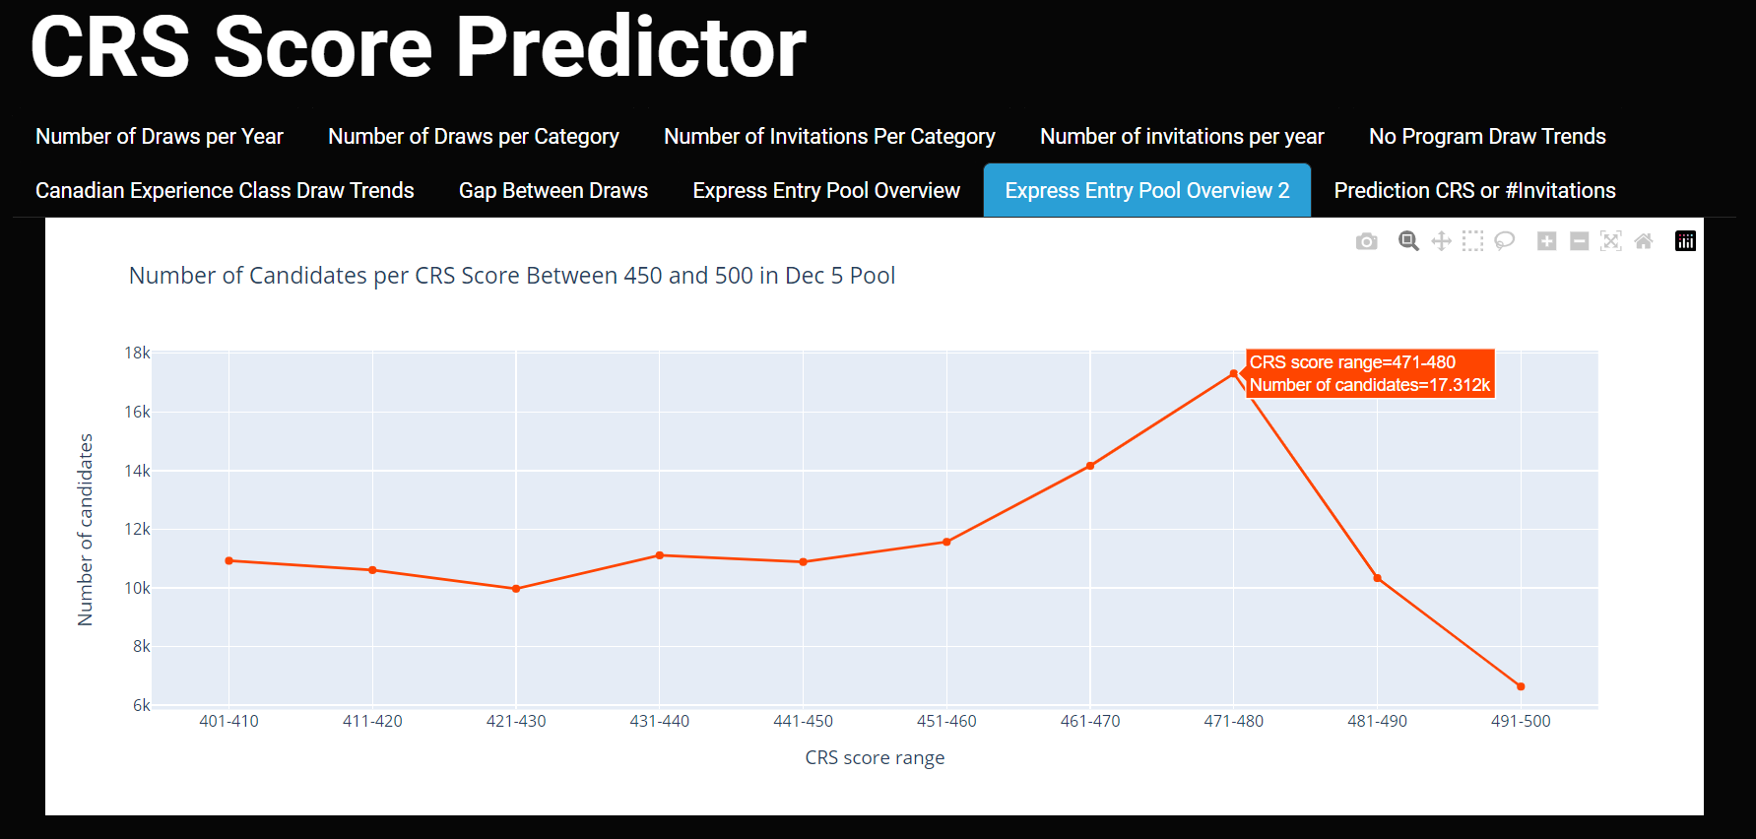
Express Entry Pool Overview
Drop Beyond 480: Beyond the 480 CRS score threshold, there is a noticeable decline in the number of candidates. This decline suggests a decrease in the candidate pool as scores move towards higher ranges, indicating a more selective distribution of candidates in the upper echelons of the CRS score spectrum.
Peak at 471-480 (17.32k Candidates): The graph highlights a significant peak in candidate numbers within the CRS score range of 471-480, indicating a concentrated cluster of candidates with scores in this competitive range. This concentration may signify a strategic grouping of applicants aiming for a specific threshold.

Slide 13
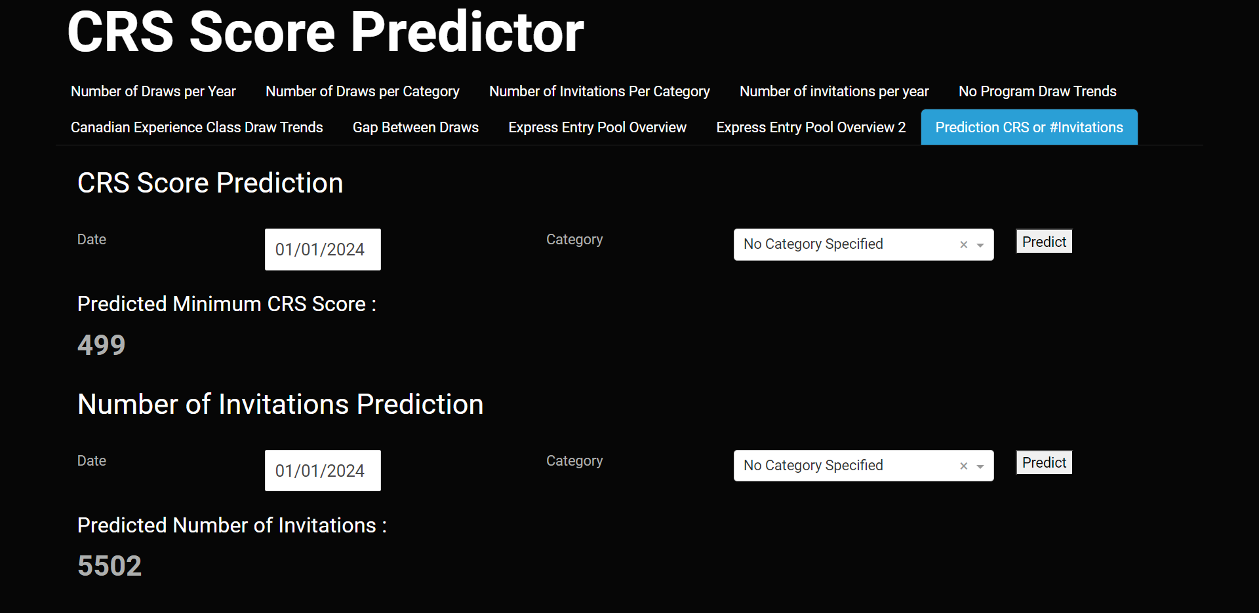
Predictions
Predicted Number of Invitations (01/01/2024 - "No Category Specified"):
The tool estimates a total of 5502 invitations for the "No Category Specified" category on January 1, 2024. This prediction serves as a strategic indicator, helping prospective immigrants gauge the level of competition and plan their applications accordingly.
Predicted Minimum CRS Score (01/01/2024 - "No Category Specified"):
The tool forecasts a minimum CRS score of 499 for applicants in the "No Category Specified" category on January 1, 2024. This predictive score serves as a valuable reference for individuals planning their Express Entry submissions, offering insights into the competitive landscape at the specified date.

Slide 14
Tech Stack and Model Summary
Data Scrapping :
Libraries Used : Beautiful Soup, Request , CSV
Website Link : https://www.canadavisa.com/express-entry-invitations-to-apply-issued.html
Data Visualization :
Plotly
Machine Learning Models:
XGB Regressor ,Linear Regression, Ridge Regression, Lasso Regression, ElasticNet Regression, Support Vector Regression, Decision Tree Regression, Random Forest Regression and Prophet
Final Model and Results : XGB Regressor
Model Tracking : Mlflow
Web Interface : Dash
Type | RMSE | MAE | R2_score
CRS Score Prediction | 20 | 3.7 | 0.97
# Invitations Prediction | 395.8 | 15.5 | 0.94

Slide 15
Project Impact
Our capstone project aims to empower individuals with the knowledge and foresight needed to make informed decisions during the Express Entry process. By blending technical expertise with real-world application, CRS Score Predictor stands as a testament to our commitment to transforming immigration strategies.

