Slide 1
RAZORPAY AI BUILDATHON 2026
TRACK 3 · AI REVENUE RECOVERY
Revenue Watchdog
Retry congestion control for the Razorpay network.
An AI agent investigates failed payments, a deterministic policy engine decides, and a network-wide scheduler coordinates retries across merchants — so one struggling bank doesn't get stampeded by everyone's dunning logic at once.
Muhammad Rehan M Jamadar
github.com/RehaanDev/razorpay-buildathon-
T3-2026-revenue-watchdog
connect.rehan@outlook.in

Slide 2
THE PROBLEM
When one bank slows down, every merchant
makes it worse — together.
An issuer degrades. Every merchant's dunning logic notices at roughly the same moment and starts retrying — independently.
None of them can see each other. The bank gets a synchronised burst of retry traffic from thousands of merchants, on top of its organic load.
The outage gets deeper and longer. Every merchant's success rate drops further. The queue grows.
EVERY MERCHANT RETRIES ALONE
capacity
“Each merchant behaved rationally. Collectively, they made their own problem worse.”
M1
M2
M3
M4
M5
M6
Six merchants, one bank, zero coordination — every bar clears the ceiling at once.
A merchant-side tool can't fix this — it has exactly one lever, its own retries, and holding back unilaterally just means it recovers less while everyone else still stampedes.
REVENUE WATCHDOG · RAZORPAY AI BUILDATHON 2026 · TRACK 3
02

Slide 3
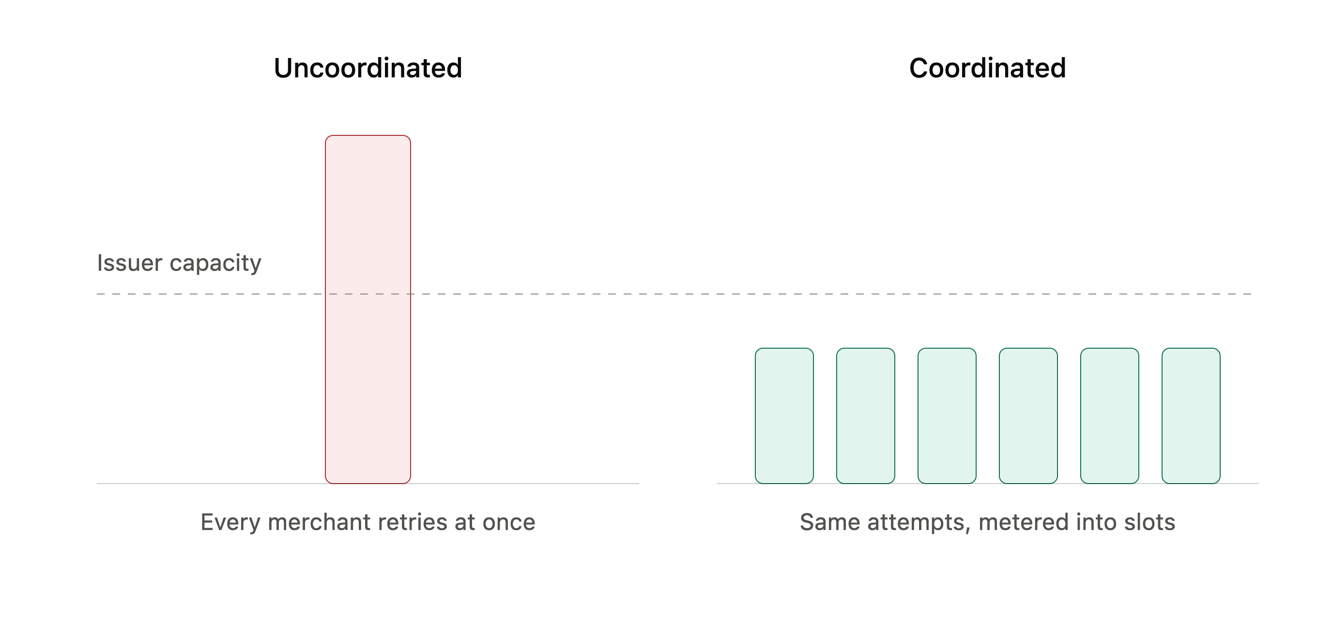
THE FIX
Meter the network, don't multiply the stampede.
UNCOORDINATED
COORDINATED
Every merchant retries at once and blows straight past issuer capacity — deepening the very outage they're trying to survive.
Same attempts, the same customers — spread across time slots and allocated by expected value under a fairness floor.
This is the layer only Razorpay can build — visibility across every merchant at once, not just one.
REVENUE WATCHDOG · RAZORPAY AI BUILDATHON 2026 · TRACK 3
03

Slide 4
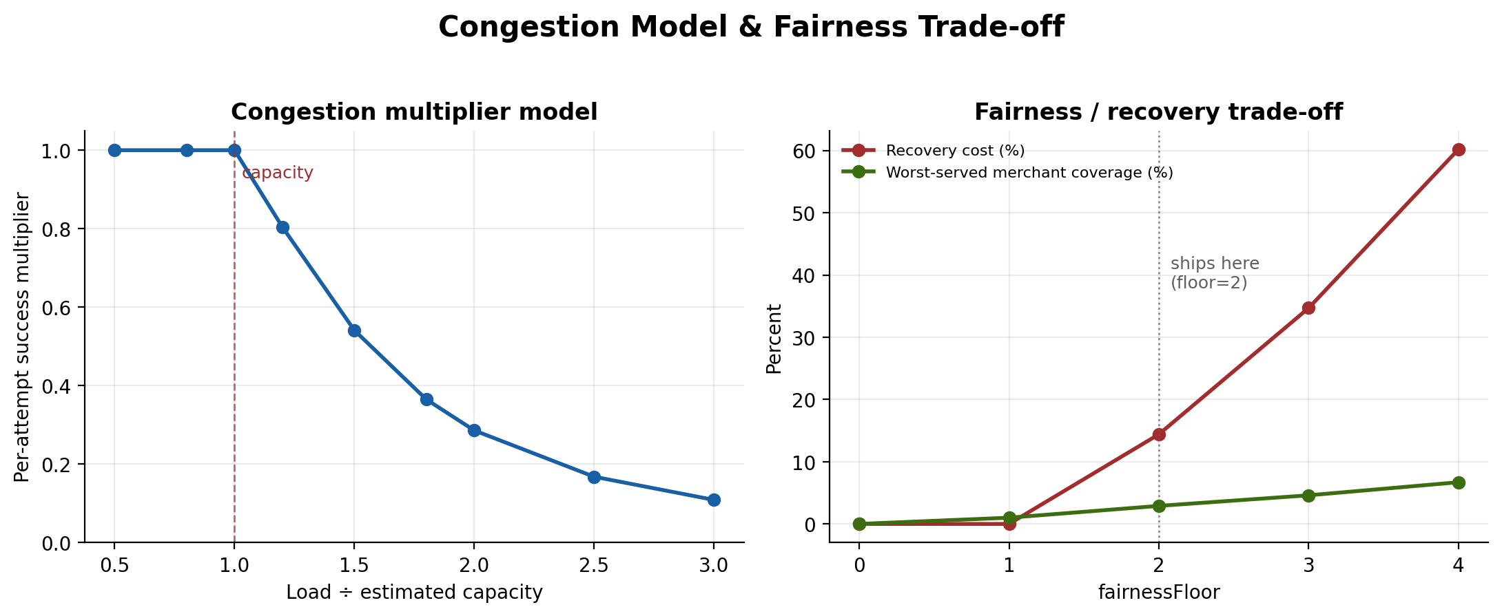
THE MODEL BEHIND THE FIX
The physics of retry congestion — and who pays for fairness
Congestion collapses success. Past 1.0× estimated capacity, per-attempt success falls fast — blind retries make things worse, not better.
Fairness has a price, and it's published. fairnessFloor guarantees every merchant a shot at scarce slots. Watchdog ships at floor = 2: a 14.4% recovery cost for a 2.9% worst-served floor.
REVENUE WATCHDOG · RAZORPAY AI BUILDATHON 2026 · TRACK 3
04

Slide 5
PROOF, NOT A DEMO
30 independent days. One reproducible number.
Control (naive dunning) versus Treatment (Watchdog), same seeded traffic, pooled across a 30-day holdout.
76.3%
60.2%
+16.02pp
₹94,802
TREATMENT RECOVERY RATE
CONTROL RECOVERY RATE
ABSOLUTE LIFT (P < 0.0001)
INCREMENTAL RECOVERY
Arm | Decisions | Recovered | Rate
Control — naive dunning | 166 | 100 | 60.2%
Treatment — Watchdog | 712 | 543 | 76.3%
REPRODUCE EXACTLY
$ npm run accumulate
Byte-identical between runs and between machines. 24 of 30 days showed positive lift, 6 negative — which is exactly why the product refuses to print a lift figure until both arms are large enough to support one.
Control is naive dunning — retry on every decline, whatever the code says — not a strawman for a tuned commercial tool. Read this as the lift over doing the obvious thing.
REVENUE WATCHDOG · RAZORPAY AI BUILDATHON 2026 · TRACK 3
05

Slide 6
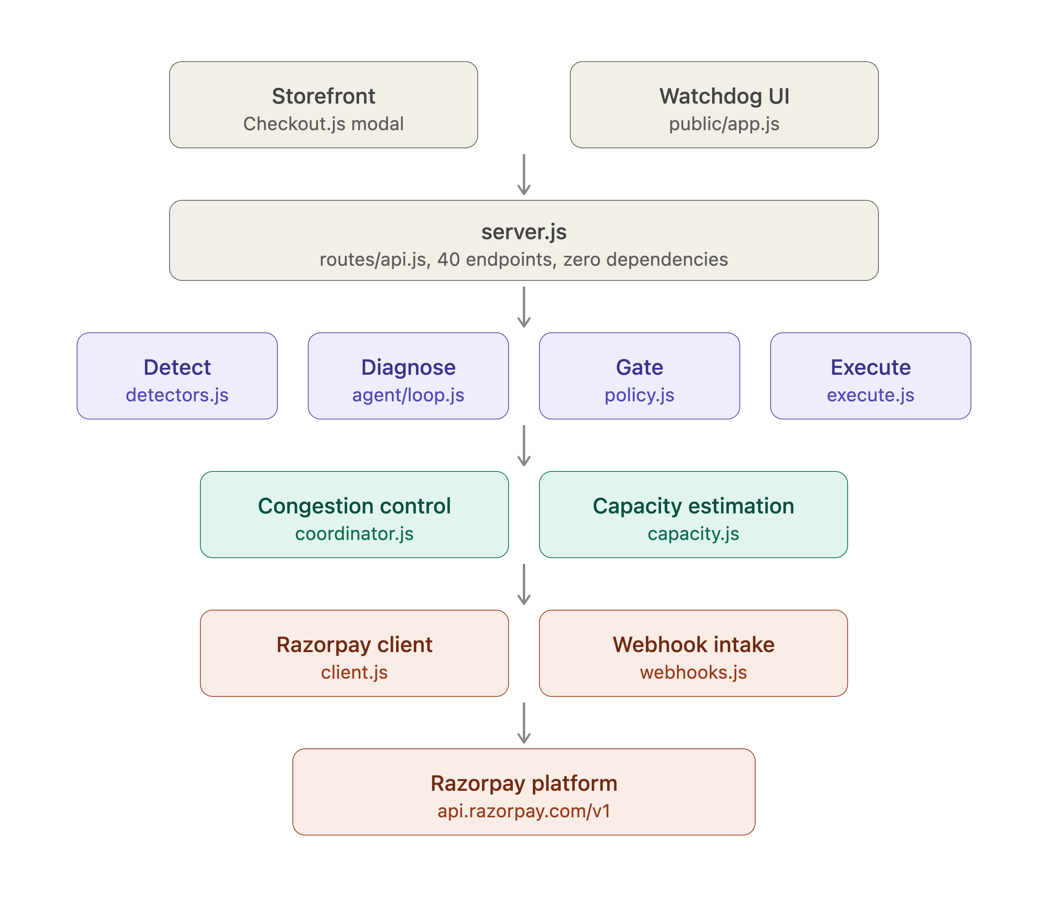
ARCHITECTURE
System architecture — zero external
dependencies
Two front doors, one server. Storefront (Checkout.js) and Watchdog UI both hit server.js — 40 REST endpoints, no framework.
Four-stage brain. Detect (detectors.js) → Diagnose (agent/loop.js) → Gate (policy.js) → Execute (execute.js), each a standalone module.
Cross-merchant layer. coordinator.js (congestion control) and capacity.js (issuer capacity estimation) — the part no single merchant could ever build alone.
Razorpay boundary. client.js is the only code that writes; webhooks.js is the only source of truth coming back.
9,821 lines of JavaScript · 0 npm dependencies · boots in ~600ms
REVENUE WATCHDOG · RAZORPAY AI BUILDATHON 2026 · TRACK 3
06

Slide 7
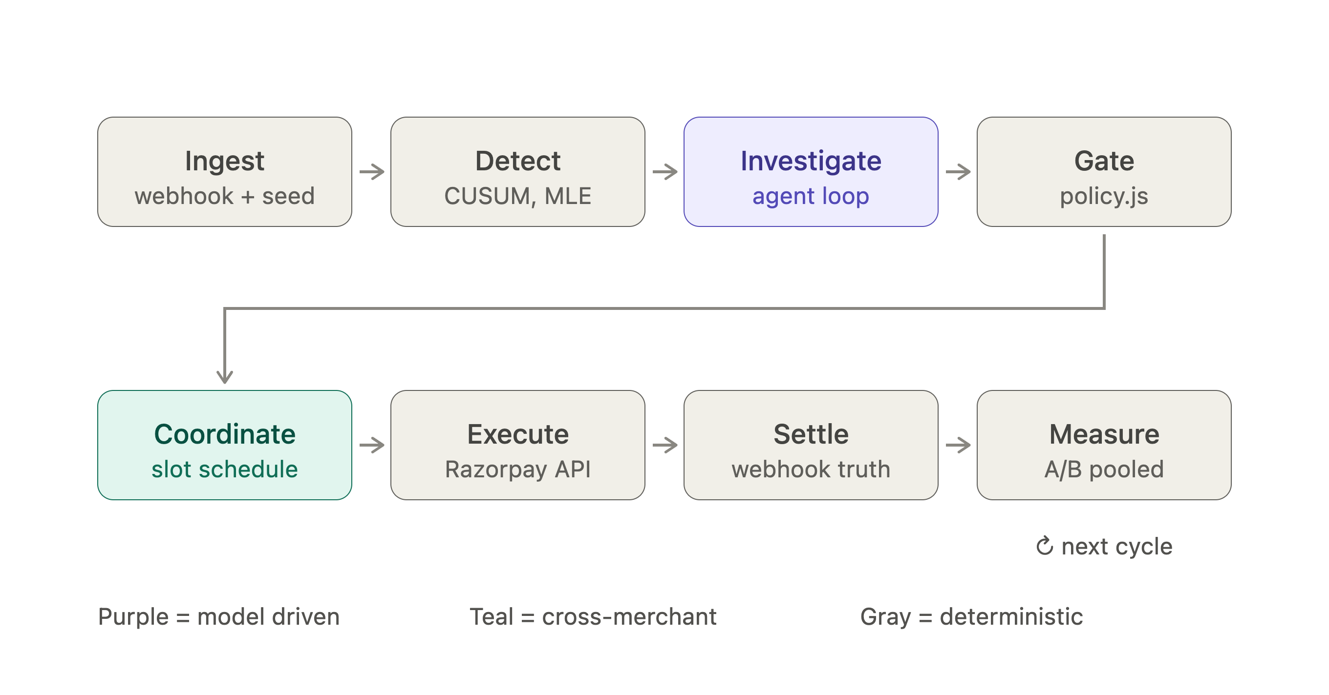
PIPELINE
One cycle, eight stages, three kinds of trust
Purple — model-driven
Teal — cross-merchant
Gray — deterministic
the only stage that ever touches a language model
the network-level coordination novelty
tested, typed, and auditable code
REVENUE WATCHDOG · RAZORPAY AI BUILDATHON 2026 · TRACK 3
07

Slide 8
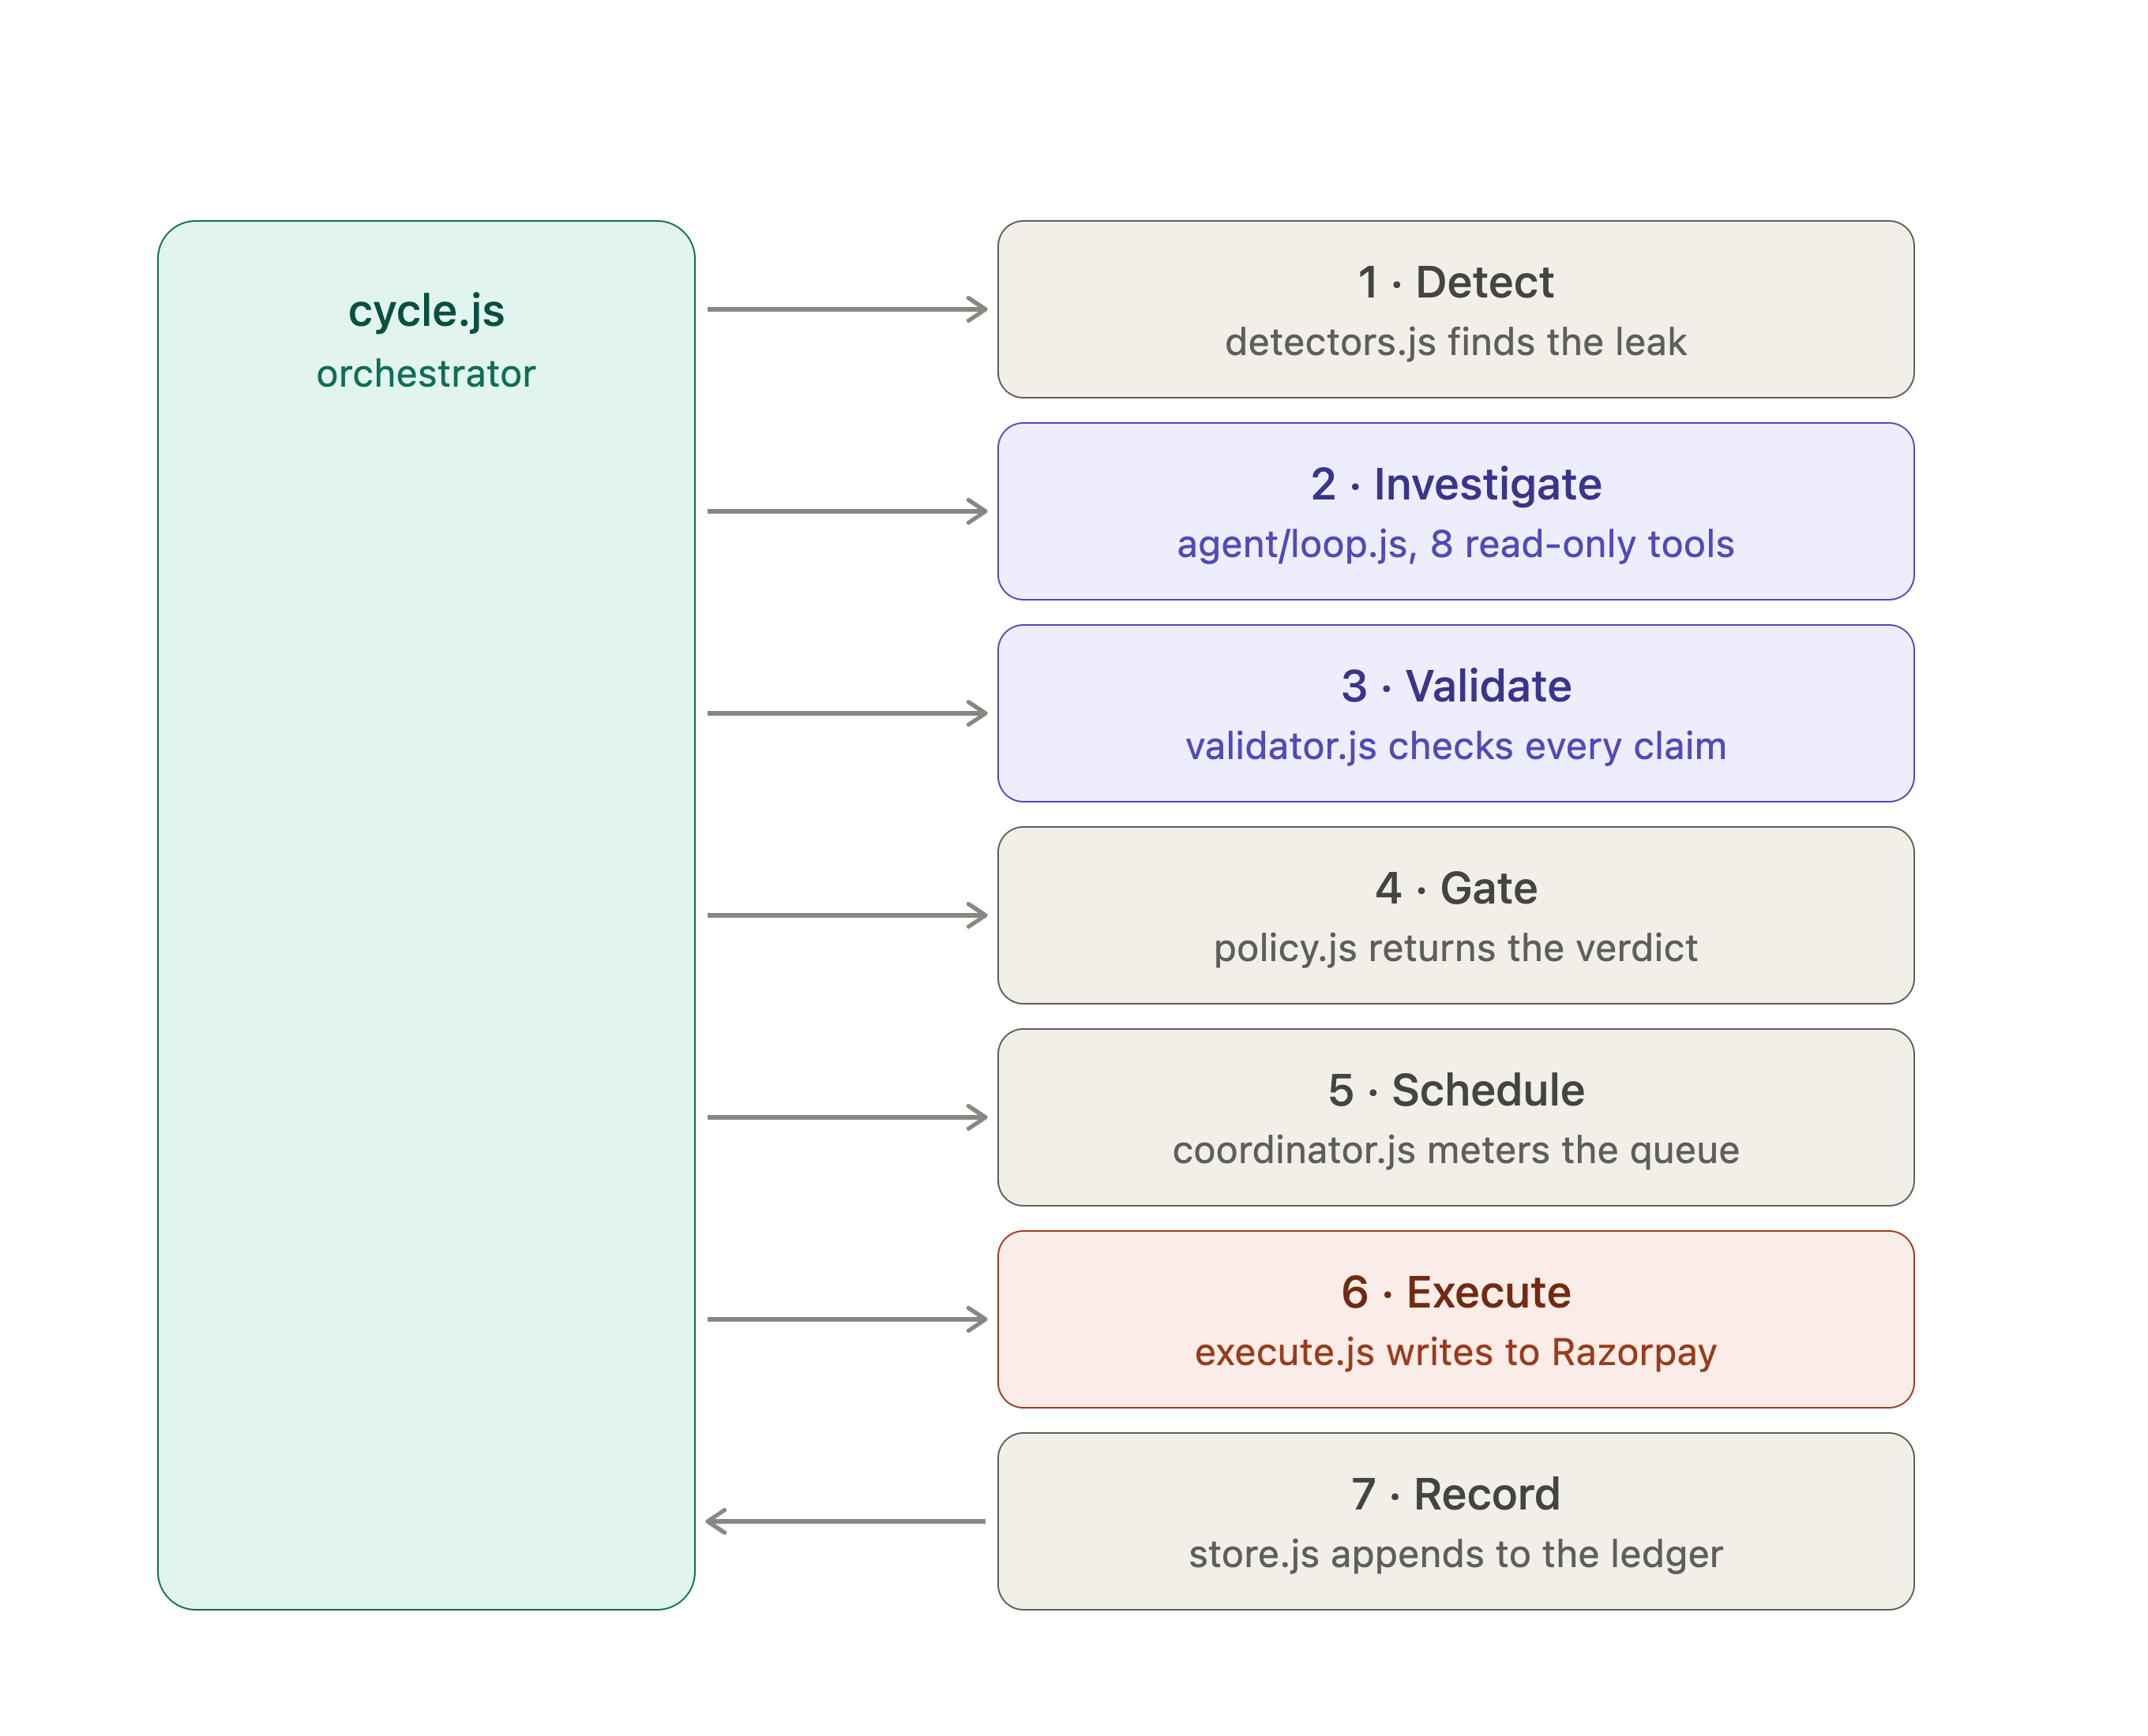
ENGINEERING
Inside cycle.js — the orchestrator
1
Detect
detectors.js finds the leak (CUSUM, MLE change-point)
2
Investigate
agent/loop.js — 8 read-only tools
3
Validate
validator.js checks every claim against a factId
4
Gate
policy.js returns AUTO / REVIEW / BLOCK
5
Schedule
coordinator.js meters the queue
6
Execute
execute.js — the only code allowed to write
7
Record
store.js appends to the ledger
Seven deterministic steps. The model only ever occupies step 2.
REVENUE WATCHDOG · RAZORPAY AI BUILDATHON 2026 · TRACK 3
08

Slide 9
THE AGENT
What the agent is allowed to know
Nine tools total. Eight are read-only. The ninth only ever writes a proposal.
R1
R2
R3
R4
list_open_leaks
inspect_payment
get_decline_breakdown
get_customer_history
R5
R6
R7
R8
estimate_recovery_probability
check_congestion
compare_across_network
simulate_policy_change
W1 propose_recovery_posture — writes a proposal, and nothing else. No route exists from here to the executor.
Every claim must cite a factId from a tool result — a number that can't be traced back is rejected before it reaches you.
10/12
100%
100%
3.7
EVAL SCENARIOS PASS
CAUSE ATTRIBUTION
POSTURE SELECTION
AVG. TOOL CALLS / RUN
REVENUE WATCHDOG · RAZORPAY AI BUILDATHON 2026 · TRACK 3
09

Slide 10
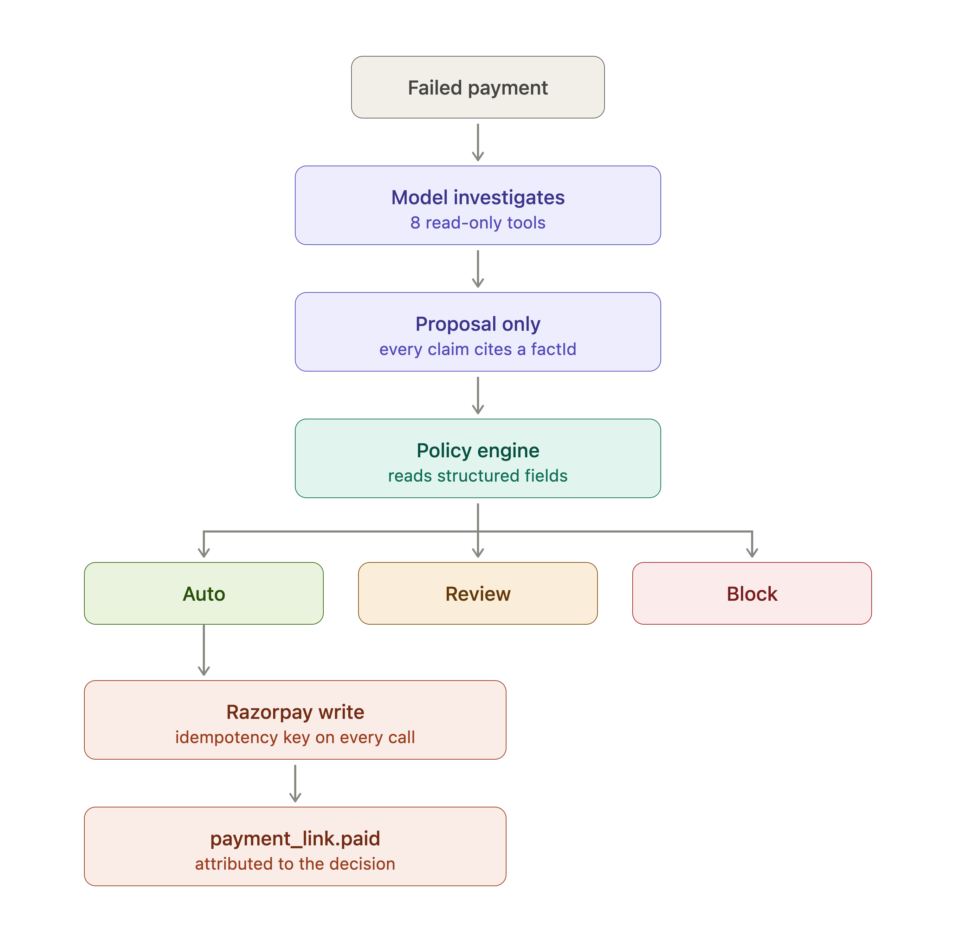
GUARDRAILS
The agent cannot move money — by
architecture, not policy
The 9th tool, propose_recovery_posture, writes a proposal and nothing else — there is no route from the model to the executor.
Every action passes a deterministic policy engine that reads structured fields only. It never reads free text.
3 TESTS PIN THIS DOWN
ok the agent has no tool that can move money
ok the only write-shaped tool is a proposal
ok nothing executed without a rule authorising it
“A perfectly successful prompt injection still cannot cause a payout — the capability was never in the model's hands.”
REVENUE WATCHDOG · RAZORPAY AI BUILDATHON 2026 · TRACK 3
10

Slide 11
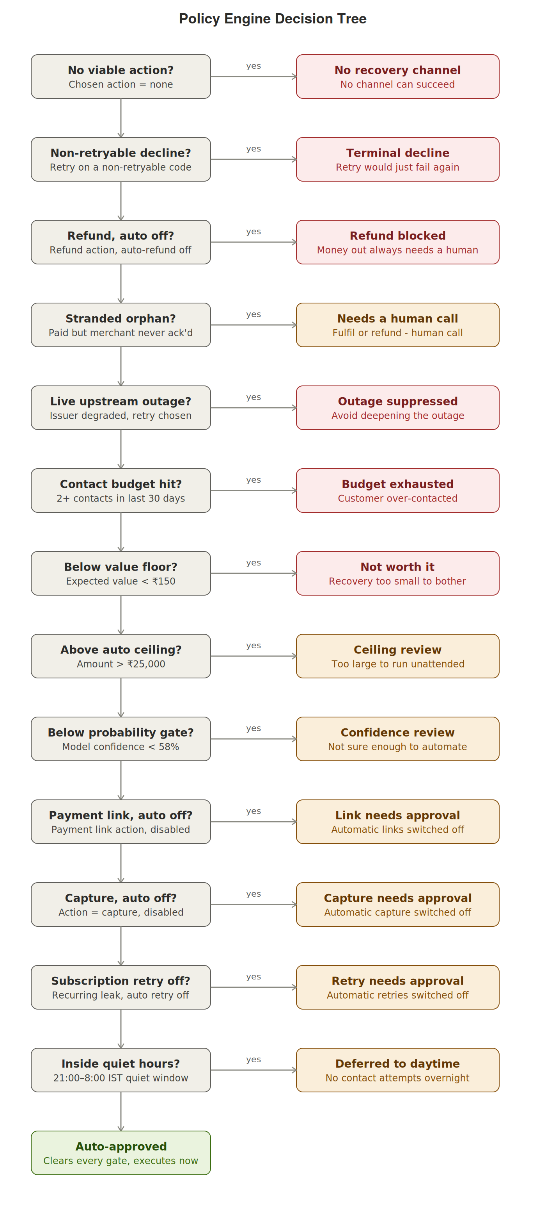
POLICY ENGINE
14 deterministic gates stand between a
suggestion and a rupee
No viable action, or a non-retryable decline code → stop immediately. Retrying would just fail again.
Money out always needs a human. Refunds and payment links ship with auto-execution off by default.
Customer protection is a gate too — a contact budget and a 21:00–8:00 IST quiet window, not just merchant protection.
Above ₹25,000 or below 58% model confidence → REVIEW, never AUTO.
Clears every gate → AUTO, executes now. Every verdict carries the reason that produced it.
AUTO
REVIEW
BLOCK
“BLOCK is a decision with a reason attached — not an error.”
REVENUE WATCHDOG · RAZORPAY AI BUILDATHON 2026 · TRACK 3
11

Slide 12
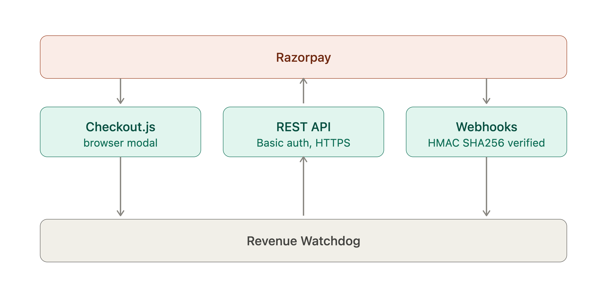
INTEGRATION
Real Razorpay, on three verified surfaces
Checkout.js
REST API
Webhooks
Real browser modal, real test-mode payments
Basic auth over HTTPS, idempotency key on every write
HMAC-SHA256 verified, deduplicated, replay-safe
payment_link.paid closes the loop — recovery attributed back to the exact decision that caused it.
REVENUE WATCHDOG · RAZORPAY AI BUILDATHON 2026 · TRACK 3
12

Slide 13
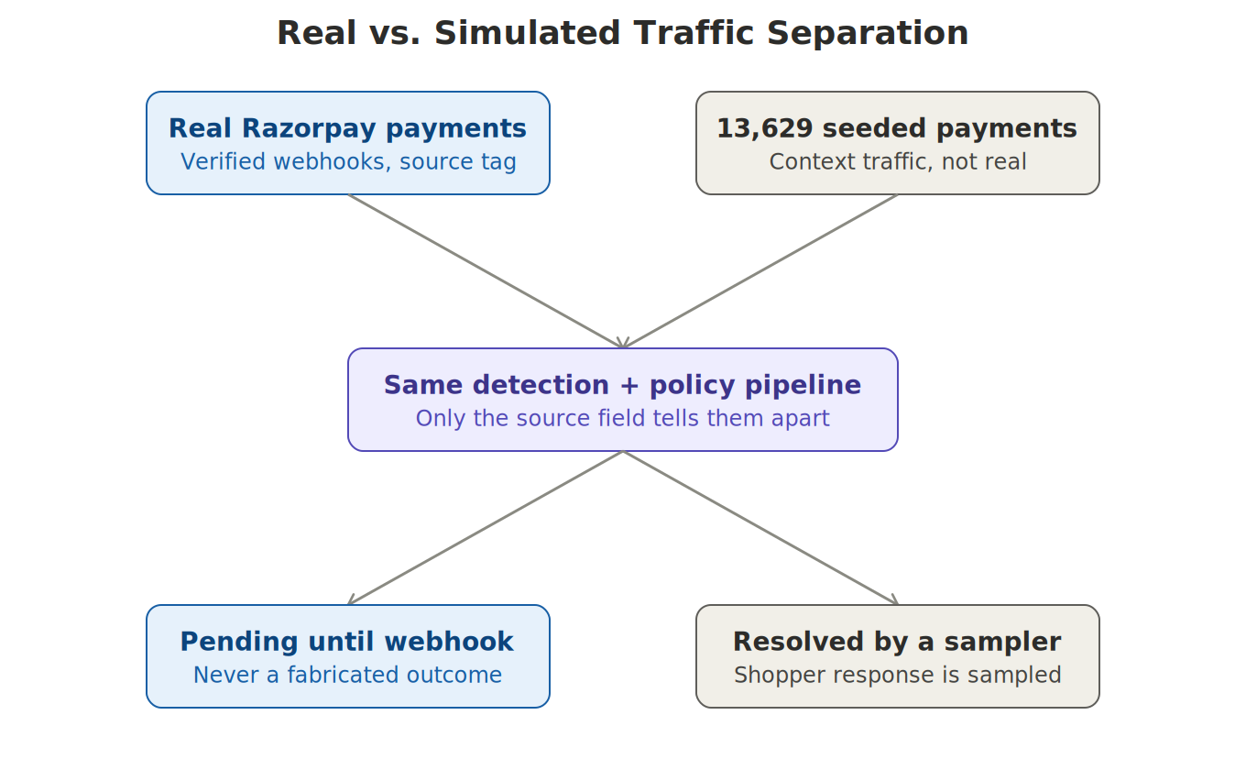
TRUST & HONESTY
Two kinds of traffic. One rule: never fabricate an outcome.
Real Razorpay payments stay pending until a verified webhook says otherwise. Seeded traffic (13,629 payments, for context) is resolved only by an explicit sampler — the two are never mixed in the same count.
REVENUE WATCHDOG · RAZORPAY AI BUILDATHON 2026 · TRACK 3
13

Slide 14
ENGINEERING RIGOR
Three bugs the tests caught before the judges did
Found by testing claims, not just code.
1
2
3
The headline number was inverted
The scheduler discarded its own capacity
The demo was never reproducible
Simulated recovery links sat unresolved in the treatment arm while control's naive retries settled instantly. accumulate.js reported −29.39pp — while all 49 assertions passed. Fixed with settleSimulatedPending(); added a test for result direction, not just presence.
Hitting one merchant's per-slot cap skipped the whole slot, abandoning room other merchants could have used. Fixing it to skip the item, not the slot, raised expected recovery about 21%.
Seeded payment IDs came from crypto.randomBytes, so the A/B holdout re-drew on every boot — arm sizes moved 10–15% per run. IDs now come from the seeded stream; 3 tests enforce it.
REVENUE WATCHDOG · RAZORPAY AI BUILDATHON 2026 · TRACK 3
14

Slide 15
INTELLECTUAL HONESTY
What we verified — and what we won't overclaim
VERIFIED
STATED UP FRONT
66 assertions, 0 failures · 12 agent evals
Webhook HMAC verification, dedup, and out-of-order handling all tested
Idempotency under replay is pinned by a test
Reproducibility: the same payment lands in the same arm on every run
Capacity estimator recovers a planted capacity, and declines a false one carrying the same success-rate drop
Fairness floor is pinned to actually cost recovery — a knob that costs nothing isn't doing anything
The A/B lift is measured against a simulator that shares a feature set with the policy — a disclosed circularity
2 of 12 eval scenarios reach the right verdict but miss a required naming check
Capacity isn't identifiable at demo volume — traffic runs ~2 orders of magnitude below where an issuer ceiling binds
Background traffic (13,629 payments) is synthetic, tagged and never mixed with real ones
Detection on an unseen issuer falls back to an assumed baseline, and says so
REVENUE WATCHDOG · RAZORPAY AI BUILDATHON 2026 · TRACK 3
15

Slide 16
WHY THIS WINS
What's actually novel here
1
2
3
Coordination, not just detection
Capacity is learned, not assumed
Fairness has a price tag
The first layer that sees retries across merchants — not within just one.
And the estimator knows exactly when to refuse to answer.
Published in a table, not buried in a default.
4
5
6
The agent can suggest, never spend
Every number traces to a fact
Honesty as a feature
Enforced by architecture — not a prompt, not a policy note.
Fabricated claims are rejected before they reach you.
Real vs. seeded traffic never mixed; bugs and limits disclosed, not hidden.
REVENUE WATCHDOG · RAZORPAY AI BUILDATHON 2026 · TRACK 3
16

Slide 17
TRACK 3 · AI REVENUE RECOVERY
Thank You
Revenue Watchdog — retry congestion control for the Razorpay network.
Muhammad Rehan M Jamadar
connect.rehan@outlook.in
github.com/RehaanDev/razorpay-buildathon-T3-2026-revenue-watchdog
MIT licensed · 9,821 lines of JavaScript · zero dependencies · npm test → 66/66

