Slide 1
IBM University Engagement Project Submission
“Exploring the Power of Agentic AI with IBM Granite and Langflow”

Slide 2

Project Tile – AI Skincare Concierge
Domain of Project – Healthcare (specifically clinical dermatology and personalized wellness)
Student Name | Recent Passport Photo | Email ID | Mobile number [WhatsApp]
Rehaan Khan |  | rehaankhan2207@gmail.com | 9439677283

Slide 3
Problem Statement -
Problem Statement - Agentic Skincare AI Platform
The Challenge
Healthy skin is a core pillar of personal wellness and confidence, but individuals constantly struggle with complex routine planning, product ingredient compatibility, and tracking shifting skin conditions. Information regarding effective skincare ingredients, skin barriers, and disease-specific topical treatments is heavily scattered across unreliable social media trends and conflicting commercial sources. Without personalized, real-time clinical guidance, many fail to maintain a balanced skin barrier, use incompatible active ingredients simultaneously, or make informed product choices.
The Objective
Democratize Clinical Dermatology – Provide individuals with instant, reliable access to personalized skincare guidance, filtering out confusing social media trends and unverified commercial product claims.
Prevent Active Barrier Damage – Protect user skin health by cross-referencing active ingredients against scientific boundaries to eliminate harmful product collisions and contraindications.
Bridge Custom Frontends with Advanced AI – Enable modern, stylized user interfaces to leverage specialized foundation models dynamically through clean, seamless tool orchestration.

Slide 4
Proposed Solution -
Multi-Agent Workflow Engine –
Intent & Profiling Agent (Core Orchestrator): Dynamically chats with the user, handles session context, and manages workflow loops using the standard platform brain.
Clinical Ingredient Knowledge Base (RAG Integration): A curated, secure data repository connected directly via Retrieval-Augmented Generation (RAG) to instantly pull scientific research regarding ingredient interactions, safety limits, and contraindications.
Dermatological Recommendation Agent (Specialized Tool): Invokes the dedicated ibm/granite-4-h-small model via a custom OpenAPI schema integration skincare_granite.json (https://drive.google.com/file/d/1z1UNiC8fIQpVULtM2pCVtkxyv8LbCYDl/view?usp=drive_link) to handle clinical reasoning, process prompt telemetry, and construct the structured 3-step clinical routine.
Telemetry Mapping & Boundary Validation – Validates user states and controls active profiles strictly against the architectural rules defined in skincare_telemetry_bounds.txt https://drive.google.com/file/d/1l41EM21D3M0fufQLzHzU0rKEkbvGak0T/view?usp=drive_link before shipping inputs to the underlying foundation model.

Slide 5
Technology Used -
Frontend: HTML5, CSS3 (Glassmorphism), and JavaScript (ES6+). Delivers a high-fidelity, responsive, and completely client-side user interface.
Backend: FastAPI (Python 3.10+), Uvicorn, and HTTPX. Acts as a secure gateway managing CORS, state validation, and integrations.
Development IDE: IBM Bob. AI-assisted development environment used for code generation, debugging, and workflow acceleration.
AI Orchestration: IBM watsonx Orchestrate. Coordinates multi-model routing workflows and handles conversational runtime logic.
Foundational Models: IBM Granite 4h Small & GPT-OSS 120B. Enterprise LLMs utilized for deep clinical reasoning and structured skincare routines.
Hosting (API): Render. Hosts the containerized Python backend environment featuring automated continuous deployment pipelines.
Hosting (UI): Vercel. Serves static UI assets globally via a high-speed Content Delivery Network (CDN).

Slide 6
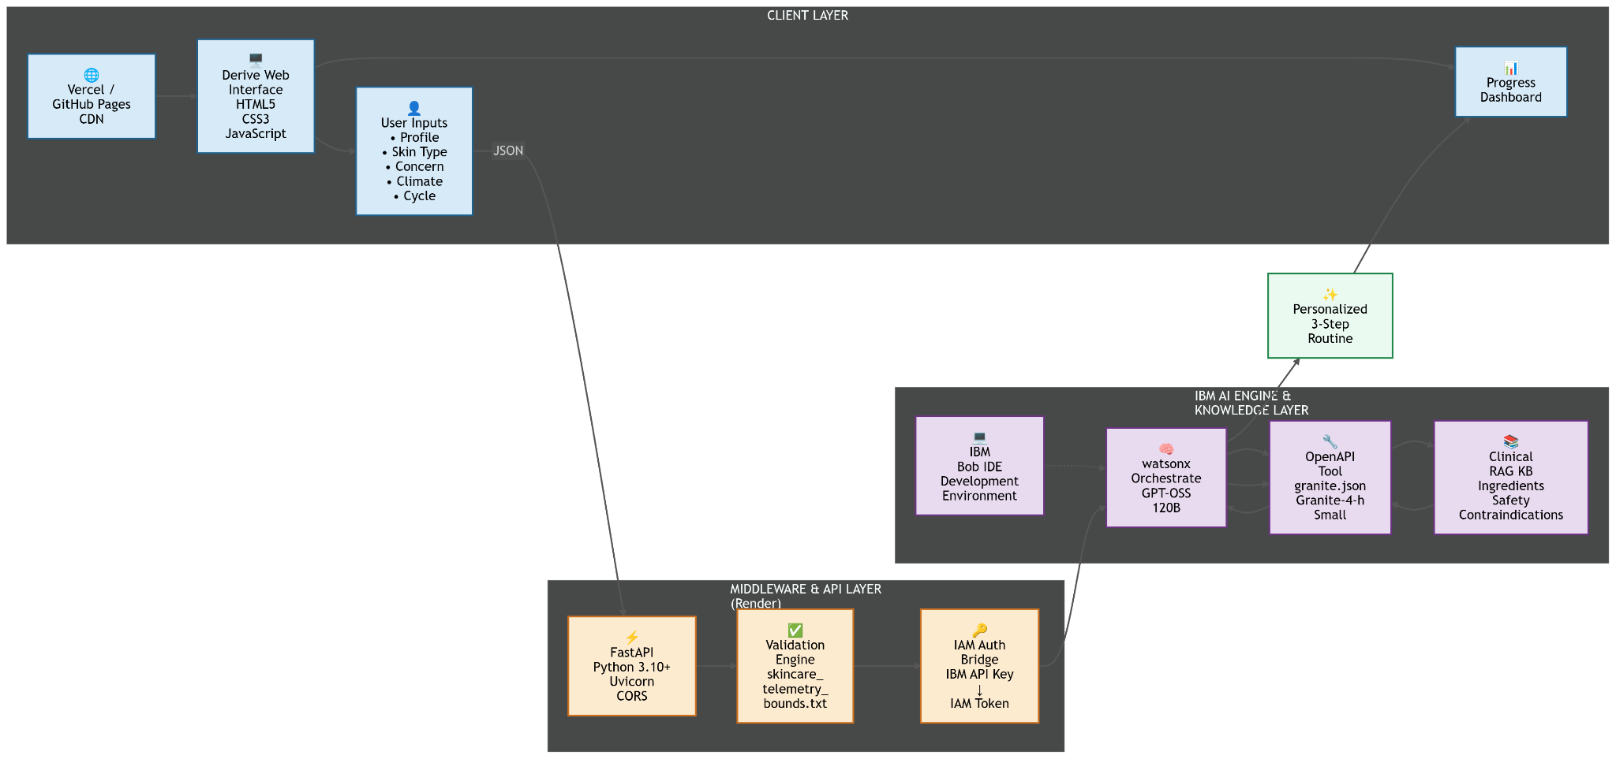
Architecture Blueprint

Slide 7

Role of Agentic AI in the solution
Unlike traditional, rigid software that relies on static decision trees, Agentic AI serves as the intelligent operational core of this platform by shifting from basic pattern matching to autonomous problem-solving and task delegation. The system utilizes GPT-OSS 120B as a central orchestrator to dynamically analyze user intent, manage complex state context, and efficiently capture structured telemetry inputs and selections directly from the user interface. Once these personal parameters are collected, the agent autonomously evaluates the workflow and delegates specialized workloads—routing clinical reasoning tasks directly to the ibm/granite-4-h-small foundation model via a custom OpenAPI schema, while simultaneously querying the RAG knowledge base for safety constraints. By acting as an independent decision-maker that evaluates boundaries, manages API dependencies, and synthesizes multi-model outputs, Agentic AI transforms a standard input selection interface into a fully integrated, automated clinical engineering pipeline.

Slide 8
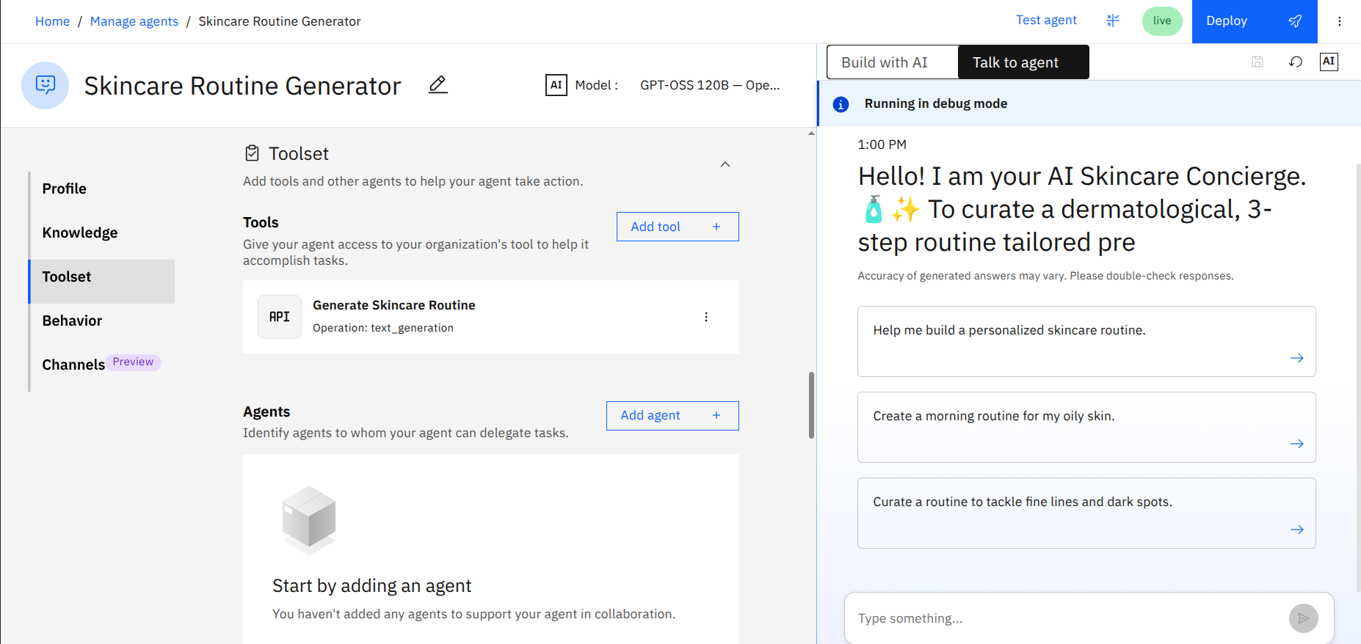
Custom Skill Integration & Agent Testing Dashboard

Slide 9
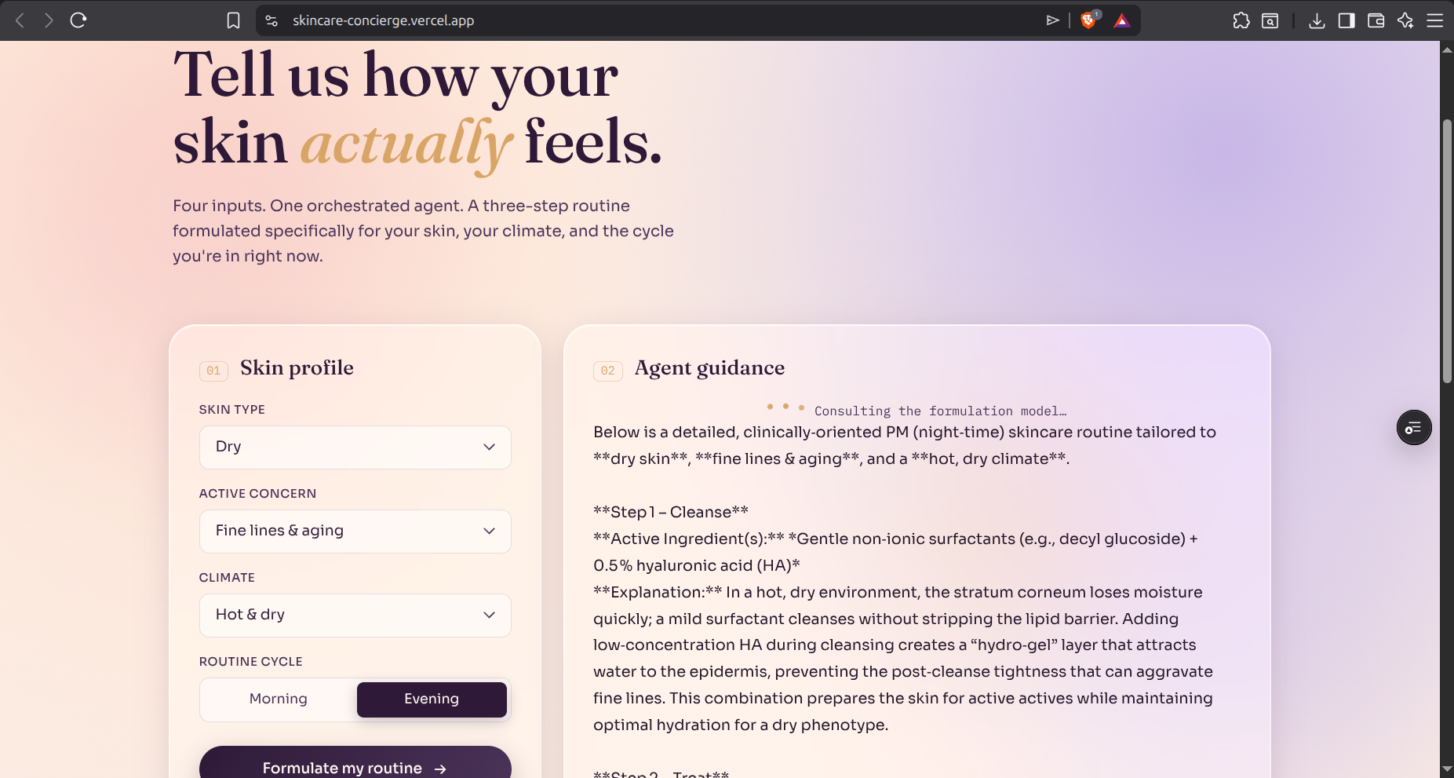
User Interface & Dynamic Routine Generation

Slide 10
Novelty and Uniqueness
Multi-Model Asynchronous Orchestration: Uniquely decouples system concerns by combining a high-speed runtime gateway (FastAPI) with an enterprise orchestrator (GPT-OSS 120B) to handle dynamic user telemetry without session or token expiration vulnerabilities.
Deterministic Guardrails for Generative AI: Replaces unpredictable LLM output behaviors with real-time, rule-based boundary enforcement (skincare_telemetry_bounds.txt), guaranteeing clinically safe ingredient combinations before foundation model processing.
By bridging flexible consumer frontends with rigid enterprise AI orchestration and deterministic safety guardrails, this architecture delivers clinical-grade personalization with total operational reliability.

Slide 11
Important Links
Github Repository Link - https://github.com/RehaanKhan2207/Skincare-Concierge
Frontend UI Link - https://skincare-concierge.vercel.app/
Backend API Link - https://skincare-concierge.onrender.com

Slide 12
Future Scope
Computer Vision Skin Analysis: Integration of client-side camera APIs to perform real-time, visual skin barrier analysis and automatically detect hyperpigmentation, acne severity, or redness alongside text inputs.
Predictive Environmental Adaptation: Connecting the backend to live, location-based weather APIs to automatically recalibrate the routine's active ingredients based on real-time UV indexes, humidity levels, and pollution spikes.
By evolving from reactive inputs to proactive visual and environmental telemetry, the next phase of the platform will establish a truly automated, preventative dermatological care ecosystem.

Slide 13
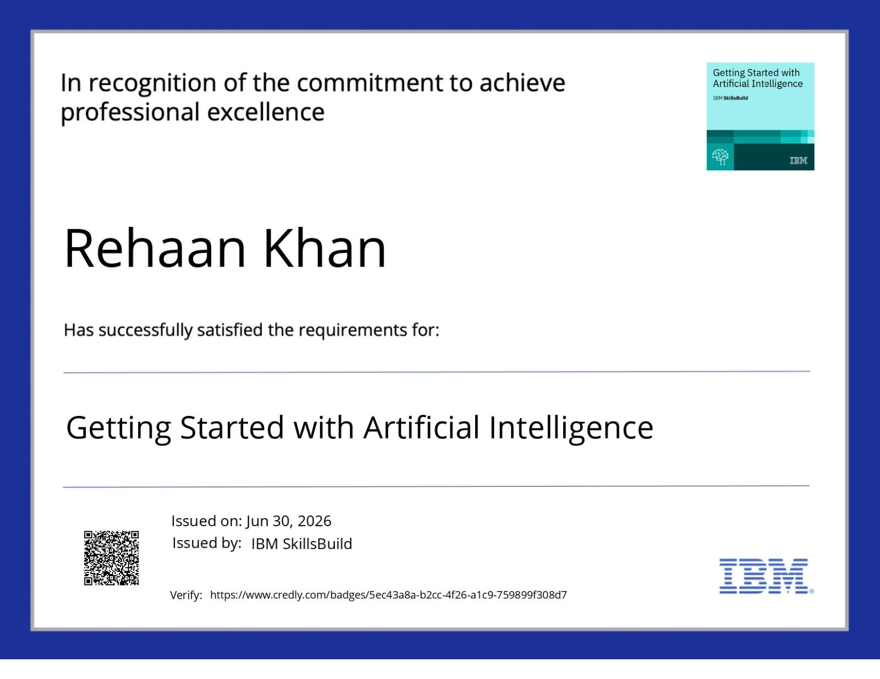
Certificates Earned:
Getting Started with Artificial Intelligence

Slide 14

Certificates Earned:
Getting Started with Artificial Intelligence

Slide 15


