Slide 1

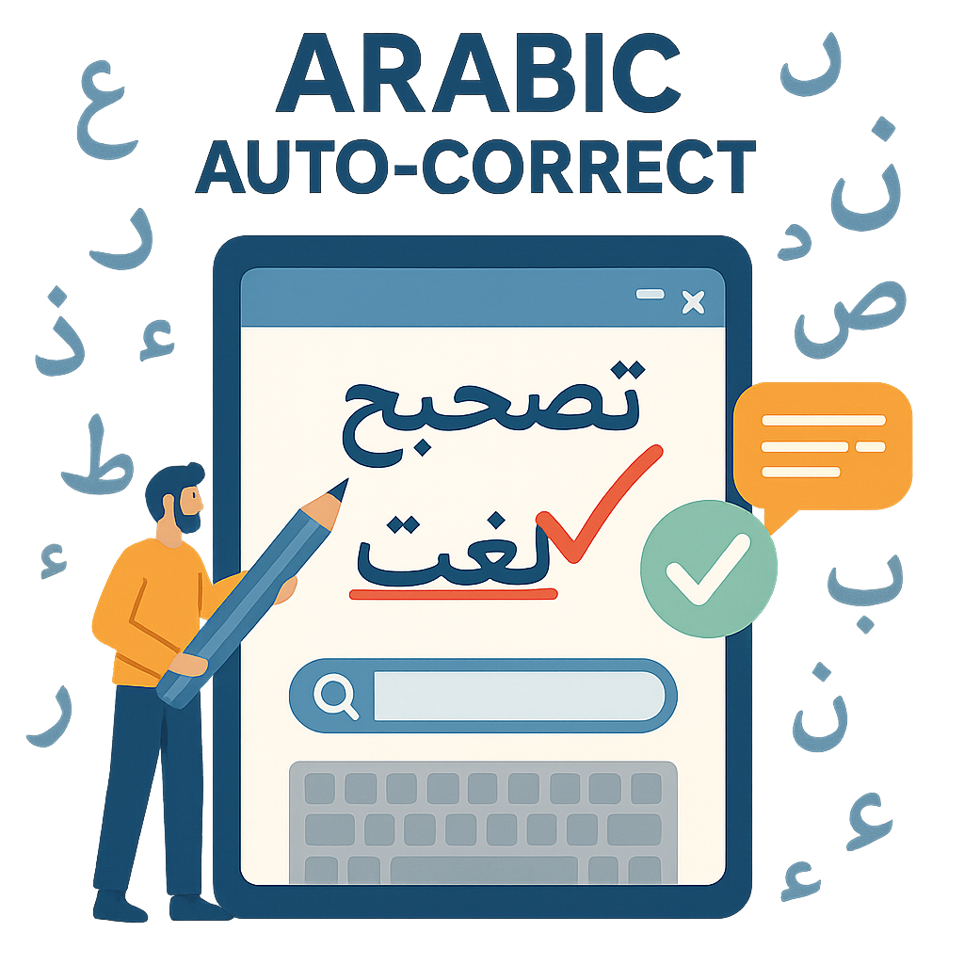
ARABIC AUTO CORRECTION

Slide 2
PROJECT OVERVIEW
This project aims to correct Arabic text using deep learning models, specifically LSTM, Transformer, and Twin-BERT-Large architectures. The goal is to detect and correct spelling and typographical errors in Arabic sentences, improving text quality across both formal and informal contexts.

Slide 3
DATASET OVERVIEW
Arabic spelling correction dataset containing real-world incorrect and correct sentence pairs.
Each entry contains an incorrect Arabic sentence and its correct form.
original_text: Contains spelling/typing errors
corrected_text: Cleaned and corrected version
Use:
For training and evaluating Arabic text correction models
Suitable for sequence-to-sequence learning tasks

Slide 4
🔍 EXPLORATORY DATA ANALYSIS (EDA)
We extracted key features from the dataset to better understand the structure and content of the Arabic text:
01
02
03
04
Word Count
Stopword Count
Emoji Count
Average Word Length
Counted the number of words in both correct and incorrect sentences.
Measured how many Arabic stopwords appear in each sentence.
Detected the number of emojis used in both sentence versions.
Calculated the average word length to analyze sentence complexity.
📌 These features help in understanding the differences between noisy and corrected text, supporting model design and error pattern analysis.

Slide 5
DATA PREPROCESSING & NOISE INJECTION
1.
DATA CLEANING
01
Removed nulls: Verified no missing values.
02
Dropped duplicates to ensure unique sentence pairs.
03
Text normalization:
Converted Arabic variants
Removed punctuation, numbers, non-Arabic characters, and extra spaces.

Slide 6
DATA PREPROCESSING & NOISE INJECTION
2.
NOISE INJECTION
we regenerate the incorrect dataset by add noise using four function to simulate real-world typing errors in Arabic text.
01
Add: Randomly inserts Arabic characters into words to mimic insertion errors.
02
Delete: Randomly removes characters from words to simulate deletion mistakes.
03
Swap: Swaps adjacent characters within a word to replicate common typos.
04
Replace: Substitutes characters with its next one behind him.

Slide 7
TOKENIZING TEXT
Utilized TensorFlow’s Keras Tokenizer to convert text into sequences.
Vocabulary size: 100,808 unique words.
Maximum sequence length: 394 tokens.
Padded sequences to ensure uniform input length for both correct and incorrect sentences.

Slide 8
DATA SPLITTING
Split data into training, validation, and test sets:
Training: 14,839 samples (70% of data).
Validation: 3,710 samples (20% of data).
Test: 2,061 samples (10% of data).

Slide 9
LSTM MODEL ARCHITECTURE
Embedding Layer: 128-dimensional embeddings
Encoder: LSTM layer with 128 units (returning sequences)
Decoder: Dense layer with Softmax over 100,875 vocabulary words.
Optimizer: Adam
Loss: Sparse Categorical Crossentropy
Total Parameters: 26,056,459
Trainable Parameters: 26,056,459

Slide 10
LSTM MODEL
TRAINING INFORMATION
MODEL PERFORMANCE
Batch Size: 16
Epochs: 10
Patience: 3 epochs
Training Accuracy: 95.96%
Validation Accuracy: 92.97%
Test Accuracy: 93.06%
Training and validation losses decreased steadily.

Slide 11
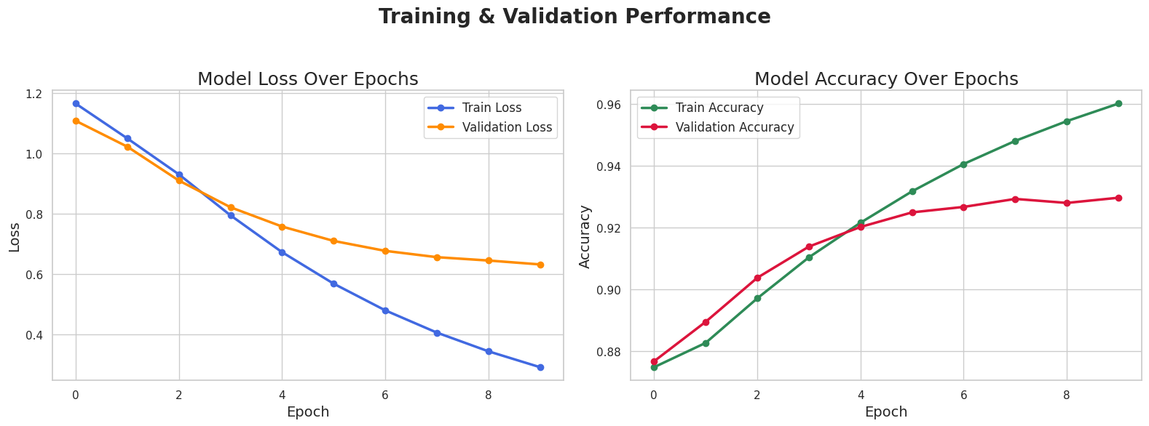
LSTM MODEL

Slide 12
TWITTER'S TWHIN-BERT-LARGE MODEL
Pretrained BERT-based model developed by Twitter for social media text.
Fine-tuned using our Arabic incorrect–correct sentence pairs.
Uses Masked Language Modeling (MLM) to predict missing or wrong words.
We replaced rare or incorrect words with [MASK] token.
The model predicts the correct word based on surrounding context.
Tokenizes input → identifies masked token → predicts most likely replacement.
Performs well on noisy and informal Arabic text.

Slide 13
MODEL LIMITATION
LSTM
Weak context understanding.
Can't handle unseen words or dialect variations well.
No pretraining, so weaker language understanding.
Less effective for complex Arabic morphology.
Twhin-BERT-Large
Not trained for auto-correction, just general understanding.
Domain-specific, weak outside social media.
Performance may vary with out-of-domain text due to dataset specificity.
Requires strong hardware.

Slide 14
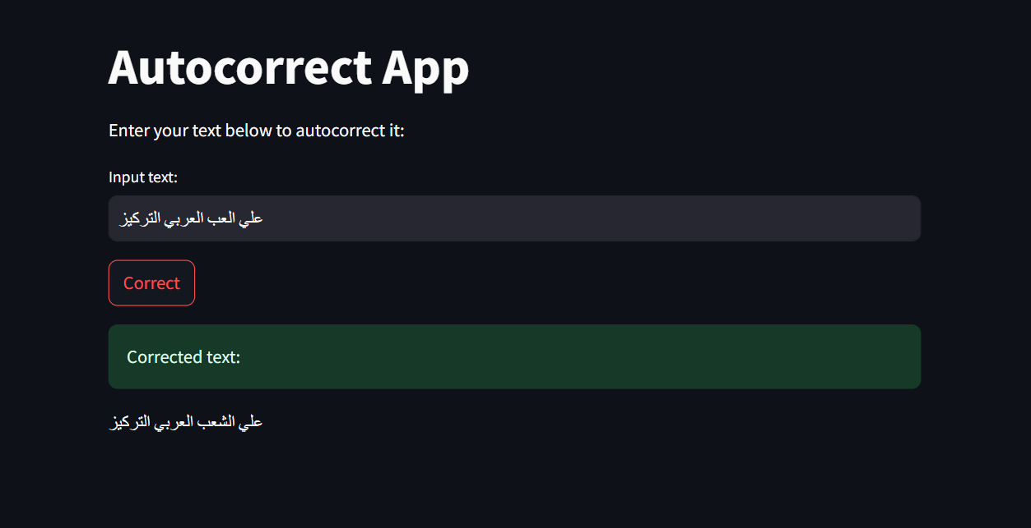
DEMO

Slide 15
Team Members
Rehab Hamdy
Mahmoud Osama
Abdelrahman Emam
Aya Mohamed
Sara Emad
Rawan Hesham
THANK YOU

