Slide 1

ARABIC AUTO CORRECTION
Arabic Auto Correction Using LSTMs, Transformers, and TwHIN-BERT-Large

Slide 2
Project overview
This project aims to automatically correct Arabic text using deep learning models, specifically LSTM, Transformer (Arabic T5), and exploring TwHIN-BERT-Large architectures. The objective is to identify and rectify spelling and typing errors in Arabic sentences, enhancing text quality for both formal and informal contexts.

Slide 3
Dataset information
Dataset
Each entry contains an incorrect Arabic sentence and its correct form
Arabic spelling correction dataset containing real-world incorrect and correct sentence pairs . with 20,643 samples
Quality
no missing value . diverse sample including formal and informal Arabic
Structure

Slide 4
Preprocessing
Normalize Arabic characters.
Removed punctuation .
Remove non-Arabic characters.
Remove numbers and extra spaces
Remove extra spaces

Slide 5
Add noise in the dataset
we regenerate the incorrect dataset by add noise using four function to simulate real-world typing errors in Arabic text.
Add: Randomly inserts Arabic characters into words to mimic insertion errors.
Delete: Randomly removes characters from words to simulate deletion mistakes.
Swap: Swaps adjacent characters within a word to replicate common typos.
Replace: Substitutes characters with its next one behind him.

Slide 6
Tokenizing text
Utilized TensorFlow’s Keras Tokenizer to convert text into sequences.
Vocabulary size: 100,808 unique words.
Maximum sequence length: 394 tokens.
Padded sequences to ensure uniform input length for both correct and incorrect sentences.

Slide 7
Data splitting
Split data into training, validation, and test sets:
Training: 14,839 samples (70% of data).
Validation: 3,710 samples (20% of data).
Test: 2,061 samples (10% of data).
Random state set to 42 for reproducibility.
Shapes:
X_train: (14,839, 394) | y_train: (14,839, 394)
X_val: (3,710, 394) | y_val: (3,710, 394)
X_test: (2,061, 394) | y_test: (2,061, 394)

Slide 8
LSTM Model architecture
Embedding Layer: 128-dimensional embeddings
Encoder: LSTM layer with 128 units (returning sequences)
Decoder: Dense layer with Softmax over 100,875 vocabulary words.
Optimizer: Adam
Loss: Sparse Categorical Crossentropy
Total Parameters: 26,056,459
Trainable Parameters: 26,056,459

Slide 9
Transformer Model architecture
Utilized a pre-trained Arabic T5 model (AutoModelForMaskedLM) fine-tuned for masked language modeling.
Tokenized using HuggingFace’s AutoTokenizer with a maximum length of 128 tokens.
Training Arguments:
Epochs: 2
Learning Rate: 1e-5
Batch Size: 4 (train and eval)
Weight Decay: 5e-4
Mixed Precision (fp16): Enabled

Slide 10
Training information
LSTM Model
Model Performance
Train-Validation-Test Split:
Train: 14,839 samples
Validation: 3,710 samples
Test: 2,061 samples
Batch Size: 16
Epochs: 10 (with Early Stopping)
Patience: 3 epochs
Training Accuracy: 95.96%
Validation Accuracy: 92.97%
Test Accuracy: 93.06%
Training and validation losses decreased steadily.

Slide 11
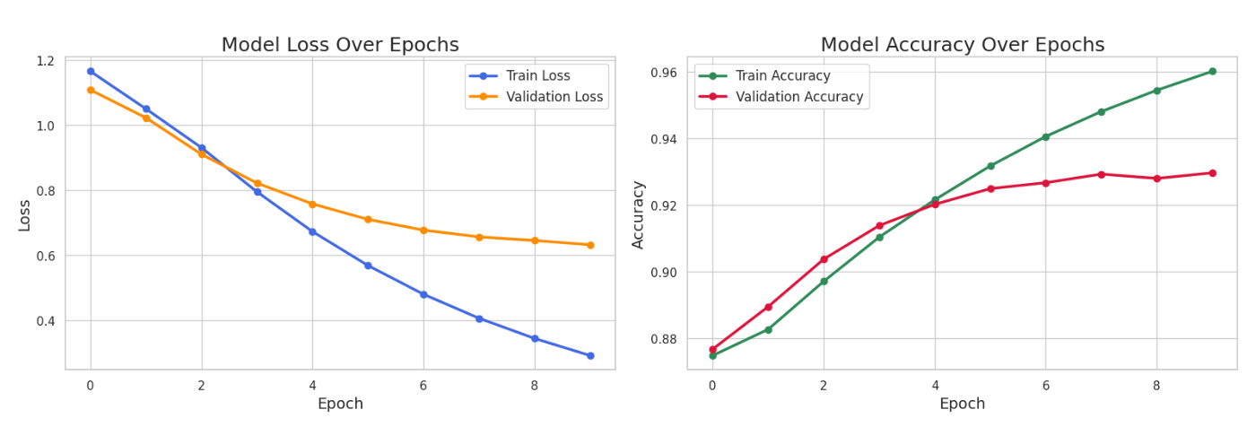

Slide 12
LSTM
Model limitation
Transformer
TwHIN-BERT-Large
Large model size (~99 MB).
Extensive vocabulary (100,874 words).
Potential performance drop for sentences exceeding 400 tokens.
Trained on basic typos (insertions/removals); complex real-world errors may challenge performance.
Computationally intensive due to fine-tuning.
Limited to 128-token sequences, potentially truncating longer sentences.
Performance may vary with out-of-domain text due to dataset specificity.
Requires fine-tuning for optimal performance on our specific dataset.
Limited to 512-token sequences, potentially truncating longer sentences.
Computationally intensive, requiring significant hardware resources.

Slide 13
Twitter's twhin-bert-large Model
Pretrained BERT-based model developed by Twitter for social media text.
Fine-tuned using our Arabic incorrect–correct sentence pairs.
Uses Masked Language Modeling (MLM) to predict missing or wrong words.
We replaced rare or incorrect words with [MASK] token.
The model predicts the correct word based on surrounding context.
Tokenizes input → identifies masked token → predicts most likely replacement.
Performs well on noisy and informal Arabic text.

Slide 14

Team Members
Rehab hamdy
Mahmoud osama
Abdelrahman emam
aya
sara emad
rawan

