Slide 1

Heap memory manager
Under supervision of: Eng. Reda Maher.
Presented by: Rehab Ahmed

Slide 2
What is HMM?
HMM (Heap Memory Manager) is a fundamental component of any programming environment, responsible for dynamically allocating and deallocating memory during program execution, This project aims to develop a custom Heap Memory Manager, tailored to meet the specific requirements of a given system or application.
. Key goals include dynamic memory allocation, deallocation, implementing various memory management policies, optimizing performance, and integrating error handling mechanisms.
Implementation Overview: The project provides functions for initializing the heap, extending it, finding suitable memory blocks, splitting blocks when necessary, merging adjacent free blocks to reduce fragmentation, and providing interfaces for memory allocation (malloc), deallocation (free), reallocation (realloc), and (calloc).

Slide 3
Agenda:
Memory.
First Fit & Best Fit algorithms.
Functions and related functions.
Implementation.
Testing HMM.
Before HMM.

Slide 4
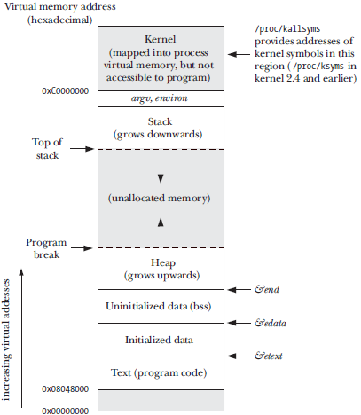
Memory:
The memory layout of a process typically consists of several segments:
Text segment : contains the machine-language instructions of the program and is read-only to prevent accidental modification.
Initialized data segment :holds global and static variables that are explicitly initialized, with their values loaded from the executable file.
The uninitialized data segment, also known as the bss : segment, stores global and static variables that are not explicitly initialized. Memory in this segment is initialized to 0 before program execution.
Stack : is a dynamically growing and shrinking segment that contains stack frames for function calls, storing local variables, arguments, and return values.
Heap : is a region for dynamic memory allocation during runtime, allowing for the allocation and deallocation of memory for variables. The top end of the heap is called the program break. Overall, this memory layout ensures efficient management and utilization of memory resources for executing programs.

Slide 5

First Fit & Best Fit algorithms.
First Fit and Best Fit are two commonly used memory allocation algorithms in computer systems. First Fit allocates memory by searching for the first available memory block that is large enough to accommodate the requested size. This approach is simple and efficient but can lead to fragmentation, where small blocks of memory are left unused between allocated blocks. On the other hand, Best Fit searches for the smallest available memory block that is large enough to satisfy the request. This minimizes fragmentation by utilizing memory more efficiently, but it can be slower than First Fit due to the need to search for the best-fitting block. Both algorithms have their advantages and disadvantages, and the choice between them depends on factors such as system requirements, performance considerations, and memory usage patterns.

Slide 6

Before heap memory manager & designing.

Slide 7
Malloc
void * malloc (size_t size)
ptrBlock heap_Init(void)
void *find_Block(ptrBlock last, size_t size)
void split_Block(ptrBlock block, size_t size)
void heap_Extent(void)

Slide 8
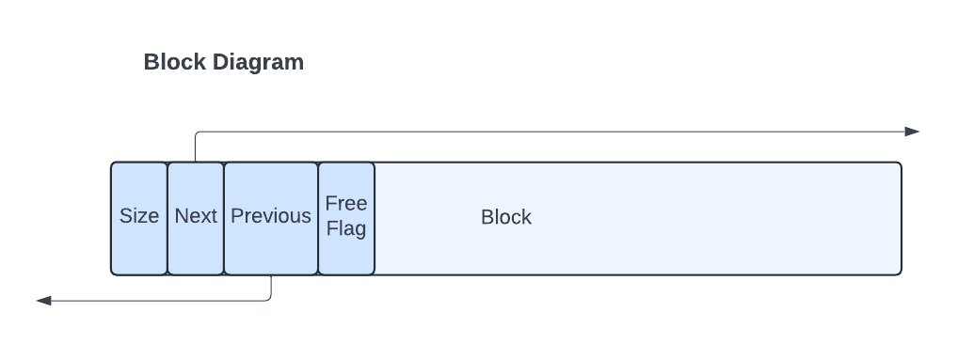
Block Specifications

Slide 9
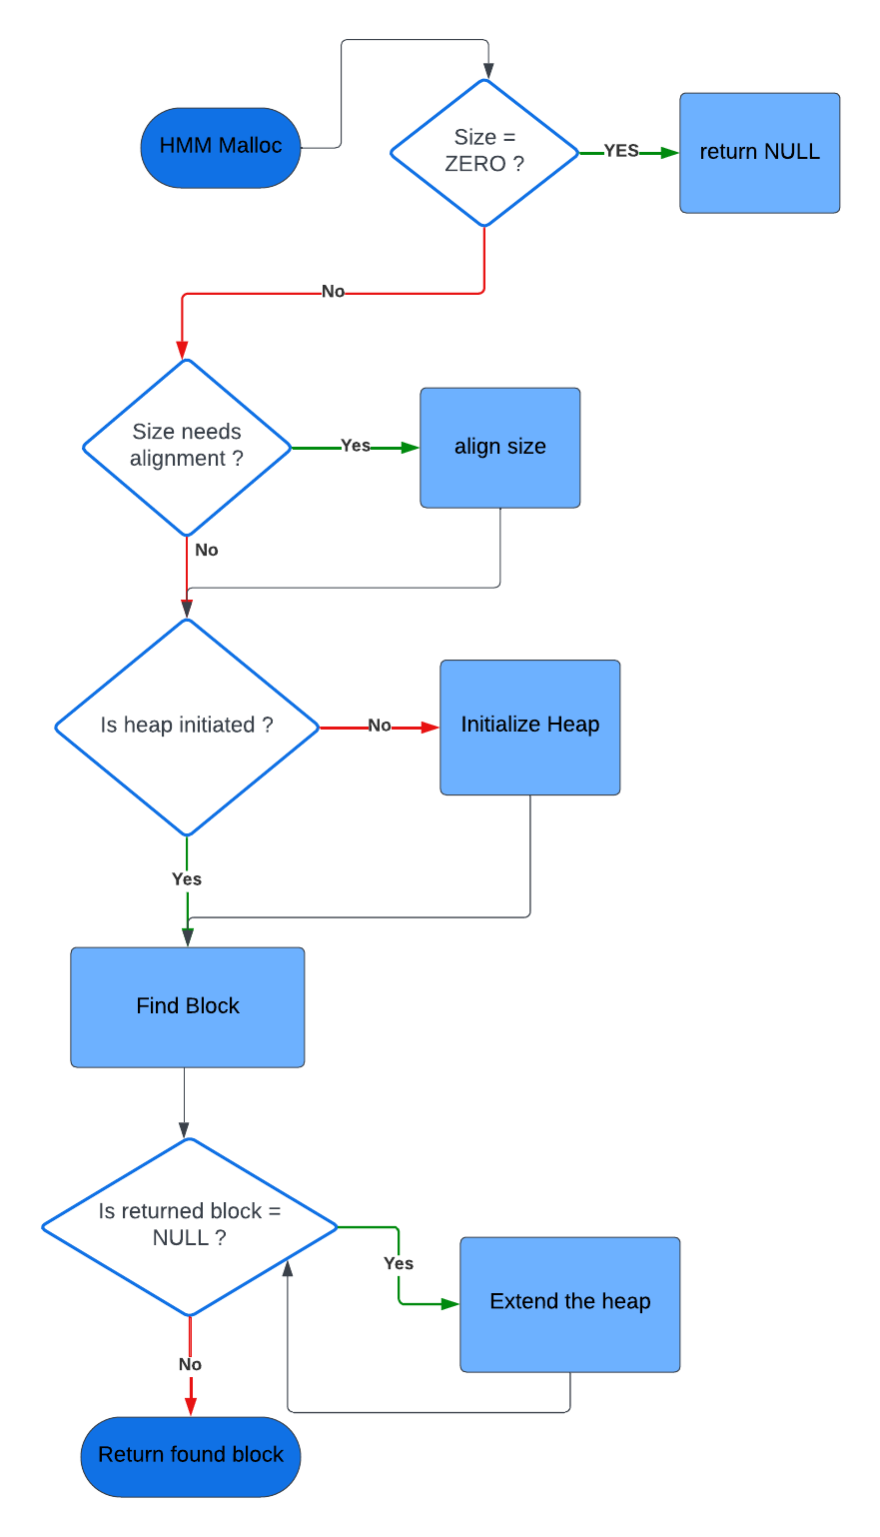
Malloc:
Key Features:
Dynamic Memory Allocation: Allocates memory of the specified size.
First-Fit Strategy: Searches for a suitable free block in the heap using the first-fit algorithm.
Heap Initialization: If it's the first call to malloc, it initializes the heap using the heap_Init function.
Heap Extension: Extends the heap if no suitable block is found by calling the heap_Extent function.
Block Splitting: Splits blocks if necessary to accommodate the requested size.
Metadata Management: Manages metadata associated with memory blocks for bookkeeping.

Slide 10
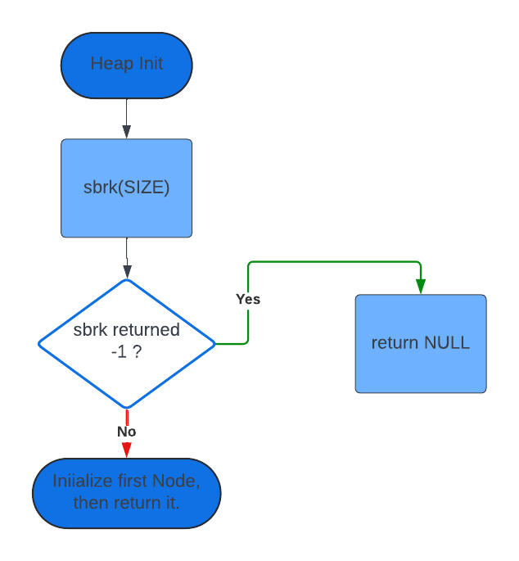
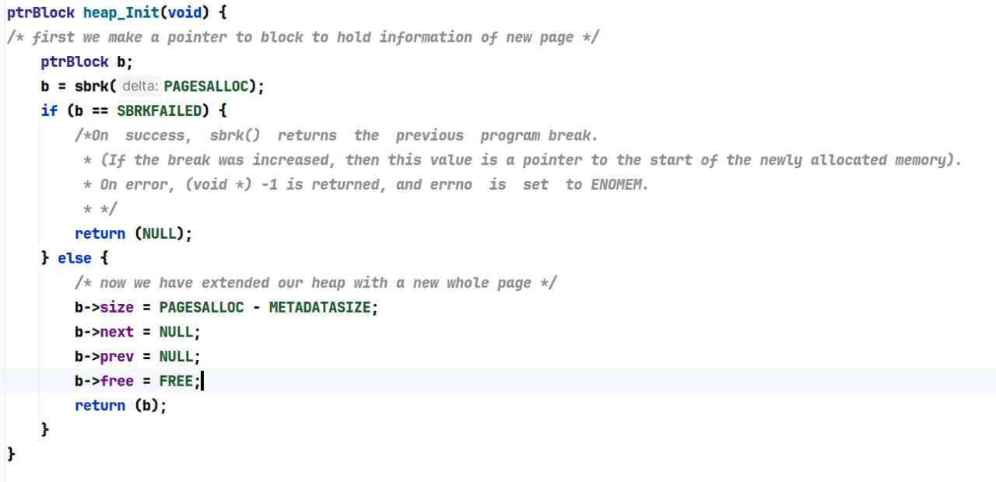
Heap init:

Slide 11
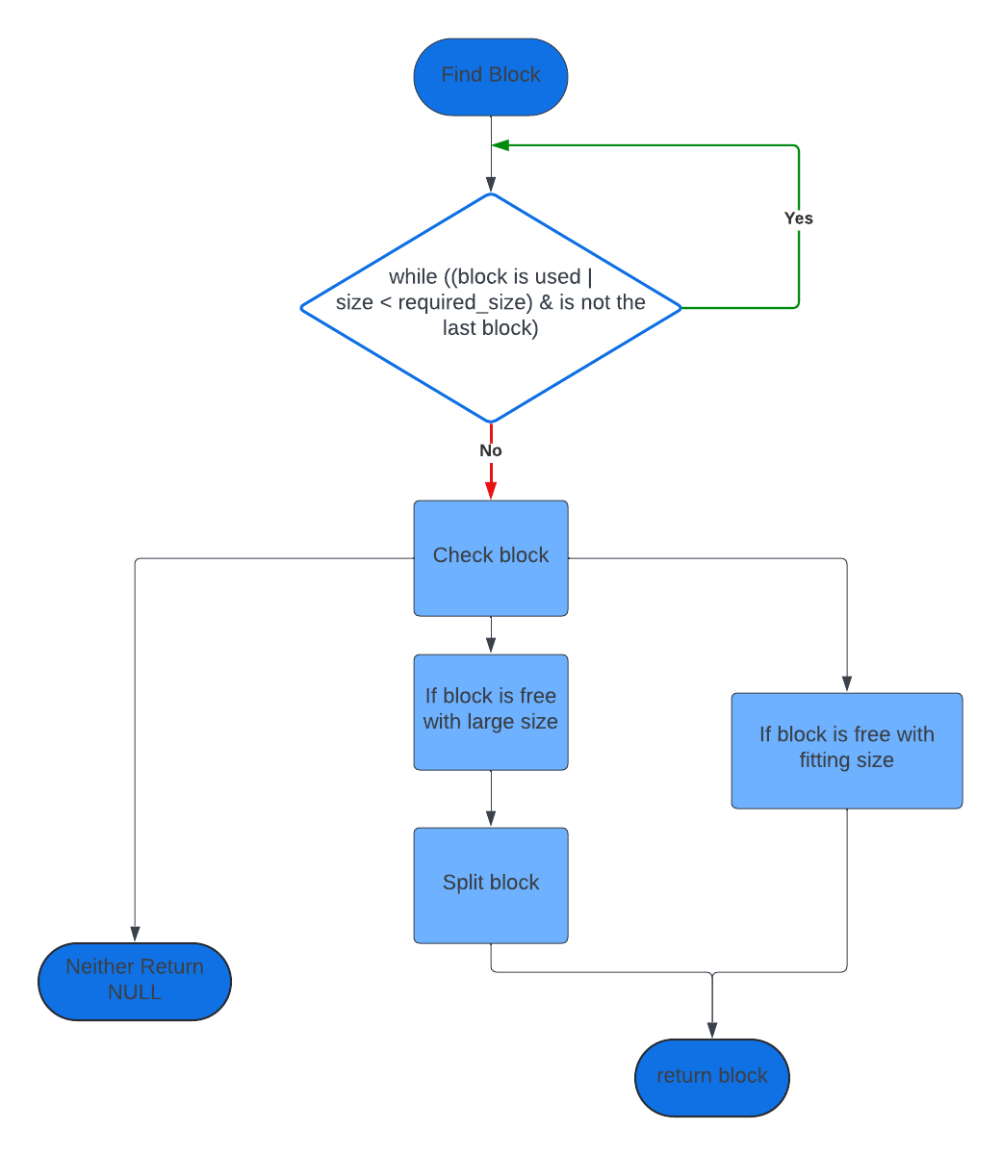
Finding block:
Finds a suitable memory block for allocation, employing the first-fit strategy.

Slide 12
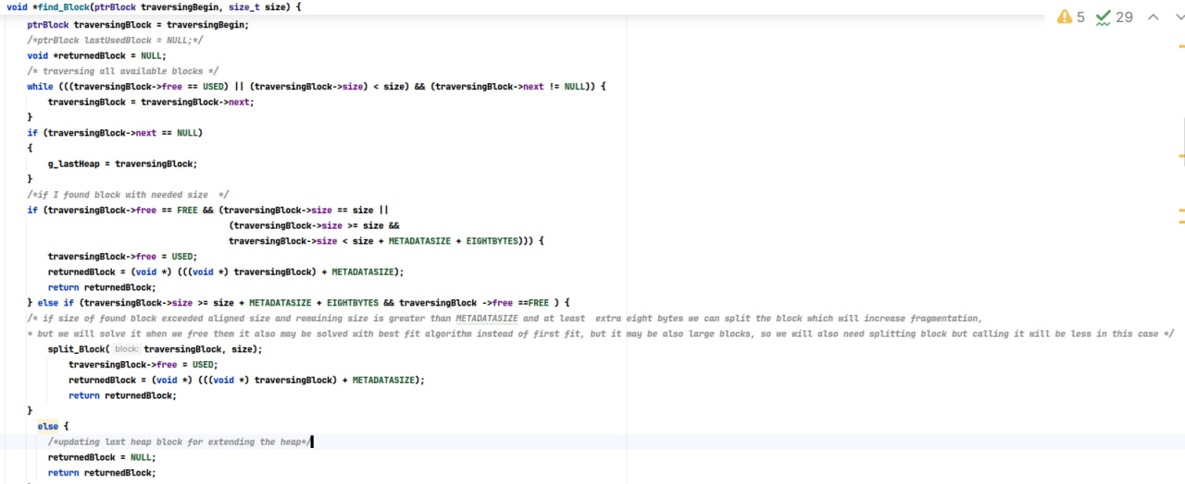
Code:

Slide 13
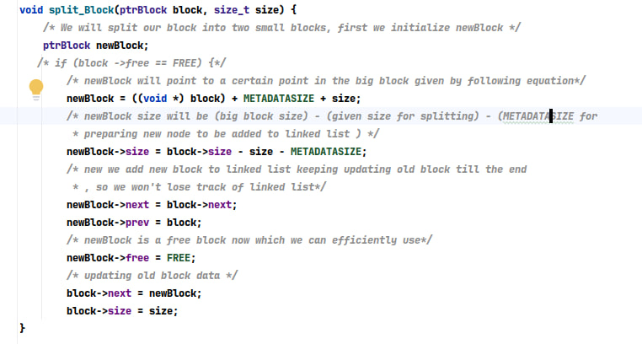
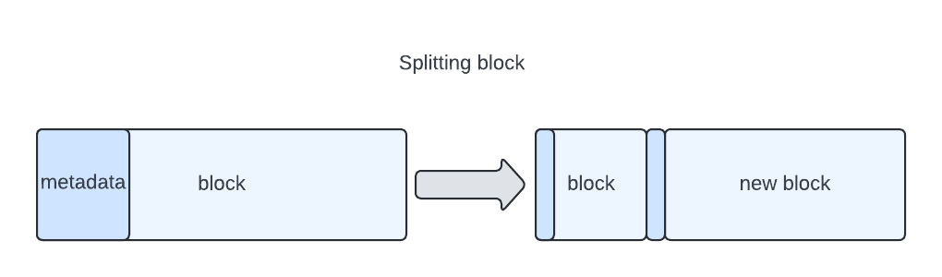
Splitting the block:

Slide 14
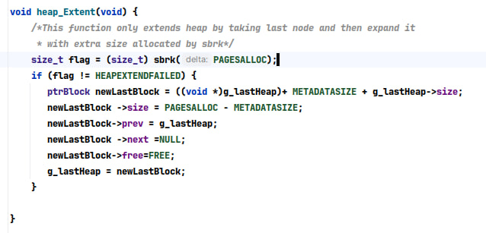
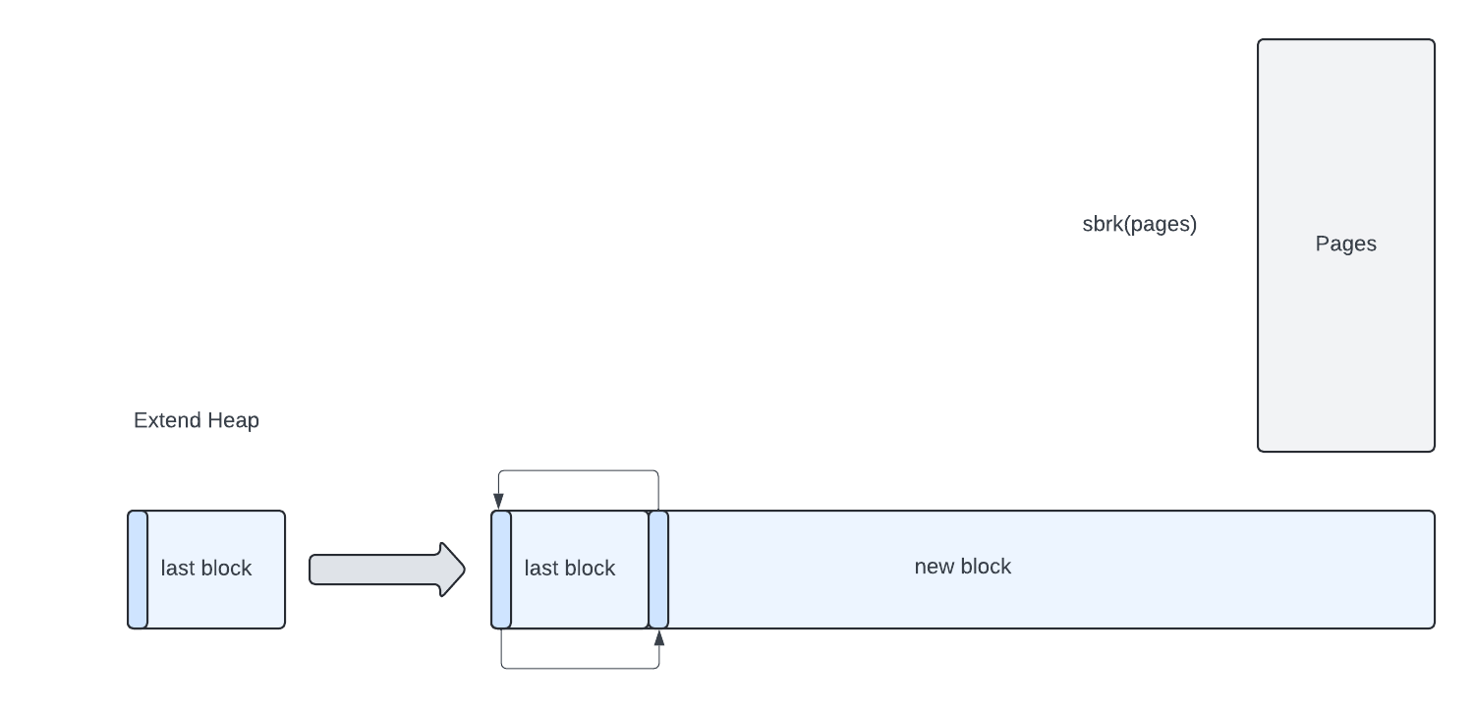
Extending the Heap:
Extends the heap by allocating additional memory using sbrk.

Slide 15
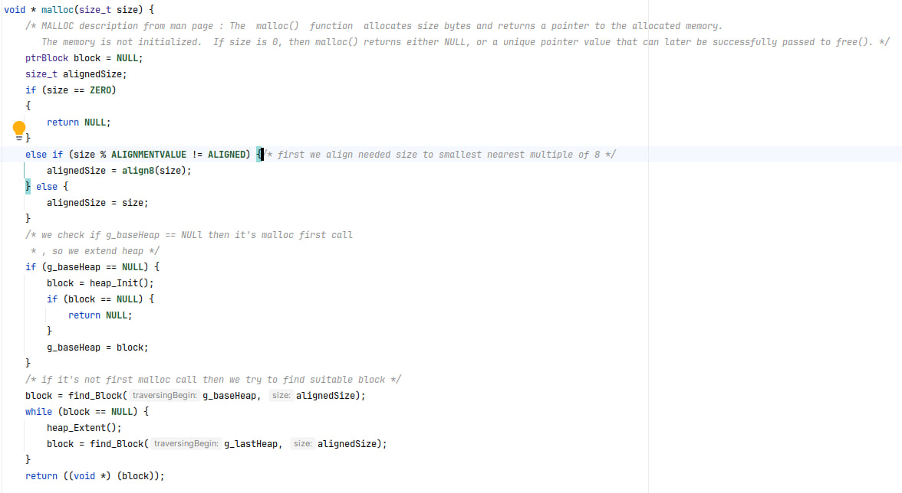
Malloc Code:

Slide 16
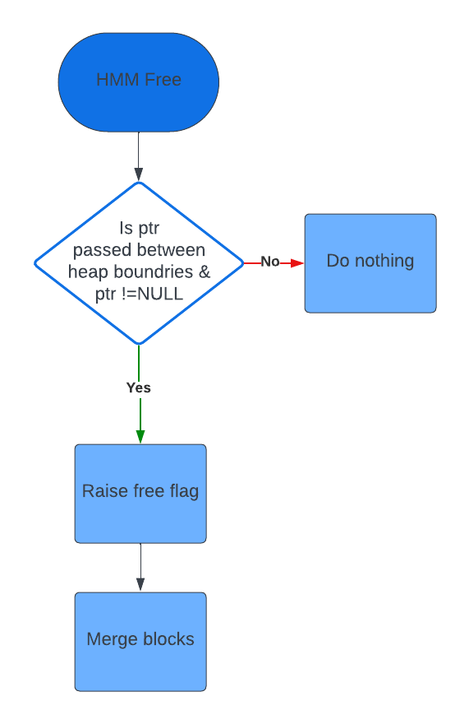
Free
Key Features:
Memory Deallocation: Frees the memory block pointed to by the given pointer.
Block Marking: Marks the memory block as free to indicate that it's available for future allocations.
Block Merging: Merges adjacent free blocks to reduce fragmentation and optimize memory usage.
Heap Management: Efficiently manages the heap structure to maintain a list of free and allocated blocks.
Validity Check: Ensures that the given pointer is within the boundaries of the heap and points to a valid allocated block before freeing it.

Slide 17
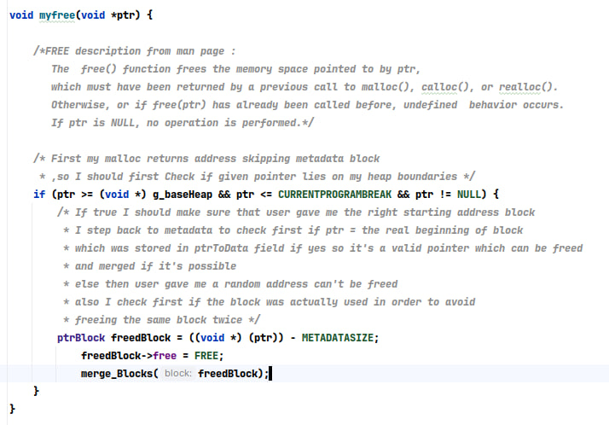
Code

Slide 18
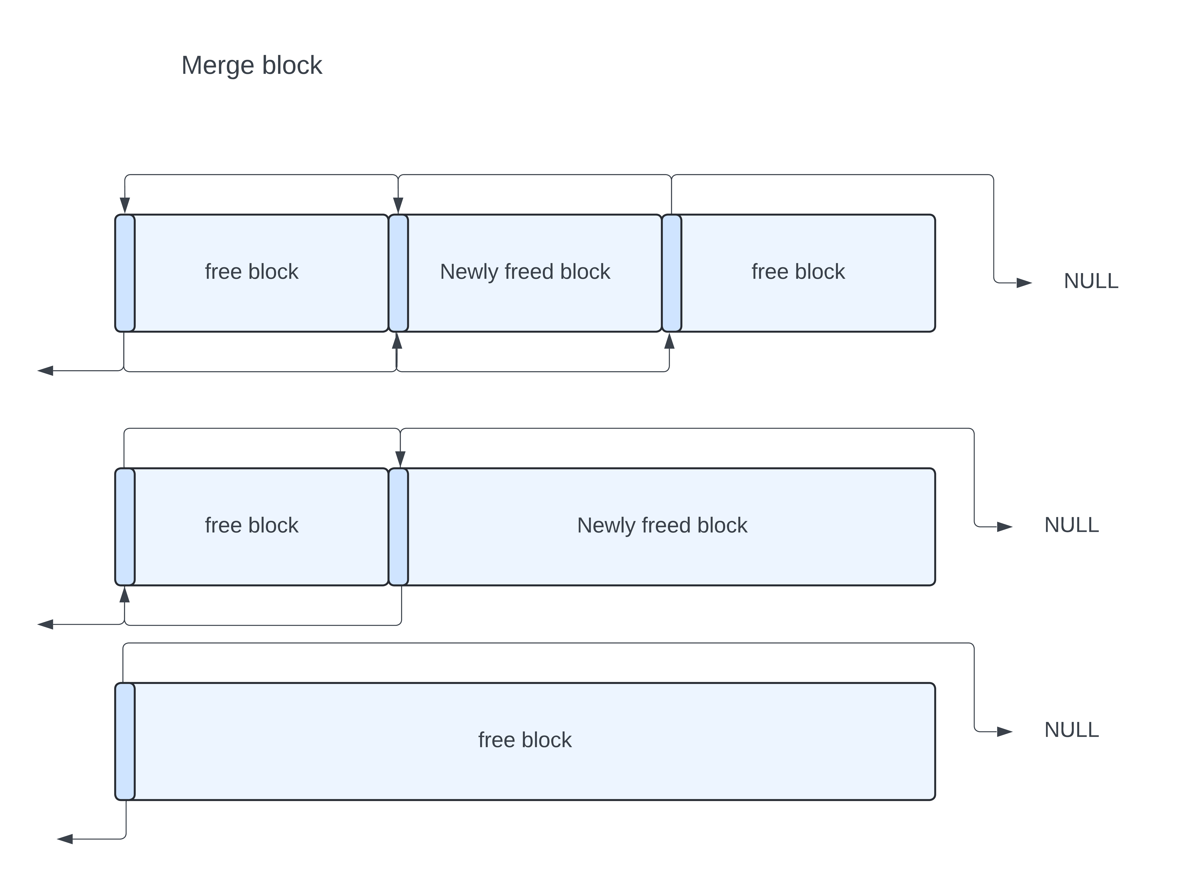
Merging Blocks

Slide 19
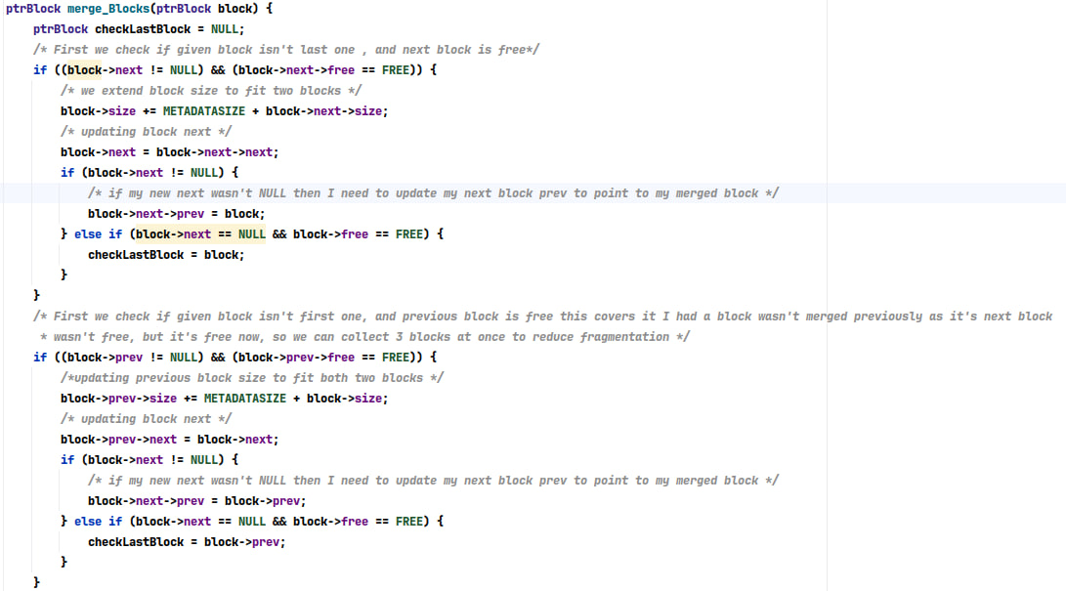
Merging Blocks:

Slide 20
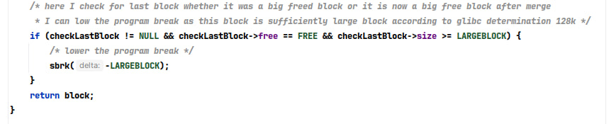
Lower program break ?

Slide 21
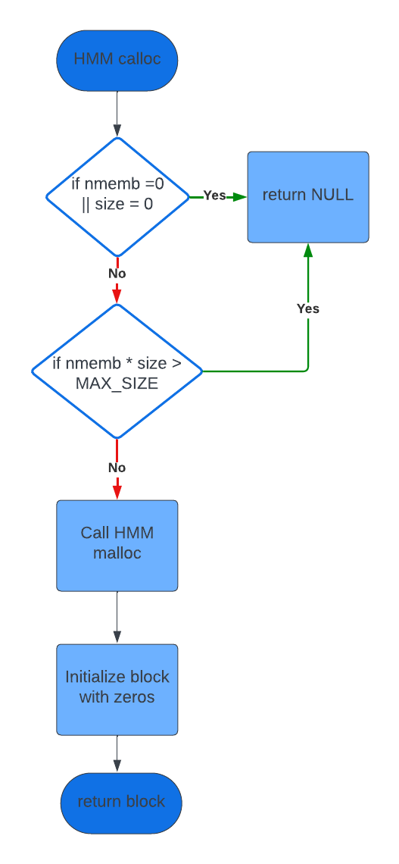
Calloc:
Key Features:
Safe Memory Allocation: Ensures secure allocation of memory for arrays while guarding against potential integer overflow.
Zero Initialization: Initializes the allocated memory block with zeros, guaranteeing a clean slate for data storage.
Error Detection: Detects and handles integer overflow scenarios during memory size calculation, preventing undefined behavior.
Integration with malloc: Seamlessly utilizes the existing malloc function for memory allocation, maintaining consistency and reliability.

Slide 22
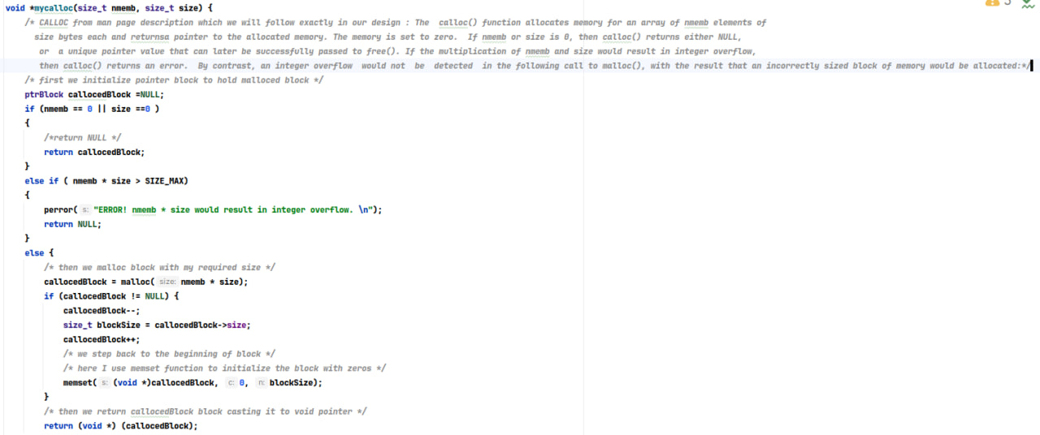
Code:

Slide 23
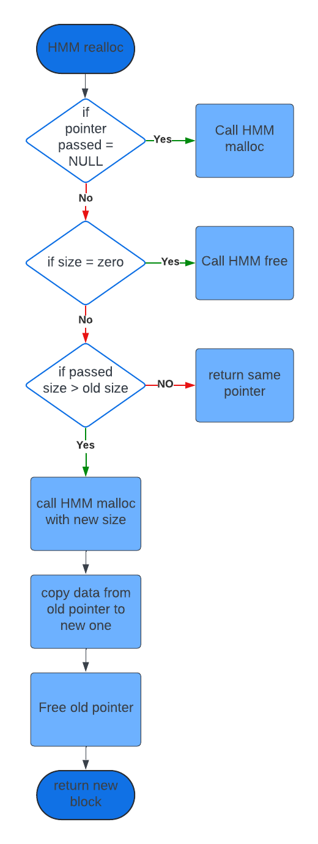
Realloc:
Key Features:
Dynamic Memory Resizing: Allows for dynamic resizing of memory blocks, enabling flexible memory management during runtime.
Memory Preservation: Preserves the contents of the original memory block up to the minimum of the old and new sizes, ensuring data integrity.
Efficient Memory Handling: Optimizes memory utilization by reallocating memory only when necessary, reducing wastage and fragmentation.
Integration with mymalloc and myfree: Seamlessly integrates with existing memory allocation and deallocation functions, maintaining compatibility and reliability.
Error Handling: Handles NULL pointer inputs gracefully, treating them as equivalent to a call to mymalloc for allocation or myfree for deallocation.
Fragmentation Reduction: Minimizes memory fragmentation by consolidating memory blocks and freeing the old block after reallocation, enhancing memory efficiency.

Slide 24
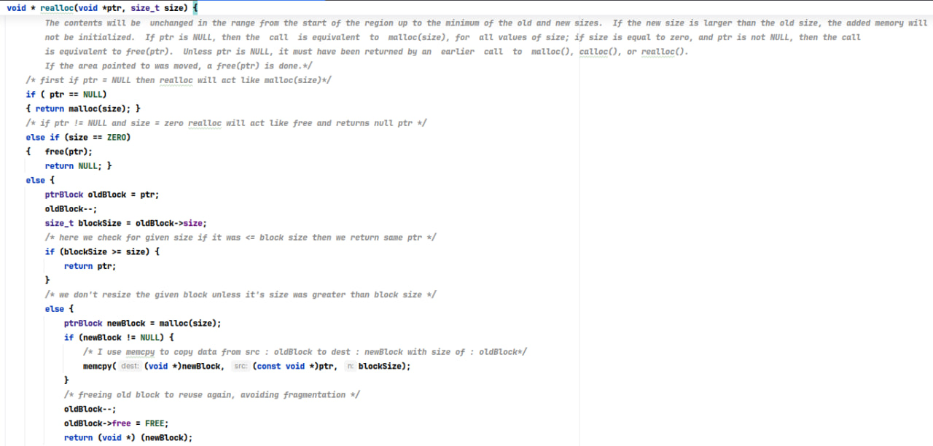
Code

Slide 25

Testing HMM?

Slide 26

Thank You.

