Slide 1
Introduction to scRNA-Seq Analysis
Badran Elshenawy
Postdoctoral Researcher
McKeating Lab

Slide 2
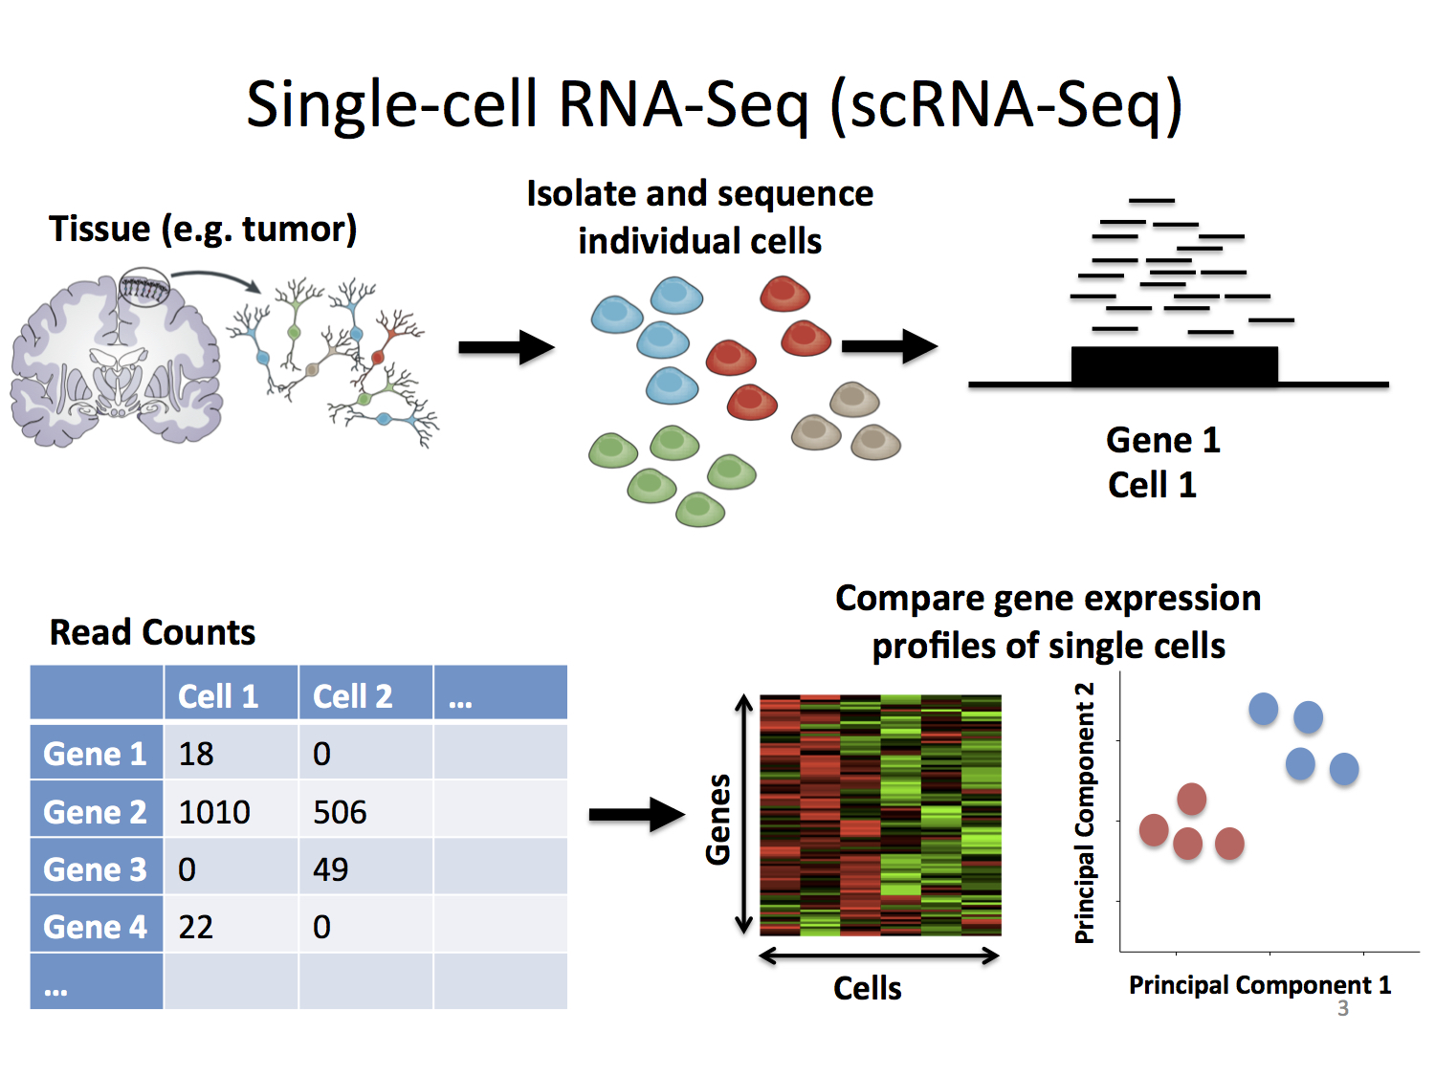
What is scRNA-Seq?
What is scRNA-Seq?
scRNA-Seq (Single-cell RNA sequencing) is a powerful technology that analyses gene expression at the resolution of individual cells.
Key Steps:
Tissue Sampling: Extract cells from a tissue (e.g., tumor).
Cell Isolation: Separate individual cells using techniques like droplet microfluidics.
Sequencing: Measure RNA transcripts for each cell and convert them into gene expression data.
Data Analysis: Compare gene expression profiles to uncover cell types, states, and heterogeneity.
Outcome:
Generates detailed read counts per gene per cell.
Visualizes results as heatmaps, PCA plots, or clusters to identify unique cell populations.

Slide 3
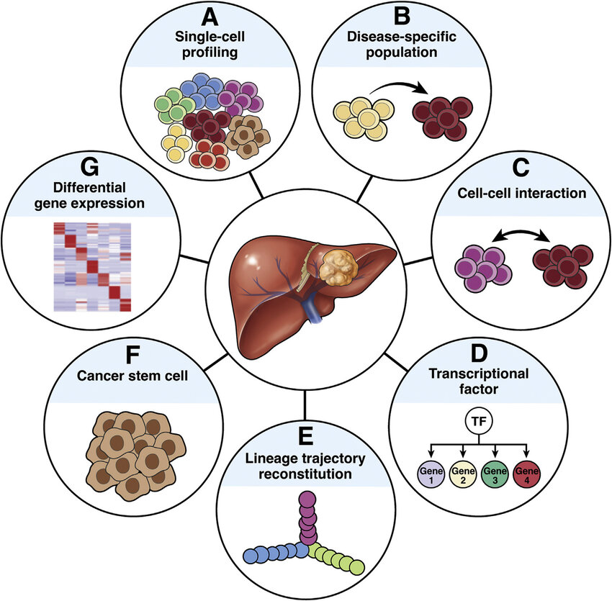
Why do scRNA-Seq Analysis?
Applications of scRNA-Seq
scRNA-Seq provides unparalleled insights into cellular diversity and dynamics across biological systems.
Key Applications:
Single-Cell Profiling (A): Identify and classify distinct cell types within complex tissues.
Disease-Specific Populations (B): Detect and characterize cell populations associated with diseases (e.g., tumor cells).
Cell-Cell Interactions (C): Study how cells communicate and influence one another.
Transcriptional Regulation (D): Explore transcription factor activity and its effect on gene expression.
Lineage Trajectory Analysis (E): Reconstruct cell developmental pathways and state transitions.
Cancer Stem Cells (F): Identify and characterize rare cancer stem cell populations.
Differential Gene Expression (G): Compare gene expression across cells to uncover functional differences.

Slide 4
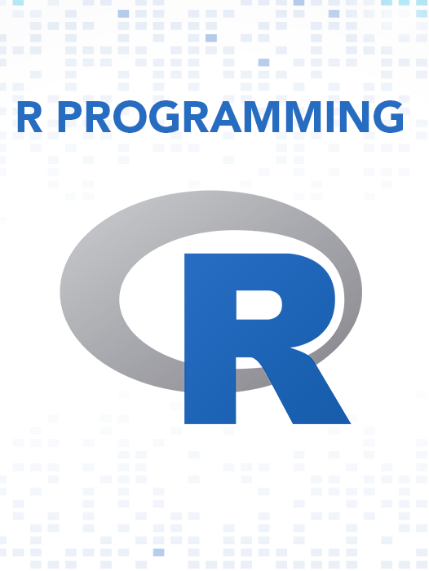
What is R?
Definition: R is a powerful, open-source programming language and software environment designed for statistical computing, data analysis, and visualization.
Key Features:
Extensive libraries for statistical methods and data manipulation.
Advanced plotting and visualization tools (e.g., ggplot2).
Highly extensible and customizable.
Applications:
Bioinformatics and transcriptomics analysis.
Data cleaning, exploration, and reporting.
Machine learning and predictive modeling.

Slide 5
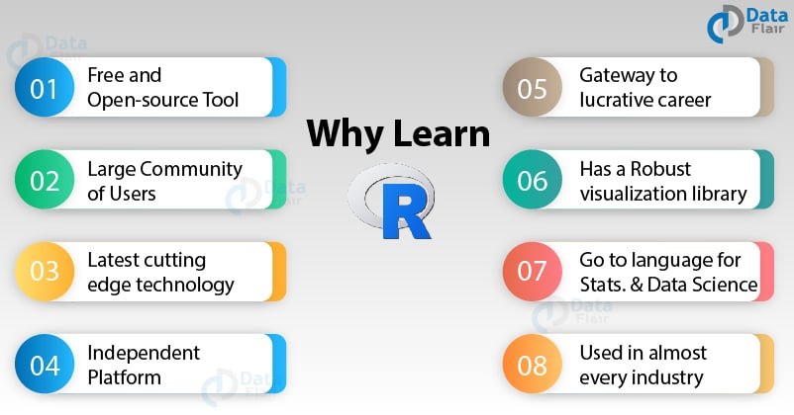
Why use R?
Free and Open-Source Tool (A): R is freely accessible, allowing bioinformatics labs and researchers to work without licensing restrictions.
Large Bioinformatics Community (B): Supported by a robust community of bioinformaticians and statisticians, with extensive documentation and tutorials.
Specialized Bioinformatics Packages (C): Powerful tools like Seurat, SingleCellExperiment, and Bioconductor enable seamless scRNA-Seq workflows
Cross-Platform Compatibility (D): Works across operating systems (Linux, macOS, Windows) and integrates with tools like Python for multiomics studies.
Advanced Visualization Capabilities (E): Create high-quality, publication-ready figures such as UMAP, t-SNE, heatmaps, and lineage trajectory plots.
Optimized for Big Data (G): Efficiently handles large datasets with parallelization tools and optimized data structures for transcriptomic studies.
Optimized for Big Data (G): Efficiently handles large datasets with parallelization tools and optimized data structures for transcriptomic studies.
Essential for Career Growth in Bioinformatics (H): Mastery of R is a highly sought-after skill in bioinformatics, genomics, and data science.

Slide 6

What about Python?

Slide 7
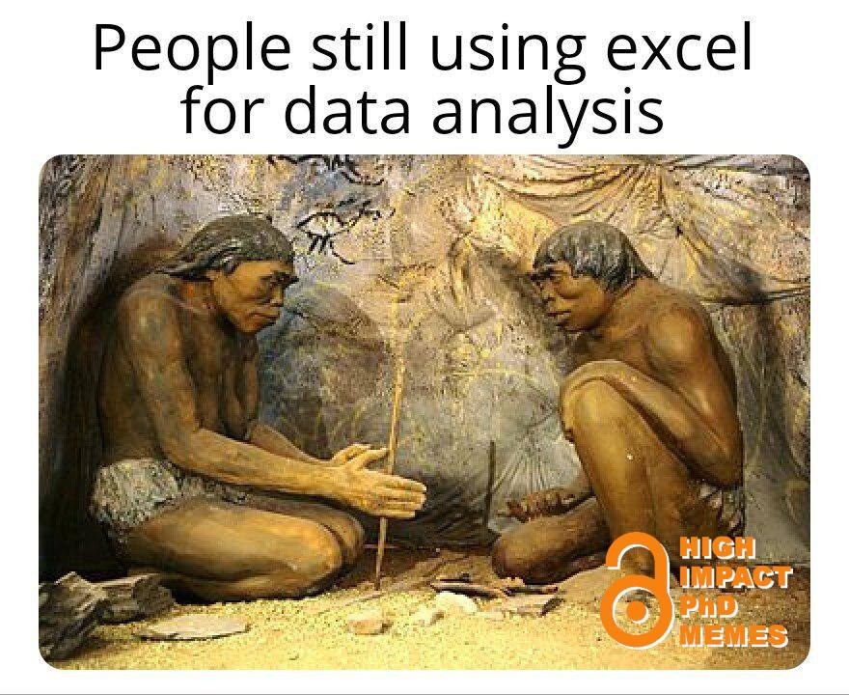
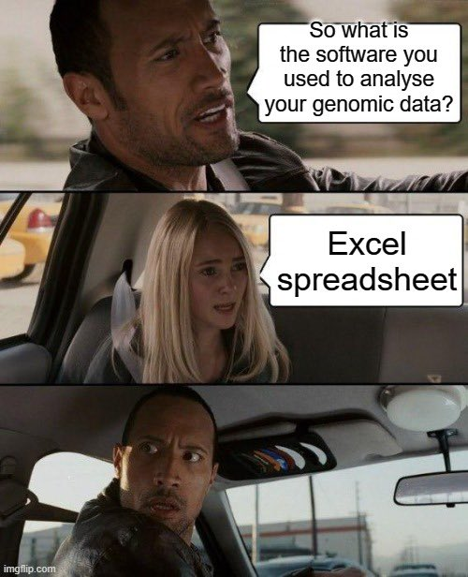
Why Not Use Excel?

