Slide 1
لقيت
La2eet
Egyptian Lost & Found Platform
An ASP.NET Core MVC web app that helps people report lost items, post found items, and reconnect through a verified claim process.
ASP.NET Core MVC • Entity Framework Core • SignalR • SQL Server
DEPI Graduation Project • Supervised by Dr. Omnia Abdelhamid

Slide 2



The Problem
Losing something in Egypt today means guessing where to even start looking.
Scattered Facebook groups
WhatsApp chains
Paper posters
Posts get buried within hours; no city or category filters.
Messages forwarded group to group with no record or search.
Limited reach, no way to verify a claimant is the real owner.
Result: found items never reach their owners, and owners have no trustworthy way to prove a claim.

Slide 3
The Solution
Laqeet centralizes lost & found reporting into one verified, searchable platform — replacing scattered posts with structured, moderated reports.
27
5
2
1:1
Egyptian governorates covered
Core data entities
Roles: User & Admin
Real-time finder ↔ claimant chat

Slide 4




Who It's For
Built for the people who lose things — and the places that host them.
Individuals
Students
Any one who loses or finds personal belongings
In universities and schools — keep books, devices, and study
supplies recoverable.
Businesses & Organizations
Public Places
Offices, universities, institutions managing lost & found services
Malls, cafés, and parks — partnerships that serve their visitors.

Slide 5
Project Overview
The essentials, before we dive in.
Goal
Target Users
Build a secure platform that reconnects lost items with their owners.
Citizens, students, public places as Clubs, Malls, Cafes, Gyms,
Metro – high traffic place to lose things
Core Features
Technologies
Reporting • Claims • Verification • Real-time Chat • Admin Moderation
ASP.NET Core MVC • EF Core • SQL Server • SignalR

Slide 6
Demo Walkthrough
One wallet, start to finish.
1
2
3
4
5
Ahmed lost his wallet
Sara finds the wallet
Ahmed submits a Lost report
Sara submits a Found report
Admin approves both reports
10
9
8
7
6
Wallet returned
Chat opens
Claim approved
Answers verification questions
Ahmed recognizes the wallet
A verified handoff, backed by a paper trail at every step.

Slide 7
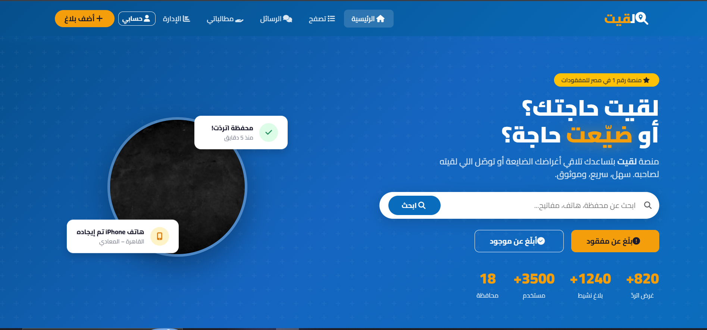
Live Preview
The homepage — searchable, bilingual, and built for trust.
la2eet.eg
Arabic-first UI, live search, and trust badges — right on the landing page.

Slide 8

Home Page
The landing page surfaces real platform activity the moment it happens.
Live Statistics
27 Governorates
Recovered Items
Trusted Listings
Real-time counters for total users, active reports, and successful recoveries.
All 27 Egyptian governorates supported, front and center in Arabic.
A running tally of successful handoffs builds visible momentum and trust.
Only admin-approved reports ever reach the homepage — no spam, no noise.
Every number updates live as new reports, claims, and recoveries happen across Egypt.

Slide 9




Authentication & Accounts
Built on ASP.NET Core Identity, with security hardened at every step.
Custom Identity model
FullName, Phone, IsVerified, IsBanned, Role, CreatedAt, with USER / ADMIN role-based access.
Hardened login
Password rules (8+ chars, mixed case, digit) and lockout after 5 failed attempts for 5 minutes.
Email verification
Accounts start unconfirmed; a mailed confirmation link (SMTP EmailService) activates the account before login.
Google sign-in & password reset
External login via Google, plus a real Identity reset-token flow for forgotten passwords.

Slide 10


User Profiles
Every account gets a public history, editable details, and an admin-level view.
Profile at a glance
Full name, verification badge, and member-since date, plus live stats: total reports, resolved reports, and total claims.
Report & claim history
Every item a user has posted and every claim they've made surface right on their profile page.
Editable details
A dedicated edit form lets users update their full name and phone number anytime, validated server-side.
Admin view
Admins open a dedicated profile view for any user, with ban status visible at a glance.

Slide 11
Lost & Found Reports
Creating a report
Verification Questions
Reported as Lost or Found, pre-filled from a ?type= query parameter
Title, description, city (all 27 governorates, Arabic names), location, date
Optional photo
Every new report starts as Pending — hidden until an admin approves it
Similar approved items in the same city are auto-matched on shared title/description keywords and shown on the details page
When posting a Found item, the finder can attach custom questions
e.g. “What's inside the wallet?”
Stored per item and surfaced to anyone who later submits a claim
Claimants must answer every question correctly before a claim can proceed

Slide 12



The Claims Workflow
Turning a match into a verified handoff.
01
02
03
04
Spot a match
Answer & submit
Reporter reviews
Approve or reject
A user browses approved reports and recognizes their item.
They answer the verification question(s) and submit a claim (can't claim their own report).
The original reporter checks the answers on their Claims dashboard.
Approved claims open live chat to arrange return; rejected ones stay logged.
Two personal dashboards keep it organized: My Claims (submitted) and Incoming Claims (received).

Slide 13




Real-Time Chat
Finder and claimant connect instantly, without leaving Laqeet.
Built on SignalR
Ahmed: Is the wallet black leather?
ChatHub.cs mapped at /chatHub broadcasts SendMessage / ReceiveMessage instantly.
Yes! With a torn inside pocket.
Persisted history
Every message (sender, receiver, item, content, timestamp) is saved to the database.
Great, let's meet today.
Scoped to one item
Chats stay tied to the specific item both users are discussing.
Closes on resolution
Item marked as Returned
Marking an item Returned fires a ChatClosed event and locks the thread for both sides.
Chat closed for both sides

Slide 14


Admin Dashboard
Full moderation and oversight, restricted to the Admin role.
Live metrics
Moderation queue
User control
Excel export
Total reports, lost vs. found counts, active claims, and a per-city breakdown at a glance.
Approve or reject pending reports before they reach the public browse page.
Ban abusive users directly from the dashboard to keep the platform trustworthy.
One-click export of all reports to .xlsx via ClosedXML, with Arabic column headers.
Admins also monitor all platform activity end-to-end — reports, claims, users, and messaging.

Slide 15


Tech Stack
A modern, server-rendered .NET stack end to end.
ASP.NET Core MVC (.NET 9)
EF Core + SQL Server
ASP.NET Core Identity
Server-rendered Razor views
Code-first data access & migrations
Auth, roles, plus Google external login
SignalR
MailKit SMTP
ClosedXML
Real-time finder ↔ claimant chat
Account confirmation & reset emails
Arabic-labeled Excel report exports

Slide 16

Data Model
Five core entities capture the full lost-and-found lifecycle.
User
Item
Claim
VerificationQuestion
Message
Extends ASP.NET Identity — full name, phone, verification/ban flags, role
A lost/found report, linked to its owner, questions, claims, and messages
A user's claim on an item, with their verification answer and approval status
Tied to a found-item report, used to vet claimants
A message between two users about a specific item
Key enums: ItemStatus (Lost / Found / Returned) • ReportStatus (Pending / Approved / Rejected) • ClaimStatus • Role • City (27 governorates)
Architecture: Repository → Service → Controller, with EF Core fluent configuration per entity.

Slide 17

Challenges & Solutions
The trickiest parts weren't the features — they were the trust and lifecycle rules behind them.
Challenge Verifying a claim without giving away the answer
Solution Verification questions are surfaced to claimants, but matching is enforced server-side — a finder's answer is never exposed up front.
Challenge A chat that needs to end cleanly for both people
Solution Marking an item Returned fires a ChatClosed SignalR event, locking the thread for both finder and claimant at once.
Challenge Keeping spam and false reports off the public feed
Solution Every new report starts Pending and only reaches Browse after an admin approves it.
Challenge A codebase that was getting hard to extend
Solution Refactored into a layered Repository → Service → Controller architecture for cleaner separation of concerns.

Slide 18
What's Next
A few directions to take Laqeet further.
Chat and Claim notifications
Mall and University Partnership
Receive instant notifications for new chat messages and claim status updates.
Partner with malls and universities to create trusted lost & found hubs and increase community reach.
Mobile App
Advanced Privacy
Extend La2eet to mobile application for a faster, easier, on-the-go experience.
End-to-end Encryption, stronger data protection, and granular privacy controls.

Slide 19
The Team
Built by five people who believed lost things deserve a better way home.
ZO
RA
MR
AE
RA
Ziad Osama
Reham Abdelrahman
Malak Rashad
Aya Eid
Rahma Alaa
Thank You
github.com/Malak-Rashad/LostAndFound

