Slide 1

summary
Rounak Banik
Notes:
NOTE:
To change the image on this slide, select the picture and delete it. Then click the Pictures icon in the placeholder to insert your own image.

Slide 2
Content Layout
Chapter 1: Getting Started with Recommender Systems
Chapter 2: Manipulating Data with the Pandas Library
Chapter 3: Building an IMDB Top 250 Clone with Pandas
Chapter 4: Building Content-Based Recommenders
Chapter 5: Getting Started with Data Mining Techniques
Chapter 6: Building Collaborative Filters
Chapter 7: Hybrid Recommenders

Slide 3
CHAPTER 1
Recommender systems are systems or techniques that recommend or suggest a particular product, service, or entity. However, these systems can be classified into the following two categories, based on their approach to providing recommendations.
Approach
Prediction problem
Ranking problem

Slide 4
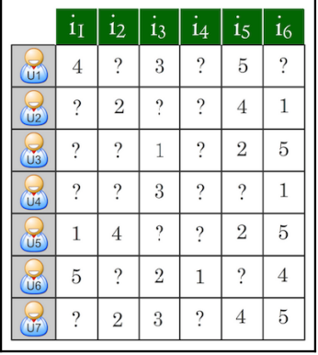
The Prediction Problem
In this version of the problem, we are given a matrix of m users and n items. Each row of the matrix represents a user and each column represents an item. The value of the cell in the i ^{th} row and the j^{th} column denotes the rating given by user i to item j. This value is usually denoted as r^{ij}.
the matrix you have is sparse. In other words, most of the entries in your matrix are empty.
The prediction problem, therefore, aims to predict these missing values using all the information it has at its disposal.
For example, if user i has not used item j, but our system predicts a very high rating (denoted by r^^{ij}), it is highly likely that i will love j should they discover it through the system.

Slide 5
The Ranking Problem
Ranking is the more intuitive formulation of the recommendation problem. Given a set of n items, the ranking problem tries to discern the top k items to recommend to a particular user, utilizing all of the information at its disposal.
It is easy to see that the prediction problem often boils down to the ranking problem. If we are able to predict missing values, we can extract the top values and display them as our results.
Example: in Airbnb, Your user has input the specific things they are looking for in their host and the space (such as their location, and budget). You want to display the top 10 results that satisfy those aforementioned conditions.

Slide 6
Types of Recommender Systems
Types
Collaborative filtering
User-based filtering
Item-based filtering
Content-based systems
Knowledge-based recommenders
Hybrid recommenders

Slide 7
Collaborative Filtering leverages the power of community to provide recommendations
User-based filtering:
these models recommend items to a user that similar users have also liked.
Example: Amazon's Customers who bought this item also bought.
Item-based filtering :
If a group of people have rated two items similarly, then the two items must be similar.
Therefore, if a person likes one particular item, they're likely to be interested in the other item too.
Example: Amazon makes good use of this model by recommending products to you based on your browsing and purchase history.
Shortcomings :
the cold start problem.
to build a good collaborative filtering system, you need data on a large number of purchases from a large number of users. However, you don't have either, and it's therefore difficult to build such a system from the start.

Slide 8
Content-based Systems
content-based systems do not require data relating to past activity. Instead, they provide recommendations based on a user profile and metadata it has on particular items.
Shortcomings: since content-based systems don't leverage the power of the community, they often come up with results that are not as impressive or relevant as the ones offered by collaborative filters.

Slide 9
Knowledge-based Recommenders
Knowledge-based recommenders are used for items that are very rarely bought: cars, houses.. etc.
In such cases, you build a system that asks for certain specifics and preferences and then provides recommendations that satisfy those aforementioned conditions.
Shortcomings: Knowledge-based recommenders also suffer from the problem of low novelty, however. Users know full-well what to expect from the results and are seldom taken by surprise.

Slide 10
Hybrid Recommenders
. Hybrid systems try to nullify the disadvantage of one model against an advantage of another.
Example: Let's consider the Netflix example again. When you sign in for the first time, Netflix overcomes the cold start problem of collaborative filters by using a content-based recommender, and, as you gradually start watching and rating movies, it brings its collaborative filtering mechanism into play.
This is far more successful, so most practical recommender systems are hybrid in nature.

