Slide 1


By: Reham Mahmoud Rushdi
Banking Financial
Analysis
Credit, Fraud & Customer Insights
Instant Software Solutions Training

Slide 2




Overview
Built on a synthetic but realistic banking dataset
Combines transactions, cards, merchants, fraud labels, and user demographics
Purpose: Fraud detection and customer behavior analysis
Time span: 2010s decade

Slide 3

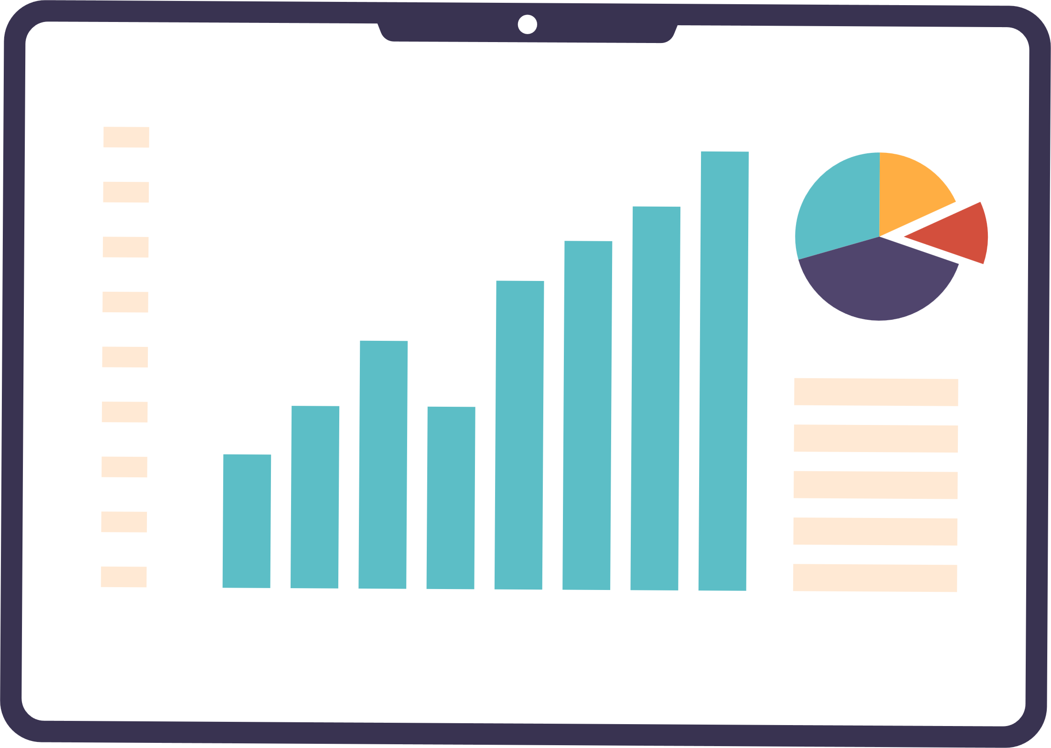

Dataset Components
Transactions Data: amounts, timestamps, merchant info
Card Information: limits, types, activation dates
Merchant Codes: classify transaction types
Fraud Labels: legitimate vs fraudulent transactions
User Data: demographics, account details
Enables linking across multiple tables for rich analysis

Slide 4




Problem Statement
Banks face huge transaction volumes → risk of fraud, errors, and customer churn
We need a central Dashboard to track:
Customer Activity & Behaviors Analysis
Financial Performance and Trends
Operational Efficiency
Risk Indicators

Slide 5




Project Pipeline
Data Integration (SQL Server Management Studio)
All raw datasets were imported into SQL Server to ensure secure storage, structured tables, and easy maintenance of relationships.
Data Preparation & Cleansing (Python)
Used Python to clean, transform, and enrich the data: handling missing values, merging tables, and creating derived fields for deeper analysis.
Analytics & Insights Generation
Performed exploratory analysis, segmentation, and calculations (fraud loss %, credit utilization %, active/inactive customers) to extract actionable insights.
Visualization & Reporting (Power BI Dashboard)
Developed an interactive Power BI dashboard to visualize key metrics, track trends, and enable decision-makers to explore data in real time.

Slide 6
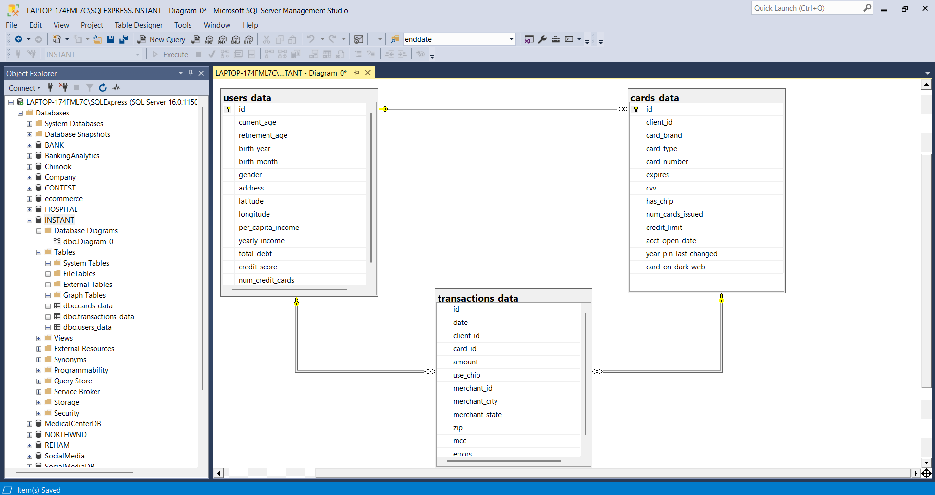

Slide 7
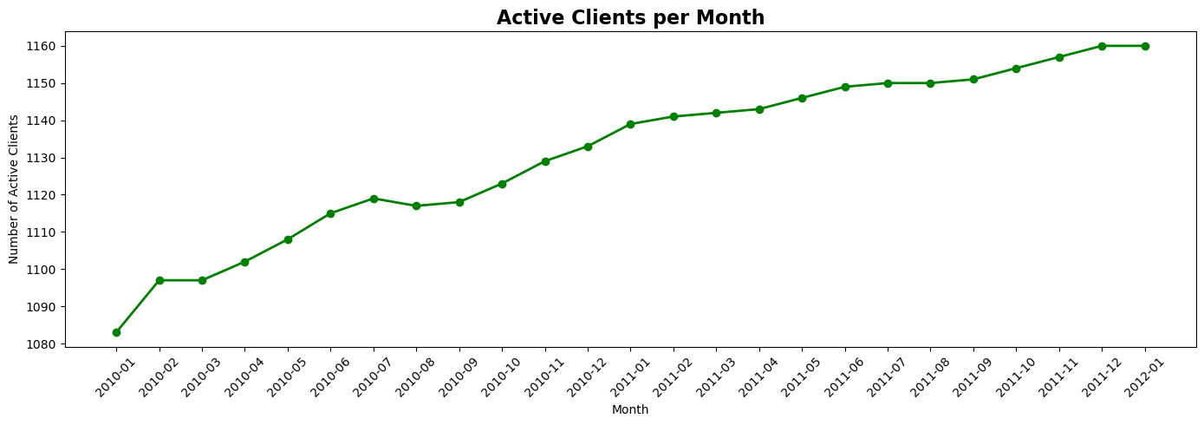
Active customer count has shown a consistent upward trend, indicating growing engagement and retention

Slide 8
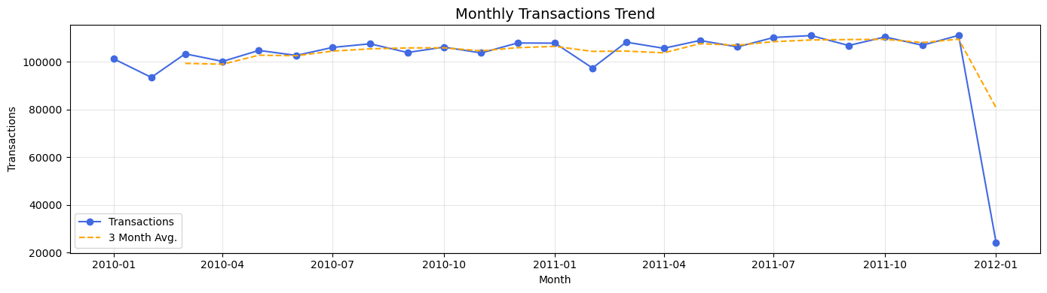
Transactions stayed above 100K per month, highlighting strong customer activity
(Stable transaction activity with minor seasonal fluctuations)

Slide 9
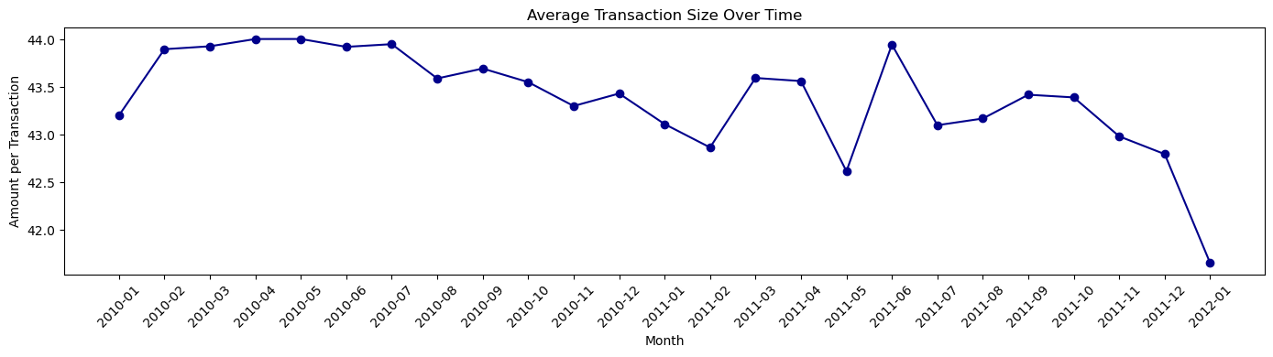
But Monthly average amount per transaction with fluctuations indicating seasonal or behavioral changes
(Recent drop likely reflects incomplete or missing data at the period’s end)

Slide 10
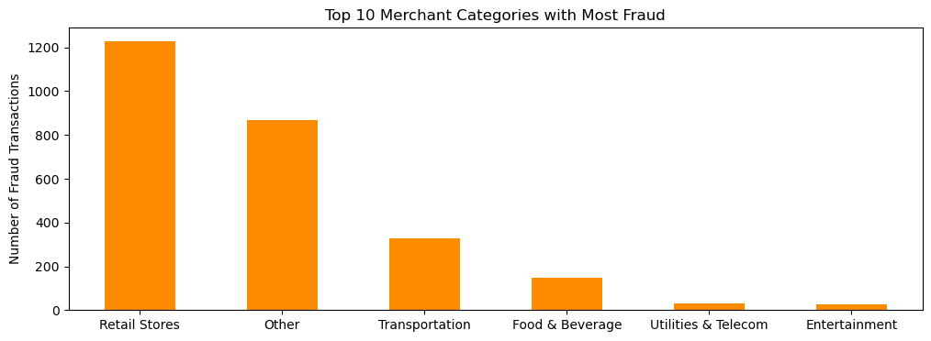
Highlighting high-risk merchant categories to improve fraud prevention strategies (Retail Stores account for the majority of fraud transactions — over 46% of total cases)

Slide 11
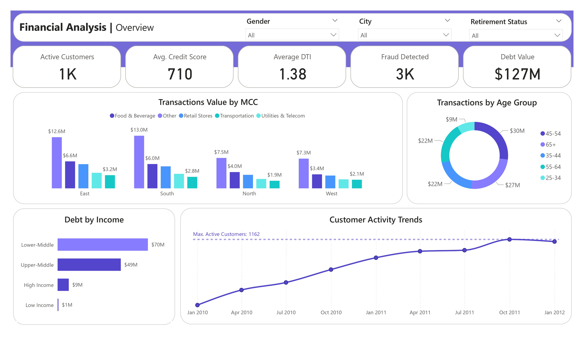

Slide 12
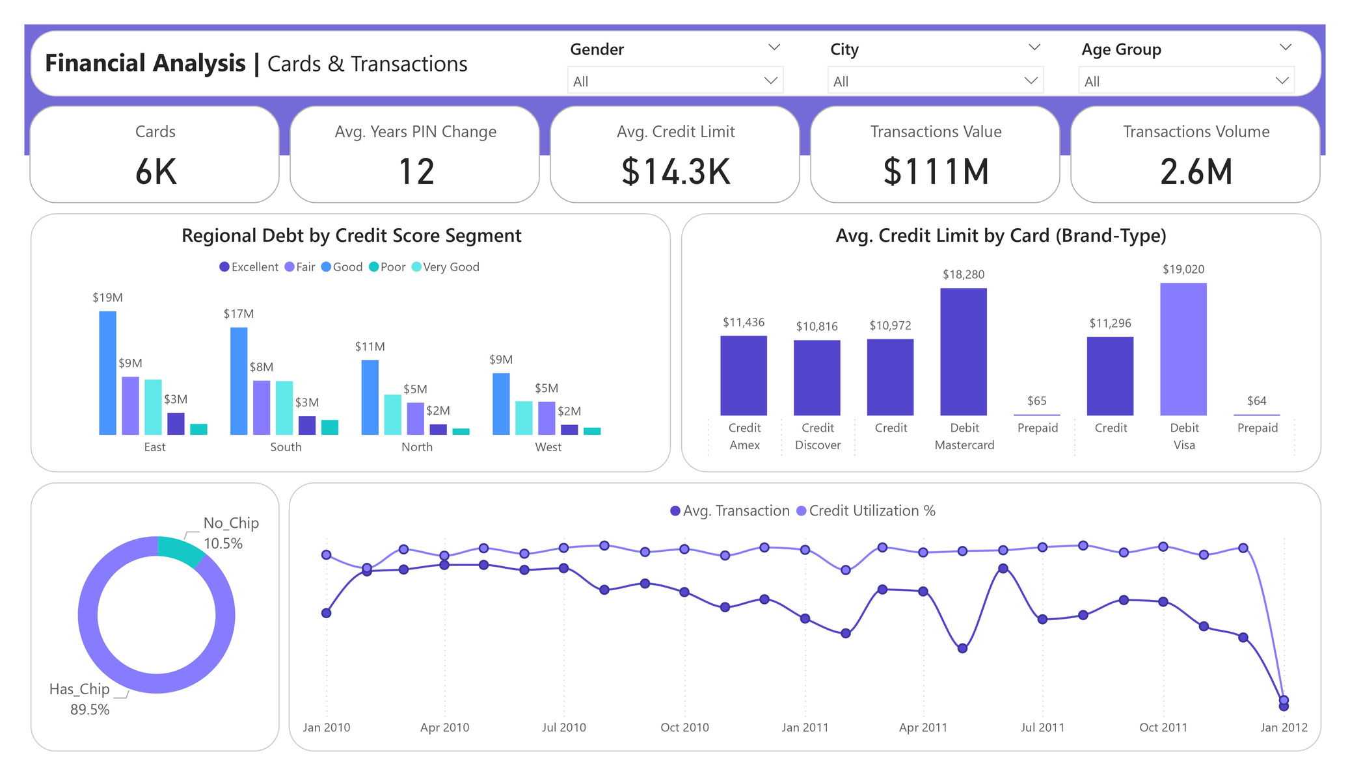

Slide 13
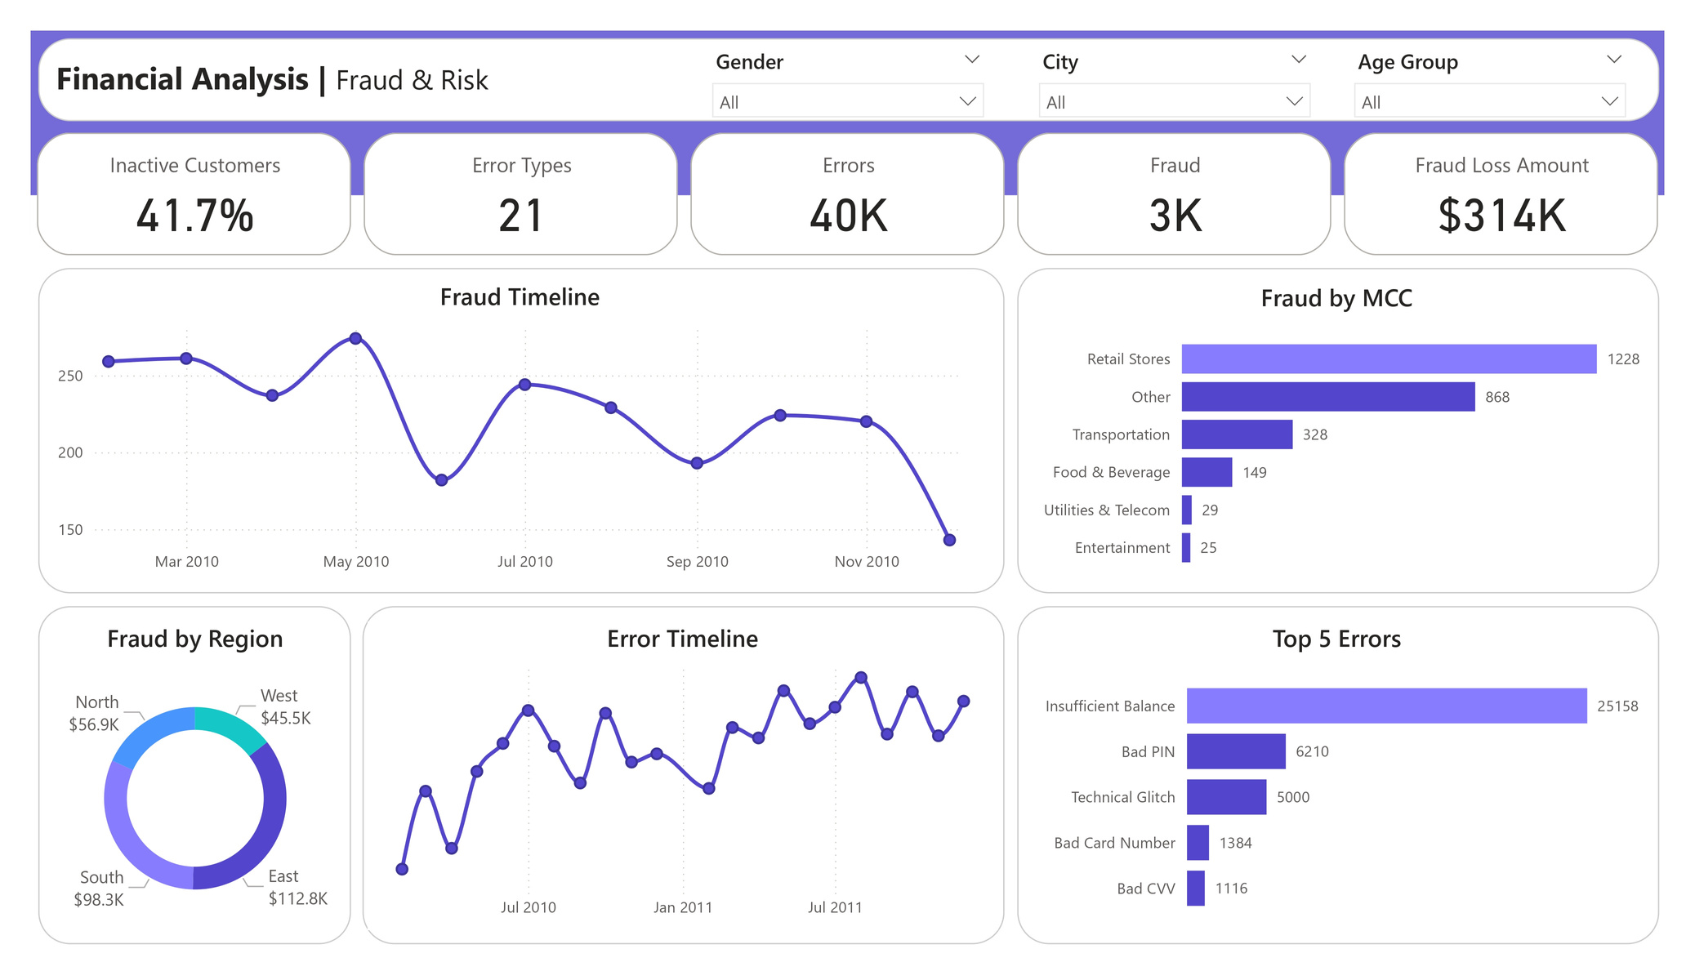

Slide 14
Conclusion
1. Growing and Valuable Customer Base
Most customers are active and spending more over time. The most valuable age groups are 45–54 and 65+, who together drive the largest share of transaction value.
2. Solid Credit Health but High Debt Concentration
Customers generally have good credit scores, but debt is heavily concentrated in middle-income segments, indicating both opportunity and risk.
3. Card Portfolio with Strong Limits & High Chip Adoption
Most cards are chip-enabled, which improves security. Credit limits are healthy, giving room for higher spending but also requiring risk monitoring.

Slide 15
Conclusion
4. Fraud Under Control but Needs Targeted Focus
Fraud losses are low overall and trending down, but retail stores and the East region remain key hotspots that require tighter monitoring.
5. Operational Errors Increasing
Errors remain low compared to total transactions but are steadily rising, signaling the need for process improvement and better controls.
6. Regional & Segment Insights
East and South regions lead in both transaction value and debt. Middle-income customers represent the largest opportunity for growth but also the highest risk exposure.

Slide 16
Strategic Takeaways
Grow Active Customers:
Target inactive customers with reactivation campaigns and loyalty offers.
Focus Fraud Controls:
Strengthen monitoring for retail stores and East region merchants.
Improve Operations:
Streamline processes to reverse the rising error trend.
Optimize Credit & Debt:
Adjust policies for middle-income groups to manage risk and drive profitability.
Segmented Offers:
Personalize products based on age, income, and region to maximize engagement.

Slide 17

Reham Mahmoud Rushdi
Thank You

